Slide 1
RTOS programming
강사명 : 김정인

Slide 2
https://github.com/imguru-mooc/RTOS_uCOSII

Slide 3
virtual box : 가상 머신
ubuntu 18.04
micro OS II 포팅

Slide 4
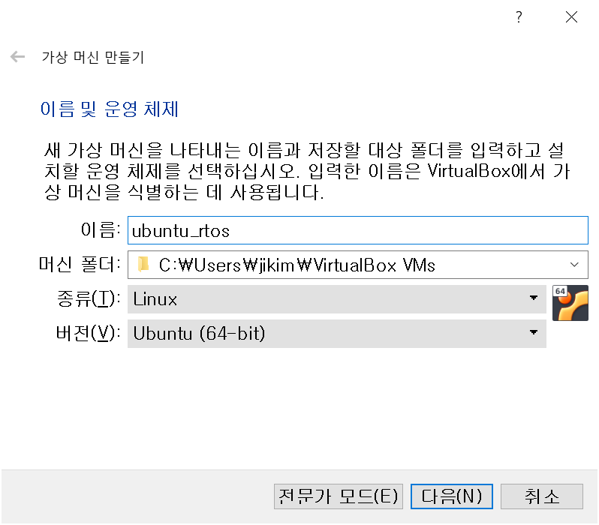
virtual box 설치 : 최신 버전
virtualbox.org 사이트에서 다운로드 후 설치
압축 파일 : ubuntu_rtos.zip => ubuntu_rtos.vdi
새로만들기 >> >> 기존 하드 드라이브 선택

Slide 5
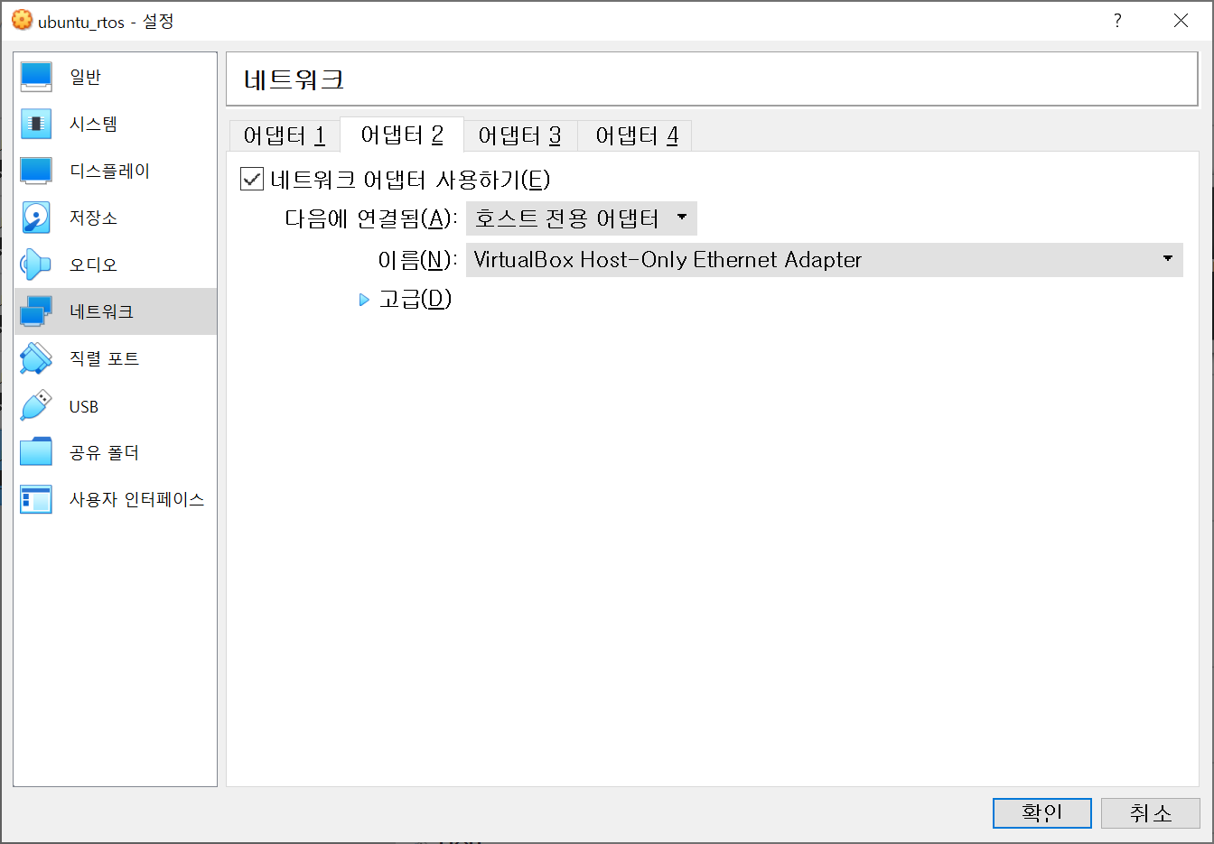
설정 >>

Slide 6
시작 >>
id: root
passwd : linux
windows
ubuntu
filezilla
putty
sshd
sftp
3
22
ipconfig
192.168.56.1
ifconfig
enp0s8 : 192.168.56.133
netstat -ant
0:22

Slide 7
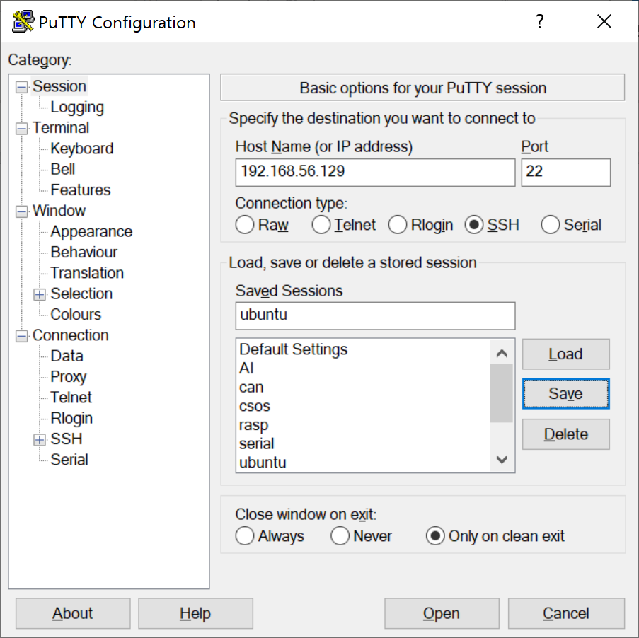
putty 설정
login as : root
passwd : linux

Slide 8
강사 PC : 192.168.0.183
id : linux
passwd : 없음

Slide 9
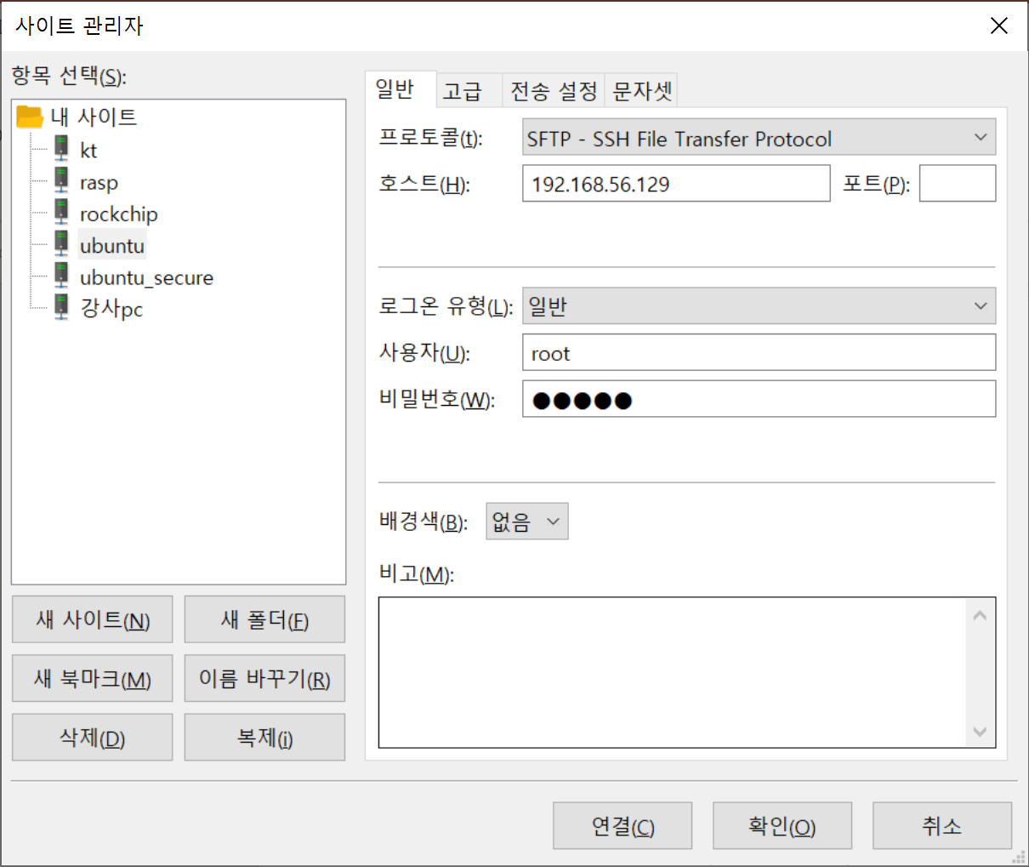
file zilla 설정
사이트 관리자 : ctrl+s

Slide 10
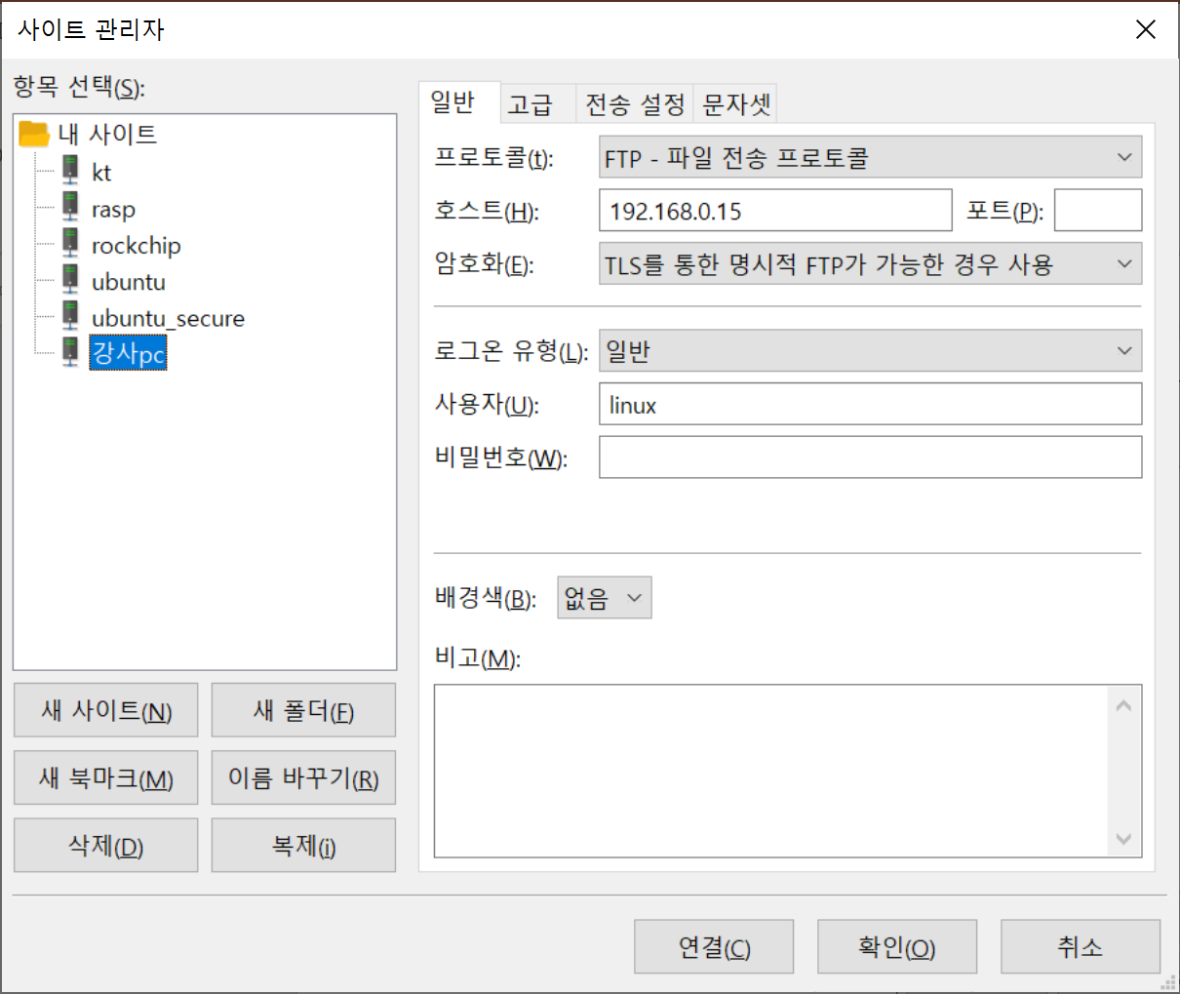
file zilla 설정
사이트 관리자 : ctrl+s
강사PC에 접속 시
192.168.0.183

Slide 11
ctags
# vi a.c
OSStart
반드시 저장후 이동
ESC >> :w
vi 종료
:q
정의로 이동 : g ]
돌아오기 : ctrl + t

Slide 12
태그 패스 설정
# vi ~/.vimrc
set ts=4
set sw=4
set cindent
set autoindent
set tags+=/root/rtos/uCOS-II/tags

Slide 13
첫번째 예제 실행
# cd uCOS-II/Ports/examples/1_day/
# cd 1.test_first
# ls
# make
# ./test
OSCPUUsage 0%
OSCPUUsage 0%
...
ESC는 프로그램의 종료

Slide 14
확장 bitmap
#include <stdio.h>
int main()
{
int item[4]={0,};
int i;
item[0] = 1;
item[3] = 1;
for(i=0; i<4; i++ )
if( item[i] != 0 )
printf("%d\n", i );
printf("-------\n");
item[3] = 0;
문제점 :
메모리를 심하게 낭비한다.
0
1
2
3
item
0
0
0
0
item
1
0
0
0
item
1
0
0
1
item
1
0
0
0

Slide 15
확장 bitmap
#include <stdio.h>
int main()
{
int item=0;
int i;
item = item | 1;
item = item | 8;
for(i=0; i<4; i++ )
if( item & (1<<i) )
printf("%d\n", i );
printf("-------\n");
item = item & ~8;
문제점 :
메모리를 심하게 낭비한다.
3
2
1
0
item
0
0
0
0
|
0
0
0
1
0
0
0
1
|
1
0
0
0
1
0
0
1

Slide 16
확장 bitmap
#include <stdio.h>
int main()
{
int item=0;
int i;
item = item | 1;
item = item | 8;
for(i=0; i<4; i++ )
if( item & (1<<i) )
printf("%d\n", i );
printf("-------\n");
item = item & ~8;
문제점 :
메모리를 심하게 낭비한다.
3
2
1
0
item
1
0
0
1
&
0
0
0
1
0
0
0
1

Slide 17
확장 bitmap
#include <stdio.h>
int main()
{
int item=0;
int i;
item = item | 1;
item = item | 8;
for(i=0; i<4; i++ )
if( item & (1<<i) )
printf("%d\n", i );
printf("-------\n");
item = item & ~8;
문제점 :
메모리를 심하게 낭비한다.
개수의 제한이 있다.
3
2
1
0
item
1
0
0
1
&
0
1
1
1
0
0
0
1

Slide 18
확장 bitmap
prio = 100;
item[0]
item[1]
item[2]
item[3]
1
100-32 => 68-32 => 36-32 => 4
몫 : 3 , 나머지 : 4
int item[4] = {0,}
item[index/32] |= (1<<(index%32));

Slide 19
확장 bitmap
문제점 :
메모리를 심하게 낭비한다.
개수의 제한이 있다.
가독성이 없다.
int item[32]={0,};
int i;
item[700/32] |= 1<<(700%32);
item[800/32] |= 1<<(800%32);
for(i=0; i<1024; i++ )
if( item[i/32] & (1<<(i%32)) )
printf("%d\n", i );
printf("-------\n");
item[800/32] &= ~(1<<(800%32));

Slide 20
확장 bitmap
문제점 :
메모리를 심하게 낭비한다.
개수의 제한이 있다.
가독성이 없다.
나누기 연산은 느리다.
#define BIT_SET(index,x) (x[index/32] |= 1<<(index%32))
#define BIT_ISSET(index,x) ( x[index/32] & (1<<(index%32)) )
#define BIT_CLR(index,x) (x[index/32] &= ~(1<<(index%32)))

Slide 21
확장 bitmap
문제점 :
메모리를 심하게 낭비한다.
개수의 제한이 있다.
가독성이 없다.
나누기 연산은 느리다.
#define BIT_SET(index,x) (x[index>>5] |= 1<<(index&31))
#define BIT_ISSET(index,x) ( x[index>>5] & (1<<(index&31)) )
#define BIT_CLR(index,x) (x[index>>5] &= ~(1<<(index&31)))

Slide 22
확장 bitmap
usigned char OSRdyTbl[8];
task_create(1);
prio_tbl[prio/8] |= 1<<(prio%8);
OSRdyTbl
1

Slide 23
함수 포인터
int i=10;
int *p = &i;
void foo(void)
{
}
void (void) *p = &foo;
void (*p)(void) = foo;
...
p();
void (*p)(void) = &foo;
...
(*p)();

Slide 24
void foo (void)
{
}
void (*p)(void) = &foo;
...
(*p)();
함수 포인터
*p++;
*++p;
int i=10;
int *p = &i;
void foo(void)
{
}
void (void) *p = &foo;
void *p(void) = &foo;
void (*p)(void) = &foo;
void foo (void)
{
}
void (*p)(void) = foo;
...
p();

Slide 25
함수 포인터
void aaa(void)
{
printf("aaa()\n");
}
void ccc(void)
{
printf("ccc()\n");
}
void bbb( void (*p)(void) )
{
p();
printf("bbb()\n");
}

Slide 26
함수 타입
void aaa(void);
// function(void) returning void
void aaa(int);
// function(int) returning void
int aaa(int);
// function(int) returning int

Slide 27
함수 타입
int *a[2];
// array of 2
// pointer to
// int
sizeof(a)=8
a+1 => 4
int i;
// int
int **p;
// pointer to
// pointer to
// int
int *p;
// pointer to
// int
int a[2];
// array of 2
// int
int (*p)[2];
// pointer to
// array of 2
// int
sizeof(p)=4
p+1 => 8

Slide 28
배열 타입
1000
p
1000
int a[5] = {1,2,3,4,5};
int *p = a;
sizeof(a) = sizeof(int [5])=20
sizeof(p) = sizeof(int *) = 8
1
a[0]
2
3
4
5
a[4]

Slide 29
배열 타입
decay : 배열의 이름은 일반적으로
배열의 첫번재 원소의 주소로 해석된다.
예외) sizeof , &
int a[5] = {1,2,3,4,5};
int *p = a; // &a[0];
sizeof(a) = sizeof(int [5])=20
sizeof(p) = sizeof(int *) = 8
1000
p
1000
1
a[0]
2
3
4
5
a[4]

Slide 30
배열 타입
decay : 배열의 이름은 일반적으로
배열의 첫번재 원소의 주소로 해석된다.
예외) sizeof , &
int a[5] = {1,2,3,4,5};
//int *p = &a;
//int [5] *p = &a;
//int *p[5] = &a;
int (*p)[5] = &a;
(*p)[4] = 10;
1000
p
1000
1
a[0]
2
3
4
5
a[4]

Slide 31
배열 타입
decay : 배열의 이름은 일반적으로
배열의 첫번재 원소의 주소로 해석된다.
예외) sizeof , &
int a[2][2] = {1,2,3,4};
int *p = a;
p[1][1] = 10;
(*(p+1))[1]
*(*(p+1)+1)
*(*(1000+1)+1)
*(*1004+1)
*(2+1)
*3 compile error
pointer+1=pointer+sizeof(*pointer)*1
1000
p
1000
1
a[0][0]
1004
2
a[0][1]
3
a[1][0]
4
a[1][1]

Slide 32
배열 타입
decay : 배열의 이름은 일반적으로
배열의 첫번재 원소의 주소로 해석된다.
예외) sizeof , &
int a[2][2] = {1,2,3,4};
int * *p = a;
p[1][1] = 10;
(*(p+1))[1]
*(*(p+1)+1)
*(*(1000+1)+1)
*(*1008+1)
*(0x0304+1)
*0x0308 runtime error
p+1=p+sizeof(*p)*1
1000
p
1000
1
a[0][0]
1004
2
a[0][1]
1008
3
a[1][0]
4
a[1][1]

Slide 33
배열 타입
decay : 배열의 이름은 일반적으로
배열의 첫번재 원소의 주소로 해석된다.
예외) sizeof , &
int a[2][2] = {{1,2},{3,4}};
int (*p)[2] = a;
p[1][1] = 10;
(*(p+1))[1]
*(*(p+1)+1)
*(*(1000+1)+1)
*(*1008+1)
*(1008+1)
*1012 = 10
p+1=p+sizeof(int[2])*1
1000
p
1000
1
a[0][0]
__a
1004
2
a[0][1]
1008
1008
3
a[1][0]
__b
1012
10
a[1][1]

Slide 34
배열 타입
int (*(*(*(*q)[2])(void))( void ))[2]
pointer to
array of 2
pointer to
function(void) returning
pointer to
function(void) returning
pointer to
array of 2
int

Slide 35
함수 타입
void foo(void);
// function(void) retuning
// void
void foo(int);
// function(int) retuning
// void
int foo(int);
// function(int) retuning
// int

Slide 36
함수 타입
void (*(*p)(void)(void);
void (*p)(void);
// pointer to
// function(void) retuning
// void
// pointer to
// function(void) returning
// pointer to
// function(void) returning
// void
void (*foo(void)(void);
//function(void) returning
//pointer to
//function(void) returning
// void

Slide 37
uC/OS-II : 분석
CPU
PC
SP
CPU의 양보 시점
I/O 요청시 CPU를 양보함
Ready Queue
Task 1
Wait Queue
PC
Task 2
Task 3
SP
PC
PC
SP
SP
schedule();
context_switch();

Slide 38
uC/OS-II : 분석
OSInit();
OS_InitRdyList();
OSPrioCur
OSRdyTbl
0
OSPrioHighRdy
0
OSTCBHighRdy
0
OSTCBCur
0

Slide 39
uC/OS-II : 분석
OSTCBTbl
[0]
[1]
[...]
[63]
OSInit();
OS_InitTCBList();
OSTCBPrio
OSTCBX
OSTCBY
OSTCBPrioTbl
OSTCBBitX
0
OSTCBBitY
0
0
OSTCBNext
0
...
OSTCBList
0
ptcb1
ptcb2
0
OSTCBPrio
OSTCBX
OSTCBFreeList
OSTCBY
OSTCBBitX
OSTCBBitY
OSTCBNext
...
0

Slide 40
NODE *head;
void insert_data(int data)
{
NODE *temp;
temp = (NODE*)malloc(sizeof(NODE));
temp->data = data;
temp->next = head;
head = temp;
}
insert_data(1);
list 의 장점
: 삽입/삭제가 빠른다.
head
temp
3
2
1
0

Slide 41
typedef struct _node
{
int data;
struct _node *next;
} NODE;
NODE *head;
void insert_data(NODE *temp)
{
temp->next = head;
head = temp;
}
list 의 장점
: 삽입/삭제가 빠른다.
head
temp
3
2
1
0

Slide 42
OSTaskCreate(prio);
OS_TCBInit(prio);
OSTCBPrioTbl
0
0
0
0
OSTCBList
...
0
OSTCBPrio
0
OSTCBX
OSTCBFreeList
OSTCBY
OSTCBBitX
OSTCBBitY
OSTCBNext
0
...
0

Slide 43
OSTaskCreate(prio);
OS_TCBInit(prio);
1<<(prio>>3)
OSRdyTbl
OSTCBPrioTbl
OSPrioCur
[0]
1
0
0
[10]
0
0
OSPrioHighRdy
...
0
0
OSTCBList
OSTCBPrio
0
OSTCBX
0
OSTCBHighRdy
OSTCBY
1
0
0
OSTCBBitX
1
OSTCBCur
OSTCBBitY
1
1
0
OSRdyGrp
OSTCBNext
0

Slide 44
OSTaskCreate(prio);
OS_TCBInit(prio);
OSRdyTbl
OSTCBPrioTbl
OSPrioCur
[1]
0
0
1
[10]
0
0
OSPrioHighRdy
OSTCBList
...
0
0
OSTCBPrio
10
OSTCBX
2
OSTCBHighRdy
OSTCBY
1
0
OSTCBBitX
4
OSTCBCur
OSTCBBitY
2
1
0
OSRdyGrp
OSTCBNext
0

Slide 45
OSTaskCreate(TaskStart, ,&TaskStartStk[TASK_STK_SIZE-1],10);
psp = (OS_STK *)OSTaskStkInit(task, pdata, ptos, 0);
OS_TCBInit(prio);
OSTCBList
OSTCBPrio
10
TaskStartStk
OSTCBX
2
OSTCBY
1
OSTCBBitX
4
TaskStart
OSTCBBitY
2
OSTCBStkPtr
...
OSTCBStat
OS_STAT_RDY
OSTCBNext
0
pbos=0
0
511
task

Slide 46
OSTaskCreate(TaskStart, ,&TaskStartStk[TASK_STK_SIZE-1],10);
psp = (OS_STK *)OSTaskStkInit(task, pdata, ptos, 0);
OS_TCBInit(prio);
OSTCBList
OSTCBPrio
10
TaskStartStk
OSTCBX
2
OSTCBY
1
OSTCBBitX
4
TaskStart
OSTCBBitY
2
OSTCBStkPtr
...
OSTCBStat
OS_STAT_RDY
ptos
OSTCBNext
0
0

Slide 47
int my_ffs(int word){
int num = 0;
if ((word & 0xffff) == 0) {
num += 16;
word >>= 16;
}
if ((word & 0xff) == 0) {
num += 8;
word >>= 8;
}
if ((word & 0xf) == 0) {
num += 4;
word >>= 4;
}
if ((word & 0x3) == 0) {
num += 2;
word >>= 2;
}
if ((word & 0x1) == 0)
num += 1;
return num;
}
int num = 12;
0001000000100000 0011000000000000
00110000 00000000
0011 0000
00 11
11

Slide 48
OSTaskCreate(prio);
OS_TCBInit(prio);
OSRdyTbl
OSTCBPrioTbl
OSPrioCur
[1]
0
10
1
[10]
0
0
OSPrioHighRdy
1
OSTCBList
...
0
1
OSTCBPrio
10
OSTCBX
2
OSTCBHighRdy
1
OSTCBY
1
10
OSTCBBitX
4
OSTCBCur
OSTCBBitY
2
1
1
1
1
OSTCBNext
0
OSRdyGrp

Slide 49
OS_InitTaskIdle()
OSIdleCtr
OS_TaskIdle
0
OSRdyTbl
OSTCBPrioTbl
OSPrioCur
0
0
0
0
0
OSPrioHighRdy
[63]
...
0
0
OSTCBList
OSTCBPrio
63
OSTCBX
OSTCBHighRdy
[7]
OSTCBY
1
0
OSTCBBitX
OSTCBCur
OSTCBBitY
1
0
OSRdyGrp
OSTCBNext
0

Slide 50
OS_InitTaskStat();
OSIdleCtr
OS_TaskIdle
0
OSRdyTbl
OSTCBPrioTbl
0
OS_TaskStat
0
0
[62]
0
[63]
OSTCBList
OSTCBPrio
63
62
OSTCBX
[7]
1
1
OSTCBY
OSTCBBitX
OSTCBBitY
1
OSTCBNext
0
0
OSRdyGrp

Slide 51
TaskStart()
{
OSStatInit()
OSTimeDly(2);
OSIdleCtr=0L;
OSTimeDly(200);
for();
printf("%d%%\n",
OSCPUUsage);
}

Slide 52
OSIdleCtr
OSCPUUsage = 100 * (1 - ------------) (units are in %)
OSIdleCtrMax
OSIdleCtr
OSCPUUsage = (100 - --------------- ) (units are in %)
OSIdleCtrMax/100
run = OSIdleCtr;
max = OSIdleCtrMax / 100L;
usage = (INT8S)(100L - run / max);

Slide 53
OSTaskCreateExt(Task1, (void *)0,
&TaskStartStk1[TASK_STK_SIZE - 1],
1,
1000,
&TaskStartStk1[0],
TASK_STK_SIZE=512,
0,
OS_TASK_OPT_STK_CHK|OS_TASK_OPT_STK_CHK);
OSTCBList
OSTCBPrio
1
TaskStartStk1
OSTCBX
pbos
OSTCBY
OSTCBBitX
Task1
OSTCBStkBottom
OSTCBStkPtr
...
OSTCBStat
OS_STAT_RDY
OSTCBNext
0
ptos
0

Slide 54
OSTaskSuspend(1);
OSRdyTbl
OSTCBPrioTbl
OSPrioCur
0
0
[1]
[1]
0
62
0
OSPrioHighRdy
...
0
ptcb
OSTCBList
OSTCBPrio
1
OSTCBX
0
OSTCBHighRdy
OSTCBY
1
1
1
62
OSTCBBitX
2
OSTCBCur
OSTCBBitY
1
1
0
OSTCBStat
OS_STAT_SUSPEND
OSRdyGrp
OSTCBNext
0

Slide 55
OSTaskResume(1);
OSRdyTbl
OSTCBPrioTbl
OSPrioCur
1
0
[1]
[1]
0
1
0
OSPrioHighRdy
...
0
ptcb
OSTCBPrio
1
OSTCBList
OSTCBX
0
OSTCBHighRdy
OSTCBY
1
1
1
1
OSTCBBitX
2
OSTCBCur
OSTCBBitY
1
1
1
OSTCBStat
OS_STAT_RDY
OSRdyGrp
OSTCBNext
0

Slide 56
irq=0
CPU
PIC
ISR
IVT
timer_interrupt_handler()
[0]

Slide 57
OSTimeDly(10);
irq=0
CPU
PIC
interruptTable[]
OSTCBPrio
0
ISR
IVT
OSTCBDly
0
OSTimeTick()
[0]
OSTCBStat
OS_STAT_RDY
OSInit()
OSInitHookBegin()
interruptTable[0] = OSTimeTick;

Slide 58
Task prio=0
ISR

Slide 59
OSTimeDlyHMSM (INT8U hours, INT8U minutes, INT8U seconds, INT16U milli)
OSTimeDlyHMSM (0, 0, 3, 500);
ticks = ((INT32U)hours * 3600L + (INT32U)minutes * 60L +
(INT32U)seconds) * OS_TICKS_PER_SEC
+ OS_TICKS_PER_SEC * ((INT32U)milli + 500L
/ OS_TICKS_PER_SEC) / 1000L;
(59+5)/10 => 6.4 => 6
OSTCBPrio
(105+5)/10 => 11 Tick
0
OSTCBDly
350
OSTCBStat
OS_STAT_RDY

Slide 60
OS_ENTER_CRITICAL();
OSTCBPrioTbl[prio] = (OS_TCB *)1;
OS_EXIT_CRITICAL();
count
local
1
local
1
1
local = count;
local = local+1;
count = local;
local = count;
local = local+1;
count = local;

Slide 61
count++;
count
local
1
local
1
1
eax = count;
eax = eax+1;
count = eax;
eax = count;
eax = eax+1;
count = eax;

Slide 62
count++;
count
1
lock
1
local
local
1
0
while(lock);
lock = 1;
local = count;
local = local+1;
count = local;
lock = 0;
while(lock);
lock = 1;
local = count;
local = local+1;
count = local;
lock = 0;

Slide 63
count++;
count
0
lock
0
local
local
0
0
while(lock);
lock = 1;
local = count;
local = local+1;
count = local;
lock = 0;
while(lock);
lock = 1;
local = count;
local = local+1;
count = local;
lock = 0;

Slide 64
CAS ( Compare And Set ) 연산
count++;
count
0
lock
1
local
local
0
0
while(CAS(&lock));
local = count;
local = local+1;
count = local;
lock = 0;
while(CAS(&lock));
local = count;
local = local+1;
count = local;
lock = 0;

Slide 65
Sleep Lock 연산
count++;
count
0
value
1
local
local
0
0
lock(&value);
local = count;
local = local+1;
count = local;
unlock(&value);
lock(&value);
local = count;
local = local+1;
count = local;
unlock(&value);

Slide 66
OS_ENTER_CRITICAL();
OSTCBPrioTbl[prio] = (OS_TCB *)1;
OS_EXIT_CRITICAL();
count
local
1
local
1
0
OS_ENTER_CRITICAL();
local = count;
local = local+1;
count = local;
OS_EXIT_CRITICAL();
OS_ENTER_CRITICAL();
local = count;
local = local+1;
count = local;
OS_EXIT_CRITICAL();

Slide 67
semaphore(세마포어)
다익스트라 :
Resource(자원)
세마포어
공용변수:1
Toilet
Task
p 연산
v 연산
CriticalSection

Slide 68
semaphore(세마포어)
다익스트라 :
Resource(자원)
세마포어
공용변수:2
Toilet
Toilet
Toilet
Task
p 연산
v 연산
CriticalSection

Slide 69
OS_InitEventList();
OSEventType
OS_EVENT_TYPE_SEM
OSEventGrp
OSEventCnt
1
OSEventPtr
OSEventTbl

Slide 70
OS_InitEventList();
OSEventTbl
[0]
[1]
[2]
[3]
OSEventFreeList
...
0

Slide 71
pevent = OSSemCreate ( 1 );
pevent
OSEventType
OS_EVENT_TYPE_SEM
OSEventGrp
OSEventCnt
1
OSEventPtr
0
OSEventTbl

Slide 72
void Task1 (void *pdata)
{
OSSemPend (pevent, 0, &err);
temp = count;
temp = temp + 1;
OSTimeDly(200*5);
OSSemPost()
}
pevent
OSEventType
OS_EVENT_TYPE_SEM
OSEventGrp
OSEventCnt
0
OSEventPtr
0
OSEventTbl
OSTCBPrio
1
[1]
OSTCBDly
800
OSTCBStat
OS_STAT_RDY
1
1
1

Slide 73
void Task2 (void *pdata)
{
OSSemPend(pevent, 200*10,&err);
temp = count;
temp = temp + 1;
OSTimeDly(200*5);
}
pevent
OSEventType
OS_EVENT_TYPE_SEM
OSEventGrp
OSEventCnt
0
OSEventPtr
0
OSEventTbl
1
OSTCBPrio
1
[1]
OSTCBDly
0
OSTCBStat
OS_STAT_RDY
1
1
1
1

Slide 74
OSSemPost (pevent)
1
pevent
[1]
OSEventType
OS_EVENT_TYPE_SEM
OSEventGrp
1
OSEventCnt
0
OSEventPtr
0
OSEventTbl
1
1
1
1
1
OSRdyGrp
OSTCBPrio
2
OSTCBDly
0
OSTCBStat
OS_STAT_SEM

Slide 75
count
1
local
flag
local
1
1
2
while(flag);
flag = 1;
local = count;
local = local+1;
count = local;
flag = 0
while(flag);
flag = 1;
local = count;
local = local+1;
count = local;
flag = 0

Slide 76
Test And Set : TAS 연산
count
0
local
flag
local
0
1
1
while(flag);
flag = 1;
local = count;
local = local+1;
count = local;
flag = 0
while(flag);
flag = 1;
local = count;
local = local+1;
count = local;
flag = 0

Slide 77
Test And Set : TAS 연산
count
0
local
flag
local
0
1
1
lock(&flag)
local = count;
local = local+1;
count = local;
unlock(&flag)
lock(&flag)
local = count;
local = local+1;
count = local;
unlock(&flag)

Slide 78
Task1
OSTimeTick()
Save Context
ISR 코드 수행
schedule();
Restore Context

Slide 79
Task1
Task2
OSTimeTick()
Save Context
ISR 코드 수행
schedule();
Restore Context
OSTimeDly(200);

Slide 80
Task1
중첩 인터럽트를 허용
OSTimeTick()
OSKeyBoard()
Save Context
ISR 코드 수행
schedule();
Restore Context
Save Context
ISR 코드 수행

Slide 81
he
Task1
중첩 인터럽트를 허용
OSKeyBoard()
OSKeyBoard()
Save Context
ISR 코드 수행
schedule();
Restore Context
ISR 코드 수행

Slide 82
0
세마포어의 문제
Task1 : 2
Task3 : 4

Slide 83
세마포어의 문제
0
Task1 : 2
Task2 : 3
Task3 : 4

Slide 84
세마포어의 문제
0
Task1 : 2
Task2 : 3
Task3 : 4

Slide 85
뮤텍스
Task1 : 2
Task2 : 3
Task3 : 1

Slide 86
pevent = OSMutexCreate ( 1, &err );
1
pevent
[1]
OSEventType
OS_EVENT_TYPE_MUTEX
OSEventGrp
OSEventCnt
1
ff
OSEventPtr
0
OSEventTbl
1
1
1
OSRdyGrp
OSTCBPrio
2
OSTCBDly
0
OSTCBStat
OS_STAT_SEM

Slide 87
OSMutexPend (pevent, 0, &err);
pevent->OSEventCnt = 0x1ff & 0xff00;
pevent
[1]
OSEventType
OS_EVENT_TYPE_MUTEX
OSEventGrp
OSEventCnt
1
4
OSEventPtr
OSEventTbl
1
1
OSRdyGrp
1
ptcb
OSTCBPrio
4
pip
mprio
OSTCBDly
0
rdy
ptcb
OSTCBStat
OS_STAT_RDY

Slide 88
OSMutexPend (pevent, 0, &err);
[0]
1
1
pevent
OSEventType
OS_EVENT_TYPE_MUTEX
OSEventGrp
OSEventCnt
1
4
OSEventPtr
OSEventTbl
1
1
OSRdyGrp
1
1
ptcb
OSTCBPrio
4
OSTCBPrio
2
pip
1
mprio
4
OSTCBDly
0
OSTCBDly
0
rdy
OSTCBStat
OS_STAT_RDY
OSTCBStat
OS_STAT_MUTEX
TRUE

Slide 89
생각하는 철학자 - Dead Lock

Slide 90
1.lock은 순서대로 잡는다.
mutex1
mutex2
lock(&mutex1)
lock(&mutex2)
unlock(&mutex1)
unlock(&mutex2)
lock(&mutex2)
lock(&mutex1)

Slide 91
lock 모두를 획득하고
모두를 동시에 해제해야 한다.
1.lock은 순서대로 잡는다.
2.lock은 역순으로 푼다.
mutex1
mutex2
lock(&mutex1)
lock(&mutex2)
unlock(&mutex2)
unlock(&mutex1)
lock(&mutex1)
lock(&mutex2)
unlock(&mutex2)
unlock(&mutex1)

Slide 92
self dead lock
123
0
ff
mutex
lock(&mutex)
lock(&mutex)
lock(&mutex)
lock(&mutex)
lock(&mutex)
unlock(&mutex)
unlock(&mutex)
unlock(&mutex)
unlock(&mutex)
unlock(&mutex)
int count=0;
int count_recur(int n)
{
if( n==0 )
return 0;
return count += count_recur(n-1);
}

Slide 93
재진입 가능 함수

Slide 94
생산자와 소비자의 문제
sem
0
Task1
Task2
lock(&mutex)
count
lock(&mutex)
p()
생산한다.
111
v()
소비한다.
unlock(&mutex)
unlock(&mutex)

Slide 95
OS_FLAG_GRP
pgrp
OSFlagType
OS_EVENT_TYPE_FLAG
OSFlagWaitList
0
OSFlagFlags
0
0
0
0
0
0
0
0

Slide 96
OSFlagPend (pgrp, 0x3, OS_FLAG_WAIT_SET_ALL, 0, &err);
pgrp
OSFlagType
OS_EVENT_TYPE_FLAG
node
OSFlagWaitList
0
OSFlagNodeNext
OSFlagFlags
0
0
0
0
0
0
0
0
0
OSFlagNodePrev
OSFlagNodeTCB
flags_cur
0
0
0
0
0
0
0
0
OSFlagNodeFlagGrp
0
0
0
0
0
0
1
1
OSFlagNodeFlags
flags_rdy
0
0
0
0
0
0
0
0
OS_FLAG_WAIT_SET_ALL
OSFlagNodeWaitType
consume
FALSE
OSTCBPrio
2
OSTCBDly
0
OSTCBStat
OS_STAT_FLAG
OSTCBFlagNode

Slide 97
'a' => 97, 'A'=>65, '0' => 48 '3'-'0' => 3
OSFlagPend (pgrp, 0xc, OS_FLAG_WAIT_SET_ANY, 0, &err);
pgrp
pnode
OSFlagType
OS_EVENT_TYPE_FLAG
0
OSFlagWaitList
0
OSFlagFlags
0
0
0
0
1
0
1
1
flags_cur
0
0
0
0
0
0
0
0
0
0
0
0
1
1
0
0
0
0
0
0
0
0
1
1
flags_rdy
0
0
0
0
0
0
1
1
OS_FLAG_WAIT_SET_ANY
OS_FLAG_WAIT_SET_ALL
consume
FALSE
OSTCBPrio
3
OSTCBPrio
2
OSTCBDly
0
OSTCBDly
0
OSTCBStat
OS_STAT_FLAG
OSTCBStat
OS_STAT_FLAG
OSTCBFlagNode
OSTCBFlagNode

Slide 98
pevent = OSMboxCreate ( 0 );
pevent
OSEventType
OS_EVENT_TYPE_MBOX
OSEventGrp
OSEventCnt
0
OSEventPtr
0
OSEventTbl

Slide 99
msg = OSMboxPend(pevent, 0, &err);
pevent
OSEventType
OS_EVENT_TYPE_MBOX
OSEventGrp
1
OSEventCnt
0
OSEventPtr
0
OSEventTbl
1

Slide 100
msg = OSMboxPend(pevent, 0, &err);
pevent
OSEventType
OS_EVENT_TYPE_MBOX
OSEventGrp
1
OSEventCnt
0
OSEventPtr
0
OSEventTbl
1
1

Slide 101
OSMboxPostOpt(pevent,"hello",OS_POST_OPT_BROADCAST);
pevent
OSEventType
OS_EVENT_TYPE_MBOX
1
OSEventGrp
OSEventCnt
0
1
1
1
OSEventPtr
0
OSEventTbl
1
1
OSTCBPrio
1
2
"Hello"
OSTCBMsg
OSTCBStat
OS_STAT_RDY
OS_STAT_RDY

Slide 102
push(1);
push(2);
push(3);
pop();
pop();
pop();
3
2
1

Slide 103
put(1);
put(2);
put(3);
get();
get();
get();
1
2
3

Slide 104
rear
1
2
3
front
put(1);
put(2);
put(3);
get();
get();
get();

Slide 105
rear
1
2
3
4
5
1
2
3
4
front
put(1);
put(2);
put(3);
put(4);
put(5);
put(1);
put(2);
put(3);
put(4);
put(5);
get();
get();
get();
get();
get();

Slide 106
int i=10;
int *p1 = &i;
int **p2 = &p1;
i = 20;
&p2;
p2;
*p2;
**p2 = 20;
992
996
p2
996
1000
p1
1000
10
i

Slide 107
pevent = OSQCreate ( (void**)my_queue , 8 );
KEY_EVENT *my_queue[8];
KEY_EVENT *(*p)[8] = &my_queue;
KEY_EVENT **p = my_queue;
pevent
pq
OSEventType
OS_EVENT_TYPE_Q
OSQPtr
void * *p ;
0
OSEventGrp
OSQStart
OSEventCnt
0
OSQEnd
OSQIn
OSEventPtr
OSQOut
0
1
2
3
4
5
6
7
OSEventTbl
OSQSize
8
*
*
*
*
*
*
*
*
OSQEntries
0
my_queue
start
0
1
2
3
4
5
6
7
key
cur
my_mem

Slide 108
temp = OSMemGet( pmem, &err );
"hello"
"olleh"
temp
pblk
*
pmem
OSMemAddr
*
OSMemFreeList
*
0
1
2
3
4
5
6
7
OSMemBlkSize
6
key
'a'
0
OSMemNBlks
8
cur
123
OSMemNFree
7
addr

Slide 109
temp = OSMemGet( pmem, &err );
"hello"
"olleh"
temp
pblk
*
pmem
OSMemAddr
*
OSMemFreeList
*
0
1
2
3
4
5
6
7
OSMemBlkSize
6
key
'a'
0
OSMemNBlks
8
cur
123
OSMemNFree
7
addr

Slide 110
OSQPost( pevent, temp );
temp
pevent
pq
OSEventType
OS_EVENT_TYPE_Q
OSQPtr
0
OSEventGrp
1
OSQStart
void**
OSEventCnt
0
OSQEnd
OSQIn
OSEventPtr
OSQOut
0
1
2
3
4
5
6
7
OSEventTbl
1
OSQSize
8
*
*
*
*
*
*
*
*
OSQEntries
1
my_queue
start
key
'a'
cur
123
addr

Slide 111
p1 = OSMemGet( pmem, &err );
nblks
8
pblk
blksize
6
pmem
p1
OSMemAddr
OSMemFreeList
0
1
2
3
4
5
6
7
OSMemBlkSize
key
'a'
0
OSMemNBlks
8
cur
100
OSMemNFree
7
addr

Slide 112
p2 = OSMemGet( pmem, &err );
p2
nblks
8
p1
blksize
6
pmem
OSMemAddr
OSMemFreeList
0
1
2
3
4
5
6
7
OSMemBlkSize
key
'a'
'b'
0
OSMemNBlks
8
cur
100
110
OSMemNFree
7
addr

Slide 113
p3 = OSMemGet( pmem, &err );
nblks
8
p2
p3
blksize
6
pmem
p1
OSMemAddr
OSMemFreeList
0
1
2
3
4
5
6
7
OSMemBlkSize
key
'a'
'b'
'c'
0
OSMemNBlks
8
cur
100
110
120
OSMemNFree
5
addr

Slide 114
OSMemPut( pmem, p2 );
*(void **)pblk = pmem->OSMemFreeList;
nblks
8
pblk
blksize
6
pmem
OSMemAddr
OSMemFreeList
0
1
2
3
4
5
6
7
OSMemBlkSize
key
'a'
'c'
0
OSMemNBlks
8
cur
100
120
OSMemNFree
5
addr

Slide 115
p4 = OSMemGet( pmem, &err );
pblk = pmem->OSMemFreeList;
pmem->OSMemFreeList = *(void **)pblk;
nblks
8
blksize
6
pmem
p4
OSMemAddr
OSMemFreeList
0
1
2
3
4
5
6
7
OSMemBlkSize
key
'a'
'd'
'c'
0
OSMemNBlks
8
cur
100
130
120
OSMemNFree
5
addr

Slide 116
OSMemPut( pmem, p2 );
nblks
8
p3
blksize
6
pmem
p1
OSMemAddr
OSMemFreeList
0
1
2
3
4
5
6
7
OSMemBlkSize
key
'a'
'c'
0
OSMemNBlks
8
cur
100
120
OSMemNFree
5
addr

Slide 117
OSMemPut( pmem, p3 );
nblks
8
p3
blksize
6
pmem
p1
OSMemAddr
OSMemFreeList
0
1
2
3
4
5
6
7
OSMemBlkSize
key
'a'
0
OSMemNBlks
8
cur
100
OSMemNFree
5
addr

Slide 118
OSMemPut( pmem, p1 );
nblks
8
blksize
6
pmem
p1
OSMemAddr
OSMemFreeList
0
1
2
3
4
5
6
7
OSMemBlkSize
key
0
OSMemNBlks
8
cur
OSMemNFree
5
addr

Slide 119
100
heap 영역
1004
score
init frame
1000
n
1000
3
main frame
n
1004
100
score

Slide 120
char **name;
"홍길동"
**
*
"한자"
*
*
"김수한무거북이와두루미"

Slide 121
char ***name;
***
"홍길동"
**
*
"한자"
char **name;
*
*
"김수한무거북이와두루미"

Slide 122
typedef struct _node
{
int data;
struct _node *next;
} NODE;
NODE *head;
head
0

Slide 123
void insert_data( int data )
{
NODE *temp;
temp = malloc(sizeof(NODE));
temp->data = data;
temp->next = head;
head = temp;
}
//----------------------------
int main()
{
insert_data(1);
return 0;
}
프로세스 내에 리스트가 두개 이상
존재 할 수 없다.
head를 인자로 처리 하자.
head
1
0

Slide 124
void insert_data( int data )
{
NODE *temp;
temp = malloc(sizeof(NODE));
temp->data = data;
temp->next = head;
head = temp;
}
//----------------------------
int main()
{
insert_data(1);
return 0;
}
head
1
0

Slide 125
void insert_data( int data , NODE **head)
{
NODE *temp;
temp = malloc(sizeof(NODE));
temp->data = data;
temp->next = *head;
*head = temp;
}
//----------------------------
int main()
{
NODE *head = 0;
insert_data(1, &head);
return 0;
}
메모리 할당을 라이브러리가 강제하면
안된다.
메모리 할당을 유저에게 위임해야
한다.
head
1
0

Slide 126
void insert_data( NODE *temp , NODE **head)
{
temp->next = *head;
*head = temp;
}
//----------------------------
int main()
{
NODE *head = 0;
NODE nodes[7];
nodes[0].data = 1;
insert_data( &nodes[0], &head1);
return 0;
}
노드의 삽입이 위치에 의존적이다.
head 를 노드로 선언하자.
head
1
0

Slide 127
void insert_data( NODE *temp , NODE *head)
{
temp->next = head->next;
head->next = temp;
}
//----------------------------
int main()
{
NODE head = {0,};
NODE nodes[7];
nodes[0].data = 1;
insert_data( &nodes[0], &head1);
return 0;
}
노드의 삽입이 위치에 의존적이다.
head 를 노드로 선언하자.
head
2
1
0
temp

Slide 128
void insert_data( NODE *temp , NODE *head)
{
temp->next = head->next;
head->next = temp;
}
//----------------------------
int main()
{
NODE tail = {0,&tail};
NODE head = {0,&tail};
NODE nodes[7];
nodes[0].data = 1;
insert_data( &nodes[0], &head1);
return 0;
}
list가 null로 끝나면 null 참조의
문제가 있다.
null 끝나지 말고 tail로 끝나게 하자.
head
tail

Slide 129
void insert_data( NODE *temp , NODE *head)
{
temp->next = head->next;
head->next = temp;
}
//----------------------------
int main()
{
NODE head = {0,&head};
NODE nodes[7];
nodes[0].data = 1;
insert_data( &nodes[0], &head1);
return 0;
}
과연 tail이 필요한가?
null 끝나지 말고 tail로 끝나게 하자.
head
temp
1

Slide 130
head
prev
4
3
2
1
next
void reverse(NODE *head)
{
NODE *prev=head;
NODE *curr=prev->next;
NODE *next;
while( curr != head )
{
next = curr->next;
curr->next = prev;
prev = curr;
curr = next;
}
curr->next = prev;
}
curr

Slide 131
typedef struct _node
{
int data;
struct _node *next;
struct _node *prev;
} NODE;
NODE head = {0,&head,&head};

Slide 132
void insert_data( NODE *temp , NODE *head)
{
temp->next = head->next;
head->next = temp;
temp->prev = head;
temp->next->prev = temp;
}
next
prev
3
2
1
temp

Slide 133
void __insert_data( NODE *temp , NODE *prev, NODE *next)
{
temp->next = next;
prev->next = temp;
temp->prev = prev;
next->prev = temp;
}
void insert_add( NODE *temp , NODE *head)
{
__insert_data(temp, head, head->next );
}
next
prev
3
2
1
temp

Slide 134
void __insert_data( NODE *temp , NODE *prev, NODE *next)
{
temp->next = next;
prev->next = temp;
temp->prev = prev;
next->prev = temp;
}
void insert_add_tail( NODE *temp , NODE *head)
{
__insert_data(temp, head->prev, head );
}
head->prev
head
3
2
1

Slide 135
리스트가 data type에 의존적이다.
void __insert_data( NODE *temp , NODE *prev, NODE *next)
{
temp->next = next;
prev->next = temp;
temp->prev = prev;
next->prev = temp;
}
void insert_add_tail( NODE *temp , NODE *head)
{
__insert_data(temp, head->prev, head );
}

Slide 136
typedef struct _node
{
void* data;
struct _node *next;
struct _node *prev;
} NODE;
리스트가 data type에 의존적이다.
void *를 도입하자.
head
*
1

Slide 137
typedef struct _node
{
void* data;
struct _node *next;
struct _node *prev;
} NODE;
NODE와 data의 동기화의 문제가 발생할 수 있다.
void *를 도입하자.
head
*
1

Slide 138
typedef struct _node
{
struct _node *next;
struct _node *prev;
} NODE;
typedef struct
{
int id;
NODE list;
} SAWON;
SAWON s;
NODE에 data를 넣지 말고,
data에 NODE를 넣어라.
1000
s
1
2
1004
temp
*
*
*
*
1004 - 4*(sizeof(char))
s = (SAWON*)((char*)temp - (sizeof(SAWON)-sizeof(NODE)));

Slide 139
typedef struct _node
{
struct _node *next;
struct _node *prev;
} NODE;
typedef struct
{
int id;
NODE list;
} SAWON;
SAWON s;
SAWON구조체가 하나의 리스트에만
포함될 수 있다.
1000
s
1
2
1004
temp1
*
*
*
*
temp2
*
*
*
*
1004 - 4*(sizeof(char))
s = (SAWON*)((char*)temp - (sizeof(SAWON)-sizeof(NODE)));

Slide 140
typedef struct _node
{
struct _node *next;
struct _node *prev;
} NODE;
typedef struct
{
int id;
NODE list;
} SAWON;
SAWON s;
SAWON구조체가 하나의 리스트에만
포함될 수 있다.
0
1000
s
1
4
1004
temp1
*
list1
*
12
1012
temp2
*
list2
*
s = (SAWON*)((char*)temp2 - (long)&((SAWON*)0)->list2 );

Slide 141
#define H_MAX 8
NODE heads[H_MAX];
for(i=0; i<H_MAX; i++ )
{
heads[i].next = &heads[i];
heads[i].prev = &heads[i];
}
[0]
*
*
[1]
*
*
[2]
*
*
[3]
*
*
[4]
*
*
[5]
*
*
[6]
*
*
[7]
*
*

Slide 142
#define H_MAX 8
NODE heads[H_MAX];
for(i=0; i<H_MAX; i++ )
{
heads[i].next = &heads[i];
heads[i].prev = &heads[i];
}
int hash_fn( int id )
{
return id%H_MAX;
}
[0]
*
200
id
*
*
[1]
*
*
*
[2]
*
*
[3]
*
*
100
id
[4]
*
*
*
*
[5]
*
*
[6]
*
*
[7]
*
*

Slide 143
LRU 알고리즘
lru_head
*
100
200
*
*
*
[0]
*
200
*
*
*
*
[1]
*
*
*
[2]
*
*
[3]
*
Tree
이진 탐색 트리
AVL 트리
RB Tree
*
100
[4]
*
*
*
*
[5]
*
*
[6]
*
*
[7]
*
*

Slide 144
RB Tree
1. 루트노드는 언제나 검정이다.
2. 새로운 노드는 빨강이다.
1

Slide 145
RB Tree
1. 루트노드는 언제나 검정이다.
2. 새로운 노드는 빨강이다.
1
2

Slide 146
RB Tree
1. 루트노드는 언제나 검정이다.
2. 새로운 노드는 빨강이다.
3. 부모노드가 빨강이면 회전한다.
R-R : rotate_left(gparent)
color flip : gparent : red
parent : black
1
2
3
2
1
3

Slide 147
RB Tree
1. 루트노드는 언제나 검정이다.
2. 새로운 노드는 빨강이다.
3. 부모노드가 빨강이면 회전한다.
R-R : rotate_left(gparent)
L-L : rotate_right(gparent)
color flip : gparent : red
parent : black
2
1
3
4
3
2
4
1
2
1
3
4

Slide 148
gparent
RB Tree
1. 루트노드는 언제나 검정이다.
2. 새로운 노드는 빨강이다.
3. 부모와 삼촌이 빨강이면
color flip : parent : black
uncle : black
4. 부모노드가 빨강이면 회전한다.
R-R : rotate_left(gparent)
L-L : rotate_right(gparent)
color flip : gparent : red
parent : black
2
uncle
parent
1
3
node
4
gparent
2
uncle
parent
1
3
node
4

Slide 149
RB Tree
1. 루트노드는 언제나 검정이다.
2. 새로운 노드는 빨강이다.
3. 부모와 삼촌이 빨강이면
color flip : parent : black
uncle : black
4. 부모노드가 빨강이면 회전한다.
R-R : rotate_left(gparent)
L-L : rotate_right(gparent)
color flip : gparent : red
parent : black
2
1
3
4
2
5
1
4
3
5

Slide 150
RB Tree
1. 루트노드는 언제나 검정이다.
2. 새로운 노드는 빨강이다.
3. 부모와 삼촌이 빨강이면
color flip : parent : black
uncle : black
gparent : red
4. 부모노드가 빨강이면 회전한다.
R-R : rotate_left(gparent)
L-L : rotate_right(gparent)
color flip : gparent : red
parent : black
2
1
4
3
5
6
2
1
4
3
5
6

Slide 151
RB Tree
1. 루트노드는 언제나 검정이다.
2. 새로운 노드는 빨강이다.
3. 부모와 삼촌이 빨강이면
color flip : parent : black
uncle : black
gparent : red
4. 부모노드가 빨강이면 회전한다.
R-R : rotate_left(gparent)
L-L : rotate_right(gparent)
color flip : gparent : red
parent : black
2
1
4
3
5
6
2
7
1
4
3
6
5
7

Slide 152
RB Tree
1. 루트노드는 언제나 검정이다.
2. 새로운 노드는 빨강이다.
3. 부모와 삼촌이 빨강이면
color flip : parent : black
uncle : black
gparent : red
4. 부모노드가 빨강이면 회전한다.
R-R : rotate_left(gparent)
L-L : rotate_right(gparent)
color flip : gparent : red
parent : black
2
1
4
3
6
5
7
8
4
2
6
1
3
5
7
8

Slide 153
RB Tree
1. 루트노드는 언제나 검정이다.
2. 새로운 노드는 빨강이다.
3. 부모와 삼촌이 빨강이면
color flip : parent : black
uncle : black
gparent : red
4. 부모노드가 빨강이면 회전한다.
R-R : rotate_left(gparent)
L-L : rotate_right(gparent)
R-L : rotate_right(parent)
rotate_left(gparent)
color flip : gparent : red
parent : black
2
4
3
2
3
3
4
2
4

