Slide 1
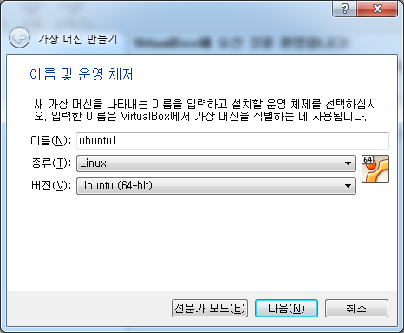
실습 환경 설정
1. virtual box 설치 : www.virtualbox.org
2. virtual box 실행
새로만들기

Slide 2
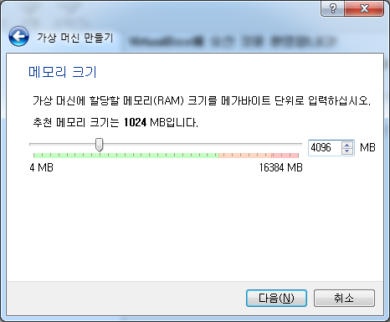

Slide 3
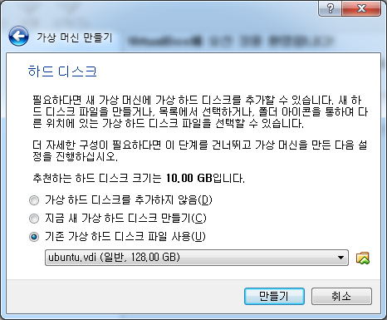
ubuntu.vdi

Slide 4
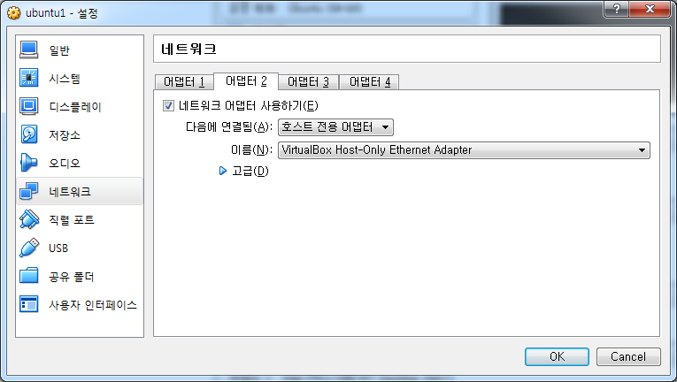

Slide 5
설정 클릭
windows
linux
호스트 전용 어댑터
NAT

Slide 6
시작 버튼 클릭 : 부팅
로그인 :
id : root
passwd : linux
#

Slide 7
설정 클릭
windows
linux
putty
sshd
22
enp0s8
enp0s3
호스트 전용 어댑터
NAT
c:\> ipconfig
host only network : 192.168.56.1
# ifconfig
enp0s8 : 192.168.56.102
# netstat -ant
0.0.0.0:22

Slide 8
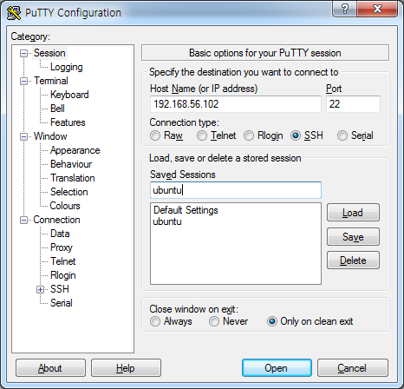
putty 설정
login as: root
password: linux
copy : 블록 씌우기
paste : 마우스 오른쪽 버튼

Slide 9
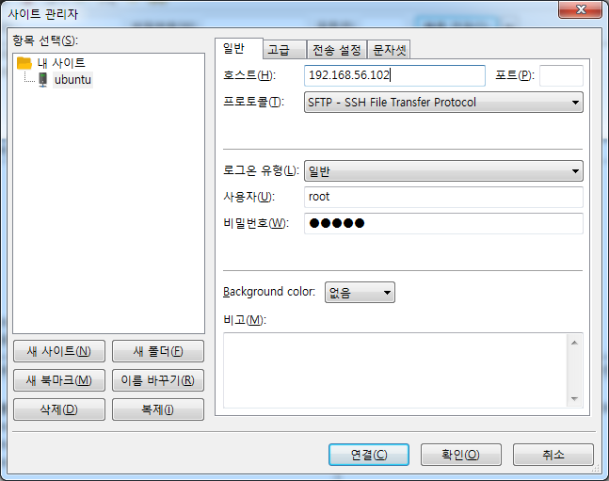
filezilla 설정
실행 후
단축키 : ctrl + s

Slide 10
장비 접속
root@linux:~# adb devices
List of devices attached
HT4APJT00403 device
root@linux:~# adb shell
flounder:/ #

Slide 11
ctags 를 이용한 소스 분석
# apt-get install ctags
# pwd
/root
# cd android/lineage
# mkdir my_test
# cd my_test
# mkdir 01_day
# cd 01_day
# vi a.c
AudioFlinger
Esc
:w
:tj SurfaceFlinger
x`
정의로 이동 : g + ]
숫자 입력후 <엔터> (숫자없으면 취소): 2
돌아오기 : ctrl + t

Slide 12
ctags path 설정
# vi ~/.vimrc
set ts=4
set sw=4
set cindent
set autoindent
set tags+=/root/android/lineage/c_tags
set tags+=/root/android/lineage/asm_tags
set tags+=/root/android/lineage/java_tags

Slide 13
안드로이드 태그 만들기
# cd /root/android/lineage
# vi build/envsetup.sh
find . -type f \( -name '*.c' -o -name '*.cc' -o -name '*.cpp' -o -name '*.h' -o -name '*.hpp' \) \
-exec ctags -a -o c_tags {} +
find . -type f \( -name '*.java' -o -name '*.inc' \) \
-exec ctags -a -o java_tags {} +
find . -type f \( -name '*.S' -o -name '*.s' \) \
-exec ctags -a -o asm_tags {} +

Slide 14
간단한 PDK 빌드 하기
# vi myapp.c
# gcc myapp.c -o myapp
타겟 보드에 업로드
# adb devices
HT4ANJT06434 device
# adb push myapp /data
또 다른 터미널 실행 후
타겟 보드에 연결
# adb shell
flounder:/ # cd data
flounder:/data # ./myapp
#include <stdio.h>
int main()
{
printf("hello android\n");
return 0;
}

Slide 15
간단한 PDK 빌드 하기
# vi myapp.c
# gcc myapp.c -o myapp
타겟 보드에 업로드
# adb devices
HT4ANJT06434 device
# adb push myapp /data
또 다른 터미널 실행 후
타겟 보드에 연결
# adb shell
flounder:/ # cd data
flounder:/data # ./myapp
#include <stdio.h>
int main()
{
printf("hello android\n");
return 0;
}

Slide 16
간단한 PDK 빌드 하기
# vi myapp.c
#include <stdio.h>
int main()
{
printf("hello android\n");
return 0;
}
# arm-linux-androideabi-gcc myapp.c -o myapp
myapp.c:1:19: fatal error: stdio.h: No such file or directory
#include <stdio.h>
^

Slide 17
간단한 PDK 빌드 하기
# vi myapp.c
# vi Android.mk
#include <stdio.h>
int main()
{
printf("hello android\n");
return 0;
}
LOCAL_PATH:= $(call my-dir)
include $(CLEAR_VARS)
LOCAL_SRC_FILES:= myapp.c
LOCAL_MODULE := myapp
include $(BUILD_EXECUTABLE)
PDK 빌드 하기
현재 디렉토리만 빌드하기
# mm
Install: out/target/product/flounder/system/bin/myapp
타겟 보드에 업로드
# adb push ../../out/target/product/flounder/system/bin/myapp /data

Slide 18
수업 내용 :
- 안드로이드 부팅 과정 분석 : init, ueventd, servicemanager
- 안드로이드 바인더 분석 : binder driver 분석
proxy 분석 구현
stub 분석 구현
역방향 바인더
- 안드로이드 Ashmem 분석 : Ashmem driver 분석
proxy 분석 구현
stub 분석 구현
MemoryHeapBase
MemoryBase
- 안드로이드 Thread 분석 : pthread library 분석
Thread Class 분석
- 안드로이드 Looper 분석 : Looper Class 분석
- JNI 분석 구현

Slide 19
start_property_service();
register_epoll_handler(property_set_fd, handle_property_set_fd);
handle_signal
handle_property_set_fd
"1"
송신부
4
5
SIGCHLD_handler
epoll_wait(epoll_fd, &ev, 1, timeout)
수신부
1
init
toolbox
"seoul"
"addr"
send_prop_msg(&msg);
signal_write_fd
signal_read_fd
property_set_fd
3
4
5
3
"/dev/socket/property_service"

Slide 20
ActionManager& am = ActionManager::GetInstance();
ServiceList& sm = ServiceList::GetInstance();
on init
sysclktz 0
copy /proc/cmdline /dev/urandom
copy /default.prop /dev/urandom

Slide 21
LoadBootScripts(am, sm);
Parser parser = CreateParser(action_manager, service_list);
section_parsers_
"on"
*
ActionParser
"service"
*
ServiceParser

Slide 22
on init
sysclktz 0
data_copy
o
n
\0
i
n
i
t
\0
state
ptr
args
"on"
"init"
text
line
2
[0]
nexttoken
T_NEWLINE
Command
do_sysclktz
Action
"sysclktz"
"init"
function
commands_
args[0]
"0"
args[1]
\0

Slide 23
on init
sysclktz 0
symlink /system/bin /bin
Command
do_sysclktz
Action
"sysclktz"
"init"
function
commands_
args[0]
"0"
args[1]
[0]
\0
Command
do_symlink
"symlink"
function
args[0]
"/system/bin "
args[1]
[0]
"/bin"
args[1]
\0

Slide 24
Command
do_write
Action
"write"
"early-init"
function
commands_
args[0]
"0"
args[1]
[0]
\0
Command
do_sysclktz
Action
"sysclktz"
"init"
function
commands_
args[0]
"0"
args[1]
[0]
\0
on early-init
# Set init and its forked children's oom_adj.
write /proc/1/oom_score_adj -1000
on init
sysclktz 0
symlink /system/bin /bin
Command
do_symlink
"symlink"
function
args[0]
"/system/bin "
args[1]
[0]
"/bin"
args[1]
\0

Slide 25
onst BuiltinFunctionMap::Map& BuiltinFunctionMap::map() const {
constexpr std::size_t kMax = std::numeric_limits<std::size_t>::max();
// clang-format off
static const Map builtin_functions = {
{"bootchart", {1, 1, {false, do_bootchart}}},
{"chmod", {2, 2, {true, do_chmod}}},
{"chown", {2, 3, {true, do_chown}}},
{"class_reset", {1, 1, {false, do_class_reset}}},
{"class_restart", {1, 1, {false, do_class_restart}}}

Slide 26
service ueventd /sbin/ueventd
class core
critical
seclabel u:r:ueventd:s0
shutdown critical

Slide 27
Service
name_
service ueventd /sbin/ueventd
class core
critical
seclabel u:r:ueventd:s0
shutdown critical
"ueventd"
classname_
"core"
flags_
0
0
1
0
1
0
0
0
pid_
2733
time_started_
0
time_crashed_
0
Service::ParseLine();
parser = parser_map.FindFunction(args);
std::invoke(*parser, this, args);
Service::ParseCritical();
flags_ |= SVC_CRITICAL;
nr_crashed_
0
uid_
0
gid_
0
supp_gids_
sockets_
envvars_
onrestart_
args_
"/sbin/ueventd"

Slide 28
Service::Reap()
{
boot_clock::time_point now = boot_clock::now();
if ((flags_ & SVC_CRITICAL) && !(flags_ & SVC_RESTART)) {
if (now < time_crashed_ + 4min) {
// 4분내에 중요 프로세스가 종료 했다면
if (++crash_count_ > 4) {
// 종료 회수를 계수한다.
// 4를 초과 하면
// 시스템이 불안정 하다고 판단하여 시스템를 리셋한다.
LOG(FATAL) << "critical process '" << name_ << "' exited 4 times in 4 minutes";
}
} else {
time_crashed_ = now;
crash_count_ = 1;
}
}
}
time_crashed_=1100
now = 1100
crash_count_=1

Slide 29
const Service::OptionParserMap::Map& Service::OptionParserMap::map() const {
constexpr std::size_t kMax = std::numeric_limits<std::size_t>::max();
// clang-format off
static const Map option_parsers = {
{"capabilities",
{1, kMax, &Service::ParseCapabilities}},
{"class", {1, kMax, &Service::ParseClass}},
{"console", {0, 1, &Service::ParseConsole}},
{"critical", {0, 0, &Service::ParseCritical}},
{"disabled", {0, 0, &Service::ParseDisabled}},

Slide 30
Service
name_
service console /system/bin/sh
class core
console
disabled
user shell
group shell log readproc
"console"
classname_
"core"
flags_
0
0
0
0
0
0
0
0
pid_
0
time_started_
0
time_crashed_
0
nr_crashed_
0
Service::ParseUser();
auto uid = DecodeUid(args[1]);
passwd* getpwnam(const char* login);
passwd* pw = android_name_to_passwd(state, login);
android_ids[n];
{ "shell", AID_SHELL },
#define AID_SHELL 2000
Service::ParseGroup();
실제 uid가 세팅되는 부분
setuid(uid_);
uid_
2000
gid_
0
supp_gids_
sockets_
envvars_
onrestart_
args_
"/system/bin/sh"

Slide 31
Service
name_
service console /system/bin/sh
class core
console
disabled
user shell
group shell log readproc
"console"
classname_
"core"
flags_
0
0
0
0
0
0
0
0
pid_
0
time_started_
0
time_crashed_
0
nr_crashed_
0
Service::ParseGroup();
auto gid = DecodeUid(args[1]);
passwd* getpwnam(const char* login);
passwd* pw = android_name_to_passwd(state, login);
android_ids[n];
{ "log", AID_LOG },
#define AID_LOG 1007
uid_
2000
gid_
2000
supp_gids_
1007
3009
sockets_
envvars_
onrestart_
args_
"/system/bin/sh"
대표 gid와 구성원이 세팅되는 부분
setgid(gid_);
setgroups(supp_gids_.size(), &supp_gids_[0])

Slide 32
Service
name_
service zygote /system/bin/app_process -Xzygote /system/bin --zygote --start-system-server
class main
priority -20
user root
group root readproc reserved_disk
socket zygote stream 660 root system
"zygote"
classname_
"main"
flags_
0
0
0
0
0
0
0
0
pid_
0
time_started_
0
time_crashed_
0
nr_crashed_
0
Service::ParseSocket();
AddDescriptor<SocketInfo>(args);
uid_
0
gid_
0
supp_gids_
SocketInfo
1007
3009
sockets_
name
"zygote"
type
"stream"
envvars_
uid
0
onrestart_
gid
2000
args_
perm
0660
/system/bin/app_process
context
std::for_each(descriptors_.begin(), descriptors_.end(),
std::bind(&DescriptorInfo::CreateAndPublish, std::placeholders::_1, scon));
소켓 생성후 열린 파일 디스크립터를 환경변수에 execve전에 세팅한다.

Slide 33
Service
name_
service console /system/bin/sh
class core
setenv HOSTNAME console
"console"
classname_
"core"
flags_
0
0
0
0
0
0
0
0
pid_
0
time_started_
0
time_crashed_
0
nr_crashed_
0
Service::ParseSetenv();
AddDescriptor<SocketInfo>(args);
uid_
2000
gid_
2000
supp_gids_
1007
3009
[0]
sockets_
"HOSTNAME"
envvars_
"console"
onrestart_
args_
"/system/bin/sh"
for (const auto& [key, value] : environment_vars_) {
setenv(key.c_str(), value.c_str(), 1);
}

Slide 34
Service
name_
service zygote /system/bin/app_process -Xzygote /system/bin --zygote --start-system-server
onrestart write /sys/android_power/request_state wake
onrestart restart audioserver
"zygote"
classname_
"main"
flags_
0
0
0
0
0
0
0
0
pid_
0
time_started_
0
time_crashed_
0
nr_crashed_
0
Service::ParseOnrestart();
uid_
0
gid_
0
Command
do_write
supp_gids_
1007
3009
"write"
sockets_
function
envvars_
args[0]
args[1]
[0]
onrestart_
args_
/system/bin/app_process
do_restart
Command
"restart"
onrestart_.ExecuteAllCommands();
ExecuteCommand(c);
command.InvokeFunc(subcontext_);
function
args[0]
args[1]
[1]
args[1]

Slide 35
ACTION의 실행 순서
"early-init"
"MixHwrngIntoLinuxRng"
"SetMmapRndBits"
"SetKptrRestrict"
"keychord_init"
"console_init"
"init"
"queue_property_triggers"
...
while (true)
{
int epoll_timeout_ms = -1;
am.ExecuteOneCommand();
if (am.HasMoreCommands())
epoll_timeout_ms = 0;
epoll_wait(epoll_fd, &ev, 1, epoll_timeout_ms)
}

Slide 36
ACTION의 실행 순서
"early-init"
"MixHwrngIntoLinuxRng"
"SetMmapRndBits"
"SetKptrRestrict"
"keychord_init"
"console_init"
"init"
"queue_property_triggers"
...
while (true)
{
int epoll_timeout_ms = -1;
am.ExecuteOneCommand();
if (am.HasMoreCommands())
epoll_timeout_ms = 0;
epoll_wait(epoll_fd, &ev, 1, epoll_timeout_ms)
}

Slide 37
Service 의 기동 시점
on boot
...
class_start core
do_class_start("core");
service->StartIfNotDisabled();
Service::Start();
pid = fork();
if (pid == 0) {
ExpandArgsAndExecv(args_);
execv();
}

Slide 38
Service 의 재기동 시점
handle_signal()
ReapAnyOutstandingChildren();
while (ReapOneProcess()) {
waitid(P_ALL, 0, &siginfo, WEXITED | WNOHANG | WNOWAIT));
service = ServiceList::GetInstance().FindService(pid, &Service::pid);
service->Reap(siginfo);
flags_ |= SVC_RESTARTING;
}
...
RestartProcesses();
s->Start()

Slide 39
# ./ueventd->init
main( argc, argv[0]="ueventd")
ueventd_main()
{
}

Slide 40
udevd
3
AF_NETLINK
pid
groups=0xffffffff

Slide 41
ueventd
3
AF_NETLINK
pid
groups=0xffffffff

Slide 42
mknod( "mykey", S_IFCHR,10,24);
ueventd
3
AF_NETLINK
pid
groups=0xffffffff
usb
devices
drivers
device_create();
kobject_uevent(&dev->kobj, KOBJ_ADD);
("mykey","usb",major=10, minor=24)
netlink_broadcast_filtered();
gpio_keys
gpio_keys
driver->probe(dev);

Slide 43
unlink( "mykey" );
ueventd
3
Linux Device Driver Model
AF_NETLINK
pid
groups=0xffffffff
usb
devices
drivers
gpio_keys
gpio_keys
device_create();
kobject_uevent(&dev->kobj, KOBJ_REMOVE);
("remove", "mykey")
netlink_broadcast_filtered();
driver->probe(dev);

Slide 44
UeventListener uevent_listener;
device_fd_.reset(uevent_open_socket(2 * 1024 * 1024, true));
addr.nl_family = AF_NETLINK;
addr.nl_pid = getpid();
addr.nl_groups = 0xffffffff;
socket(PF_NETLINK, SOCK_DGRAM | SOCK_CLOEXEC, NETLINK_KOBJECT_UEVENT);
bind(s, (struct sockaddr*)&addr, sizeof(addr)

Slide 45
ColdBoot cold_boot(uevent_listener, device_handler);
cold_boot.Run();
ColdBoot::RegenerateUevents();
uevent_listener_.RegenerateUevents();
kRegenerationPaths[] = {"/sys/class", "/sys/block", "/sys/devices"};
RegenerateUeventsForPath(path, callback);
opendir(path.c_str());
RegenerateUeventsForDir(d.get(), callback);
int fd = openat(dfd, "uevent", O_WRONLY);
write(fd, "add\n", 4);
while ((de = readdir(d))
{
fd = openat(dfd, de->d_name, O_RDONLY | O_DIRECTORY);
if (fd < 0) continue;
RegenerateUeventsForDir(d2.get(), callback)
}

Slide 46
write(fd, "add\n", 4);
------------------------------------------------------------
sys_write();
...
store_uevent();
kobject_uevent(&dev->kobj, action);
...
device_create_file(dev, &uevent_attr);
__ATTR(uevent, S_IRUGO | S_IWUSR, show_uevent, store_uevent);
ueventd
device_fd
4
AF_NETLINK
addr.nl_pid = 2238
addr.nl_groups = 0xffffffff;
( "ACTION=add" , "DEVPATH=/dev/input/event3" , "
SUBSYSTEM=input" , 0 , "MAJOR=13", "MINOR=67" )

Slide 47
write(fd, "add\n", 4);
------------------------------------------------------------
sys_write();
...
store_uevent();
kobject_uevent(&dev->kobj, action);
...
device_create_file(dev, &uevent_attr);
__ATTR(uevent, S_IRUGO | S_IWUSR, show_uevent, store_uevent);
ueventd
device_fd
4
AF_NETLINK
addr.nl_pid = 2238
addr.nl_groups = 0xffffffff;
( "ACTION=add" , "DEVPATH=/dev/input/event3" , "
SUBSYSTEM=input" , 0 , "MAJOR=13", "MINOR=67" )

Slide 48
ParseConfig({"/ueventd.rc"});
device_handler.HandleDeviceEvent(uevent);
HandleDevice(uevent.action, devpath, block, uevent.major, uevent.minor, links);
if (action == "add") {
MakeDevice(devpath, block, major, minor, links);
mknod(path.c_str(), mode, dev);
chown(path.c_str(), uid, -1)
setegid(AID_ROOT);
}
ueventd
device_fd
4
AF_NETLINK
addr.nl_pid = 2238
addr.nl_groups = 0xffffffff;
( "ACTION=add" , "DEVPATH=/dev/input/event3" , "
SUBSYSTEM=input" , 0 , "MAJOR=13", "MINOR=67" )

Slide 49
# cd ./native/cmds/servicemanager
# vi service_manager.c

Slide 50
서비스 매니저의 등록 과정
servicemanager
proc
node
0

Slide 51
서비스의 등록 과정
svclist
"vold"
1
0x1000
vold
servicemanager
void
proc
proc
node
ref
node
0x1000
1
0

Slide 52
서비스의 검색 과정
svclist
"vold"
1
vold_client
servicemanager
"vold"
proc
proc
ref
node
ref
1
0
proc
1
node
0x1000

Slide 53
서비스의 검색 과정
svclist
handle=1
"sip"
144
sip_client
servicemanager
"vold"
proc
proc
ref
node
ref
...
0
proc
1
144
node
0x2000

Slide 54
서비스의 검색 과정
handle=1
0x2000
sip
sip_client
sip
data
proc
proc
ref
node
1
0x2000

Slide 55
서비스 매니저의 등록 과정
bs = binder_open(driver, 128*1024);
bs->fd = open(driver, O_RDWR | O_CLOEXEC);
bs->mapsize = mapsize;
bs->mapped = mmap(NULL, mapsize, PROT_READ, MAP_PRIVATE, bs->fd, 0);
bs
fd
3
mapped
mapsize
128*1024
/dev/binder
3
10, 45

Slide 56
서비스 매니저의 등록 과정
bs = binder_open(driver, 128*1024);
bs->fd = open(driver, O_RDWR | O_CLOEXEC);
...
binder_open();
misc_register(&binder_device->miscdev);
binder_open
binder_fops
open
ioctl
release
binder_ioctl
binder_release

Slide 57
서비스 매니저의 등록 과정
bs = binder_open(driver, 128*1024);
bs->fd = open(driver, O_RDWR | O_CLOEXEC);
...
binder_open();
proc
threads
nodes
refs_by_desc
refs_by_node
pid
tsk

Slide 58
서비스 매니저의 등록 과정
binder_become_context_manager(bs);
ioctl(bs->fd, BINDER_SET_CONTEXT_MGR, 0);
...
binder_ioctl(BINDER_SET_CONTEXT_MGR);
case BINDER_SET_CONTEXT_MGR:
ret = binder_ioctl_set_ctx_mgr(filp);
context->binder_context_mgr_node = binder_new_node(proc, 0, 0);
proc
threads
nodes
refs_by_desc
refs_by_node
node
pid
rb_node
tsk
proc
0
ptr
0
cookie

Slide 59
서비스 매니저 폴더에서 샘플을 복사
# cd /root/android/lineage/frameworks/native/cmds/servicemanager
# cp bctest.c /root/android/lineage/my_test/02_day/
# cp binder* /root/android/lineage/my_test/02_day/
# cd /root/android/lineage/my_test/02_day/
# cp bctest.c my_server.c

Slide 60
Android.mk
LOCAL_PATH:= $(call my-dir)
svc_c_flags = \
-Wall -Wextra -Werror \
ifneq ($(TARGET_USES_64_BIT_BINDER),true)
ifneq ($(TARGET_IS_64_BIT),true)
svc_c_flags += -DBINDER_IPC_32BIT=1
endif
endif
include $(CLEAR_VARS)
LOCAL_SHARED_LIBRARIES := liblog
LOCAL_SRC_FILES := my_server.c binder.c
LOCAL_CFLAGS += $(svc_c_flags)
LOCAL_MODULE := my_server
LOCAL_MODULE_TAGS := optional
include $(BUILD_EXECUTABLE)

Slide 61
서비스의 기동
flounder:/data # ./my_server led.service
flounder:/data # service list

