Slide 1
0
0
0
0
0
0
1
2
3
4
0
0
0
0
0
1
1
1
1
1
*
0
1
2
3
4
0
1
2
3
4
2
2
2
2
2
0
1
2
3
4
0
2
4
6
8

Slide 2

sample_pos_encoding = PositionalEncoding(50, 128)
self.positional_encoding( (50,1) , (1,128), 128 ))
position
PositionalEncoding
self.positional_encoding()
i
$$angle=\frac{1}{{10000}^{(2∗i)/128}}∗position$$
(position, i)
(50, 128)

Slide 3
np.set_printoptions(suppress=True) # 1000000 => 1.0e+5
temp_k = tf.constant([[10,0,0],
[0,10,0],
[0,0,10],
[0,0,10]], dtype=tf.float32) # (4, 3)
temp_k
10
0
0
0
10
0
0
0
10
0
0
10

Slide 4
temp_v = tf.constant([[ 1,0],
[ 10,0],
[ 100,5],
[1000,6]], dtype=tf.float32) # (4, 2)
temp_k
temp_v
10
0
0
1
0
0
10
0
10
0
0
0
10
100
5
0
0
10
1000
6

Slide 5
temp_q = tf.constant([[0, 0, 10]], dtype=tf.float32) # (1, 3)
temp_q
temp_k
temp_v
0
0
10
10
0
0
1
0
0
10
0
10
0
0
0
10
100
5
0
0
10
1000
6

Slide 6
def scaled_dot_product_attention(query, key, value, mask):
matmul_qk = tf.matmul(query, key, transpose_b=True)
key
10
0
0
0
10
0
0
0
10
0
0
10
query
(1, 3)
key.T
(3, 4)
matmul_qk
(1, 4)
0
0
10
.
10
0
0
0
=
0
0
100
100
0
10
0
0
0
0
10
10

Slide 7
def scaled_dot_product_attention(query, key, value, mask):
...
depth = tf.cast(tf.shape(key)[-1], tf.float32)
logits = matmul_qk / tf.math.sqrt(depth)
matmul_qk
(1, 4)
logits
(1, 4)
0
0
100
100
0
0
57.73
57.73

Slide 8
def scaled_dot_product_attention(query, key, value, mask):
...
attention_weights = tf.nn.softmax(logits, axis=-1)
logits
(1, 4)
attention_weights
(1, 4)
0
0
57.73
57.73
0
0
0.5
0.5

Slide 9
def scaled_dot_product_attention(query, key, value, mask):
...
output = tf.matmul(attention_weights, value)
return output, attention_weights
value
(4, 2)
1
0
attention_weights
(1, 4)
output
.
10
0
0
0
0.5
0.5
=
550
5.5
100
5
1000
6

Slide 10
def scaled_dot_product_attention(query, key, value, mask):
matmul_qk = tf.matmul(query, key, transpose_b=True)
key
10
0
0
0
10
0
0
0
10
0
0
10
query
(3, 3)
key.T
(3, 4)
matmul_qk
(3, 4)
0
0
10
.
10
0
0
0
=
0
0
100
100
0
10
0
0
10
0
0
0
100
0
0
10
10
0
0
0
10
10
100
100
0
0

Slide 11
def scaled_dot_product_attention(query, key, value, mask):
...
depth = tf.cast(tf.shape(key)[-1], tf.float32)
logits = matmul_qk / tf.math.sqrt(depth)
matmul_qk
(3, 4)
logits
(3, 4)
0
0
100
100
0
0
57.73
57.73
0
100
0
0
0
57.73
0
0
100
100
0
0
57.73
57.73
0
0

Slide 12
def scaled_dot_product_attention(query, key, value, mask):
...
attention_weights = tf.nn.softmax(logits, axis=-1)
logits
(4, 4)
attention_weights
(3, 4)
0
0
57.73
57.73
0
0
0.5
0.5
0
57.73
0
0
0
1
0
0
57.73
57.73
0
0
0.5
0.5
0
0

Slide 13
def scaled_dot_product_attention(query, key, value, mask):
...
output = tf.matmul(attention_weights, value)
return output, attention_weights
value
(4, 2)
attention_weights
(3, 4)
output
(3, 2)
1
0
0
0
0.5
0.5
550
5.5
.
10
0
0
1
0
0
=
10
0
100
5
0.5
0.5
0
0
5.5
0
1000
6

Slide 14
small_transformer = transformer(
vocab_size = 9000,
num_layers = 4,
dff = 512,
d_model = 128,
num_heads = 4,
dropout = 0.3,
name="small_transformer")
model = encoder(vocab_size=vocab_size, num_layers=num_layers, dff=dff,
d_model=d_model, num_heads=num_heads, dropout=dropout,
)
enc_outputs = model(inputs=[inputs, enc_padding_mask]) # call method가 호출된다.

Slide 15
input
(10000,40)
(40,4)
output
from tensorflow.keras.models import Sequential
from tensorflow.keras.layers import Dense
model=Sequential()
model.add(Dense(4, input_dim=40))
model.add(Dense(3))
model.add(Dense(1, activation='sigmoid'))
model.compile()
model.fit()
(4,3)
(3,1)
Dense()
Dense()
Dense()

Slide 16
input
(10000,40)
(40,4)
output
from tensorflow.keras.layers import Input, Dense
# 텐서를 리턴한다.
inputs = Input(shape=(40,))
hidden1 = Dense(4)(inputs)
hidden2 = Dense(3)(hidden1)
output = Dense(1, activation='sigmoid')(hidden2)
model = Model(inputs=inputs, outputs=output)
model.compile()
model.fit()
(4,3)
(3,1)
Dense()
Dense()
Dense()

Slide 17
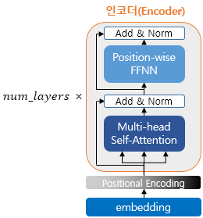
encoder_layer
encoder
LayerNormalization
LayerNormalization
Dropout
Dense
Dense
Dropout
LayerNormalization
Dropout
MultiHeadAttention
Input
Dense
(11000, 40)
LayerNormalization
Dropout
Dense
Dense
Dense
LayerNormalization
Dropout
LayerNormalization
MultiHeadAttention
Input
(11000, 40)
LayerNormalization
Dropout
Dropout
Dense
Dense
LayerNormalization
Dropout
MultiHeadAttention
MultiHeadAttention
Input
(11000, 40)
LayerNormalization
Input
Dropout
Dense
Dense
(11000, 40)
LayerNormalization
Dropout
MultiHeadAttention
Input
(11000, 40)

Slide 18
def scaled_dot_product_attention(query, key, value, mask):
# query 크기 : (batch_size, num_heads, query의 문장 길이, d_model/num_heads)
# key 크기 : (batch_size, num_heads, key의 문장 길이, d_model/num_heads)
# value 크기 : (batch_size, num_heads, value의 문장 길이, d_model/num_heads)
# padding_mask : (batch_size, 1, 1, key의 문장 길이)
# Q와 K의 곱. 어텐션 스코어 행렬.
matmul_qk = tf.matmul(query, key, transpose_b=True)
(1, 4, 40, 32 ) (1, 4, 40, 32 ).T
(1, 4) (40, 32) (40, 32 ).T
(1, 4) (40, 32) (32, 40)
(1, 4, 40, 40)

Slide 19
temp_q = tf.constant([[[[0, 0], [0, 10], [10, 10]],
[[0, 0], [0, 10], [10, 10]],
[[0, 0], [0, 10], [10, 10]],
[[0, 0], [0, 10], [10, 10]]]],dtype=tf.float32) # (1,4,3,2)
temp_k = tf.constant([[[[0, 0], [0, 10], [10, 10]],
[[0, 0], [0, 10], [10, 10]],
[[0, 0], [0, 10], [10, 10]],
[[0, 0], [0, 10], [10, 10]]]],dtype=tf.float32) # (1,4,3,2)
matmul_qk = tf.matmul(temp_q, temp_k, transpose_b=True)
print(matmul_qk)
0
0
0
0
0
(1, 4, 3, 2 ) (1, 4, 3, 2 ).T
0
0
10
(1, 4) (3, 2) (3, 2 ).T
0
10
.
=
0
100
100
0
10
10
(1, 4) (3, 2) (2, 3)
(1, 4, 3, 3)
10
10
0
100
200

Slide 20
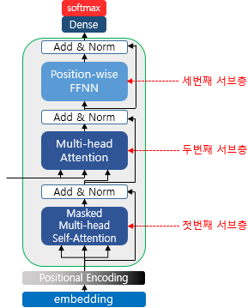
decoder_layer
LayerNormalization
Dropout
Dense
Dense
decoder
LayerNormalization
Dropout
enc_outputs
MultiHeadAttention
LayerNormalization
MultiHeadAttention(Masked)
Input
(11000, 40)
(11000, 40)

Slide 21
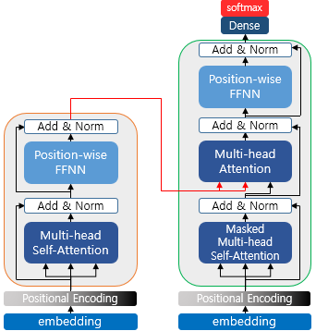
encoder_layer
LayerNormalization
Dropout
LayerNormalization
Dense
Dropout
Dense
Dense
LayerNormalization
Dense
Dropout
LayerNormalization
enc_outputs
MultiHeadAttention
Dropout
LayerNormalization
MultiHeadAttention
MultiHeadAttention(Masked)
Positional Encoding
Positional Encoding
embedding
embedding
(11000, 40)
Input
Input
(11000, 40)

