Slide 1
0
0
0
0
0
0
1
2
3
4
0
0
0
0
0
1
1
1
1
1
*
0
1
2
3
4
0
1
2
3
4
2
2
2
2
2
0
1
2
3
4
0
2
4
6
8

Slide 2
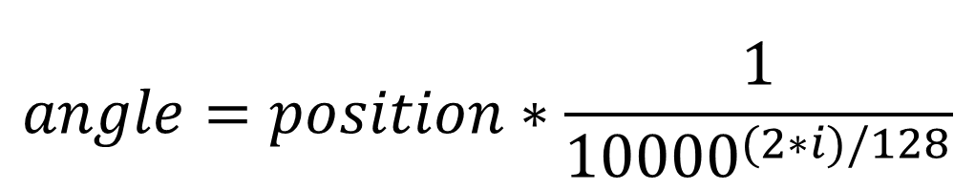
sample_pos_encoding = PositionalEncoding(50, 128)
angle_rads = self.get_angles( (50,1) , (1,128), 128 ))
i
position
PositionalEncoding
0
0
0
0
0
0
1
2
3
4
0
0
0
0
0
self.positional_encoding()
1
1
1
1
1
0
1
2
3
4
0
1
2
3
4
2
2
2
2
2
*
0
1
2
3
4
=
0
2
4
6
8
3
3
3
3
3
0
1
2
3
4
0
3
6
9
12
4
4
4
..
4
0
1
2
..
4
0
4
8
..
16
5
5
5
5
5
0
1
2
3
4
0
5
10
15
20
6
6
6
6
6
0
1
2
3
4
0
6
12
18
24
angles = 1 / tf.pow(10000, (2 * (i // 2)) / tf.cast(d_model, tf.float32))
$$angle=position∗\frac{1}{{10000}^{(2∗i)/128}}$$
(position, i)
(50, 128)
(50, 1)
(1, 128) => (50, 128)

Slide 3
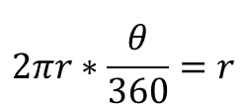


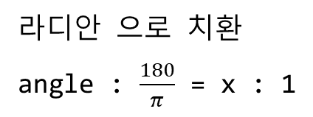
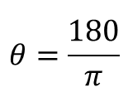
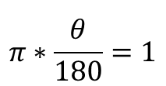
r
1
$$θ$$
r
90
180
270
360
$$2πr∗\frac{θ}{360}=r$$
$$π∗\frac{θ}{180}=1$$
you
$$θ=\frac{180}{π}$$
you
라디안 으로 치환
angle : $\frac{180}{π}$ = x : 1
angle* $\frac{π}{180}$ = x

Slide 4
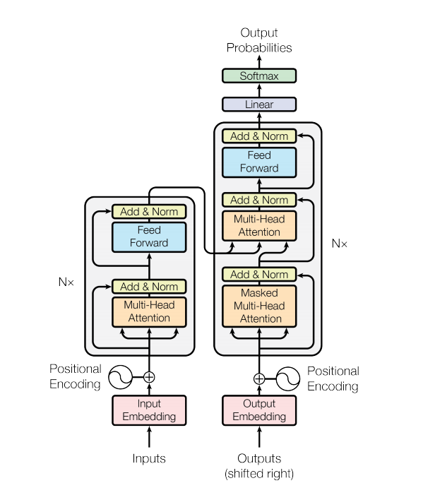

Slide 5
np.set_printoptions(suppress=True) # 1000000 => 1.0e+5
temp_k = tf.constant([[10,0,0],
[0,10,0],
[0,0,10],
[0,0,10]], dtype=tf.float32) # (4, 3)
temp_k
10
0
0
0
10
0
0
0
10
0
0
10

Slide 6
temp_v = tf.constant([[ 1,0],
[ 10,0],
[ 100,5],
[1000,6]], dtype=tf.float32) # (4, 2)
temp_k
temp_v
10
0
0
1
0
0
10
0
10
0
0
0
10
100
5
0
0
10
1000
6

Slide 7
temp_q = tf.constant([[0, 0, 10]], dtype=tf.float32) # (1, 3)
temp_q
temp_k
temp_v
0
10
0
10
0
0
1
0
0
10
0
10
0
0
0
10
100
5
0
0
10
1000
6

Slide 8
def scaled_dot_product_attention(query, key, value, mask):
matmul_qk = tf.matmul(query, key, transpose_b=True) # np.dot( query, key.T )
key
10
0
0
0
10
0
0
0
10
0
0
10
query
(1, 3)
key.T
(3, 4)
matmul_qk
(1, 4)
0
0
10
.
10
0
0
0
=
0
0
100
100
0
10
0
0
0
0
10
10

Slide 9
def scaled_dot_product_attention(query, key, value, mask):
...
depth = tf.cast(tf.shape(key)[-1], tf.float32)
logits = matmul_qk / tf.math.sqrt(depth)
matmul_qk
(1, 4)
logits
(1, 4)
0
0
100
100
0
0
57.73
57.73

Slide 10
def scaled_dot_product_attention(query, key, value, mask):
...
attention_weights = tf.nn.softmax(logits, axis=-1)
logits
(1, 4)
attention_weights
(1, 4)
0
0
57.73
57.73
0
0
0.5
0.5

Slide 11
def scaled_dot_product_attention(query, key, value, mask):
...
output = tf.matmul(attention_weights, value)
return output, attention_weights
value
(4, 2)
1
0
attention_weights
(1, 4)
output
.
10
0
0
0
0.5
0.5
=
550
5.5
100
5
1000
6

Slide 12
def scaled_dot_product_attention(query, key, value, mask):
matmul_qk = tf.matmul(query, key, transpose_b=True)
key
10
0
0
0
10
0
0
0
10
0
0
10
query
(3, 3)
key.T
(3, 4)
matmul_qk
(3, 4)
0
0
10
.
10
0
0
0
=
0
0
100
100
0
10
0
0
10
0
0
0
100
0
0
10
10
0
0
0
10
10
100
100
0
0

Slide 13
def scaled_dot_product_attention(query, key, value, mask):
...
depth = tf.cast(tf.shape(key)[-1], tf.float32)
logits = matmul_qk / tf.math.sqrt(depth)
matmul_qk
(3, 4)
logits
(3, 4)
0
0
100
100
0
0
57.73
57.73
0
100
0
0
0
57.73
0
0
100
100
0
0
57.73
57.73
0
0

Slide 14
def scaled_dot_product_attention(query, key, value, mask):
...
attention_weights = tf.nn.softmax(logits, axis=-1)
logits
(4, 4)
attention_weights
(3, 4)
0
0
57.73
57.73
0
0
0.5
0.5
0
57.73
0
0
0
1
0
0
57.73
57.73
0
0
0.5
0.5
0
0

Slide 15
def scaled_dot_product_attention(query, key, value, mask):
...
output = tf.matmul(attention_weights, value)
return output, attention_weights
value
(4, 2)
attention_weights
(3, 4)
output
(3, 2)
1
0
0
0
0.5
0.5
550
5.5
.
10
0
0
1
0
0
=
10
0
100
5
0.5
0.5
0
0
5.5
0
1000
6

Slide 16
small_transformer = transformer(
vocab_size = 9000,
num_layers = 4,
dff = 512,
d_model = 128,
num_heads = 4,
dropout = 0.3,
name="small_transformer")
model = encoder(vocab_size=vocab_size, num_layers=num_layers, dff=dff,
d_model=d_model, num_heads=num_heads, dropout=dropout,
)
enc_outputs = model(inputs=[inputs, enc_padding_mask]) # call method가 호출된다.

Slide 17
input
(10000,40)
(40,4)
output
from tensorflow.keras.models import Sequential
from tensorflow.keras.layers import Dense
model=Sequential()
model.add(Dense(4, input_dim=40))
model.add(Dense(3))
model.add(Dense(1, activation='sigmoid'))
model.compile()
model.fit()
(4,3)
(3,1)
Dense()
Dense()
Dense()

Slide 18
input
(10000,40)
(40,4)
output
from tensorflow.keras.layers import Input, Dense
# 텐서를 리턴한다.
inputs = Input(shape=(40,))
hidden1 = Dense(4)(inputs)
hidden2 = Dense(3)(hidden1)
output = Dense(1, activation='sigmoid')(hidden2)
model = Model(inputs=inputs, outputs=output)
model.compile()
model.fit()
(4,3)
(3,1)
Dense()
Dense()
Dense()

Slide 19
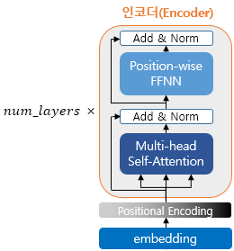
encoder_layer
encoder
LayerNormalization
LayerNormalization
Dropout
Dense
Dense
Dropout
LayerNormalization
Dropout
MultiHeadAttention
Input
Dense
(11000, 40)
LayerNormalization
Dropout
Dense
Dense
Dense
LayerNormalization
Dropout
LayerNormalization
MultiHeadAttention
Input
(11000, 40)
LayerNormalization
Dropout
Dropout
Dense
Dense
LayerNormalization
Dropout
MultiHeadAttention
MultiHeadAttention
Input
(11000, 40)
LayerNormalization
Input
Dropout
Dense
Dense
(11000, 40)
LayerNormalization
Dropout
MultiHeadAttention
Input
(11000, 40)

Slide 20
def scaled_dot_product_attention(query, key, value, mask):
# query 크기 : (batch_size, num_heads, query의 문장 길이, d_model/num_heads)
# key 크기 : (batch_size, num_heads, key의 문장 길이, d_model/num_heads)
# value 크기 : (batch_size, num_heads, value의 문장 길이, d_model/num_heads)
# padding_mask : (batch_size, 1, 1, key의 문장 길이)
# Q와 K의 곱. 어텐션 스코어 행렬.
matmul_qk = tf.matmul(query, key, transpose_b=True)
(1, 4, 40, 32 ) (1, 4, 40, 32 ).T
(1, 4) (40, 32) (40, 32 ).T
(1, 4) (40, 32) (32, 40)
(1, 4, 40, 40)

Slide 21
0
0
0
0
0
0
0
0
num_heads=4
d_model//num_heads
0
10
0
10
0
10
0
10
10
10
10
10
10
10
10
10
0
0
0
0
0
0
0
0
0
10
0
10
0
10
0
10
10
10
10
10
10
10
10
10
0
0
0
0
0
(1, 4, 3, 2 ) (1, 4, 3, 2 ).T
0
0
10
(1, 4) (3, 2) (3, 2 ).T
0
10
.
=
0
100
100
0
10
10
(1, 4) (3, 2) (2, 3)
(1, 4, 3, 3)
10
10
0
100
200

Slide 22
0
0
0
0
0
0
0
0
num_heads=4
d_model//num_heads
0
10
0
10
0
10
0
10
10
10
10
10
10
10
10
10
.
.
.
.
0
0
10
0
0
10
0
0
10
0
0
10
0
10
10
0
10
10
0
10
10
0
10
10
0
0
0
0
0
(1, 4, 3, 2 ) (1, 4, 3, 2 ).T
0
0
10
(1, 4) (3, 2) (3, 2 ).T
0
10
.
=
0
100
100
0
10
10
(1, 4) (3, 2) (2, 3)
(1, 4, 3, 3)
10
10
0
100
200

Slide 23
4
1
3
2
5
I am a student .
4
[[0. 1. 1. 1. 1.]
[0. 0. 1. 1. 1.]
[0. 0. 0. 1. 1.]
[0. 0. 0. 0. 1.]
[0. 0. 0. 0. 0.]]
1
3
2
5
4
0
0
2
5
4
[[0. 1. 1. 1. 1.]
[0. 1. 1. 1. 1.]
[0. 1. 1. 1. 1.]
[0. 1. 1. 0. 1.]
[0. 1. 1. 0. 0.]]
0
0
2
5

Slide 24
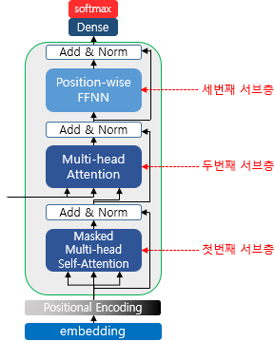
decoder_layer
LayerNormalization
Dropout
Dense
Dense
decoder
LayerNormalization
Dropout
enc_outputs
MultiHeadAttention
LayerNormalization
MultiHeadAttention(Masked)
Input
(11000, 40)
(11000, 40)

Slide 25
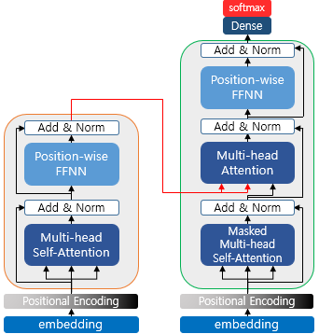
encoder_layer
LayerNormalization
Dropout
LayerNormalization
Dense
Dropout
Dense
Dense
LayerNormalization
Dense
Dropout
LayerNormalization
enc_outputs
MultiHeadAttention
Dropout
LayerNormalization
MultiHeadAttention
MultiHeadAttention(Masked)
Positional Encoding
Positional Encoding
embedding
embedding
(11000, 40)
Input
Input
(11000, 40)

Slide 26
D_MODEL = 256
NUM_LAYERS = 2
NUM_HEADS = 8
DFF = 512
DROPOUT = 0.1
model = transformer(
vocab_size=VOCAB_SIZE,
num_layers=NUM_LAYERS,
dff=DFF,
d_model=D_MODEL,
num_heads=NUM_HEADS,
dropout=DROPOUT)
model.fit(dataset, epochs=EPOCHS)
(1,40, 256)
(40, 256)
(40, 256)
(8180, 256)
(40, 256)
(8180, 256)
(1, 40)
(11823, 40)

