Slide 1
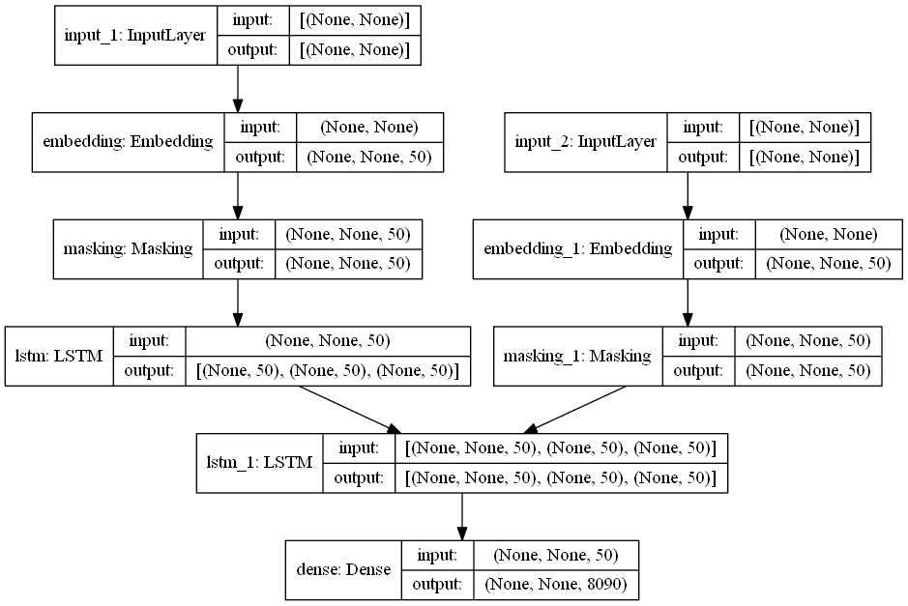
encoder_inputs
encoder_inputs = Input(shape=(None,))
enc_emb = Embedding(src_vocab_size, latent_dim)(encoder_inputs)
enc_masking = Masking(mask_value=0.0)(enc_emb)
encoder_lstm = LSTM(latent_dim, return_state=True)
encoder_outputs, state_h, state_c = encoder_lstm(enc_masking)
encoder_states = [state_h, state_c]
enc_emb
enc_masking
encoder_lstm
state_h, state_c
emb = Embedding()
emb() # emb.__called__()
Embedding()()
Embedding
self.idx
__called__

Slide 2
model = Model([encoder_inputs, decoder_inputs], decoder_outputs)
encoder_inputs
decoder_inputs = Input(shape=(None,))
dec_emb_layer = Embedding(tar_vocab_size, latent_dim)
dec_emb = dec_emb_layer(decoder_inputs)
dec_masking = Masking(mask_value=0.0)(dec_emb)
# 상태값 리턴을 위해 return_state는 True, 모든 시점에 대해서 단어를 예측하기 위해 return_sequences는 True
decoder_lstm = LSTM(latent_dim, return_sequences=True, return_state=True)
# 인코더의 은닉 상태를 초기 은닉 상태(initial_state)로 사용
decoder_outputs, _, _ = decoder_lstm(dec_masking,
initial_state=encoder_states)
# 모든 시점의 결과에 대해서 소프트맥스 함수를 사용한 출력층을 통해 단어 예측
decoder_dense = Dense(tar_vocab_size, activation='softmax')
decoder_outputs = decoder_dense(decoder_outputs)
enc_emb
decoder_inputs
enc_masking
dec_emb
encoder_lstm
dec_masking
state_h, state_c
decoder_outputs
decoder_outputs

Slide 3
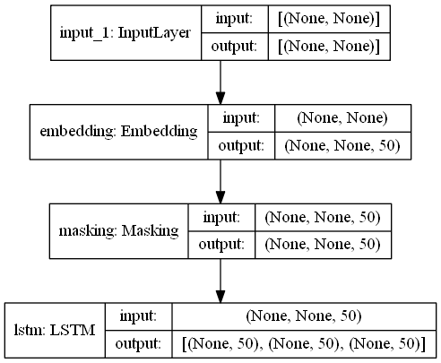
encoder_model
encoder_model = Model(encoder_inputs, encoder_states)

Slide 4
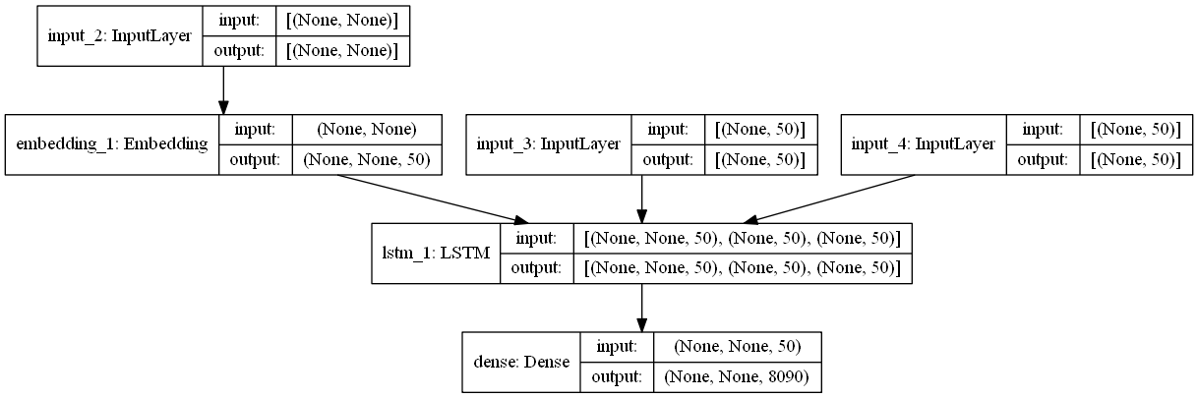
'sos'
decoder_model
decoder_inputs
decoder_state_input_h
decoder_state_input_c
dec_emb2
decoder_states_inputs
decoder_outputs2
decoder_outputs2
decoder_state_input_h = Input(shape=(latent_dim,))
decoder_state_input_c = Input(shape=(latent_dim,))
decoder_states_inputs = [decoder_state_input_h, decoder_state_input_c]
dec_emb2= dec_emb_layer(decoder_inputs)
decoder_outputs2, state_h2, state_c2 = decoder_lstm(dec_emb2, initial_state=decoder_states_inputs)
decoder_states2 = [state_h2, state_c2]
decoder_outputs2 = decoder_dense(decoder_outputs2)

Slide 5
'sos'
decoder_model
decoder_inputs
decoder_state_input_h
decoder_state_input_c
dec_emb2
decoder_states_inputs
decoder_outputs2
decoder_outputs2
decoder_model = Model(
[decoder_inputs] + decoder_states_inputs,
[decoder_outputs2] + decoder_states2)

Slide 6
훈련할 때
Softmax
Softmax
Softmax
Softmax
Affine
Affine
Affine
Affine
c
LSTM
LSTM
LSTM
LSTM
h
Embedding
Embedding
Embedding
Embedding
'<sos>'
'vous'
'faites'
'des'

Slide 7
테스트할 때
'vous'
'etes'
'me'
'eos'
Softmax
Softmax
Softmax
Softmax
Affine
Affine
Affine
Affine
c
c
c
c
LSTM
LSTM
h
LSTM
LSTM
h
h
h
Embedding
Embedding
Embedding
Embedding
'<sos>'

