Slide 1
강사명 : 김정인
email : jikim@imguru.co.kr
강의자료 : https://github.com/imguru-mooc/opencv_vision
https://colab.research.google.com/github/imguru-mooc/opencv_vision/blob/main/01.ipynb
수업 : 45분
쉬는시간 : 15분

Slide 2
image
output
1
2
3
4
kernel
14
18
22
5
6
7
8
1
1
30
34
38
9
10
11
12
1
1
46
50
54
13
14
15
16
O=N-F+1
3=4-2+1

Slide 3
image
output
14
14
18
22
1
2
3
4
kernel
14
14
18
22
5
6
7
8
1
1
30
30
34
38
9
10
11
12
1
1
46
46
50
54
13
14
15
16
O=N+P-F+1
[[14 14 18 22]
[14 14 18 22]
[30 30 34 38]
[46 46 50 54]]
4=4+1-2+1

Slide 4
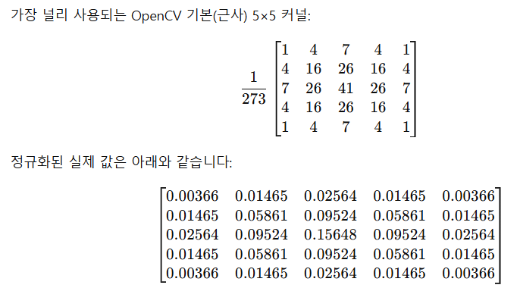

Slide 5
100
1
2
3
4
5
6
7
8
9
10
1
2
3
4
5
100
6
7
8
9
10
1
2
3
4
5
6
7
8
9
10
1
4
3
2

Slide 6
a = np.array([1,2,3,4])
len(a) => 4
a.shape => (4,)
1
2
3
4

Slide 7
a = np.array([[1,2,3,4]])
len(a) => 1
a.shape => (1, 4)
1
2
3
4

Slide 8
a = np.array([[1,2],
[3,4]])
len(a) => 2
a.shape => (2, 2)
a = np.array([[1,2],[3,4]])
len(a) => 2
a.shape => (2, 2)
1
2
3
4
1
2
3
4

Slide 9
a = np.array([[[1,2],[3,4]],
[[5,6],[7,8]]])
len(a) => 2
a.shape => (2, 2, 2)
1
2
3
4
５
６
７
８

Slide 10
a = np.array([[[[1,2],[3,4]],
[[5,6],[7,8]]],
[[[1,2],[3,4]],
[[5,6],[7,8]]]])
len(a) => 2
a.shape => (2, 2, 2, 2)
1
2
3
4
５
６
７
８
1
2
3
4
５
６
７
８

Slide 11
item = np.zeros(4);
0
1
2
3
메모리를 심하게 낭비
1
0
0
1

Slide 12
item = 0
item = 9
메모리를 심하게 낭비
3
2
1
0
1
1

Slide 13
item = 0
item = item | 1
item = item | 8
메모리를 심하게 낭비
3
2
1
0
0
0
0
0
|
0
0
0
1
0
0
0
1
|
1
0
0
0
1
0
0
1

Slide 14
item = 0
item = item | 1
item = item | 8
메모리를 심하게 낭비
3
2
1
0
1
0
0
1
&
0
0
0
1
0
0
0
1

Slide 15
item = 0
item = item | 1
item = item | 8
item = item & (~8)
메모리를 심하게 낭비
3
2
1
0
1
0
0
1
&
0
1
1
1
0
0
0
1

Slide 16
playground.tensorflow.org

