Slide 1

H-Tech
Online Learning System

Slide 2
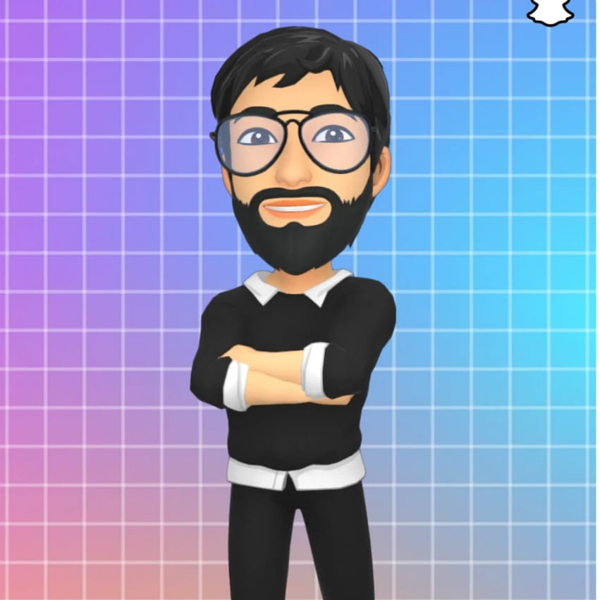
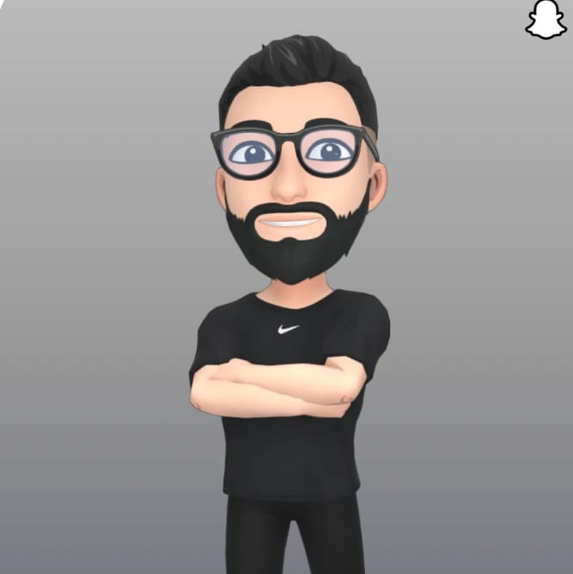
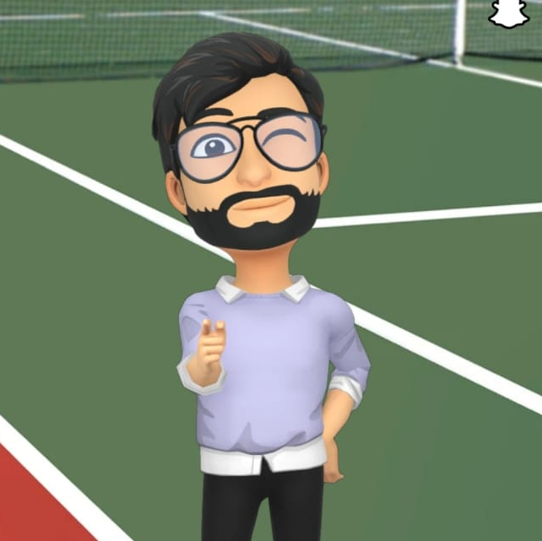
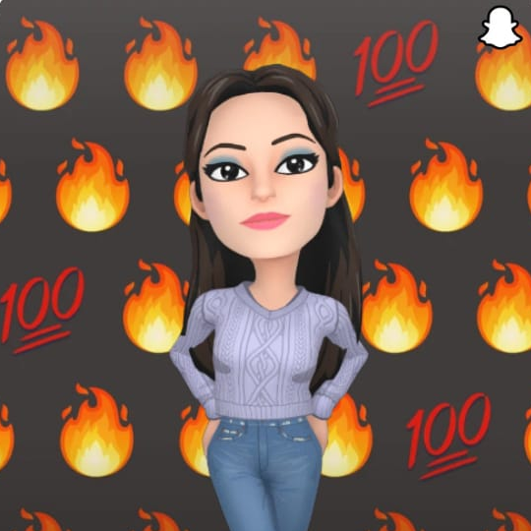

Haresh Baraiya
Meet Our Team
Pranav Rathod
Milan Solanki
Prof. Harshit Jain
Pooja Hansaliya

Slide 3
01
Introduction
Table of Contents
02
Technology
03
Features

Slide 4
04
Live Demo
Table of Contents
05
Conclusion
06
Future Development

Slide 5

Let’s Start With Introduction
This project is all about online course management system, similarly like coursera, udemy & many others.
It’ll help us to learn different-different courses.
Used to gain knowledge of particular courses.
Learn international courses of different university can easily available on this site.

Slide 6

Technology
WordPress
PHP
CSS & JS
MySql
Infinityfree hosting & Domain

Slide 7

Features
Strong Validation
User friendly UI
Self-Paced Learning Option
Practice Quizzes
Graded Assignments with Peer Feedback
Self Registration
Responsive Design
Collaboration of various learning tools

Slide 8
Live Demo
H-tech.rf.gd

Slide 9
Future Development
Build Strong Network
Continuous Learning
06
01
Certification
Personalized
Learning Paths
05
Categories
02
04
03
On Demand
Learning
Social Learning

Slide 10

Conclusion
In conclusion, online learning is beneficial to the
students, tutors and the institution offering these
courses. I would therefore recommend that online
learning be implemented on all learning institutions
and research on how to improve this learning
process should be carried out.

Slide 11
Thank You!

