Slide 1

SMART INDIA HACKATHON 2026
Problem Statement ID – 26170
Problem Statement Title-
AI-Driven Anomaly Detection in
Component Burn-In & Screening
Theme- Smart Automation
PS Category - Software
Team ID- SIH26-A0H-T282
Team Name - Odyysix

Slide 2

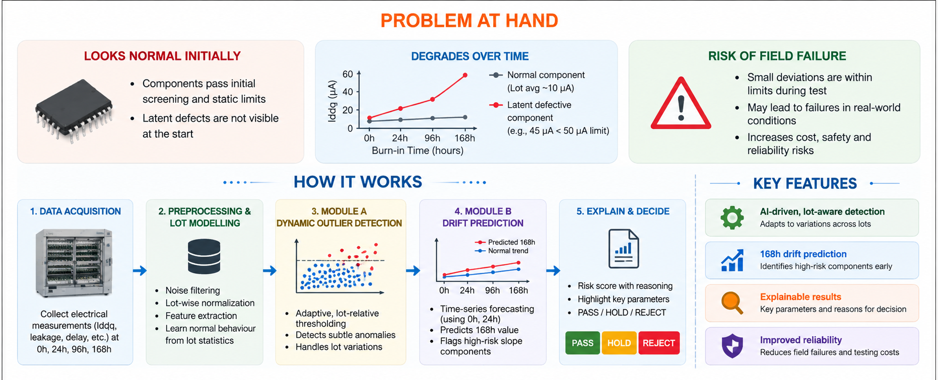
AI-Driven Anomaly Detection in Component
Burn-In & Screening

Slide 3
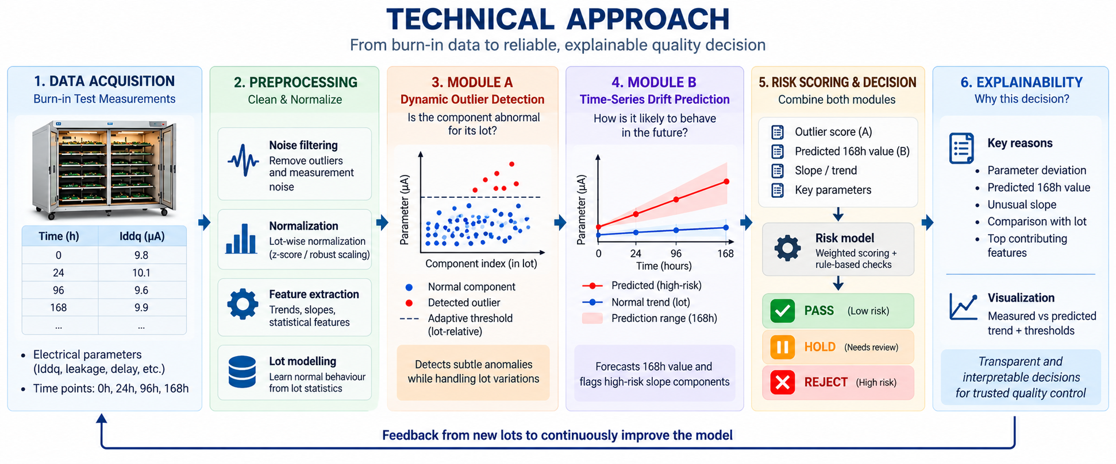
TECHNICAL APPROACH

Slide 4
FEASIBILITY AND VIABILITY
WHY THE IDEA IS FEASIBLE
SOFTWARE-ONLY
DATA-READY
MODEL-READY
DEPLOYABLE
• ML pipeline + dashboard
• PS defines time-series inputs
• Module A and B are independent
• CSV / telemetry input
• Runs on standard CPU
• 0h / 24h / 96h / 168h checkpoints
• Lightweight statistical + regression models
• Python ML service
• No new screening hardware needed for prototype
• Designed to ingest organizer format
• Easy to test and benchmark
• QA dashboard + API
IMPLEMENTATION PATH
1
Development data
2
Train & validate
3
Stress test
4
Deploy
Realistic aging behaviour
+ SIH-aligned test data
Lot-aware anomaly
+ 168h prediction
Noise • lot variation
• borderline defects
Risk score →
PASS / HOLD / REJECT
KEY CHALLENGES
MITIGATION & RISK CONTROL
• Exact SIH evaluation data may be limited / hidden.
• Use external aging data only for development / method validation; never claim it as SIH ground truth.
• Lot-to-lot variation can defeat fixed thresholds.
• Lot-relative robust statistics handle normal lot variation.
• False negatives are costly in high-reliability screening.
• Optimize recall and keep HOLD / REVIEW for uncertain cases.
• Early data may not perfectly predict 168h behaviour.
• Use conservative prediction intervals around the 168h forecast.

Slide 5
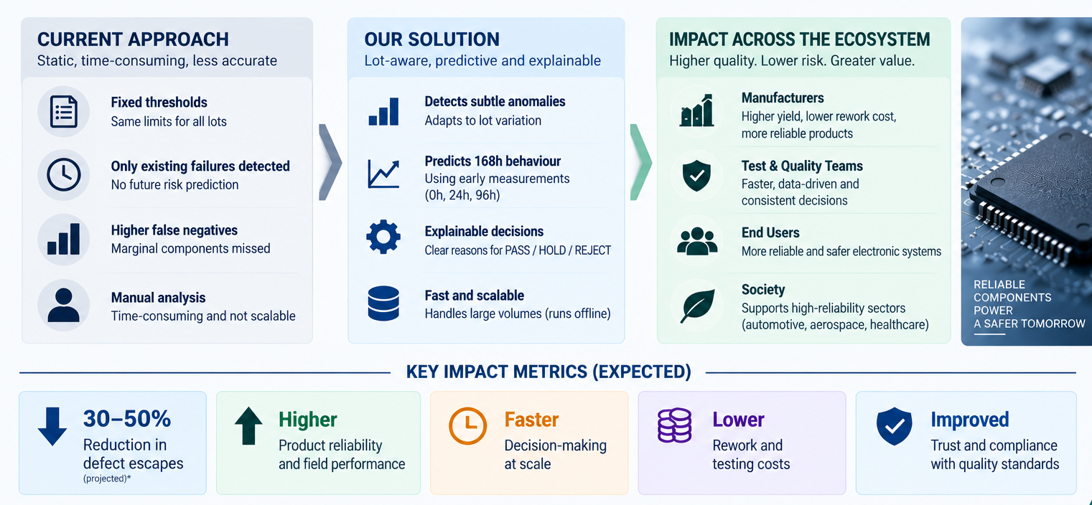
IMPACT AND BENEFITS

Slide 6
RESEARCH AND REFERENCES
🔗 KEY RESOURCES
📖 CITATIONS / REFERENCES
1
NASA PCoE — IGBT Accelerated Aging Dataset
1
Celaya, J. R., Saxena, A., Saha, S., & Goebel, K.
Thermal-overstress aging data from 6 devices; electrical measurements for degradation analysis.
“Prognostics of Power MOSFETs under Thermal Stress Accelerated Aging using Data-Driven and Model-Based Methodologies,” Annual Conference of the PHM Society, 2011.
https://data.nasa.gov/dataset/insulated-gate-bipolar-transistor-igbt-accelerated-aging
2
NASA — MOSFET Thermal-Stress Aging Dataset
2
Celaya, J. R., Saxena, A., Wysocki, P., Saha, S., & Goebel, K.
Controlled accelerated aging with continuous degradation / run-to-failure data.
“Towards Prognostics of Power MOSFETs: Accelerated Aging and Precursors of Failure,” Annual Conference of the PHM Society, 2010.
https://data.nasa.gov/dataset/prognostics-of-power-mosfets-under-thermal-stress-accelerated-aging-using-data-driven-and--3f82a
3
NASA — Electrical Overstress & Prognostics
3
Chandola, V., Banerjee, A., & Kumar, V.
Accelerated aging, degradation modelling and future-state prediction for power MOSFETs.
“Anomaly Detection: A Survey,” ACM Computing Surveys, Vol. 41, No. 3, 2009.
https://data.nasa.gov/dataset/accelerated-aging-with-electrical-overstress-and-prognostics-for-power-mosfets
4
NASA — PCoE Data Set Repository
4
Pedregosa, F., Varoquaux, G., Gramfort, A., et al.
Prognostics and health-management datasets for algorithm development and validation.
“Scikit-learn: Machine Learning in Python,” Journal of Machine Learning Research, Vol. 12, pp. 2825–2830, 2011.
https://www.nasa.gov/intelligent-systems-division/discovery-and-systems-health/pcoe/pcoe-data-set-repository/
5
scikit-learn — Outlier Detection
5
Lundberg, S. M. & Lee, S.-I.
Official documentation for outlier / novelty detection methods.
“A Unified Approach to Interpreting Model Predictions,” Advances in Neural Information Processing Systems (NeurIPS), 2017.
https://scikit-learn.org/stable/modules/outlier_detection.html
SHAP — Explainable AI
6
Saha, B. & Goebel, K.
6
“Model-Based and Data-Driven Prognostics of Power Electronics Devices,” NASA Prognostics Center of Excellence research, 2011.
Official documentation for feature-level explanations of ML predictions.
https://shap.readthedocs.io/en/latest/
ODYYSIX
SIH26170
SMART SCREENING • RELIABLE COMPONENTS • SAFER TOMORROW

