Slide 1

SMART INDIA HACKATHON 2026
Problem Statement ID – 26173
Problem Statement Title-
iTantra -Indian Multilingual TTS& STT
Aided Neural Transceiver Radio
Access for low bitrate links
Theme- Smart Automation
PS Category - Software
Team ID- SIH26-A0H-T282
Team Name - Odyysix

Slide 2

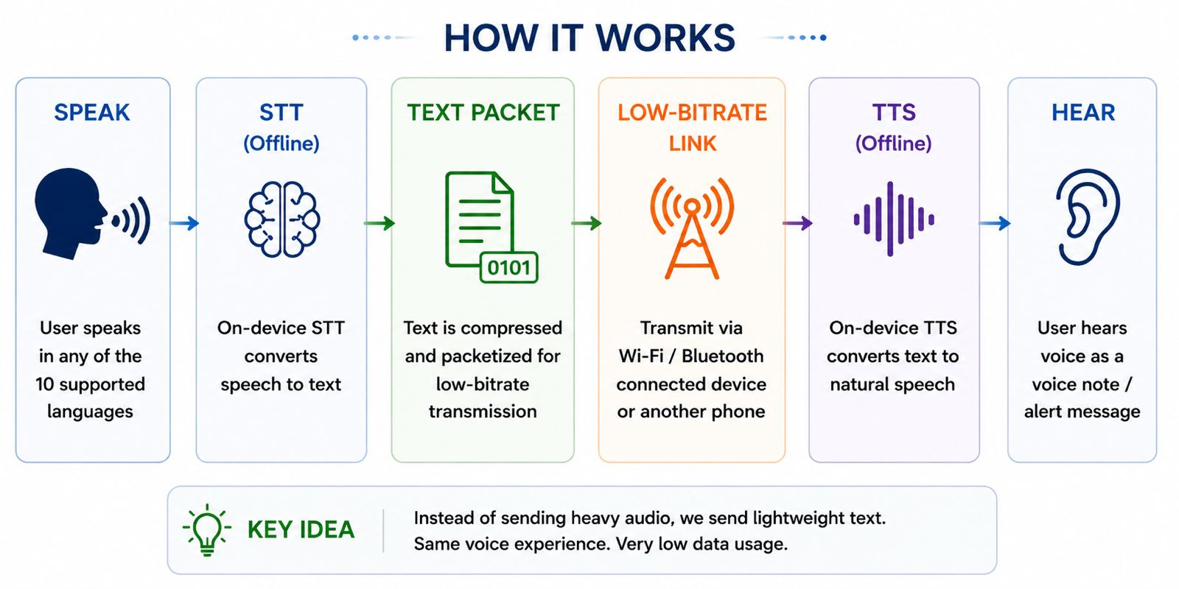
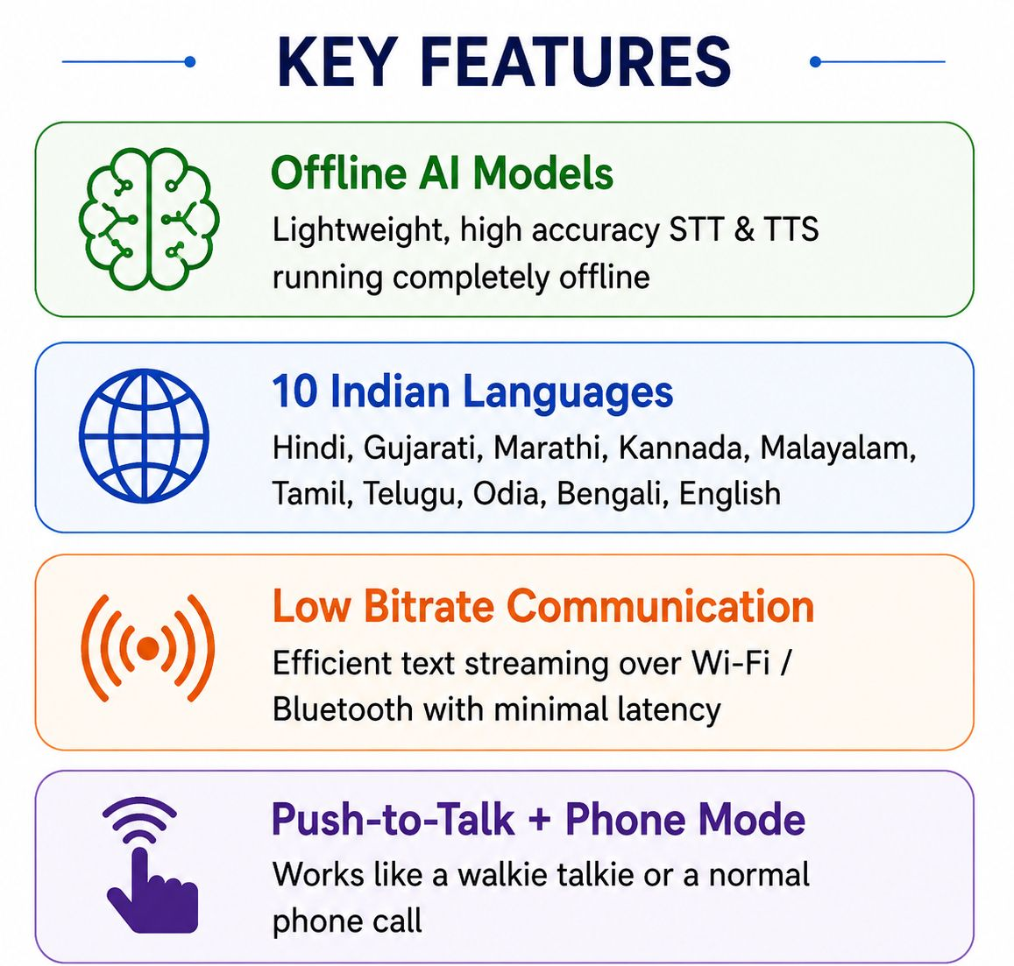
iTantra -Indian Multilingual TTS & STT Aided
Neural Transceiver Radio Access for low bitrate links
Proposed Solution
PROBLEM AT HAND
DATA-HUNGRY AUDIO
VOICE IS CRITICAL
OFFLINE REQUIREMENT
Continuous voice is difficult to transmit over low-data-rate links.
In alert/distress situations, voice is more inclusive than relying only on written messages.
Remote environments cannot depend on internet-hosted STT/TTS APIs.

Slide 3
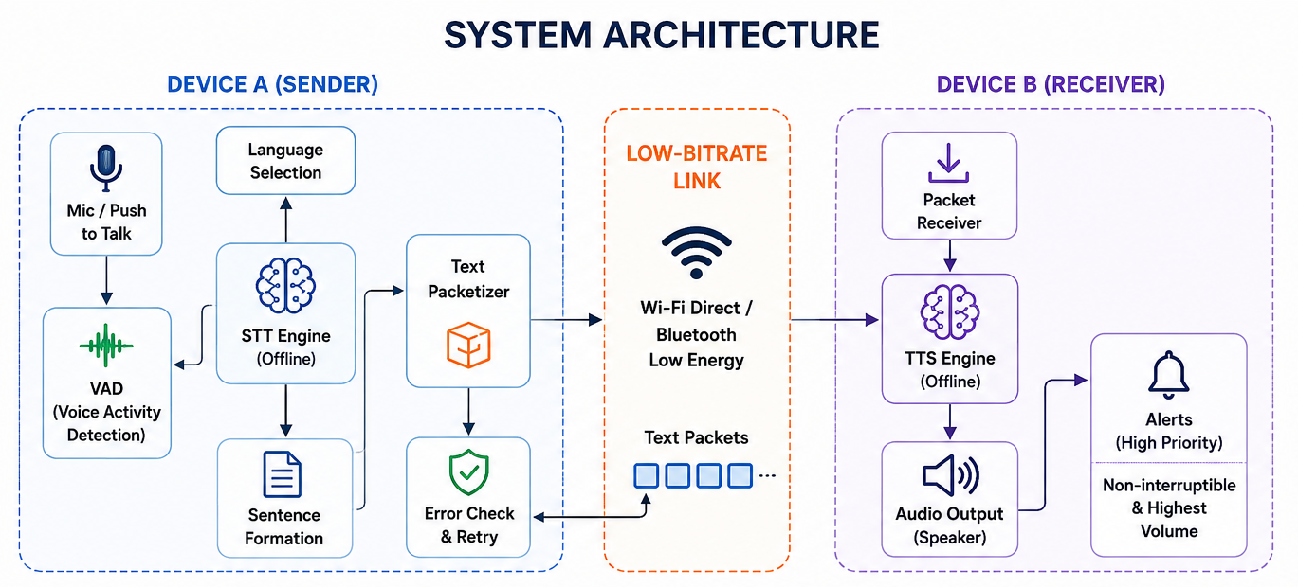
TECHNICAL APPROACH
ON-DEVICE AI
• Open-source STT/TTS pipeline
• Local inference — no hosted speech API
• Model optimization for low-/mid-range Android
• Target: low STT Word Error Rate + intelligible TTS
COMMUNICATION
• Convert speech to compact text
• Packetize and transmit sentence data
• Bluetooth / Wi-Fi Direct for local demo
• Modular interface for low-bitrate links

Slide 4
FEASIBILITY AND VIABILITY
TECHNICAL FEASIBILITY
RESOURCE FEASIBILITY
• Android application can host optimized open-source speech models.
• Offline inference directly satisfies the PS requirement.
• Bluetooth / Wi-Fi Direct provides a practical two-phone demonstration path.
• Prototype can be built incrementally: 1–2 languages → full language set.
• Use lightweight models and optimize memory/CPU footprint.
• Sentence-level text transmission greatly reduces payload compared with raw audio.
• Use asynchronous STT → transmission → TTS to reduce perceived delay.
KEY CHALLENGES
MITIGATION PLAN
• STT accuracy across Indian languages, accents and noisy environments.
• Model size and CPU/RAM limits on low- and mid-range phones.
• Low end-to-end latency while maintaining intelligibility.
• Reliable packet handling when the communication link is constrained.
• Quantization / lightweight inference and model profiling.
• Voice Activity Detection + pause-based sentence formation.
• Streaming/incremental processing where supported.
• Buffering, packet framing and recovery for the communication layer.

Slide 5
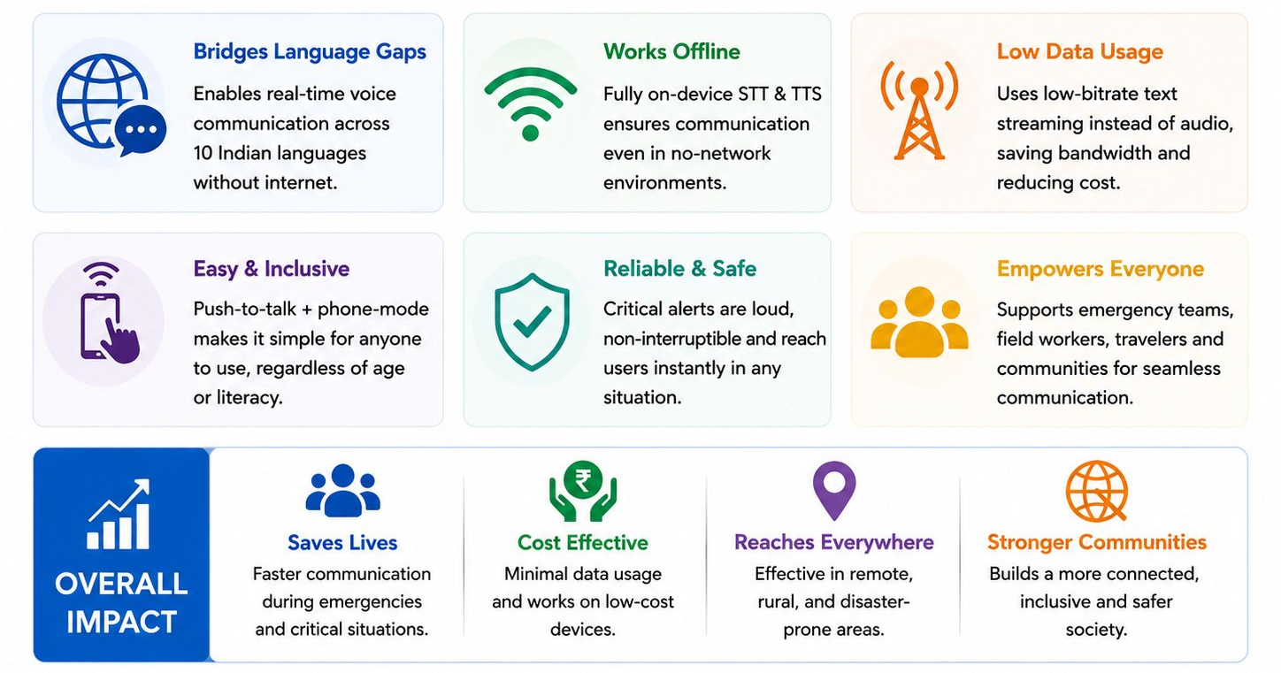
IMPACT AND BENEFITS

Slide 6
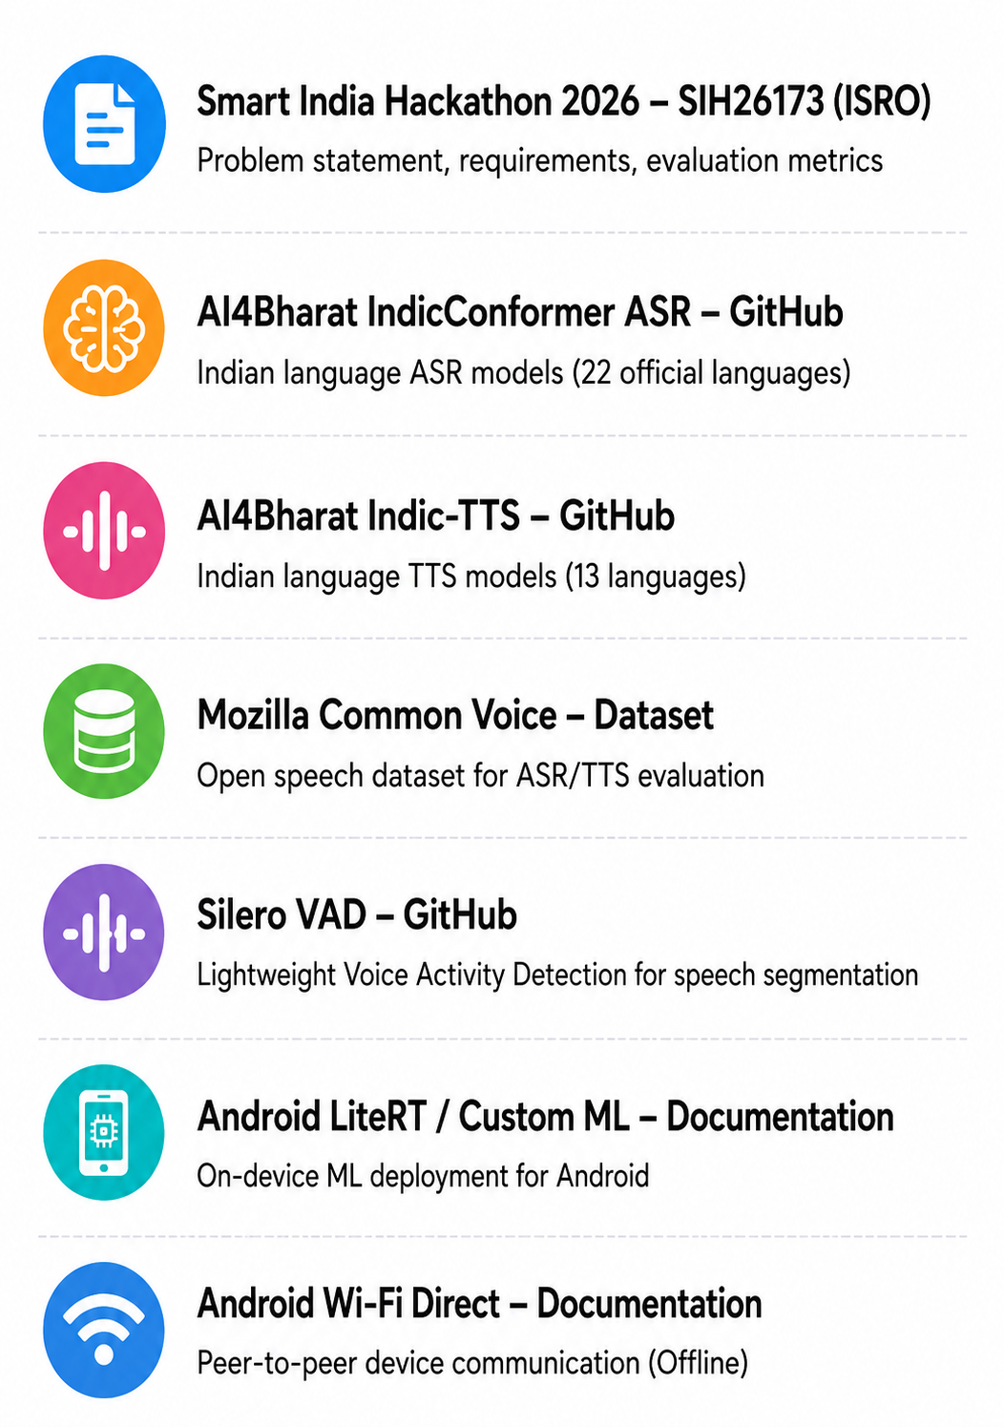
RESEARCH AND REFERENCES
https://github.com/AI4Bharat/IndicConformerASR
📖 REFERENCES
1) L. R. Rabiner and R. W. Schafer, Digital Processing of Speech Signals, Prentice-Hall, 1978.
2) L. R. Rabiner and B. H. Juang, Fundamentals of Speech Recognition, Prentice Hall, 1993.
3) AI4Bharat, IndicConformer: Conformer-based ASR for Indian Languages, 2024.
4) A. Sankar et al., “IndicVoices-R: Unlocking a Massive Multilingual Multi-speaker Speech Corpus for Scaling Indian TTS,” NeurIPS 2024 Datasets and Benchmarks, 2024.
https://github.com/AI4Bharat/Indic-TTS
https://commonvoice.mozilla.org/data
https://github.com/snakers4/silero-vad
https://developer.android.com/ai/custom
https://developer.android.com/develop/connectivity/wifi/wifi-direct

