Slide 1
Numerical Computing CS3073 Section4
Muhammad Saqib

Slide 2
Numerical computing
Numerical computing is an approach for solving complex mathematical problems using simple arithmetic operations . The approach involves formulation of mathematical models physical situations that can be solved with arithmetic operations. It requires development, analysis and use of algorithms.

Slide 3
Why Numerical Computing?
The great advantage of using numerical analysis is that it investigates and provides accurate solutions to real-life problems from the field of science, engineering, biology, astrophysics and finance etc.

Slide 4
Error
Difference between a true value and an estimate, or approximation, of that value.
Types
Absolute Error
Relative Error
Percent Error

Slide 5
Absolute Error
Absolute Error is the amount of error in your measurements.
It is the difference between the measured value and “true” value. For example, if a scale states 90 pounds but you know your true weight is 89 pounds, then the scale has an absolute error of 90 lbs – 89 lbs = 1 lbs.
Formula:
Absolute Error = |x2-x1|

Slide 6
Relative Error
The relative error is defined as the ratio of the absolute error of the measurement to the actual measurement. Using this method we can determine the magnitude of the absolute error in terms of the actual size of the measurement.
Relative error is a measure of the uncertainty of measurement compared to the size of the measurement. It's used to put error into perspective. For example, an error of 1 cm would be a lot if the total length is 15 cm, but insignificant if the length was 5 km
Formula:
Relative Error = |x2-x1|/x2

Slide 7
Percent Error
Percent error is the difference between estimated value and the actual value in comparison to the actual value and is expressed as a percentage. In other words, the percent error is the relative error multiplied by 100.
Formula:
Percent Error = |x2-x1|/x2 x 100

Slide 8
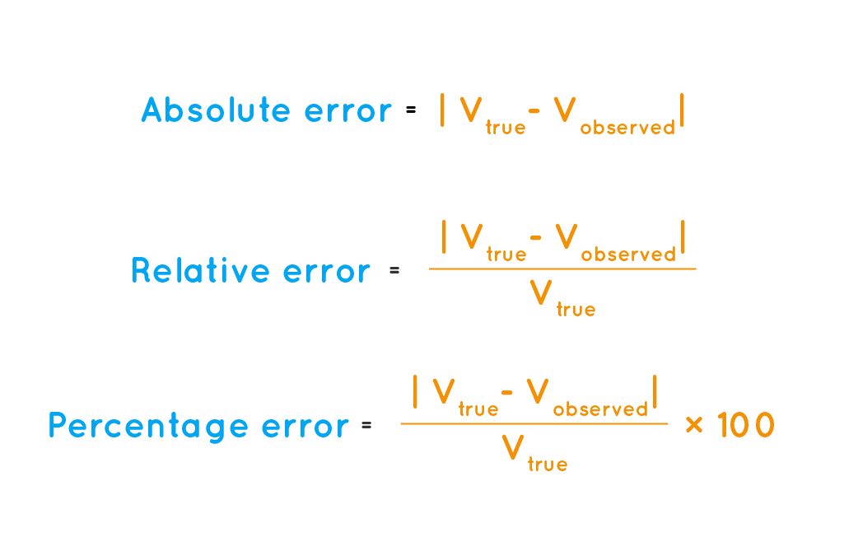

Slide 9
MATLAB
MATLAB is a high-performance language for technical computing. It integrates computation, visualization, and programming in an easy-to-use environment where problems and solutions are expressed in familiar mathematical notation. Typical uses include: Math and computation. Algorithm development.

Slide 10
HomeTask
MATLAB
Flowcharts
Psuedocode
Script file
Function file

Slide 11
script
The simplest type of MATLAB® program is called a script. A script is a file that contains multiple sequential lines of MATLAB commands and function calls. You can run a script by typing its name at the command line.

Slide 12
Function file
In MATLAB, functions are defined in separate files. The name of the file and of the function should be the same. Functions operate on variables within their own workspace, which is also called the local workspace, separate from the workspace you access at the MATLAB command prompt which is called the base workspace.

Slide 13
