Slide 1
AI Assisted AI Chip Design
Harsh Agarwal
M1332006
Advisors:
I-Chyn Wey, CGU
Teo T. Hui, SUTD

Slide 2
Contents
Introduction
Background
Objective and Motivation
Proposed Solution
Implementation
Results & Analysis
Proposed Flow

Slide 3
Introduction
Convolutional Neural Networks (CNNs) are essential in tasks such as image recognition and generative AI, but their computations are resource-intensive
A hardware accelerator is a special type of computer hardware designed to perform specific tasks faster and more efficiently than general-purpose processors
In CNNs, hardware accelerators optimize operations like matrix multiplication and convolutions to achieve the target of faster computations

Slide 4
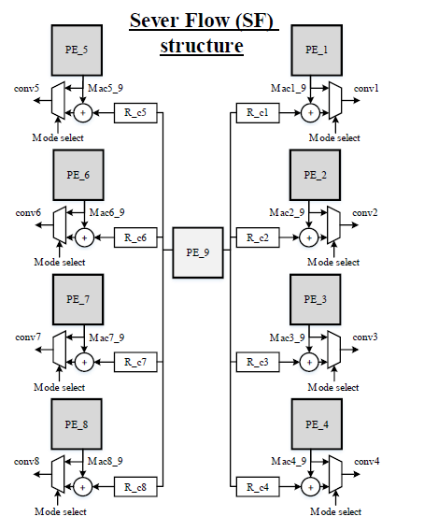
Background
Traditional CNN accelerators struggle with high power consumption, inefficiency in parallel processing, and large silicon area
Therefore, there is a need for optimization of such accelerators to enhance the chip performance.
A CNN accelerator, Server Flow Multi-Mode CNN (SF-MMCN) is designed to address the challenge.
SF-MMCN consists of multiple Processing Elements(PE) connected in a server-like structure
Figure 1. Server Flow Multi-Mode CNN (SF-MMCN) structure
Source: Hsu et al., (2024) SF-MMCN: Low-Power Sever Flow Multi-Mode Diffusion Model Accelerator(https://arxiv.org/abs/2403.10542)

Slide 5
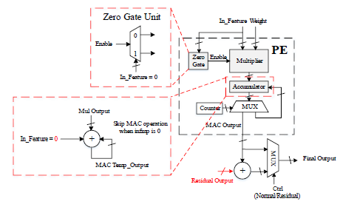
Objective
The current Processing Element unit consists of a multiplier-accumulator structure (MAC). It is provided with a zero gate unit which helps in skipping zero inputs.
The objective is to enhance the zero skipping operation to include pattern-based skipping by implementing a sparse input detection circuit
Figure 2. Processing Element Structure
Source: Hsu et al., (2024) SF-MMCN: Low-Power Sever Flow Multi-Mode Diffusion Model Accelerator(https://arxiv.org/abs/2403.10542)

Slide 6
Motivation
Paper Title | Remark | Relevance
Xu et al. (2023) Accelerating Convolutional Neural Network by exploiting sparsity on GPUs (https://dl.acm.org/doi/10.1145/3600092) | New parallel strategy to avoid redundant computation of zero values | Achieves more than 1.5x performance for all the models tested in the study
Nair et al. (2024) OzMAC: An Energy-Efficient Sparsity-Exploiting Multiply-Accumulate-Unit Design for DL Inference (https://arxiv.org/html/2402.19376v1) | The proposed architecture, called OzMAC (Omit-zero-MAC), skips over zeros within a binary input value and performs simple shift-and-add-based compute in place of expensive multipliers | 8-bit OzMAC improves all three metrics of area, power, and energy significantly by 21%, 70%, and 28%, respectively

Slide 7
Proposed Solution
At present the zero inputs are detected by the circuit and skipped accordingly saving a MAC operation every time
However, this mechanism can be enhanced by adding a sparsity checker. This will reduce extra computations
Sparse input is an input vector having more than a certain number of zeros.
The threshold value is configurable
The sparse checker skips these inputs because they do not contribute much to the multiplication operation (as the result tends to zero)
Enhanced Sparse Detection Unit
Sparse Pattern Detector
Zero Gate
Block Skip
Predictive
Fig 3. Simple conceptual diagram explaining proposed enhancement

Slide 8
Implementation
There are two fronts to the implementation: Software and Hardware
On the hardware front, the Processing Element circuitry discussed in the SF-MMCN structure was implemented in Verilog
Once implemented, the PE code was modified to add the sparsity detection circuit
Both the original PE structure and the enhanced structure was synthesized on the gate level to obtain the netlist
The gate-level netlist displays the logic gates used and the inter-connections between them

Slide 9
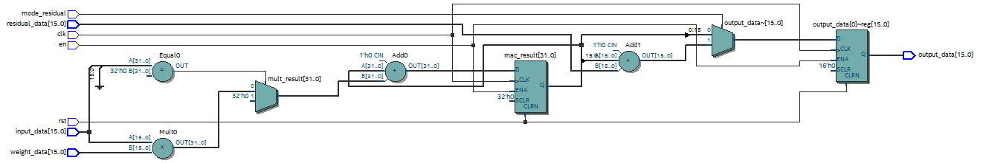
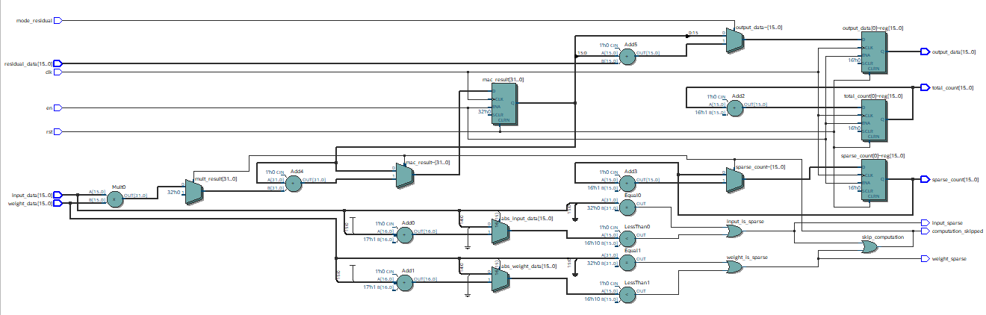
Fig 4. Gate netlist of original PE
Source: Hsu et al., (2024) SF-MMCN: Low-Power Sever Flow Multi-Mode Diffusion Model Accelerator(https://arxiv.org/abs/2403.10542)
Fig 5. Gate netlist of PE with sparsity detection

Slide 10
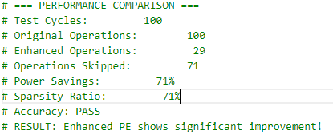
Performance Comparison
Once the netlist is generated, the performance of the two structures need to be compared.
For this, a testbench(TB) needs to be developed which will test the two designs against randomized inputs
Although the inputs are randomized, both the circuits will be tested using the same values
It was seen after the execution of the TB that the sparsity circuit showed significant improvement with a power saving of about 71%.
As the sparsity ratio and power savings are same, this means that the new circuit was able to detect and skip all sparse inputs
Fig. Testbench results

Slide 11
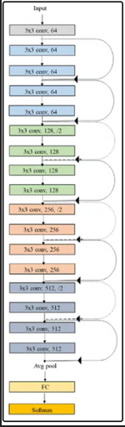
Implementation (contd)
In the software implementation, the proposed design needs to be tested with different Deep Convolutional Neural Network (DCNN) models.
One such model is ResNet-18. ResNet-18 consists of different layers and each layer has certain parameters(weights and biases) associated with it. The aim is to calculate and store these parameters for testing the performance of the implemented hardware at a later stage.
For this work, the ResNet-18 model was implemented on Google Colab. PyTorch Python library was used to obtain a pre-trained model, and the parameters were obtained.
Fig 6. ResNet-18 model

Slide 12
ResNet-18 training results
Layer: conv1.weight, Shape: torch.Size([64, 3, 7, 7]) Layer: bn1.weight, Shape: torch.Size([64]) Layer: bn1.bias, Shape: torch.Size([64]) Layer: layer1.0.conv1.weight, Shape: torch.Size([64, 64, 3, 3]) Layer: layer1.0.bn1.weight, Shape: torch.Size([64]) Layer: layer1.0.bn1.bias, Shape: torch.Size([64]) Layer: layer1.0.conv2.weight, Shape: torch.Size([64, 64, 3, 3]) Layer: layer1.0.bn2.weight, Shape: torch.Size([64]) Layer: layer1.0.bn2.bias, Shape: torch.Size([64]) Layer: layer1.1.conv1.weight, Shape: torch.Size([64, 64, 3, 3]) Layer: layer1.1.bn1.weight, Shape: torch.Size([64]) Layer: layer1.1.bn1.bias, Shape: torch.Size([64]) Layer: layer1.1.conv2.weight, Shape: torch.Size([64, 64, 3, 3]) Layer: layer1.1.bn2.weight, Shape: torch.Size([64]) Layer: layer1.1.bn2.bias, Shape: torch.Size([64]) Layer: layer2.0.conv1.weight, Shape: torch.Size([128, 64, 3, 3]) Layer: layer2.0.bn1.weight, Shape: torch.Size([128]) Layer: layer2.0.bn1.bias, Shape: torch.Size([128]) Layer: layer2.0.conv2.weight, Shape: torch.Size([128, 128, 3, 3]) Layer: layer2.0.bn2.weight, Shape: torch.Size([128]) Layer: layer2.0.bn2.bias, Shape: torch.Size([128]) Layer: layer2.0.downsample.0.weight, Shape: torch.Size([128, 64, 1, 1]) Layer: layer2.0.downsample.1.weight, Shape: torch.Size([128]) Layer: layer2.0.downsample.1.bias, Shape: torch.Size([128]) Layer: layer2.1.conv1.weight, Shape: torch.Size([128, 128, 3, 3]) Layer: layer2.1.bn1.weight, Shape: torch.Size([128]) Layer: layer2.1.bn1.bias, Shape: torch.Size([128]) Layer: layer2.1.conv2.weight, Shape: torch.Size([128, 128, 3, 3]) Layer: layer2.1.bn2.weight, Shape: torch.Size([128]) Layer: layer2.1.bn2.bias, Shape: torch.Size([128]) Layer: layer3.0.conv1.weight, Shape: torch.Size([256, 128, 3, 3]) Layer: layer3.0.bn1.weight, Shape: torch.Size([256]) Layer: layer3.0.bn1.bias, Shape: torch.Size([256]) Layer: layer3.0.conv2.weight, Shape: torch.Size([256, 256, 3, 3]) Layer: layer3.0.bn2.weight, Shape: torch.Size([256]) Layer: layer3.0.bn2.bias, Shape: torch.Size([256]) Layer: layer3.0.downsample.0.weight, Shape: torch.Size([256, 128, 1, 1]) Layer: layer3.0.downsample.1.weight, Shape: torch.Size([256]) Layer: layer3.0.downsample.1.bias, Shape: torch.Size([256]) Layer: layer3.1.conv1.weight, Shape: torch.Size([256, 256, 3, 3]) Layer: layer3.1.bn1.weight, Shape: torch.Size([256]) Layer: layer3.1.bn1.bias, Shape: torch.Size([256]) Layer: layer3.1.conv2.weight, Shape: torch.Size([256, 256, 3, 3]) Layer: layer3.1.bn2.weight, Shape: torch.Size([256]) Layer: layer3.1.bn2.bias, Shape: torch.Size([256]) Layer: layer4.0.conv1.weight, Shape: torch.Size([512, 256, 3, 3]) Layer: layer4.0.bn1.weight, Shape: torch.Size([512]) Layer: layer4.0.bn1.bias, Shape: torch.Size([512]) Layer: layer4.0.conv2.weight, Shape: torch.Size([512, 512, 3, 3]) Layer: layer4.0.bn2.weight, Shape: torch.Size([512]) Layer: layer4.0.bn2.bias, Shape: torch.Size([512]) Layer: layer4.0.downsample.0.weight, Shape: torch.Size([512, 256, 1, 1]) Layer: layer4.0.downsample.1.weight, Shape: torch.Size([512]) Layer: layer4.0.downsample.1.bias, Shape: torch.Size([512]) Layer: layer4.1.conv1.weight, Shape: torch.Size([512, 512, 3, 3]) Layer: layer4.1.bn1.weight, Shape: torch.Size([512]) Layer: layer4.1.bn1.bias, Shape: torch.Size([512]) Layer: layer4.1.conv2.weight, Shape: torch.Size([512, 512, 3, 3]) Layer: layer4.1.bn2.weight, Shape: torch.Size([512]) Layer: layer4.1.bn2.bias, Shape: torch.Size([512]) Layer: fc.weight, Shape: torch.Size([1000, 512]) Layer: fc.bias, Shape: torch.Size([1000])

Slide 13
Proposed Flow/Next Steps
Work done:
Calculate weights and biases of ResNet-18 architecture
Implemented the enhanced PE architecture in Verilog
Next Steps:
Develop testbench files to check the Verilog code developed in the previous step
Test the circuit with the calculated weights and biases of the ResNet-18 model
Check the performance of the circuit after plugging the code into the full chip codebase and compare the results with the original accelerator design
Proceed for Placement and Routing and Tapeout depending upon the results

Slide 14
References
Code Implementation Links:
https://github.com/HarshSUTD/VerilogLabs/tree/main/project
Links to additional Literature Survey:
SF-MMCN: Low-Power Sever Flow Multi-Mode Diffusion Model Accelerator (https://arxiv.org/abs/2403.10542)
Hardware Acceleration of LLMs: A comprehensive survey and comparison (https://arxiv.org/html/2409.03384v1)
A Design of Sparse Neural Network Accelerator for Memory Access Optimization (https://ieeexplore.ieee.org/document/9544146)

Slide 15
THANK YOU

