Slide 1

Linux editors

Slide 2



Linux Editors
“Vi” Editor
“nano” editor
“gedit” editor

Slide 3
“vi” Editor
Visual Editor
Started by Bill Joy in 1976 (co-founder of Sun Microsystems which is taken over by Oracle)
Similar editors nano, ex, ed, kedit, geditand more

Slide 4
“vi” Editor
Comes with every version of Linux/Unix
Most popular editor among unixusers and new version is called as “vim”
vi is unformatted editor. No fonts, no graphics
Case sensitive
Multiple files editing vi file1 file2 file3

Slide 5
“vi” Editor
Type vi <file name> at the shell prompt “$, # …”
After pressing enter you will see blank screen with “~”character at the beginning of all the lines.
“~” character indicates that line is blank

Slide 6
“vi” Editor modes
Vi works in three main modes:
Command Mode (default)
Used for navigation and commands.
Insert Mode
Used for typing/editing text.
Last Line Mode
Used for saving, quitting, and advanced commands.

Slide 7
“vi” “insert” mode
From command mode press:
Key | Action
i | Insert before cursor
a | Insert after cursor
o | New line below
O | New line above

Slide 8
“vi” basic navigation
Key | Move
h | Left
l | Right
k | Up
j | Down

Slide 9
“vi” save files
Press “esc” key
Command | Meaning
:w | Save
:q | Quit
:wq | Save and quit
:q! | Quit without saving

Slide 10
“vi” search in files
Press “esc” key
/word Press “n” for next search
Search and replace :%s/word1/word2/g

Slide 11
“vi” commands
Command Function X Delete character in current position X Delete character in left of current position dd Delete current line dw Delete a word Ndw, ndd Deletes n words and n lines d0 Deletes till beginning of line d$ Deletes till end of line

Slide 12
“vi” commands
Command Function Ctrl f scroll forward Ctrl b scroll backward

Slide 13
“vi” commands
Command Function :set num shows line number :show mode shows modes :set ic ignore case-sensitive

Slide 14
“vi” & “vim” difference
Feature | Vi | Vim
Full name | Visual Editor | Vi Improved
Features | Basic | Advanced
Syntax highlighting | ❌ No | ✅ Yes
Undo levels | Limited | Multiple undo
Plugins | ❌ No | ✅ Yes
User friendly | Less | More

Slide 15
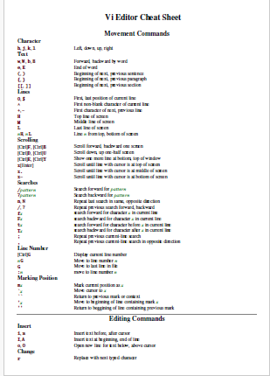

Slide 16
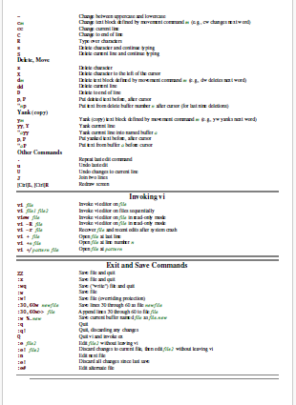

Slide 17
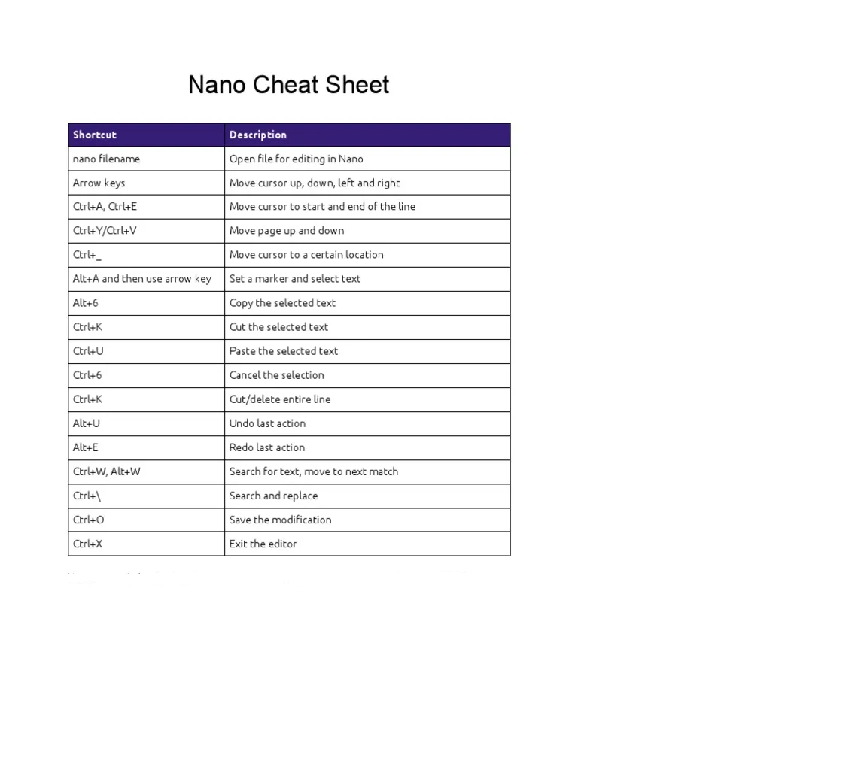

Slide 18
Vi and nano
Feature | Nano | Vi
Easy for beginners | ✅ Yes | ❌ Hard
Commands displayed | ✅ Yes | ❌ No
Typing mode | Default | Need insert mode
Advanced editing | Limited | Powerful

