Slide 1
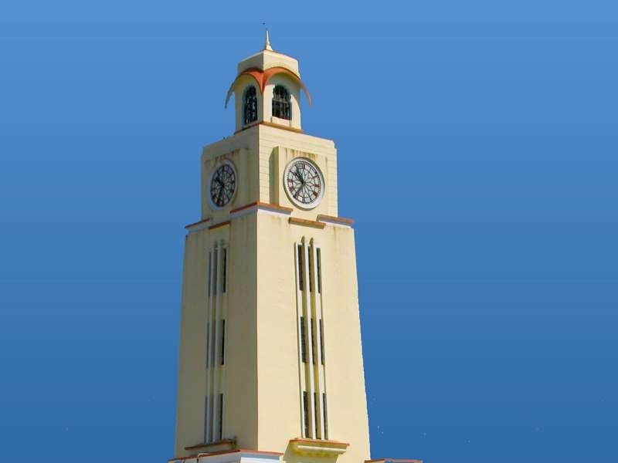

,
Neural Networks and Fuzzy Logic: Design Project
Harshit Agrawal-2018A8PS0484P
Akshat Gupta-2018A3PS0447P
Saiyam Bhatnagar
BITS Pilani, Pilani Campus

Slide 2
Paper Id- 63
Learning Temporal Pose Estimation From Sparsely Labeled Video
(Gedas Bertasius, Christoph Feichtenhofer, Du Tran, Jianbo Shi, Lorenzo Torresani)
http://papers.nips.cc/paper/8567-learning-temporal-pose-estimation-from-sparsely-labeled-videos.pdf

Slide 3
1. DOMAIN Pose estimation is one of the most sought areas in Computer Vision domains. Its heavy usage in industry such as Gaming, Animation, Action Recognition has encouraged researchers and computer vision practitioners to bring forth different algorithms that reduces human efforts in some of the stages of the Pose Estimation Process. 2. PROBLEM TARGETED IN OUR PAPER Pose estimation required tonnes of data to enable its model to sufficiently learn. However, manually labelling all the frames in a video to generate more and more data is both economically and manually expensive. A video typically contains hundreds of frames that need to be densely-labeled by human annotators. As a result, datasets for video Pose Estimation are typically smaller and less diverse compared to their image counterparts. Thus, this is one of the major problems that poses a hurdle before Pose Estimation researchers. 3. THE SOLUTION To get over with this issue, the PoseWarper network we implemented takes a labelled frame and an unlabelled frame and predicts pose of labelled frame using the unlabelled frame. Example- If a person has to generate data to work on a Pose Estimation project he/she wants, he just has to manually label a few frames in a video (every five/ten seconds, depending on the accuracy he desires to achieve). Hence, using the PoseWarper implementation large, diverse datasets can be created to work on a Pose Estimation problem.
Overview The Dataset Data Issues The model Results Takeaways

Slide 4
What does a Pose Estimation try to achieve: 1. The focus is to achieve key-points of the joints of a human body a person wants his model to estimate. 2. These key-points are the X, Y co-ordinates of an image, typically the pixel in which the joint is located. 3. The output we obtain is JOINTS - (n,3) array, n – number of joints estimated by our model. The 1st column is the X co-ordinate of all the pixels, the 2nd column is the y co-ordinate while the 3rd column represents the probability of the estimated co-ordinates. How is a Pose Estimation model trained (general approach): 1. There have been several approaches and modifications regarding the training of Pose Estimation model. The two significant ones are (a) Pure encoder-decoder networks take an image as input and output heatmaps for each key-point. Mask-RCNN is a versatile architecture that predicts bounding boxes for objects in an image and then predicts poses within the regions of the image enclosed in the box. (b) Convolutional pose machines build on the encoder-decoder architecture by iteratively refining heatmap predictions using additional network layers and feature extraction. The final output is a single set of heatmaps, and post-processing involves identifying the pixels at which the heatmap probability is the highest for each key-point. The PoseWarper network we implemented, is trained on similar lines to approach (b).
Overview The Dataset Data Issues The model Results Takeaways

Slide 5
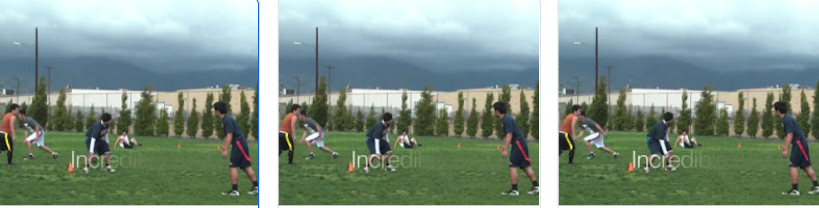
Overview The Dataset Data Issues The model Results Takeaways
The Datasets recommended to use is PoseTrack17 and PoseTrack18 which collectively comprised of 540 training videos. However, due to technical and resource constraints we could train our model with only 52 videos. Approximately 1/10th of the total PoseTrack 2018 dataset. The link to the data is given in the Readme of the repository. Therefore we could not achieve the accuracy that was mentioned in the paper. A single data file consisted of around 52 videos, each of which had several frames ranging from 75 to 120. The frames in a specific video folder were shots which were captured after uniform steps of time. Each frame had several people engaged in an activity.

Slide 6
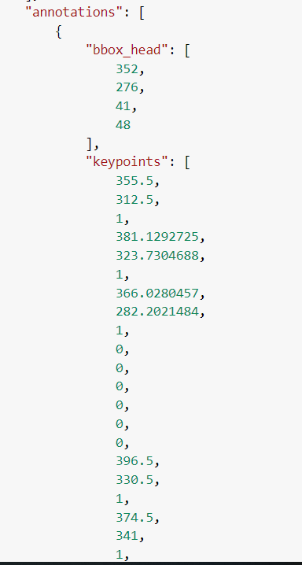
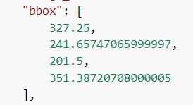
Overview The Dataset Data Issues The model Results Takeaways
WHAT ARE ANNOTATIONS AND HOW DO THEY LOOK LIKE
We had annotations of the labelled frames that we obtained form the same link to that of the Datasets. The annotations were JSON files that were to loaded in a dictionary and then iterated over the frames to get annotations for each person. The Annotations contained the bounding box for a person, the bounding box of his head, the co-ordinates of the 17 joints of a person’s body and more of such information. These Annotations were used to get the ground truth heatmap of a person.

Slide 7
Overview The Dataset Data Issues The model Results Takeaways
THE PROBLEM OF CHANGING LABELLED TO UNLABELLED RATIO
A single data file consisted of around 52 videos, each of which had several frames ranging from 75 to 120. The frames in a specific video folder were shots which were captured after uniform steps of time. Some of the frames had labelled annotations which were used to specify the ground truth of our model. However, on inspection, we found that the most of the frames were unlabelled and the ratio of labelled to those of unlabelled changed significantly. Eg. Video 1 had 90 frames, 30 of which were labelled. While video 2 had 117 frames, 47 of which were labelled.
THE PROBLEM OF IRREGULARY PLACED LABELLED FRAMES
The basic idea of our model was to have labelled frames at approximately equal steps of time. For instance, the paper read that we were supposed to have labelled frames after every specific steps of time. However, the data set had great irregularity. The labelled and unlabelled frames occurred in clusters. Ex- Video 1 had 60 continuous unlabelled frames and then 30 continuous unlabelled frames.
THE PROBLEM OF DISAPPEARING JOINTS IN A LABELLED FRAME
As stated earlier that a frame had several people in it. In case, a person was behind another one, the co-ordinates of his joints were written to 0 in the dataset. Therefore for the creation of bounding boxes, we had to eliminate all those people who were hidden behind someone. We also faced the problem of object disappearing between frames.
THE VALIDATION SET- The last 4 videos

Slide 8
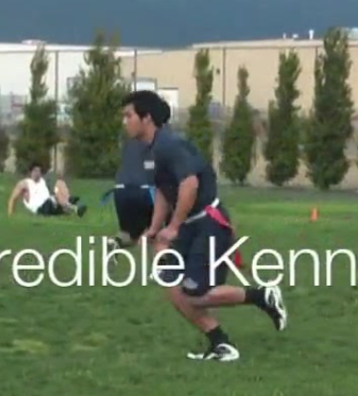
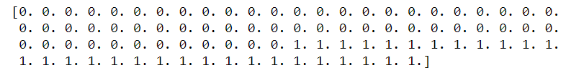
Overview The Dataset Data Issues The model Results Takeaways
THE PROBLEM OF IRREGULARY PLACED LABELLED FRAMES
THE PROBLEM OF DISAPPEARING JOINTS IN A LABELLED FRAME
0 represents the unlabeled frames while 1 represents labelled ones.

Slide 9
Overview The Dataset Data Issues The model Results Takeaways
The major part of the Data Processing dealt with removing the problems in creating the training data.
THE PROBLEM OF CHANGING LABELLED TO UNLABELLED RATIO was dealt with creating separate lists of labelled and unlabelled frames of a video in accordance to the different ratios of labelled to unlabelled frames. For instance is the ratio is 0.25 we gave 3 unlabelled frames for a labelled frame.
THE PROBLEM OF IRREGULARY PLACED LABELLED FRAMES was dealt by minimizing the time interval between a labelled and unlabelled frame so that we could obtain least difference between both the frames.
THE PROBLEM OF DISAPPEARING JOINTS IN A LABELLED FRAME was dealt by checking if a there appeared any annotation with nothing but zeros in it. Such an annotation was removed via iteration as it could alter the calculation of bounding boxes for the labelled frame from the unlabelled ones significantly.
THE PROBLEM OF NOT MUCH TRAINING DATA was dealt by data augmentation. We simply augmented the heatmaps of the people . We applied 2 data augmentation techniques, namely horizontal flipping and rotation. We did not augment the images themselves but the heatmaps as input to our model were heatmaps.

Slide 10
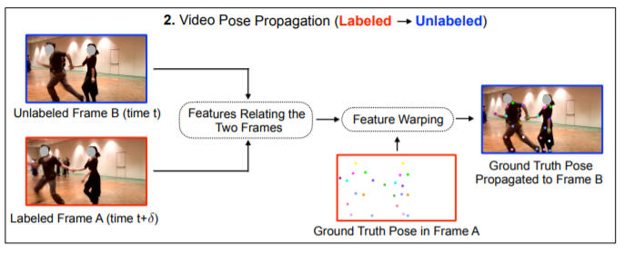
Overview The Dataset Data Issues The model Results Takeaways
MODEL BUILT
As stated earlier we built a convolution approach for pose Estimation.
Given two video frames—a labeled Frame A and an unlabeled Frame B—our model is allowed to compare Frame A to Frame B but it must predict Pose A (i.e., the pose in Frame A) using the features from Frame B.
Our model is able to extract motion offsets relating these two frames. Using these motion offsets our model must then be able to rewarp the detected pose heatmap extracted from an unlabeled Frame B in order to optimize the accuracy of pose detection in a labeled Frame A.
We build a Convolution neural network and to pass the heatmaps of FRAME A and FRAME B. Then we used five parallel convolution layers with different dilation rates to process the output of our CNN network(stacks of 3x3 Convolution blocks).

Slide 11
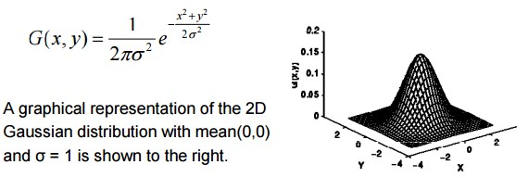
Overview The Dataset Data Issues The model Results Takeaways
The output of these five parallel Convolution layers is our offset which was then used to rewarp the heatmap B. The five rewarped heatmaps were the summed up and this was the output of our model. i.e the estimated heatmap of labelled frame A. We trained the model by minimizing the mean squared error between the predicted pose in A and the actual pose in labelled frame A.
The Ground truth heatmap of the labelled frame was obtained by using a 2D Gaussian filter around the location of each joint.
We used a Guassian function with standard deviation as 5.

Slide 12
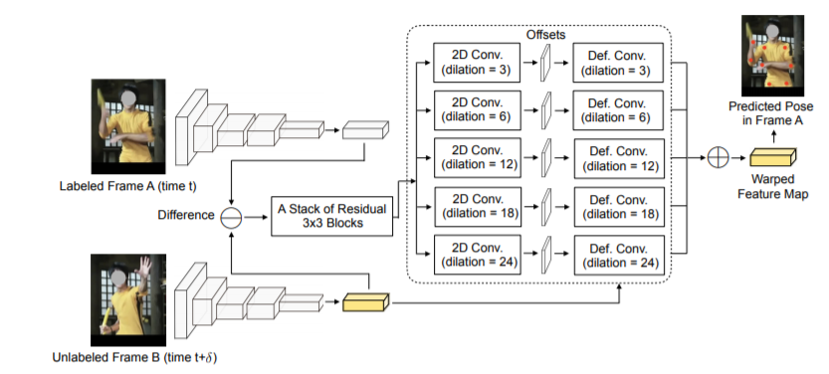
Overview The Dataset Data Issues The model Results Takeaways
Mean squared error is minimized between the Predicted heatmap and the ground truth heatmap.

Slide 13
Overview The Dataset Data Issues The model Results Takeaways
Input_1 – (384,288,3) dimensional heatmap of a person cropped from unlabelled frame using the bounding box of the same person given annotations of the labelled frame.
Input_2 - (384,288,3) dimensional heatmap of a person cropped from labelled frame.
A pretrained HRNet outputs the joints predicted. We form heatmaps using these joints and feed it to our model.
Then phi= fb-fa is fed into the stack of (3x3) convolution block, where fa and fb are labelled and unlabelled heatmaps respectively.
After having obtained the offsets post using 5 different dialations, rewarp fb using the offsets to predict the pose in labelled frame A.
This feature rewarping is done by using deformable convolutions.

Slide 14
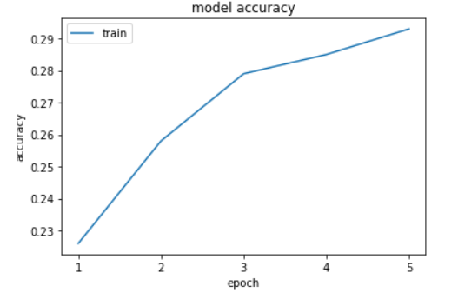
Overview The Dataset Data Issues The model Results Takeaways
Due to unavailability of much training data we were not able to reach the accuracy that was mentioned in the paper. The researchers had trained the data over 540 videos while we were only able to train it on 52 videos. Therefore we could only reach the accuracy of 29%. We propagated some poses and tried to compare our results with pretrained SimpleHRNet. We reckon that the the unavailability of training data and computational resources did not allow our model to outperform SimpleHRNet. Following is an accuracy vs epoch plot illustrating our results.

Slide 15
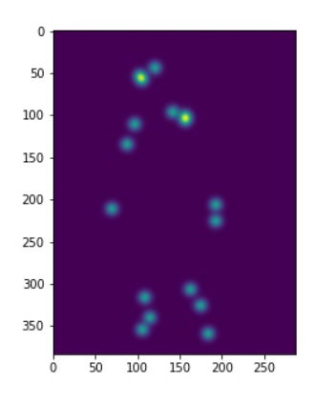
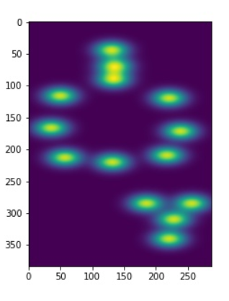
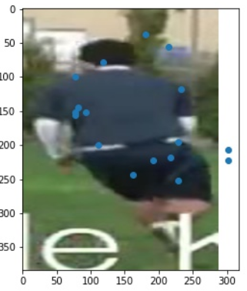
Overview The Dataset Data Issues The model Results Takeaways
We then ran our model to make some predictions. Our model predicts the joints of people present in a frame. For instance, first figure is a sample input of our model with keypoints displayed over it and second is the corresponding output and third is the ground truth.

Slide 16
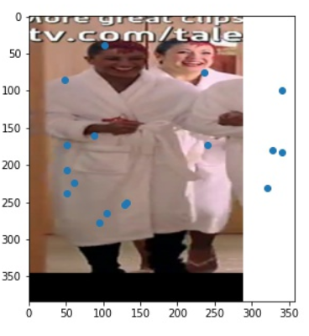
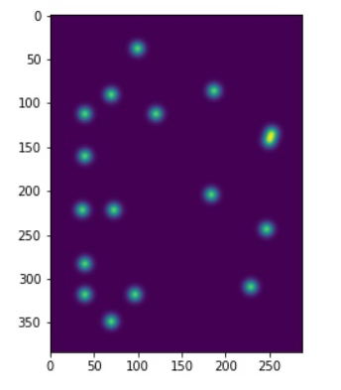
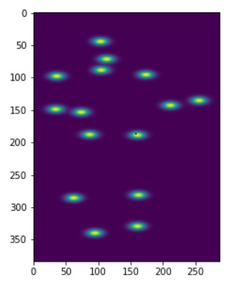
Overview The Dataset Data Issues The model Results Takeaways
Our model predicts the joints of people present in a frame. For instance, first figure is a sample input of our model and second is the corresponding output and third is the ground truth.

Slide 17
Overview The Dataset Data Issues The model Results Takeaways
In this project, we learned a few things/techniques about using dataset and about ML
a) working with annotations
b) keypoints estimation
c) generating and cropping bounding boxes
d) generating heatmaps using gaussian functions
e) working in tensorflow and tensorlayers
f) pose estimation and its important applications
g) working with deformable convolutional layers

Slide 18
Overview The Dataset Data Issues The model Results Takeaways
Thank you

