Slide 1
Capstore
(Search Module)
- HARSH MALIK (190111)

Slide 2
Introduction
CapStore is a commercial website which allows consumers to directly buy goods from merchants using a web browser. A customer can find a product of interest by visiting the website of the merchants directly or by searching the required product via name, category, type etc.
On e-Commerce sites, up to 60% of visitors will use the site search bar to navigate.
These users are showing a clear intent to purchase by entering product names they may wish to browse. Therefore, you want to ensure you’re making the most of it and create the best experience for your visitors.

Slide 3
Software requirements
Spring Tool Suite
Angular 6
Postman
Browser
Windows/Linux/Mac

Slide 4
HOW SEARCH WORKS:
ADMIN:
Admin is allowed to search all the details of the customers, merchants and the products.
MERCHANT:
Merchant is allowed to search products in his own inventory.
CUSTOMER:
Customer is allowed to search any product according to their requirements.

Slide 5
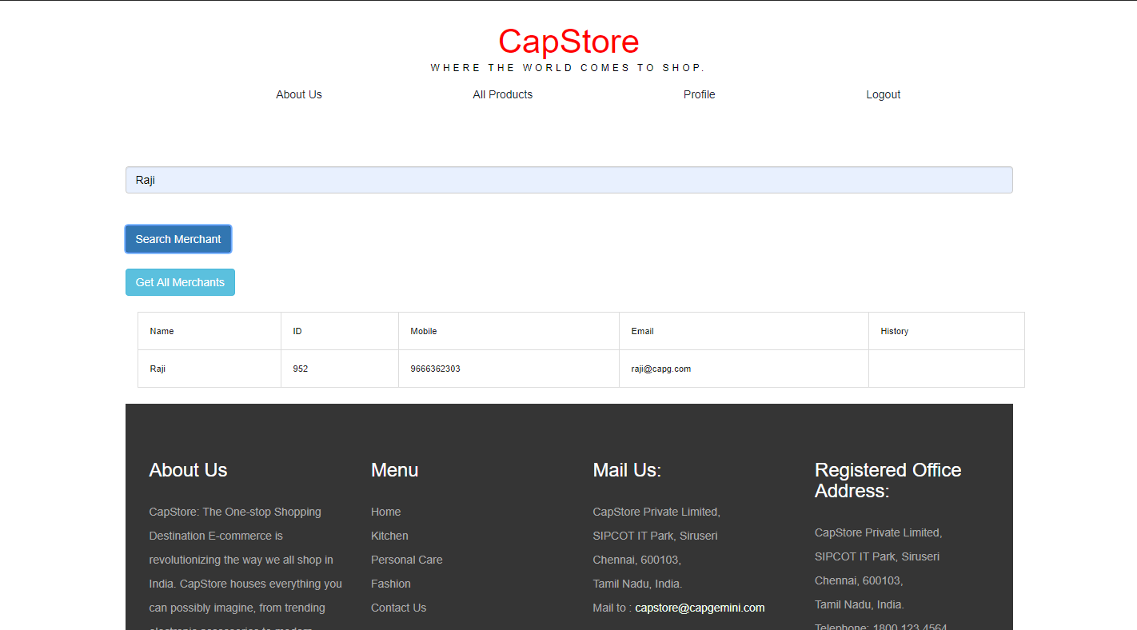
Admin searches merchant by name:

Slide 6
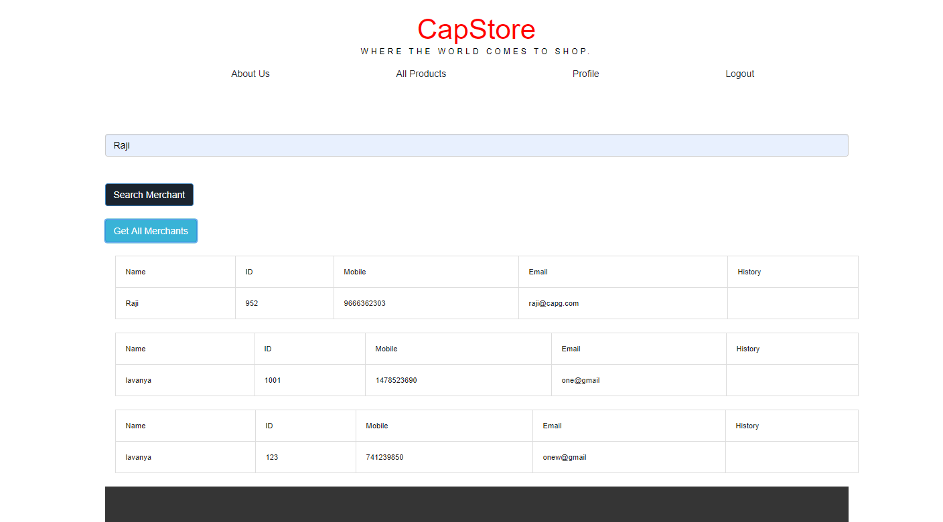
Get details of all the merchants:

Slide 7
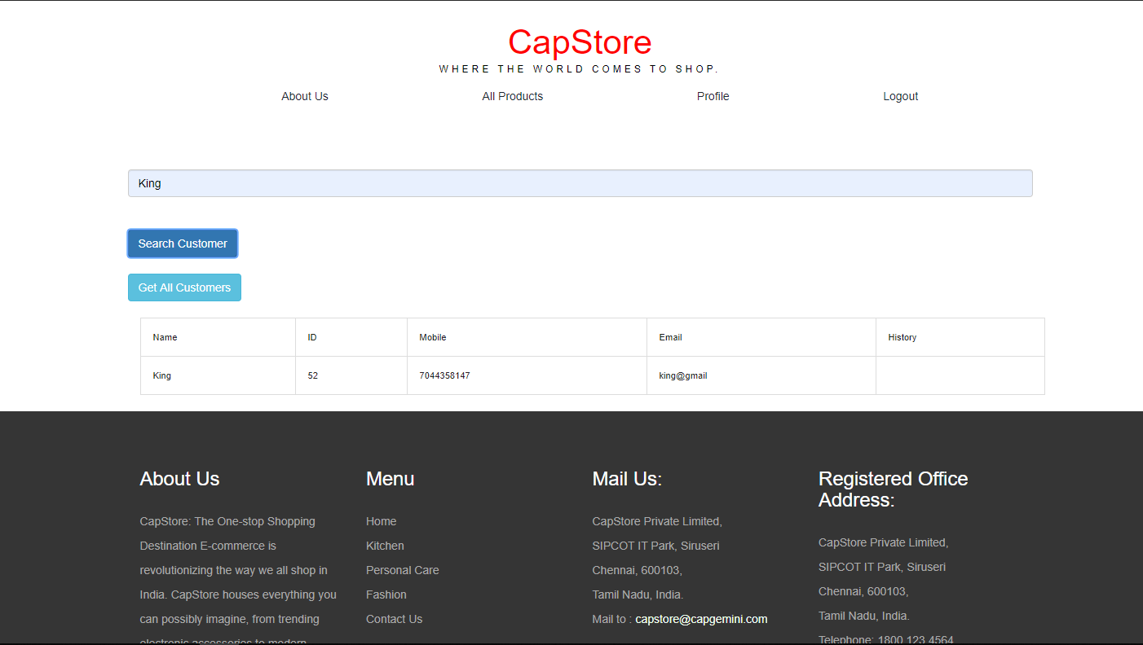
Admin Searches customer by name:

Slide 8
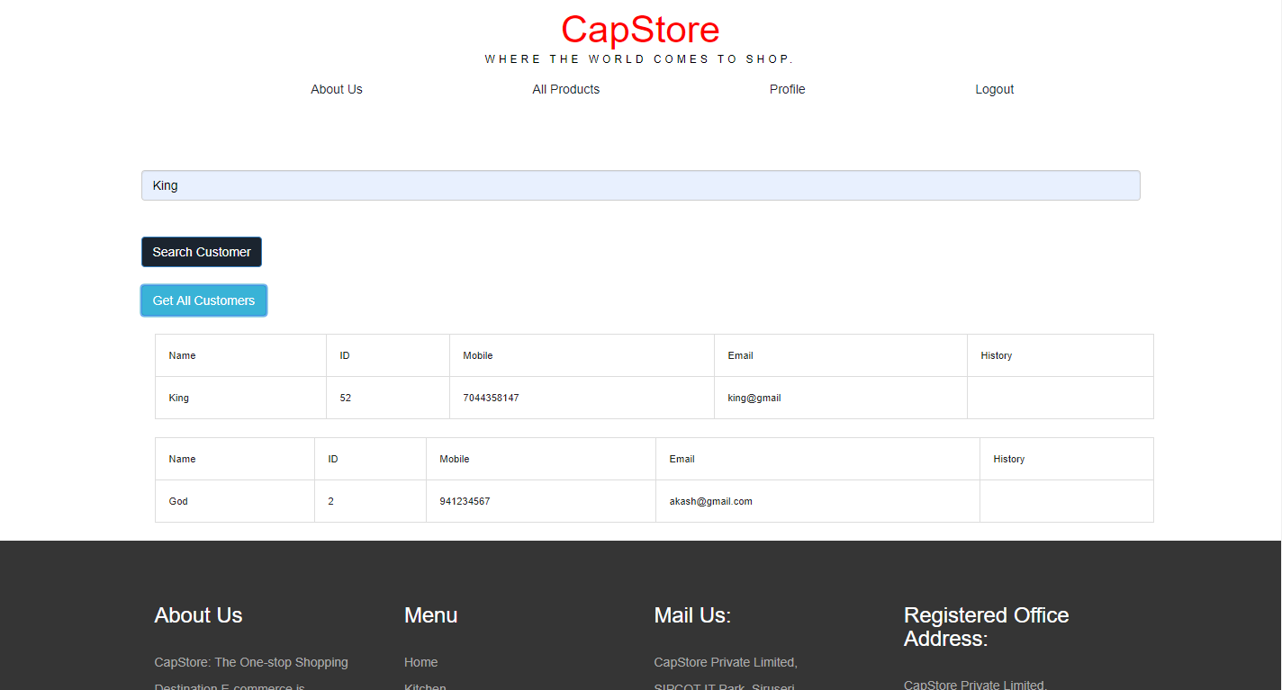
Get details of all the customers:

Slide 9
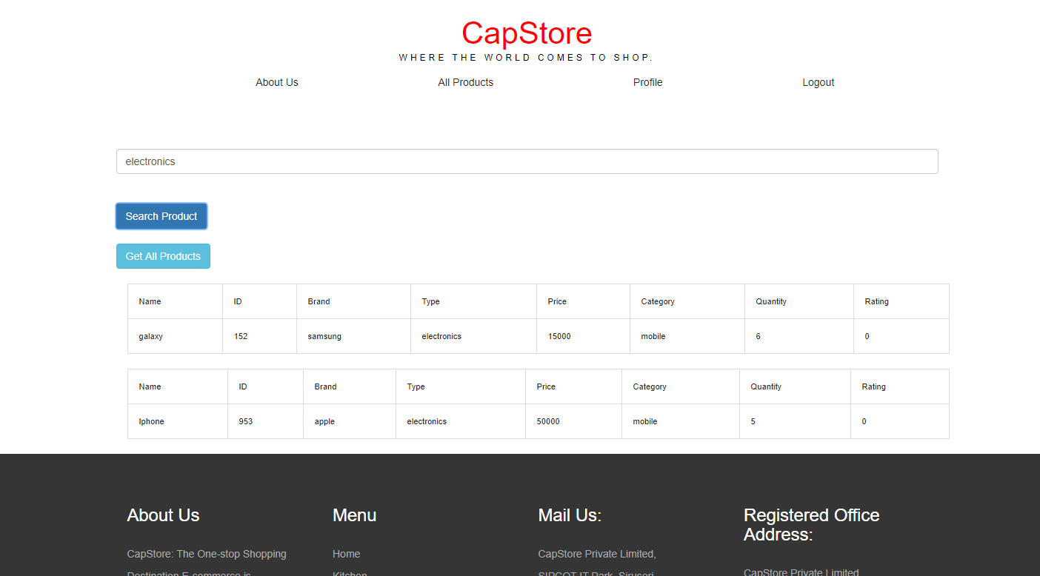
Search product by category:

Slide 10
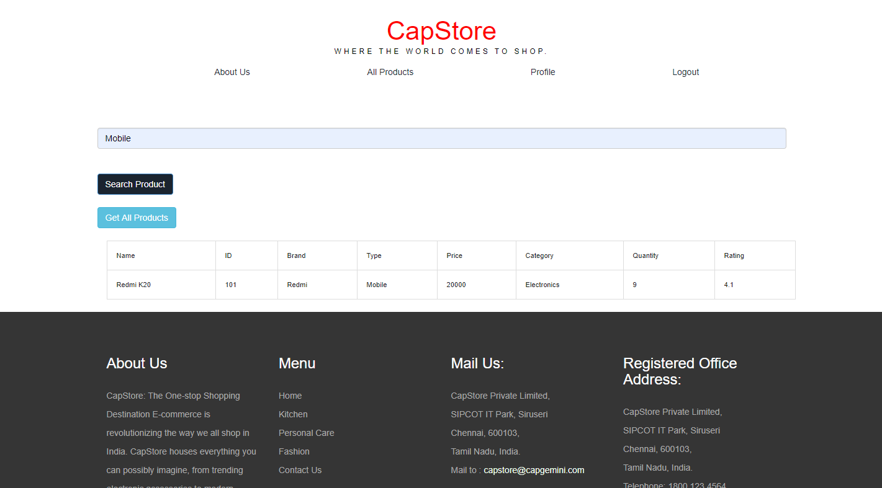
Search product by type:

Slide 11
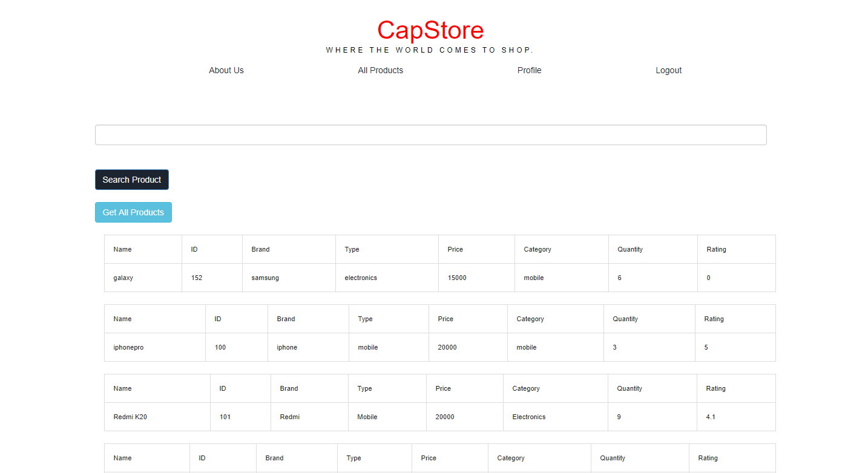
Get details of all the products:

