Slide 1

TeamPulse AI
TeamPulse AI
Client Website Redesign
4 tasks · 5 members
Homepage redesign
Submitted
See risks earlier. Keep teams moving.
Payment integration
Needs check-in
An AI-powered web app for team task management and early risk detection
Mobile checkout UI
In progress
GROUP NO. ___
Potential deadline risk detected
Muhammad Hashim
BS Computer Science · Semester ___
Muhammad Saffi Ullah
BS Computer Science · Semester ___
90% reported · no update in 3 days · deadline Fri
Next: check for blockers, offer support
Department of Computer Science · University of Chenab
Product mockup · illustrative
Notes:
Introduce TeamPulse AI, the group number and both members with semesters. The dashboard on the right is a product mockup with illustrative data.

Slide 2
Projects fall behind before anyone notices
What goes wrong
A familiar pattern
1
Unclear ownership
Monday
Members aren't sure who owns which task and deadline.
“Almost done, will finish today.”
2
Outdated progress
Updates like “almost done” hide stalled work.
Wednesday
“Just a little left.”
3
Late intervention
Leads discover blockers when it's too late to help.
Friday
Who faces it
Deadline missed. The blocker surfaces.
Team leads
Software houses
University groups
Also startups, agencies and any team working to deadlines
Notes:
Who: team leads managing 4 to 10 people at small software houses, university project groups, startups. Problem: people hesitate to say they're stuck, so status reports look fine until the deadline. No statistics claimed.

Slide 3
One workspace that spots risk early
TeamPulse AI is a web app where leads assign work, members report progress, and AI flags tasks that may need support before the deadline.
1
2
3
4
5
Assign
›
Notify
›
Check in
›
Detect
›
Support
Lead creates tasks with owners, priority and deadlines
Members get WhatsApp and in-app alerts
Members share progress, blockers and submissions
AI compares reported progress with real task activity
Lead sends a friendly, reviewed check-in message
EXAMPLE INSIGHT · ILLUSTRATIVE
Suggested message for the lead
Payment integration: potential deadline risk
“Is anything blocking this task? Happy to work through it together.”
Reported 90% · no meaningful update for 3 days · deadline approaching
Notes:
The AI only flags potential risks from stored evidence. It never claims someone is lying, and the lead approves every message before it is sent.

Slide 4
AI & technology used
AI
APIs & services
Languages & stack
Google Gemini API
WhatsApp Cloud API
JavaScript
Analyzes check-ins and task history; returns risk level, evidence and next step
Assignment, submission and deadline notifications
Across frontend and backend
Rule-based fallback
REST API (Express)
React · Vite · Tailwind CSS
Keeps risk alerts working if the AI is unavailable
Projects, tasks, check-ins, reviews, risk
Responsive web interface
Claude Code
Cloudinary · Mailtrap
Node.js · Express · MongoDB
AI coding assistant used during development
File uploads · email verification
API, JWT auth and Mongoose data layer
Notes:
Mention that API keys stay on the server and that the app keeps working if Gemini or WhatsApp is down. Remove Claude Code if you prefer not to list development tools.

Slide 5
Live demo & future scope
WORKS TODAY
FUTURE
Secure sign-up, login and email verification
Projects, members and task assignment
Submissions with lead approval or revision
Daily progress check-ins
AI risk insights with evidence + message drafts
In-app notifications and WhatsApp alerts
GitHub activity signals
Commit data as extra evidence
Mobile app
Check-ins on the go
Urdu voice check-ins
Speak updates instead of typing
Workload analytics
Demo: lead assigns → member submits → AI flags a stalled task → lead sends support
Balance tasks across the team
Notes:
Before presenting, remove anything from Works today that is not working in your build. Then switch to the live app for the demo.

Slide 6
THANK YOU
See risks earlier.
Keep teams moving.
TeamPulse AI helps leads support their team before deadlines slip, with clear ownership, timely notifications and evidence-based AI insights.
Questions?
Muhammad Hashim · Muhammad Saffi Ullah · Group ___
Notes:
Thank the judges and invite questions. The product walkthrough video is on the next slide if you want to show it.

Slide 7
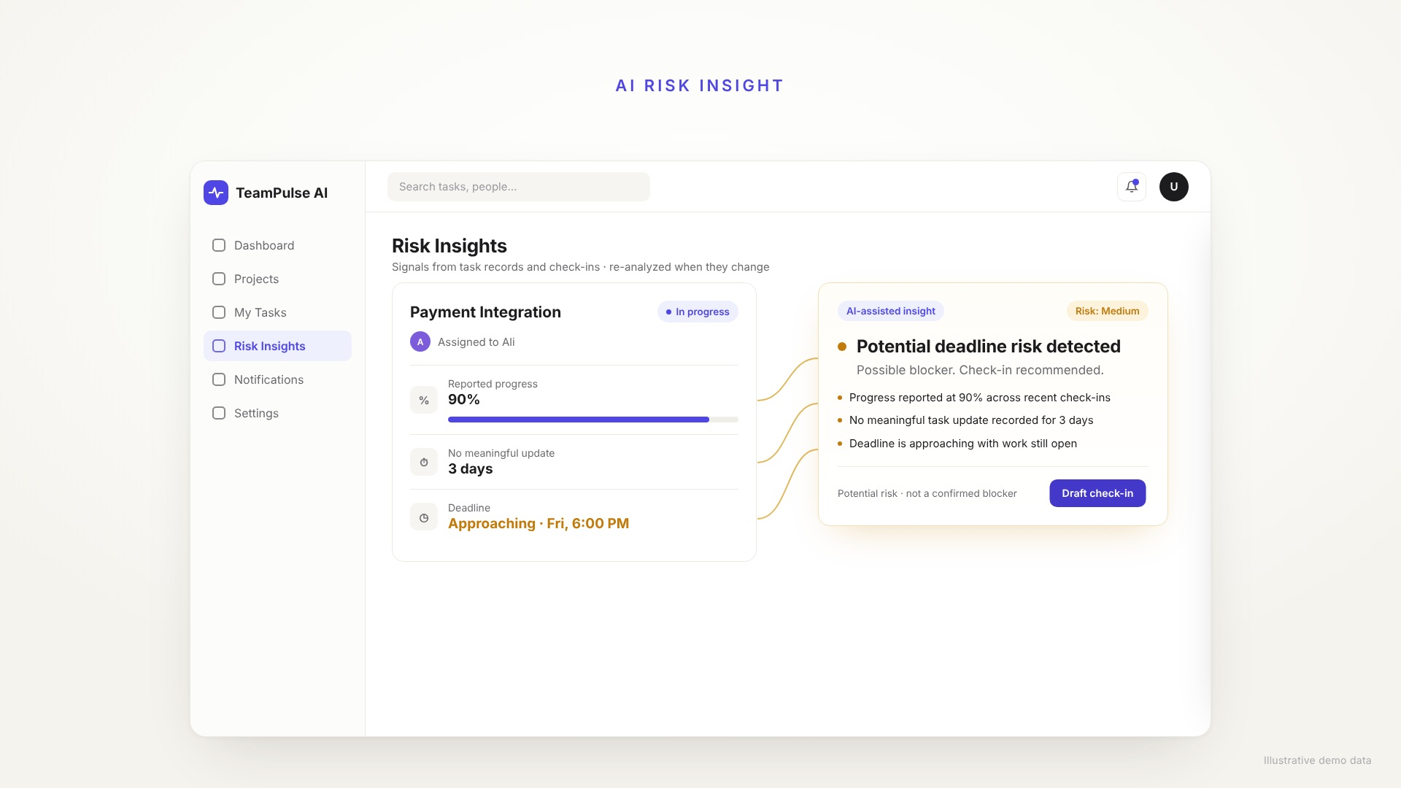
Product walkthrough
25 seconds · illustrative demo data
Notes:
The video plays automatically. It uses illustrative demo data.

