Slide 1
TeamPulse AI
Project overview
TeamPulse AI
Website redesign
In progress
See risks earlier. Keep teams moving.
Payment integration
Needs attention
Final QA
In review
AI-powered team operations and early risk detection
Potential deadline risk detected
Check for blockers and offer support.
Presented by
Muhammad Hashim
Muhammad Saffi Ullah
Product mockup — illustrative
Notes:
Introduce TeamPulse AI and the two presenters. The dashboard on the right is a product mockup, not real user data.

Slide 2
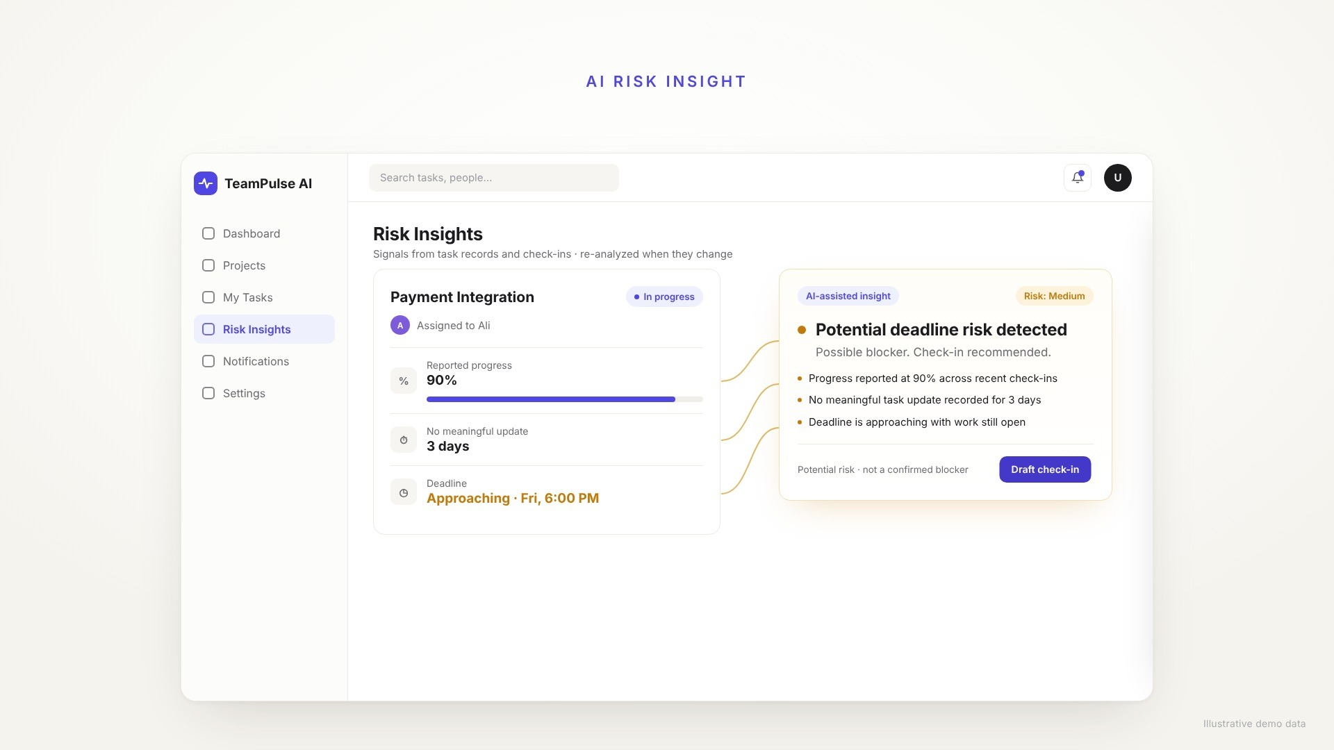
See TeamPulse AI in action
25-second product walkthrough · illustrative demo data

Slide 3
Projects fall behind before anyone notices
1
2
3
Unclear ownership
Limited visibility
Late intervention
Team members may not know exactly what they are responsible for.
Progress updates can be incomplete or outdated.
Blockers are often discovered when deadlines are already close.
Task assigned
→
Progress becomes unclear
→
Deadline approaches
→
Project risk increases
Notes:
Three common problems: unclear ownership, limited visibility, late intervention. The chain below shows how risk grows when no one sees it early. No statistics are claimed.

Slide 4
One workspace. Clearer decisions
Projects and team members
Check-ins and submissions
TeamPulse
AI
Tasks and deadlines
WhatsApp notifications
AI-powered risk insights
Notes:
The five capabilities share one data model, so assignments, updates, notifications and AI insights reinforce each other instead of living in separate tools.

Slide 5
From task assignment to verified completion
→
→
→
→
→
→
1
2
3
4
Lead creates a project
Members and responsibilities are added
Tasks and deadlines are assigned
Members receive notifications
→
→
5
6
7
Members update progress and submit work
Lead reviews submissions
TeamPulse updates progress and highlights risks
Steps 1–7 repeat as new tasks and check-ins arrive.
Notes:
Walk through the seven steps left to right, top to bottom. Step 7 is where AI risk insights appear.

Slide 6
Everything a team needs to stay aligned
1
2
3
4
Projects and members
Tasks and status
Deadline reminders
Submit and review
Create projects and manage who is on them.
Assign owners and track status.
Set due dates and get timely nudges.
Members submit; leads review.
5
6
7
8
Progress check-ins
In-app notifications
WhatsApp integration
Role dashboards
Regular updates on reported progress.
Alerts for assignments and updates.
Task and deadline messages via WhatsApp.
Separate views for leads and members.
Notes:
Eight MVP feature areas. Confirm which are implemented in the current build before presenting; do not claim anything unfinished as complete.

Slide 7
Detect potential blockers before deadlines slip
Evidence the AI considers
ILLUSTRATIVE EXAMPLE
Reported progress
Time since meaningful task updates
Deadline proximity
Repeated delays
Check-in history
Submission and review history
Task: Payment integration
Reported progress: 90%
Last meaningful update: 3 days ago
Deadline: Approaching
Potential deadline risk detected
High reported progress, but no recent meaningful update and the deadline is near.
Next: check for blockers and offer support.
AI flags potential risks from evidence. It cannot know with certainty whether anyone is being truthful.
Notes:
The example is illustrative, not real user data. Stress that this is a potential-risk signal based on evidence, not an accusation.

Slide 8
Turn signals into actionable insights
Tasks
Product mockup — illustrative data
Risk insight: Payment integration
Website redesign
90% reported progress
No meaningful update in 3 days
Deadline approaching
In progress
Due Tue
Payment integration
Recommended action: check for blockers and offer support.
Needs attention
Due Fri
Draft message
Final QA
“Is anything blocking this task? I can help you work through it.”
Submitted for review
Due next Mon
Notes:
This is a product mockup, not a screenshot of the live application unless you replace it. Point out the evidence list and the supportive draft message.

Slide 9
Keep everyone informed, without constant follow-ups
1
›
2
›
3
›
4
›
5
›
6
Lead assigns task
Member gets WhatsApp notification
Deadline approaches
Reminder is sent
Member submits work
Lead is notified
To member (illustrative)
To lead (illustrative)
New task assigned: Payment integration. Deadline: Friday, 6:00 PM.
Work submitted: Payment integration is ready for your review.
Notifications depend on valid WhatsApp API configuration and successful message delivery.
Notes:
Messages shown are illustrative. Do not say a message was delivered unless you have tested it.

Slide 10
Built with a practical, modular architecture
Node + Express
Backend API
Users
Leads and members
React
Frontend + Tailwind CSS
MongoDB
Mongoose data layer
Auth + authorization
Reminder scheduler
AI provider
External · risk analysis
WhatsApp Cloud API
External · notifications
Notes:
Matches the project brief. Verify against the repository before presenting: only show the scheduler, AI provider and WhatsApp integration if they are actually built, otherwise label them planned.

Slide 11
Useful intelligence. Responsible implementation
1
Reliability
2
Responsible AI
Project-level access control
Members see only authorized projects and tasks
Server-side validation and authorization
Secure handling of API credentials
Graceful handling of AI or notification failures
Risk assessments linked to supporting evidence
Confirmed blockers kept distinct from potential risks
Supportive recommendations, not automatic accusations
Notes:
No security audit or compliance certification is claimed.

Slide 12
Designed for teams that need earlier visibility
Software teams
Agencies
Startups
Features, bugs and releases
Client projects and deliverables
Cross-functional work and deadlines
Roadmap (planned, not part of the current MVP)
Next
Later
Improve AI risk analysis and check-ins
Refine notification scheduling
Improve project analytics
Authorized GitHub activity integration
More advanced workload insights
Additional integrations and reporting
Notes:
Use cases are examples, not customers. No measured savings or adoption are claimed.

Slide 13
Thank you
See risks earlier. Keep teams moving.
TeamPulse AI — Projects, people, deadlines, and actionable AI insights.
Questions?
Muhammad Hashim · Muhammad Saffi Ullah
Notes:
Thank the judges and open for questions.

