Slide 1


Development of Online Hotel Booking System for Hotel Sea Place
Prepared For: Practicum Defense Committee
Department of Computer Science and Engineering
IUBAT- International University of Business Agriculture and Technology
Supervised By:
Nusrath Tabassum, Senior Lecturer
Department of Computer Science and Engineering- IUBAT
Prepared By:
Md. Ariful Islam
ID: 18103144
Program: BCSE

Slide 2
Table of Contents
Introduction
Project Overview
Process Model
Requirement Engineering
System Planning
Cost Estimation
Risk Management
Analysis & Designing
Demonstration
Limitation
Future Plan
Conclusion

Slide 3
Introduction
Development of Online Hotel Booking System is website project developed for Kodeeo Limited. Online is a Web-based application that allows individuals too conveniently and securely access the web as online through any Web-connected device, such as a computer, laptop, Smartphone or tablet. A hotel booking system is a software application that is implemented by hotels to allow guests to create secure online bookings. Through this system guests can book their room through online. They can make their payment. Guest can see all the rooms with their pictures then they can choose their desired rooms.

Slide 4
Objectives
The specific objectives of this project are:
To add rooms, room types.
To manage all booking, payment records.
To reduce duplication of information.
To give power to admin to control the accessibility to the system.
To improve information accuracy

Slide 5
Project Overview
By this online Hotel Booking System people can search for the room by giving their check in time and check out time.
From there they can choose their desired room. They can see the details of the room. After that they have to register themselves to book their desired room through online.
In this system admin will manage everything like can cancel booking or approve booking, add the rooms, amenities and so on.
Customer can see all of their booking details whether they are approved or disapproved.
They can make their payment after reaching the hotel and they don’t have to pay total amount at a time. The total amount will be calculated based on the day’s difference between two days. The due amount will be auto calculated.
Admin can see the report of the list of booking and can search the list but giving the range of dates and also can make the pdf. So it is an easy online system to book the room.

Slide 6
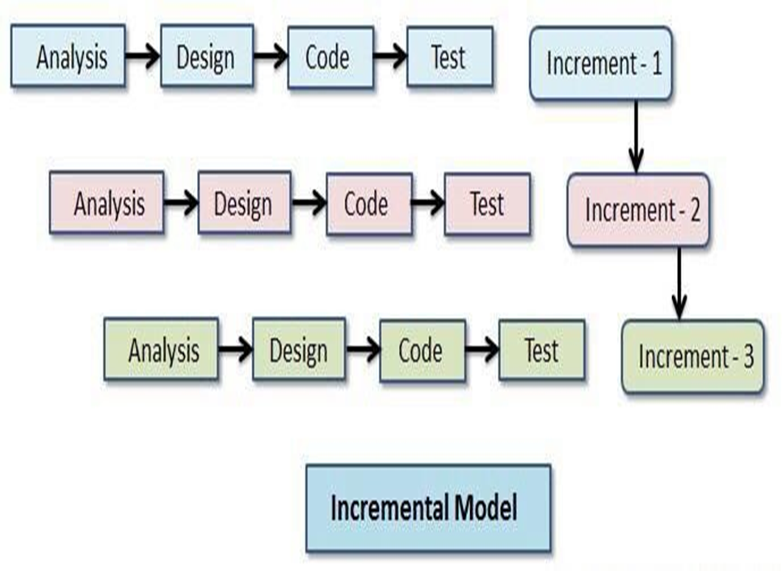
Process Model
Figure: Incremental Process Model

Slide 7
Reason for Choosing Incremental Model
Provides better support for process iteration.
Reduces rework in the software construction process.
As it reduces rework in coding, it is time efficient.
Allows early delivery of parts of the system.
Supports easier integration of sub-systems.
Lower risk of project failure.
Delivery priorities can be more easily set.

Slide 8
System Benefits
To make booking easy and comfortable.
To serve the guest without wasting their precious time.
To make the system user-friendly.
To make strong relationship with the guests
Admin can manage the whole system.

Slide 9
Feasibility Study
Technical Feasibility:
To develop this project it needs a open-source server-side scripting language like PHP(Laravel) & also JavaScript, CSS3, HTML5, Bootstrap 5. For database it requires MySQL.
Economic Feasibility:
The entire development period the organization requires manpower, computer, internet connection .
Operational Feasibility:
The proposed system is designed from a user’s point of view. So, all of the features are included only for the benefit of the user.

Slide 10
Requirement Engineering
User Requirements.
System Requirements.
Functional Requirements.
Non-Functional Requirements.

Slide 11
User Requirements
Admin
Guest
Admin can log in to the system
Can manage the hotel information
Can manage the room types
Can manage the rooms
Can manage the amenities
Can approve or disapprove any booking
Can manage the payment related details
Can manage the report generation
Guest can check the available room
Can see all the room types
Can see all the rooms
Can book any available room
Can see the booking information

Slide 12
System Requirements
Admin
Admin can manage the hotel information
In here admin can add the hotel information
Can update the hotel information
Can manage the room types
Admin can add the room types
Can see all the added room types
Can edit/view/ update the room types
Can manage the rooms
Can add the rooms
Can choose the room types
4. Can approve or disapprove any booking
Admin can see the booking details
Can approve any booking and see the approved list
Can disapprove any booking and see the disapproved list
5. Can manage the payment related details
Can take the payment and change the status to paid
6. Can manage the report generation
Can see the booking details here
Can search the booking details by giving the date range
Can print the details

Slide 13
System Requirements
Guest
Guest can check the available room
Will give the check in date and check out date to see the available rooms
Without login to the system can see the rooms
Can see all the room types
Can see the room type details
Can choose any room types
Can see all the rooms
Can see all the room details
Can see the room image
Can book the room
4. Can book any available room
For booking guest must have to signup
Then they have to login to the system
Then guest will fill up the booking form
After submission they will get a success message
5. Can see the booking information
See the booking information in my booking list
Can see the status whether the booking is approved or not

Slide 14
Functional Requirements
Associate every online booking with an account
Accept the date and time to check available rooms for that particular date
Booking confirmation will be sent to the specified user by changing the status
User can show the booking list
Calculate and display accommodation charges
Report generation

Slide 15
Non-Functional Requirements
This system provides a well secure and trustable platform.
Easy tracking of records and updating can be done
Without providing valid information the form won’t submitted.
Without filling up mandatory fields no form will be submitted.

Slide 16
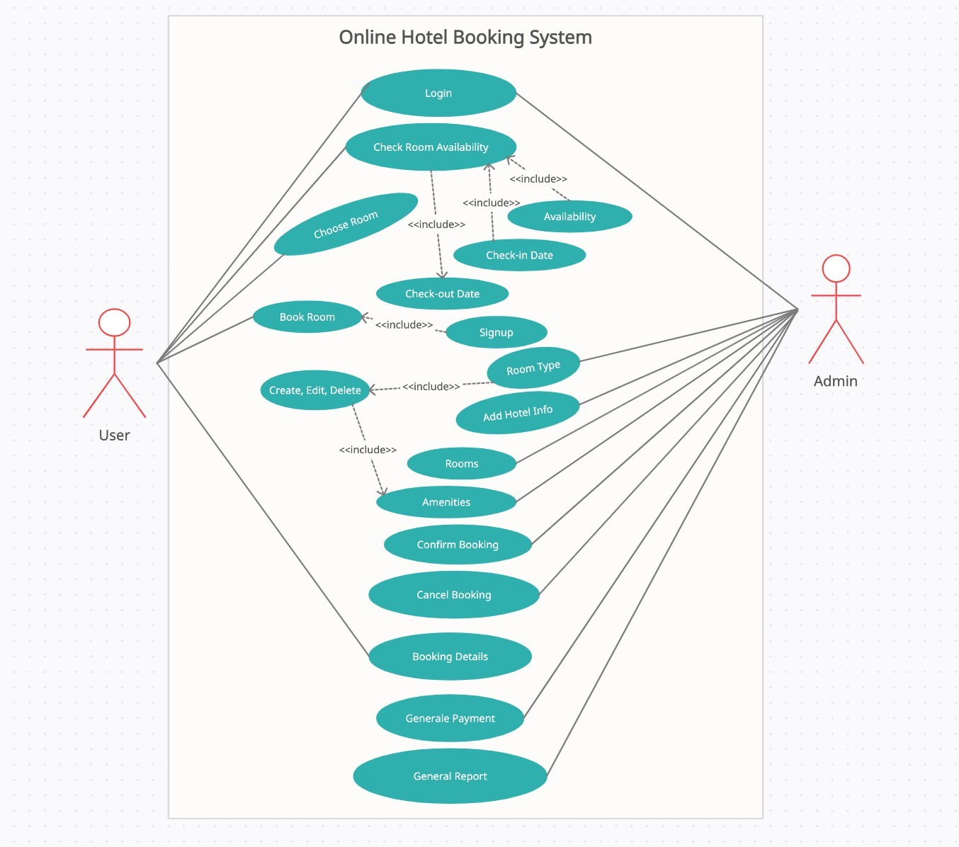
Use Case Diagram

Slide 17
System Planning

Slide 18
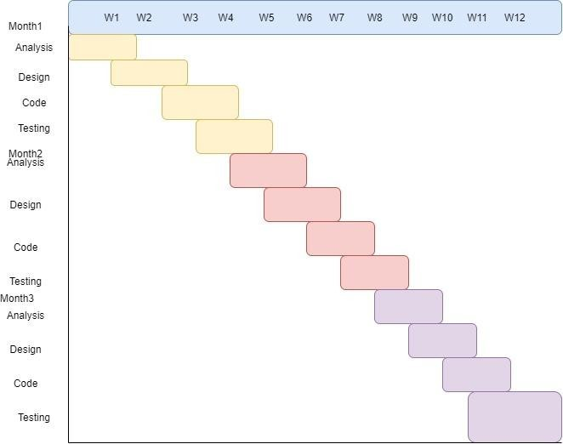
Project Schedule Chart
Figure: Project Schedule Chart

Slide 19
Function Point Estimation
Total Degree of Influence (TDI) = 32
Value Adjustment Factor (VAF) = (0.65 + (0.01*TDI))
= (0.65 + (0.01*32))
= 0.97
UFP = UFP (Data Function) + UFP (Transition Function) = 56+61
=117
Adjusted Function Point (AFP) = UFP*VAF
=117*0.97
= 113.49

Slide 20
Function Point Estimation
Efforts for Project, = AFP * Productivity
= 113.49×15.5
=1759 per hour
One person work 12 hour per day, = 1759 /12
= 146 days
In a month, 25 days are working days, = 146/25
= 5.8 month

Slide 21
Cost Estimation

Slide 22
Personnel cost
Position | Salary/month | Salary/hour
System Analyst | 35000 | 182.29
Designer | 25000 | 130.2
Coder | 20000 | 104.17
Tester | 20000 | 104.17
 | Total= 1,00000

Slide 23
Hardware Cost
Hardware | Cost
Computer | 26,500
Modem | 1600
Printer | 5000
Total | 28,600 BDT

Slide 24
Software Cost
Name | Amount
Windows 10 | 8500
MS Office 2016 | Free
XAMPP | Free
MySQL | Free
Notepad++ | Free
Total | 8,500 BDT

Slide 25
Other Cost
Name | Price (BDT)
Transport | 8000
Internet bill | 2800
Other | 1500
Total | 12,300 BDT

Slide 26
Total Cost
Name | Price | Total
Personnel cost | 100,000 BDT
Hardware Cost | 28,600 BDT | 149,400 BDT
Software Cost | 8,500 BDT
Other | 12,300 BDT

Slide 27
Risk Management
The RMMM Plan
Risk Mitigation: Proactive planning for risk avoidance.
Risk Monitoring: Assessing whether predicted risks occur or not, ensuring preventive steps are being properly applied, collect information for future risk analysis, attempt to determine which risks caused which problem.
Risk Management: Actions to be taken in the event that mitigation steps have failed and the risk has become a live problem.

Slide 28
Analysis and Designing

Slide 29
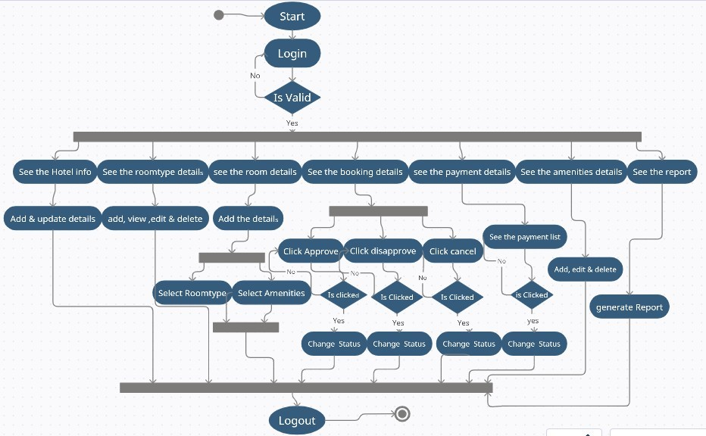
Activity Diagram for Admin

Slide 30
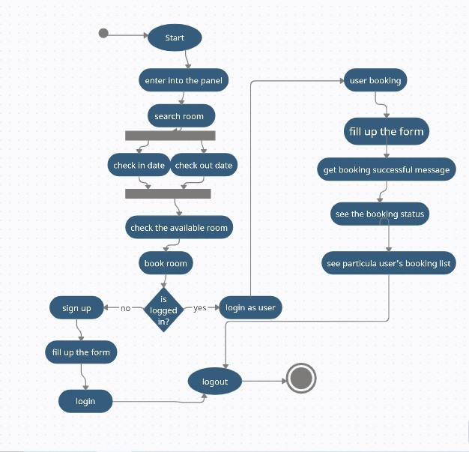
Activity Diagram for User

Slide 31
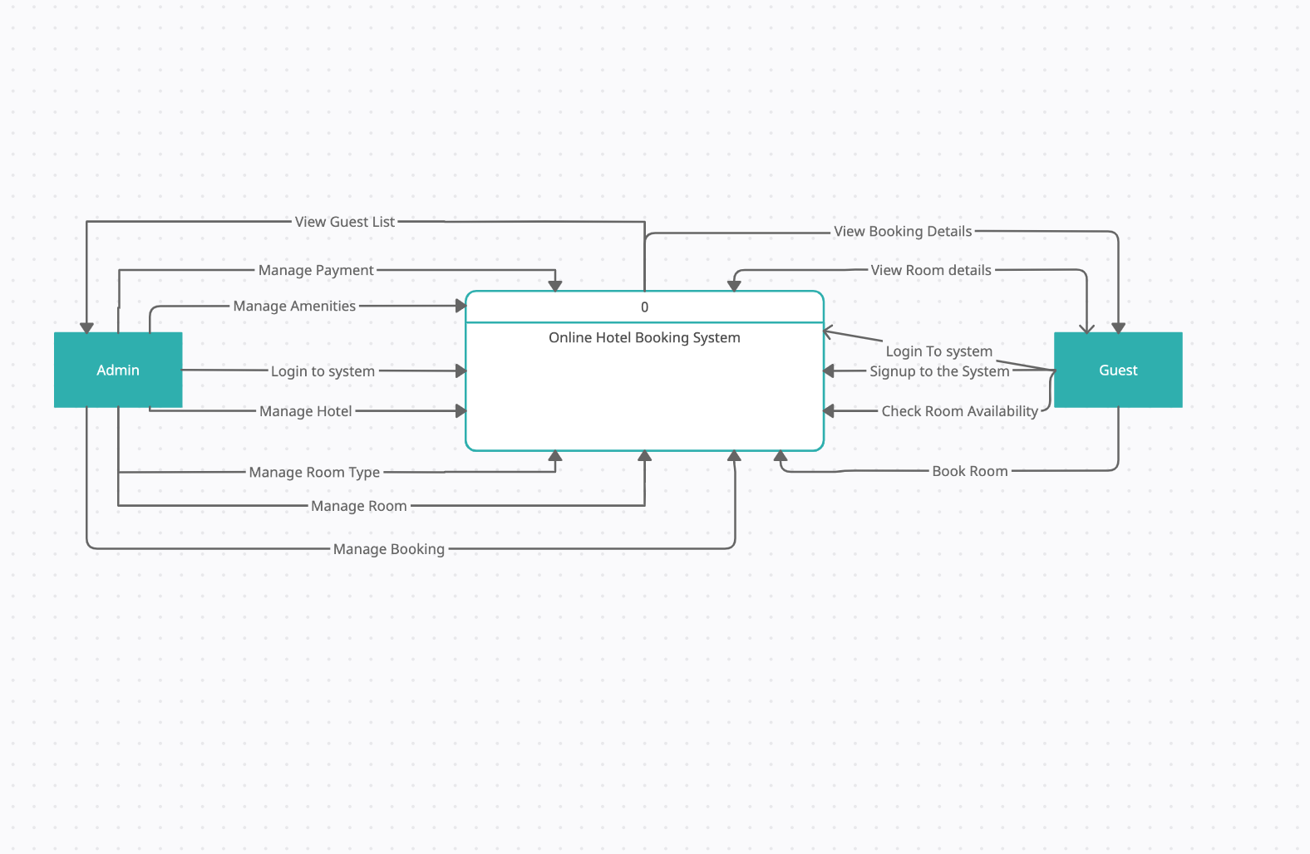
Data Flow Diagram
Figure: Context Level Diagram

Slide 32
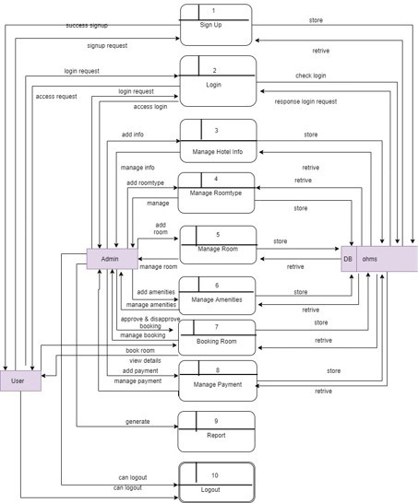
Level 1 DFD
Figure: Level 1 DFD

Slide 33
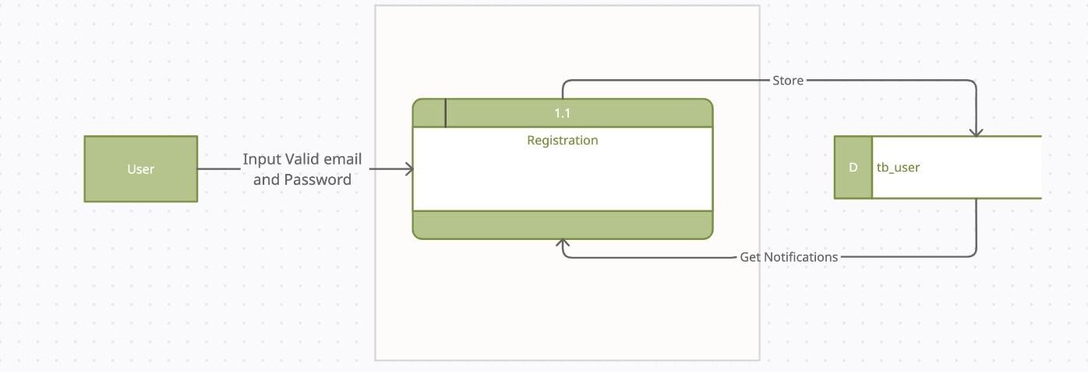
Data Flow Diagram
Figure: level 2 process 1

Slide 34
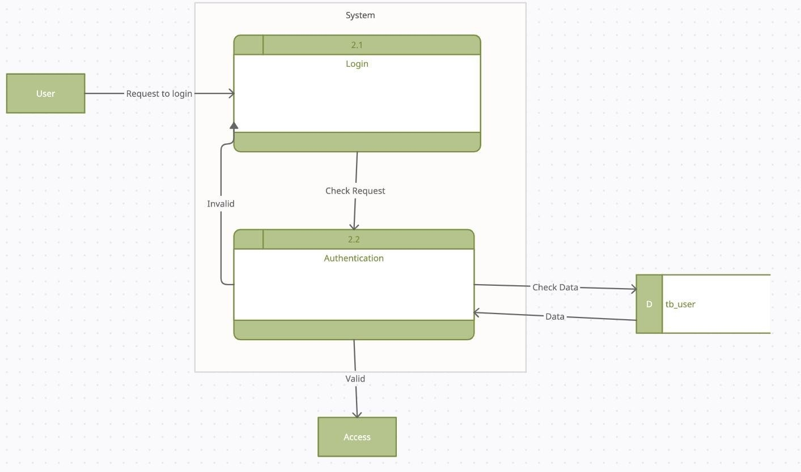
Data Flow Diagram
Figure: level 2 process 2

Slide 35
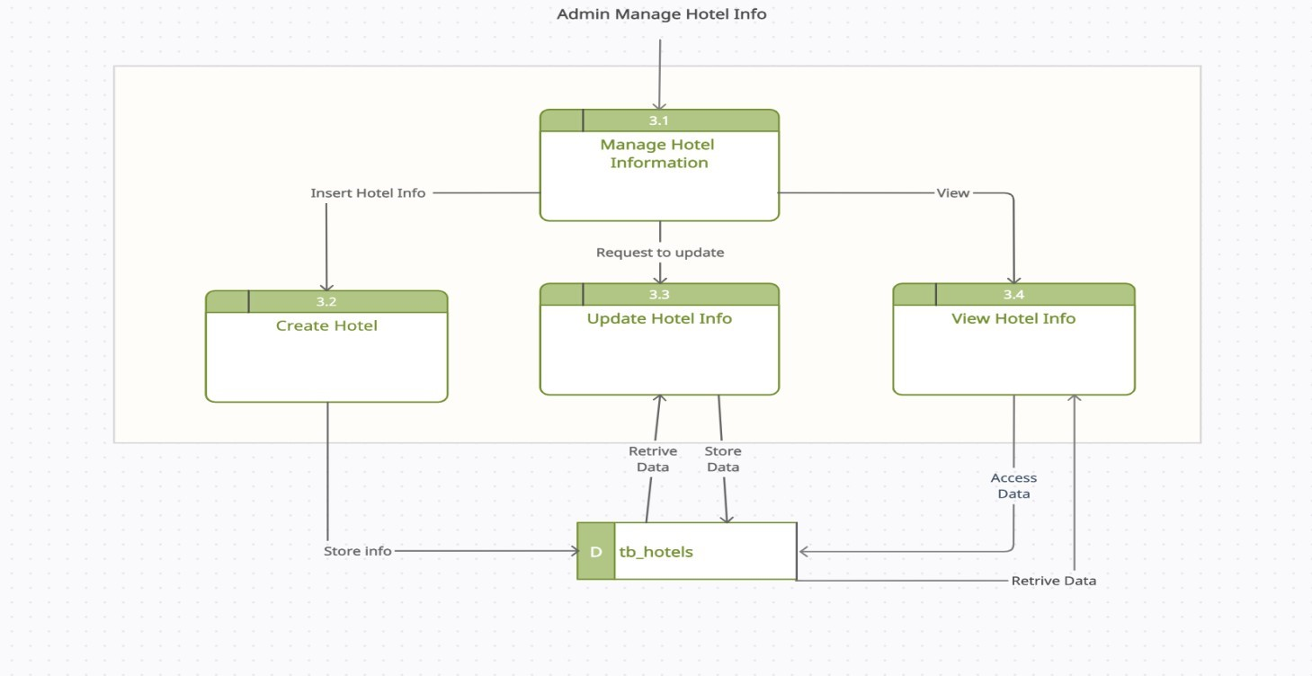
Data Flow Diagram
Figure: level 2 process 3

Slide 36
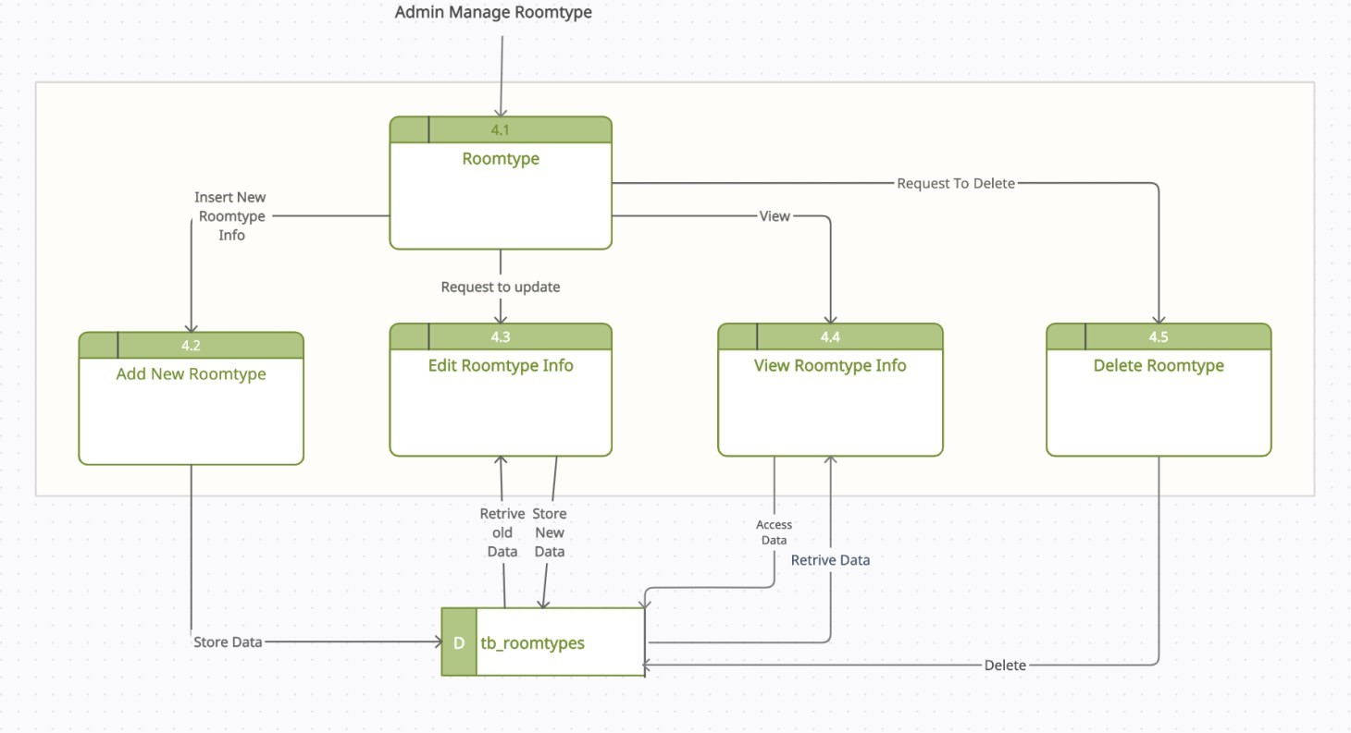
Data Flow Diagram
Figure: level 2 process 4

Slide 37
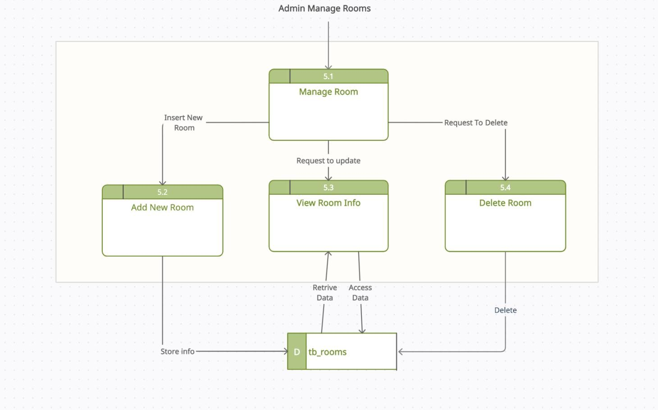
Data Flow Diagram
Figure: level 2 process 5

Slide 38
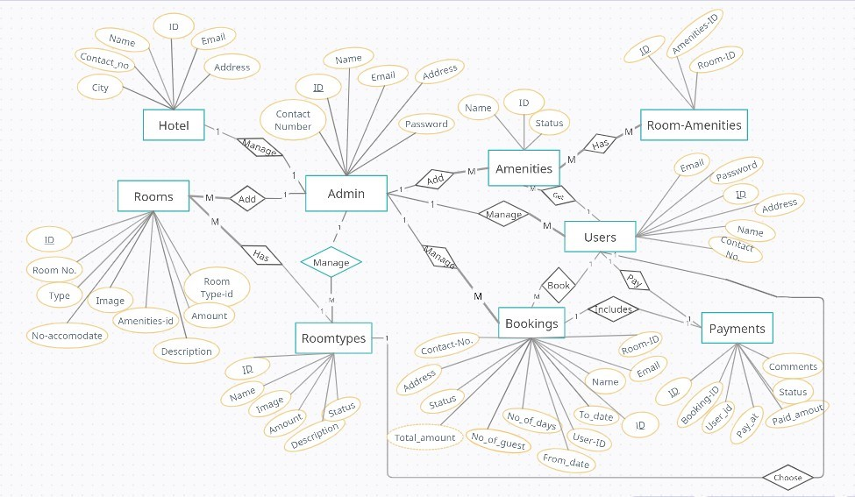
Entity Relationship Diagram

Slide 39

Demonstration

Slide 40
Limitation
In this software there is no forgetting password function.
The system can’t send any email confirmation.
In this software half payment is not possible.

Slide 41
Future Work
This project is in initial stage. So, we will include more features for this system and based on user’s need we will maintain this system and give them support. Some more features are stated below:
Geographical map
Login or Signup through Google Account or social media account.
Advance payment through online and refund option
Include invoice

Slide 42
Conclusion
The biggest experience working at Kodeeo Limited is indeed being a part of designing and implementing software. I have learnt a lot of new things which was so much unknown to me. I have also learnt some technical issues which help to do better in future life.

Slide 43


