Slide 1



Waste Classification using CNN model

Slide 2

Learning Objectives
- Understand Convolutional Neural Networks (CNNs).
- Train a CNN model to classify waste images.
- Implement data augmentation to reduce overfitting.
- Evaluate model performance using accuracy and confusion matrix.
GOAL
Source :
www.freepik.com/

Slide 3







Tools and Technology used
Python, TensorFlow, Keras
OpenCV for image processing
Jupyter Notebook for development
- Matplotlib & Seaborn for visualization
- ImageDataGenerator for data augmentation

Slide 4


Methodology
- Data Collection & Preprocessing
- CNN Model Design and Training
- Data Augmentation and Regularization
- Model Evaluation using Confusion Matrix
- Predictions and Performance Analysis
RAW DATA
Feature Extraction
Model

Slide 5

Problem Statement:
Waste misclassification leads to inefficient recycling and environmental pollution. A deep learning model can automate waste classification, improving the recycling process.

Slide 6

Solution:
- A Convolutional Neural Network (CNN) trained on waste images.
- Uses batch normalization and dropout to prevent overfitting.
- Automates waste segregation for improved recycling efficiency.

Slide 7
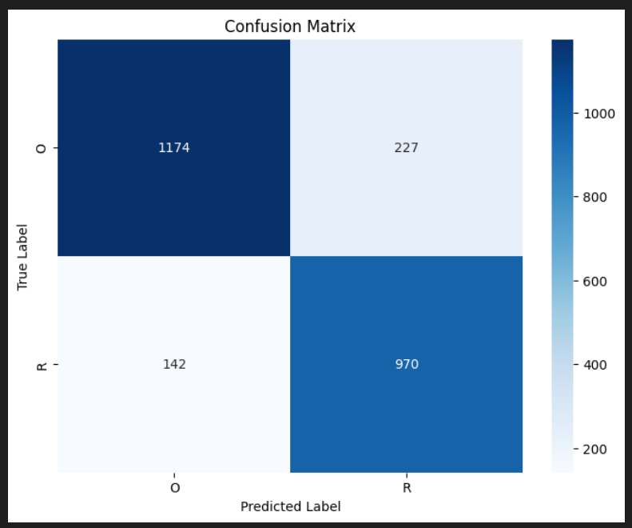
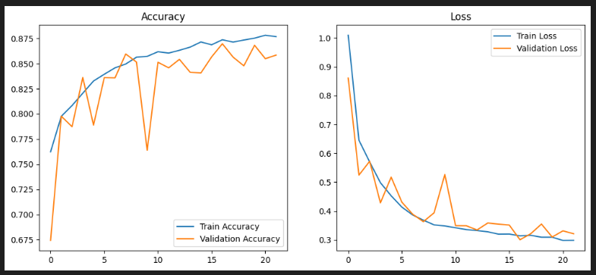
Screenshot of Output:
Confusion Matrix
Training & Validation Accuracy Plot

Slide 8


Click on icon to follow link
Conclusion:
Successfully implemented CNN for waste classification.
Improved generalization using data augmentation.
Future Scope:
Use more diverse datasets, apply transfer learning (ResNet, MobileNet).
GITHUB
GOOGLE DRIVE

