Slide 1
ONLINE HOSPITAL MANAGEMENT SYSTEM (EMEDITIMES)
Make Your Life Easier ……

Slide 2
Introduction
Imran Hasan 1520161642
Saffat Al Amin 1520101042
Md Foysal Hossain 1611533642
GROUP 5

Slide 3
GOAL
We came up with the idea to make a Online Hospital Management System which is easy to be handled by an average patient.
Designed a system which automatically counts and dispenses the correct number of pills with minimal error
To make taking daily medications simple and efficient
To provide a way for patients to keep track of daily pill intake to prevent under or over dosage
To keep track of different prescription of different doctors .
Patients will get an remainder when the medicine is prescribed by a doctor duringthe time of taking a pill.

Slide 4
Flowchart
eMediTimes
Patient
Sign IN/UP
Doctor
Hospital
Prescription

Slide 5
How it works….
Doctor
Prescription
Complication
Drug Name
Web/App
Sign In
Patient
Dosage Duration
Hospital
Report
Per day

Slide 6
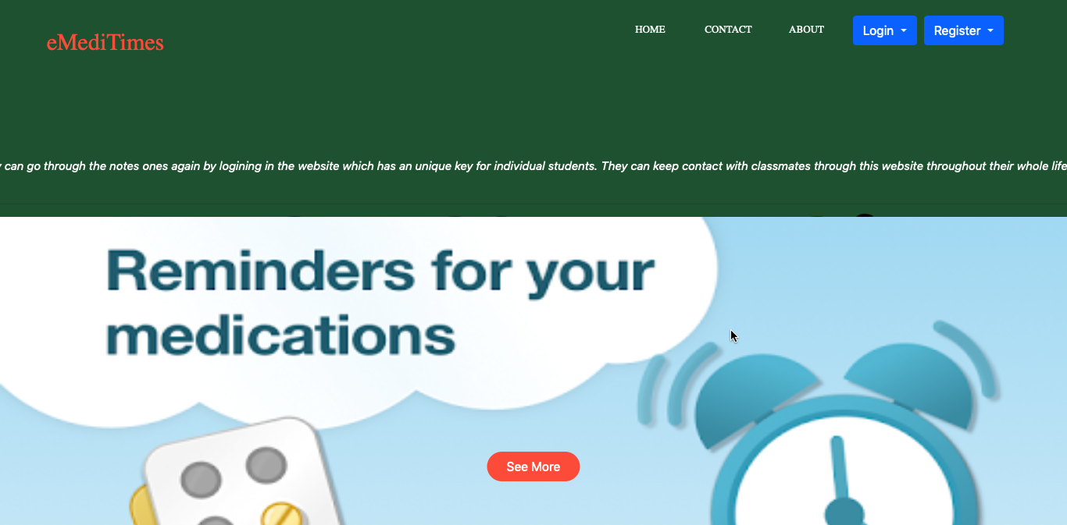
Main Home Page

Slide 7
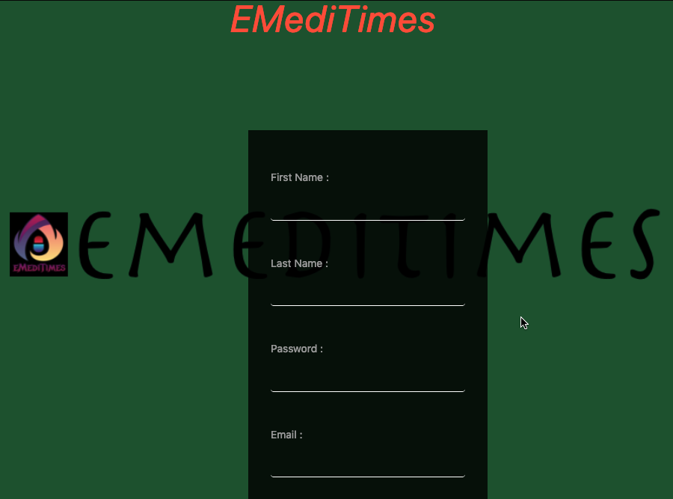
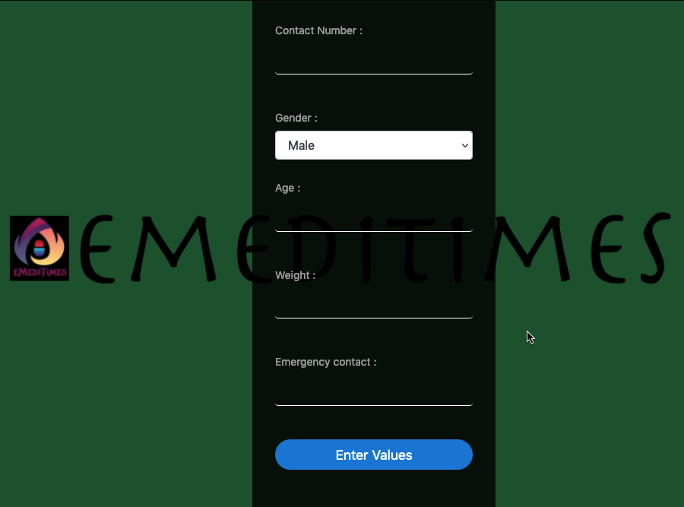
REGISTER PANEL

Slide 8
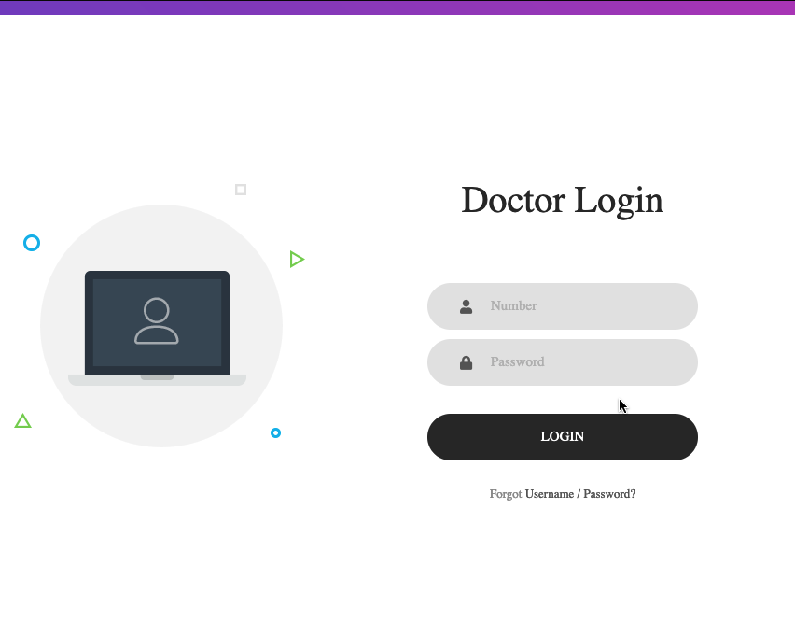
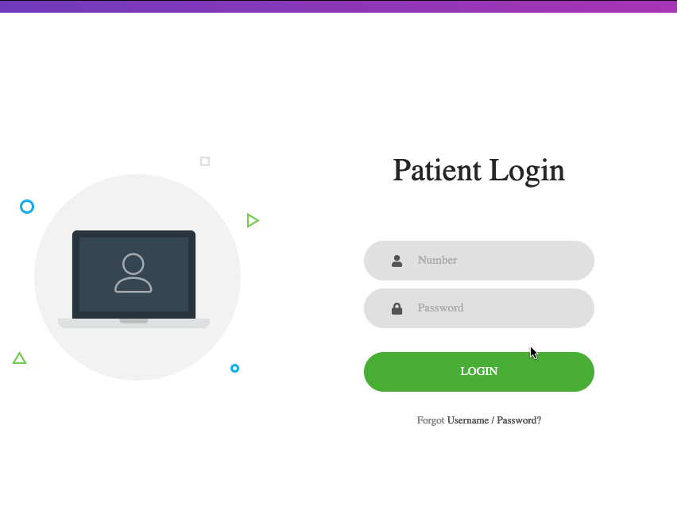
LOGIN PANELS

Slide 9
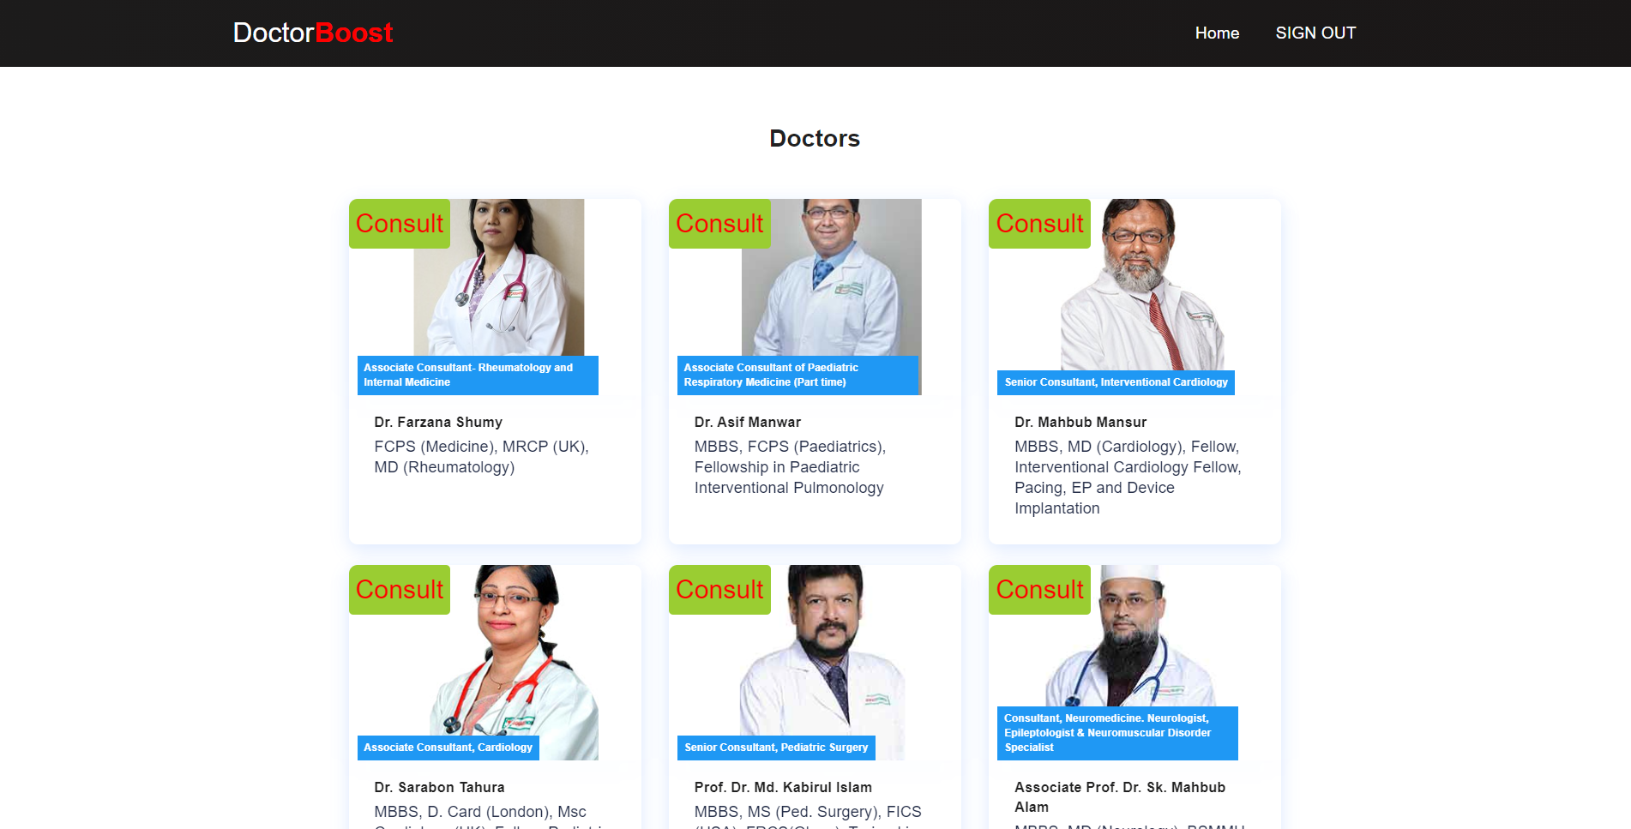
CONSULT WITH DOCTORS
There are list of doctors from which patient can choose to consult with .
Patient can consult with their Doctors using our chat platform (Doctor Boost)
Patients can consult with different department of doctor related to their diseases .

Slide 10
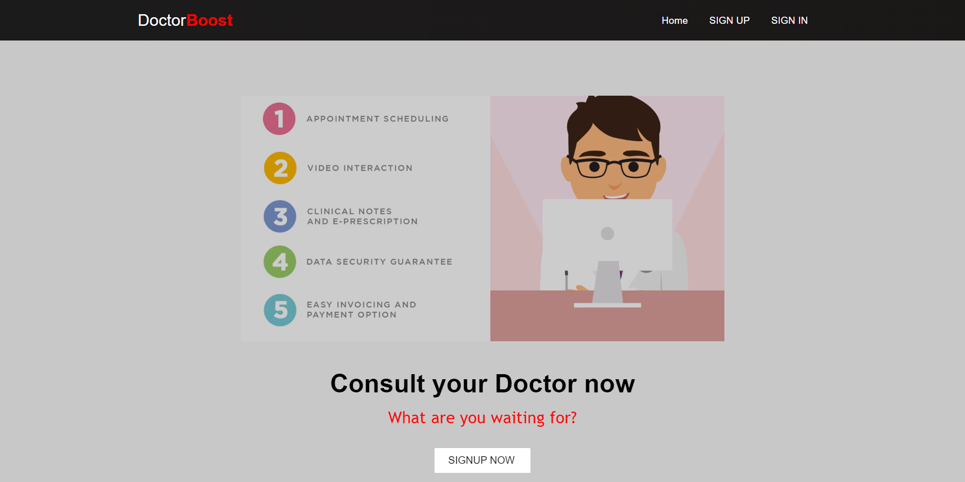
COVERSATION WITH DOCTOR
Patient can privately chat with their desired Doctor which they have selected from the list.
Patient can also have video chat with the doctor if needed.
Even Doctors can consult with other doctors each other to find best curable method for the patient.
Doctor will prescribe the patient after hearing the patients illness.
Doctor can see previous patients doctor prescription if needed.

Slide 11
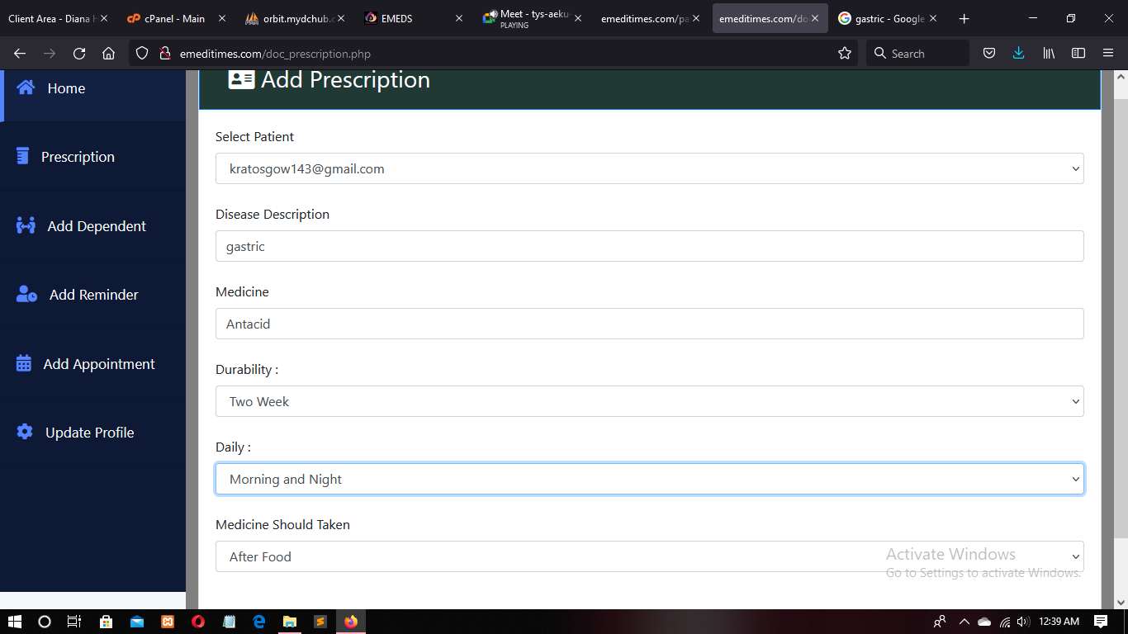
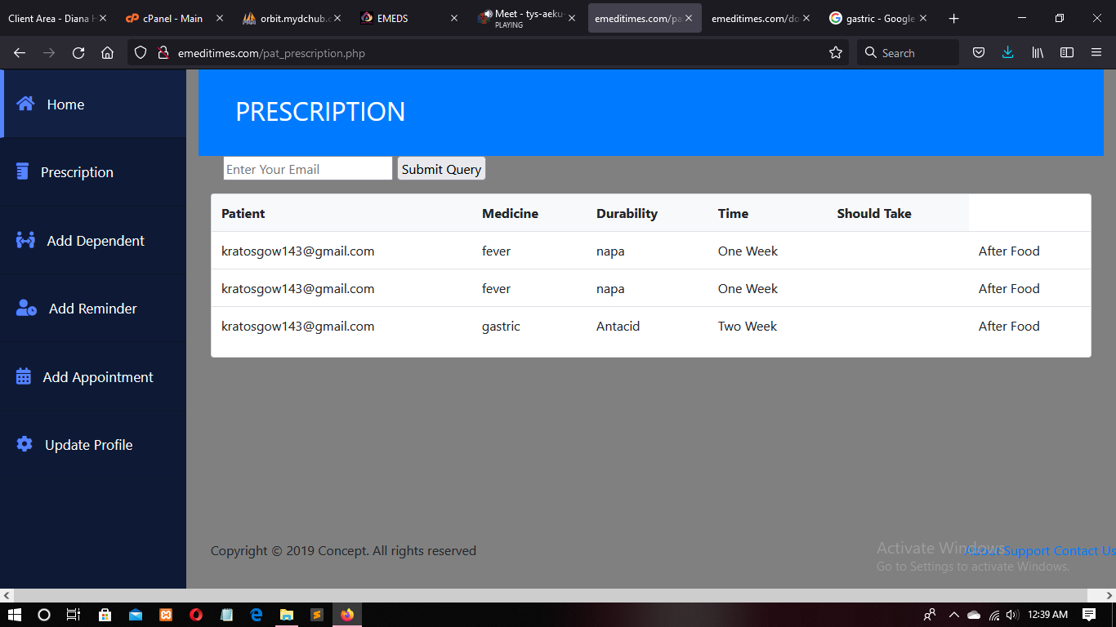
PRESCRIPTION
Doctor’s End
Patient’s End

Slide 12
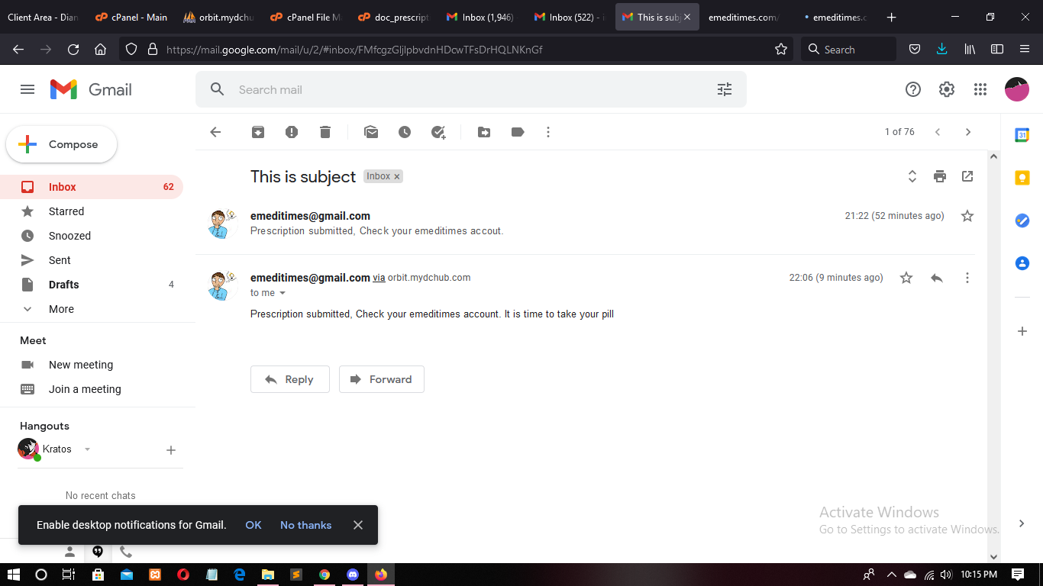
PRESCRIPTION NOTIFICATION
As the doctor prescribes the patient , the prescription is submitted to the patients Mail ID.
And every time it gives notification through Mail ID whenever its time for the medicine to intake

Slide 13
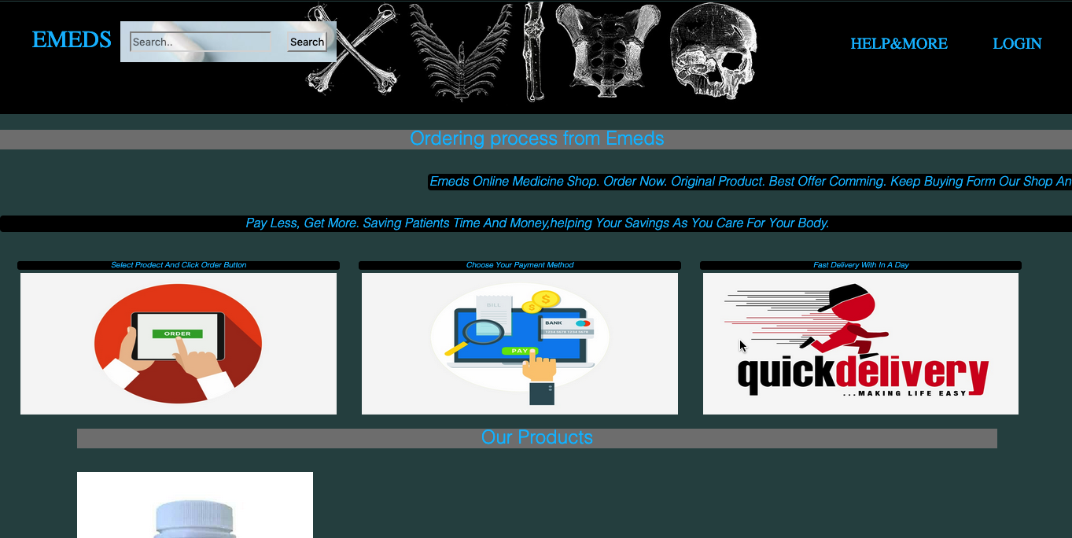
E-PHARMACY
EVERYTHING IS WITHIN OUR PATIENTS REACH TO MAKE THEIR LIFE EASIER WE CREATED E-PHARMACEUTICAL STORE.
PATIENT CAN SELECT THE ITEM AND ORDER IT
DIFFERENT PAYMENTS METHOD ARE AVAILABLE

Slide 14
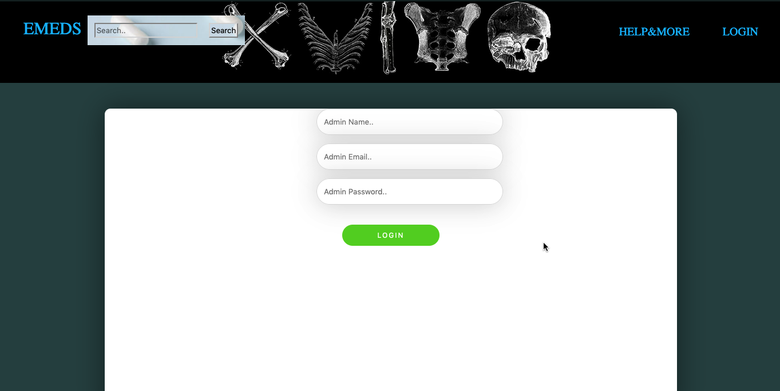
ADMIN
ADMINS ARE THE USERS THAT ARE STORED IN MYSQL DATABASE
ADMIN USER CANT BE CREATED

Slide 15
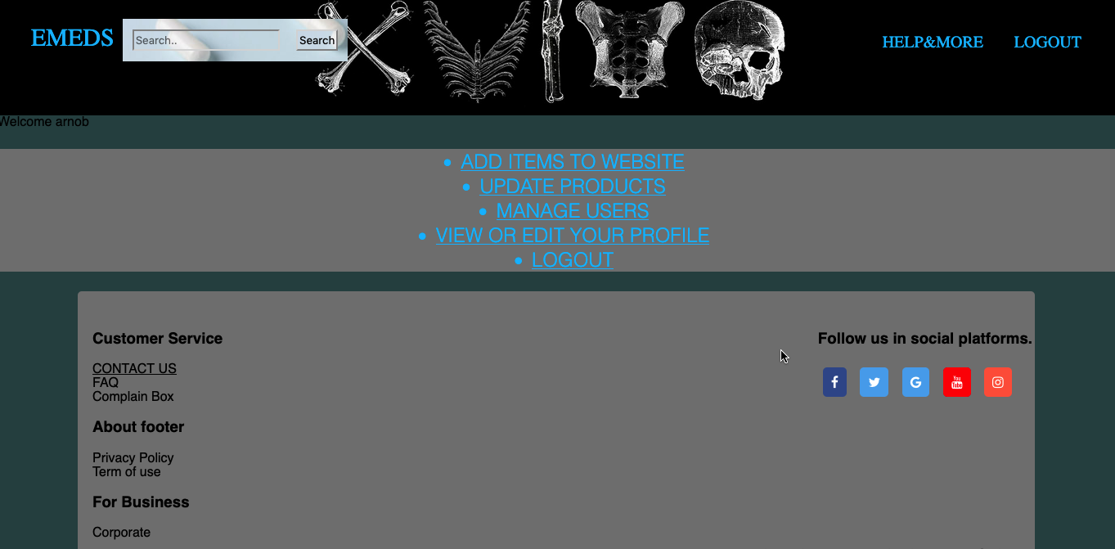
ADMIN PANEL
ONLY ADMIN CAN ADD ITEMS
ONLY ADMIN CAN UPDATE PRODUCTS AND DELETE IT .
ONLY ADMIN CAN MANAGE USERS

Slide 16
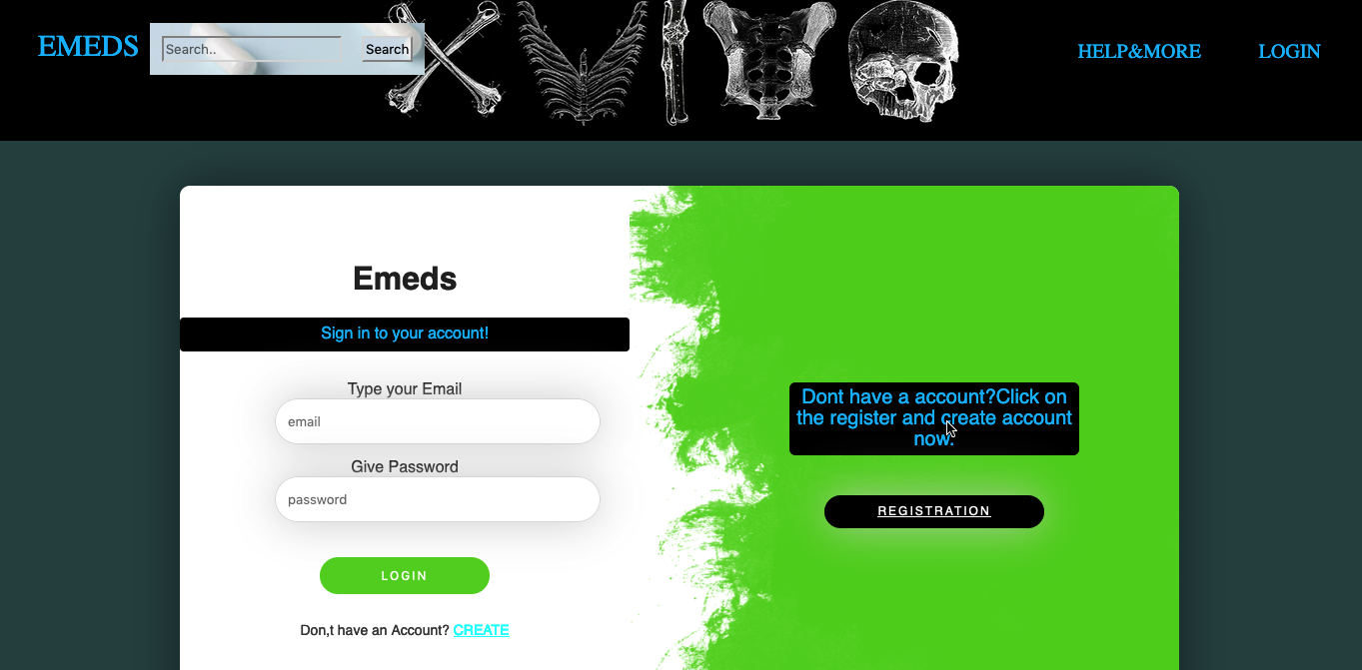
CUSTOMER LOGIN
HERE PATIENTS ARE CUSTOMERS
PATIENTS WILL CREATE A CUSTOMER PROFILE

Slide 17
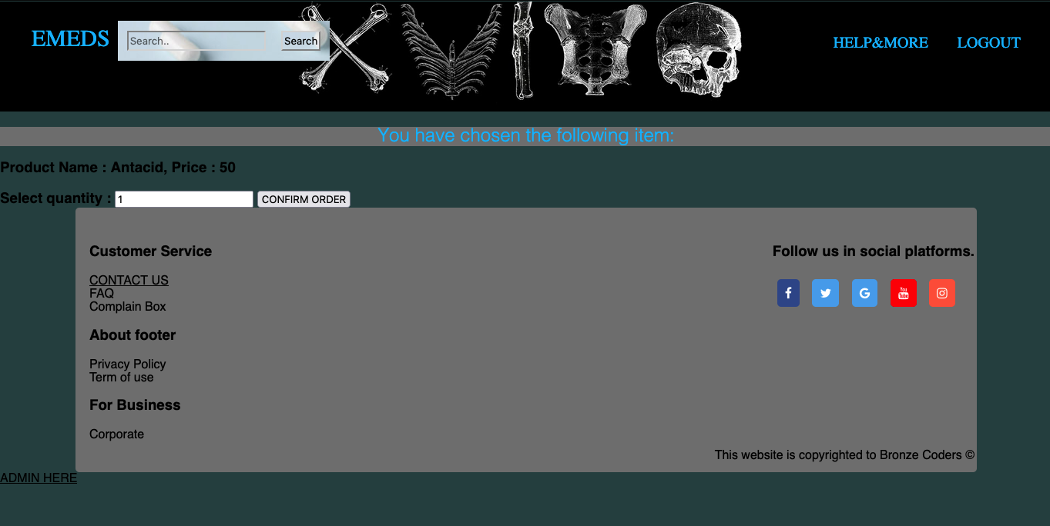
CUSTOMERS CAN ONLY SELECT ITEMS AND DISCARD IT .
And Order it by clicking Confirm Order button.

Slide 18
DIFFICULTIES FACED
REMAINDER- Notification send every intake time of medicine
CART SYSTEM - List of all medicine purchased and making an invoice
PAYMENT METHOD – Mobile banking , Card etc

Slide 19
That’s All For Today
THANK YOU!

