Slide 1
Chapter 1
Introduction
1 -<number>

Slide 2
Bit and data type
bit: basic unit of information.
data type: interpretation of a bit pattern.
e.g. 0100 0001 integer 65
ASCII code ’A’
BCD 41
(binary coded decimal)
1100 0001 unsigned integer 193
1’s complement -62
2’s complement -63
1 -<number>

Slide 3
1’s and 2’s complements
range of 1’s complement in 8 bits
-(2⁷-1)~2⁷-1
-127~127
range of 2’s complement in 8 bits
01111111 = 127
10000000 = -128
-(2⁷-1)~2⁷-1
-128~127
1 -<number>

Slide 4
Data type in programming (1)
data type:
  a collection of values and a set of operations on those values.
e.g. int x, y; // x, y, a, b are identifiers
float a, b;
x = x+y; // integer addition
a = a+b; // floating-point addition
Are the two additions same ?
1 -<number>

Slide 5
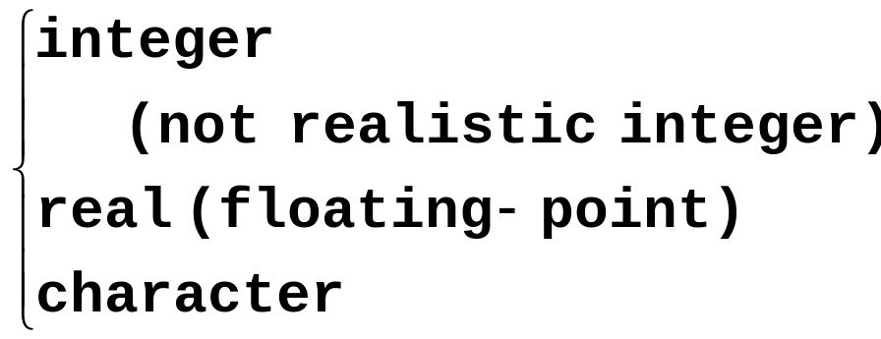
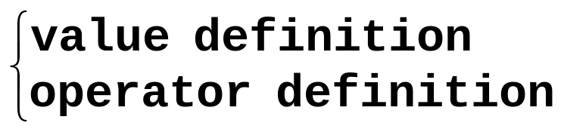
Data type in programming (2)
native data type
  by hardware implementation
abstract data type (ADT)
two parts
  defined by existing data types
  Internal representation and operation implementation are hidden.
  by software implementation
  examples: stack, queue, set, list, ...
1 -<number>

Slide 6
ADT example—rational numbers
Rational numbers
/*value definition*/ numerator(分子)
abstract typedef <integer, integer> RATIONAL;
condition RATIONAL[1] != 0; denominator(分母)
/*operator definition*/
abstract RATIONAL makerational(a, b); //
int a, b;
precondition b != 0;
postcondition markerational[0] == a;
markerational[1] == b;
1 -<number>

Slide 7
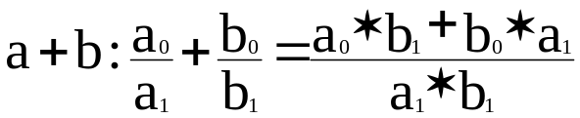
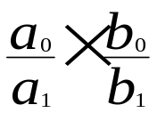
Pseudo-code of rational numbers
abstract RATIONAL add(a, b); /*written a + b*/
RATIONAL a, b;
postcondition add[1] == a[1] * b[1];
add[0] == a[0] * b[1] + b[0] * a[1];
/* */
abstract RATIONAL mult(a, b) /*written a * b*/
RATIONAL a, b;
poscondition mult[0] == a[0] * b[0]; /* */
mult[1] == a[1] * b[1];
abstract equal(a, b) /*written a==b*/
RATIONAL a, b;
postcondition equal == (a[0]*b[1] == b[0]*a[1]);
※This is not a C program.
1 -<number>

Slide 8
Sequence representation in ADT
sequence: an order set of elements
e.g. s = <s0, s1, …, Sn-1>
abstract typedef <<int>> intseq; /* sequence of integers of any length */
abstract typedef <integer, char, float> seq3;
/* sequence of length 3 consisting of an
integer, a character and a
floating-point number */
abstract typedef <<int, 10>> intseq;
/* sequence of 10 integers */
abstract typedef <<,2>> pair;
/* arbitrary sequence of length 2 */
1 -<number>

Slide 9
ADT example—string (1)
varying-length character strings
abstract typedef <<char>> STRING;
abstract length(s)
STRING s;
postcondition length == len(s);
abstract STRING concat(s1, s2)
// 連接兩個字串
STRING s1, s2;
postcondition concat == s1 + s2;
1 -<number>

Slide 10
ADT example—string (2)
abstract STRING substr(s1, i, j);
//從位置i起, 長度為j,找出子字串
STRING s1; int i, j;
precondition 0 <= i < len(s1);
0 <= j <= len(s1) –i;
postcondition substr == sub(s1, i, j);
1 -<number>

Slide 11
ADT example—string (3)
abstract pos(s1, s2) // 子字串s2在字串s1之位置
STRING s1, s2;
postcondition /*lastpos = len(s1) – len(s2) */
( (pos == -1) && ( for (i = 0; i <= lastpos; i++)
(s2 <> sub(s1, i, len(s2))) ))
// 不存在時, return -1
||
( (pos >= 0) && (pos <= lastpos) // 存在
&& (s2 == sub(s1, pos, len(s2))
&& (for (i = 1; i < pos; i++)
(s2 <> sub(s1, i, len(s2)))));
// pos 之前, 無相同之字串
1 -<number>

Slide 12
The length of a string
#define STRSiZE 80
char string[STRSiZE];
strlen(string)
char string[];
{
int i;
for (i = 0; string[i] != ’\0’; i++);
/* 字串結尾是 ’\0’ */
return(i);
}/* end strlen */
1 -<number>

Slide 13
String matching
int strpos(char s1[], char s2[])
//找子字串s2在字串s1之位置
{
int len1, len2;
int i, j1, j2;
len1 = strlen(s1);
len2 = strlen(s2);
for (i = 0; i + len2 <= len1; i++)
for (j1 = i, j2 = 0; j2<= len2 &&
s1[j1] == s2[j2]; j1++, j2++)
if (j2 == len2)
return(i);
return(-1); /* 未找到 */
} /* end strpos */
1 -<number>

Slide 14
Concatenation of two strings
void strcat(char s1[], char s2[])
/* s1= s1+s2 */
{
int i, j;
for (i=0; s1[i] != ’\0’; i++)
;
for (j = 0; s2[j] != ’\0’;
s1[i++] = s2[j++])
;
} /* end strcat */
1 -<number>

Slide 15
Getting a substring
void substr(char s1[], int i,int j, char s2[])
/* 在s1中, 從 i 起, 長度j, 放入s2 */
{
int k, m;
for (k=i, m = 0; m < j; s2[m++] = s1[k++])
;
s2[m] = ’\0’;
} /*end substr */
1 -<number>

Slide 16
Programming skills
int a[100];
for (i = 0; i < 100; a[i++] = 0);
Better:Constants defined by identifiers
#define NUMELTS 100
int a[NUMELTS];
for (i = 0; i < NUMELTS; a[i++] = 0);
1 -<number>

Slide 17
Two-dimensional arrays
e.g.
int a[3][5]; // declaration
Position of a[2][3]
Logical view:
Column Column Column Column Column
0 1 2 3 4
Row 0
Row 1
Row 2
a[0][0]
a[0][1]
a[0][2]
a[0][3]
a[0][4]
a[1][0]
a[1][1]
a[1][2]
a[1][3]
a[1][4]
a[2][0]
a[2][1]
a[2][2]
a[2][3]
a[2][4]
1 -<number>

Slide 18
Physical view of 2D arrays (1)
(1) row-major representation : (e.g. Pascal, C)
a[0][0]
a[0][1]
a[0][2]
a[0][3]
a[0][4]
a[1][0]
a[1][1]
a[1][2]
a[1][3]
a[1][4]
a[2][0]
a[2][1]
a[2][2]
a[2][3]
a[2][4]
base(a)
starting address of a
Row 0
Row 1
Row 2
1 -<number>

Slide 19
Physical view of 2D arrays (2)
(2) column-major representation : (e.g. Fortran)
a[0][0]
a[1][0]
a[2][0]
a[0][1]
a[1][1]
a[2][1]
a[0][2]
a[1][2]
a[2][2]
a[0][3]
a[1][3]
a[2][3]
a[0][4]
a[1][4]
a[2][4]
base(a)
column 0
starting address of a
column 1
column 2
column 3
column 4
1 -<number>

Slide 20
Address calculation of 2D arrays
int ar[r1][r2];
(1) row-major:
address of ar[i1][i2]:
base(ar) + (i1*r2 + i2)* element size
/* base(ar) : address of ar[0][0]
starting address of array ar */
e.g. a[2][3] : base(a) + (2*5+3)*4
1 -<number>

Slide 21
Address calculation of 2D array
(2) column-major
address of ar[i1][i2];
base(ar) + (i1 + i2*r1)* element size
e.g. a[2][3] : base(a) + (2+3*3)*4
1 -<number>

Slide 22
Structures in C
struct atype{
int f1;
float f2;
char f3[10];
};
struct atype r;
assumption: integer: 4 bytes
floating point: 8 bytes
1 char: 1 byte
starting address of r: 200
offset: the location of a field – starting address
1 -<number>

Slide 23
Element locations in a structure
e.g.
offset of f1: 0
offset of f2: 4
offset of f3: 12
address of r.f1: 200
r.f2: 204
r.f3[0]: 212
r.f3[1]: 213
# of bytes allocated for r: **
struct atype{
int f1;
float f2;
char f3[10];
};
struct atype r;
1 -<number>

Slide 24
Restriction on starting addresses
If an integer has to start at an address
divisible by 4 and a real number has to
start at an address divisible by 8, then
offset of f1: 0 // 4 bytes are wasted
offset of f2: 8
offset of f3: 16
# of bytes allocated for r: **
struct atype{
int f1;
float f2;
char f3[10];
};
struct atype r;
1 -<number>

Slide 25
Unions in structures
struct stint{
int f3, f4;
};
struct stfloat{
float f5, f6;
};
struct sample{
int f1;
float f2;
int utype;
union{
struct stint x;
struct stfloat y;
}f;
}s;
1 -<number>

Slide 26
Element locations in a union
The union permits a variable to be interpreted in several different ways.
Assume: starting address: 100
address of s.f1 : 100
s.f2 : 104
s.utype : 112
s.f.x.f3: 116
s.f.x.f4: 120
s.f.y.f5: 116
s.f.y.f6: 124
# of bytes allocated for s: **
1 -<number>

Slide 27
Sets in Pascal
var x, x1, x2: set of 1..10;
x = [1, 2, 3, 5, 9, 10]
A set is represented by a bit string.
e.g. 1110100011 1: in the set
0: not in the set
e.g. x1 = [2, 4, 6, 8] 0101010100
x2 = [1, 2, 5, 9] 1100100010
union 聯集:
x1 ∪ x2 = **
x1 + x2 = [1, 2, 4, 5, 6, 8, 9]
**
1 -<number>

Slide 28
x1 = [2, 4, 6, 8] 0101010100
x2 = [1, 2, 5, 9] 1100100010
Intersection 交集:
x1 ∩ x2 = **
x1 * x2 = [2]
**
difference 差集:
x1 – x2 = **
x1 – x2 = [4, 6, 8]
**
contain 包含:
x1 ⊆ x2 ⬄
x1 ⊇ x2 ⬄ **
a in x1 ⬄
The size of a set is limited.
1 -<number>

Slide 29
Classes in C++
structure: collection of fields
classes: collection of fields and functions
ADT rational in C++:
class Rational{
long numerator;
long denominator;
void reduce(void);
public:
Rational add(Rational);
Rational mult(Rational);
Rational divide(Rational);
int equal(Rational);
void print(void);
void setrational(long, long);
}
1 -<number>

Slide 30
Private and public
Default is “private”. State explicitly:
class Rational{
private:
long numerator;
public :
Rational add(Rational);
}
…
…
1 -<number>

Slide 31
The method (body of a function) written in the class
class Rational{
long numerator;
...
public:
Rational add(Rational);
...
void print(void);
void setrational(long n, long d)
{
if (d == 0)
error(“ERROR: denominator may not be zero”);
numerator = n;
denominator = d;
reduce(); // reduce to lowest terms
} /* end setrational */
} /* end Rational */
1 -<number>

Slide 32
Methods written outside the class (after the class declaration)
void Rational::setrational(long n, long d)
{ // setrational() belongs to class Rational
if (d == 0)
error(“ERROR: denominator may not be zero”);
numerator = n;
denominator = d;
reduce(); //reduce to lowest terms
} /* end setrational */
1 -<number>

Slide 33
Reducing to lowest terms
void Rational::reduce(void)
{
int a, b, rem, sign;
if (numerator == 0)
denominator = 1;
sign = 1; // assume positive
// check if any negatives
if (numerator < 0 && denominator < 0){
numerator = -numerator; // convert to positive
denominator = -denominator;
}
if (numerator < 0){
numerator = -numerator;
sign = -1;
}
1 -<number>

Slide 34
if (denominator < 0){
denominator = -denominator;
sign = -1;
}
if (numerator > denominator){
a = numerator;
b = denominator;
}
else{
a = denominator;
b = numerator;
}
while (b != 0){ // calculate GCD of a and b
rem = a % b;
a = b;
b = rem;
} // at this point, a is the GCD
numerator = sign * numerator / a;
denominator = denominator / a;
} /* end reduce */
1 -<number>

Slide 35
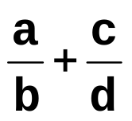

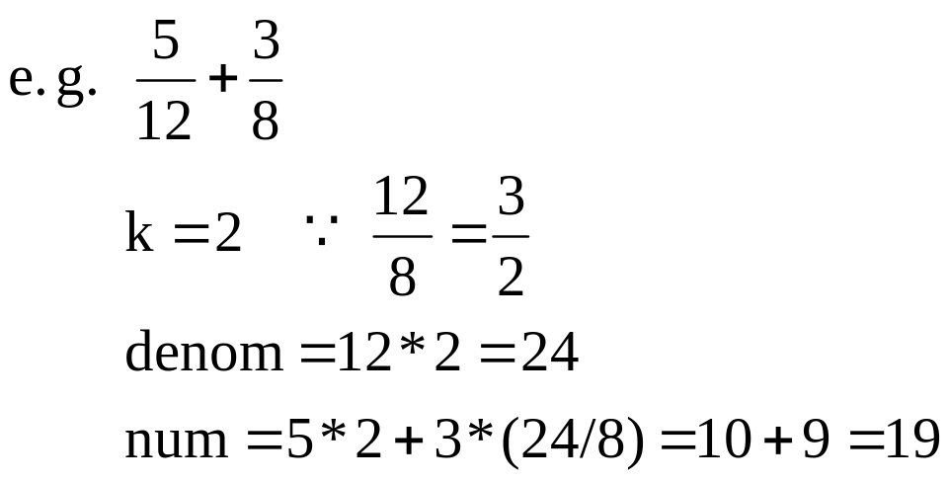
Addition of two rational numbers
Algorithm of Computing
k = rden(b, d); //rden(b, d)算出 最簡分數之分母
denom = b*k; // resulting denominator
num = a*k + c*(denom/d); //resulting numerator
1 -<number>

Slide 36
Implementation of addition
Rational Rational::add(Rational r)
// add another Rational r to this object
{
int k, denom, num;
Rational rnl;
//first reduce both rationals to lowest terms
reduce();
r.reduce();
//implement k = rden(b, d);
rnl.setrational(denominator, r.denominator);
rnl.reduce();
k = rnl.denominator;
k = rden(b, d);
denom = b*k;
num = a*k + c*(denom/d)
1 -<number>

Slide 37
// compute the denominator of the result
// denom = b*k;
denom = denominator * k;
// compute the numerator of the result
// num = a*k + c*a(denom/d);
num = numerator*k + r.numerator*(denom/r.denominator);
// form a Rational from the result and reduce
// the result to lowest terms
rnl.setrational(num, denom);
rnl.reduce();
return rnl;
} /* end add*/
k = rden(b, d);
denom = b*k;
num = a*k + c*(denom/d)
1 -<number>

Slide 38
Implementation of multiplication
Rational Rational::mult(Rational r)
// multiply this object with r
{
Rational rnl, rnl1, rnl2;
int num, denom;
// reduce both inputs to lowest terms
reduce();
r.reduce();
// switch numerators and denominators and reduce
rnl1.setrational(numerator, r.denominator);
rnl1.reduce();
rnl2.setrational(r.numerator, denominator);
rnl2.reduce();
1 -<number>

Slide 39
// compute result
num = rnl1.numerator * rnl2.numerator;
denom = rnl1.denominator * rnl2.denominator;
rnl.setrational(num, denom);
return rnl;
} /* end mult */
1 -<number>

Slide 40
Implementation of division
Rational Rational::divide(Rational r)
// divide this object by r
{
Rational rnl;
// Compute the reciprocal of r
rnl.setrational(r.denominator, r.numerator);
// Multiple by the reciprocal
return mult(rnl);
}
1 -<number>

Slide 41
Implementation of equality
int Rational::equal(Rational r)
// check if this object is equal to r
{
reduce();
r.reduce();
if (numerator == r.numerator &&
denominator == r.denominator)
return TRUE;
else
return FALSE;
} /* end equal */
1 -<number>

Slide 42
Output for rational numbers
void Rational::print(void)
{
cout << numerator << ”/” << denominator << endl;
} /* end print */
1 -<number>

Slide 43
Output streams in C++
以下表格是 cout 用來控制輸出的符號。
 | 符 號 | 適用I/O 型態 | 說 明
1 2 3 4 5 6 7 8 9 10 11 | dec ends endl flush hex oct setfill(char c) setprecision(int n) setw(int n) ws setbase(int n) | I/O O O O I/O I/O O O I/O I I/O | 十進位 I/O 格式 加入字串結束符號 令 (‘\0’) 加入換行符號 ‘\n’ 輸出資料流內容 十六進位 I/O 格式 八進位 I/O 格式 設定資料流內容為某字元 設定輸出格式到 n 個小數 設定 I/O 的欄位寬度 跳過空白 (White space, 即空白, tab 及換行) 設定 I/O 進位格式
1 -<number>

Slide 44
Overloading in C++ (1)
/* same function name for different functions */
class Rational{
public:
Rational add(Rational);
Rational add(long);
}
…
…
1 -<number>

Slide 45
Overloading in C++ (2)
(1) Rational Rational::add(Rational r)
// for Rational
{
}
(2) Rational Rational::add(long i)
// for long integer
{
Rational r;
r.setrational(i, 1);
return add(r);
}
…
1 -<number>

Slide 46
Inheritance in C++
class Rational{
protected:
long numerator;
long denominator;
void reduce(void);
public:
...
};
class Integer::public Rational{
// Integer inherits Rational
public:
void setrational(long, long);
void setrational(long);
};
private : class 內部可用
protected: 繼承者內部亦可用
public : 全部可用
1 -<number>

Slide 47
使兩個 integer 及一個 integer 均為 Rational:
void Integer::setrational(long num, long denom)
{
if (denom != 1)
error(“ERROR: non-integer assigned to
Integer variable”);
numerator = num;
denominator = 1;
}
void Integer::setrational(long num)
{
numerator = num;
denominator = 1;
}
1 -<number>

Slide 48
Constructors in C++ (1)
We can also use a constructor to initialize a Rational object:
Rational(void);
Rational(long);
Rational(long, long);
Rational::Rational(void)
{
// assume the rational number is 0
numerator = 0;
denominator = 1;
}
1 -<number>

Slide 49



Constructors in C++ (2)
Rational::Rational(long i)
{
numerator = i;
denominator = 1;
}
Rational::Rational(long num, long denom)
{
numerator = num;
denominator = denom;
}
e.g. Rational r; // r =
Rational r(3); // r =
Rational r(2, 5); // r =
1 -<number>

Slide 50


Constructors in C++ (3)
When ”new” is called, the constructor is also invoked automatically.
e.g.
(1) Rational * p = new Rational;
// initial value =
(2) Rational * p = new Rational(2, 5);
// initial value =
p points to a newly allocated rational object with initial value.
1 -<number>

