Slide 1
Formal models of concurrency and communication
based on the slides of Gottfried Vossen,
Univ. of Münster, Germany

Slide 2
Formal models of concurrency and communication
Introduction. Concurrent Models
Concurrency control: serialization, complexity, control, conflicts, algorithms
Concurrency control for the object model
Concurrency control in relational databases
Failure & Recovery modeling: recovery in page, object and multimedia model
Distributed concurrency control
CCS (Calculus of Communication Systems) models for concurrent processes
Pi-Calculus models for concurrent processes

Slide 3
Part I: Introduction. Concurrent Models
1 What Is It All About?
2 Computational Models

Slide 4
1. What Is It All About?
1.1 Application Examples
1.2 System Paradigms
1.3 Virtues of Transactions
1.4 Architecture of Database Servers
1.5 Lessons Learned

Slide 5
Serial vs. Concurrent vs. Parallel computation
Sequential processes
Concurrent processes
Parallel processes
time
shared data
low clarity & correctness, relatively high performance
very good clarity, correctness, low performance
good clarity & correctness, high performance

Slide 6
Producer-consumer scenario
Producer Consumer
Read(x);
Read(x); x--;
x++; Write(x);
Write(x); …
…. Read(x);
Read(x); x--;
x++; Write(x);
Write(x); …
…
=> Atomicity is enough

Slide 7
Application Examples
OLTP, e.g., funds transfer
E-commerce, e.g., Internet book store
Workflow, e.g., travel planning & booking

Slide 8
OLTP Example: Debit/Credit
void main ( ) {
EXEC SQL BEGIN DECLARE SECTION
int b /*balance*/, a /*accountid*/, amount;
EXEC SQL END DECLARE SECTION;
/* read user input */
scanf (“%d %d”, &a, &amount);
/* read account balance */
EXEC SQL Select Balance into :b From Account
Where Account_Id = :a;
/* add amount (positive for debit, negative for credit) */
b = b + amount;
/* write account balance back into database */
EXEC SQL Update Account
Set Balance = :b Where Account_Id = :a;
EXEC SQL Commit Work;
}
Notes:
Bank operation: traditional teller or home PC with Internet access or credit card reader at a merchant or a cyber cash carrier

Slide 9
OLTP Example 1.1: Concurrent Executions
P1 Time P2
Select Balance Into :b₁
From Account 1
Where Account_Id = :a
/* b₁=0, a.Balance=100, b₂=0 */
Select Balance Into :b₂
2 From Account
Where Account_Id = :a
/* b₁=100, a.Balance=100, b₂=100 */
b1 = b1-50 3
/* b₁=50, a.Balance=100, b₂=100 */
4 b₂ = b₂ +100
/* b₁=50, a.Balance=100, b₂=200 */
Update Account
Set Balance = :b₁ 5
Where Account_Id = :a
/* b₁=50, a.Balance=50, b₂=200 */
Update Account
6 Set Balance = :b₂
Where Account_Id = :a
/* b₁=50, a.Balance=200, b₂=200 */
Observation: concurrency or parallelism may cause inconsistencies,
requires concurrency control for “isolation”

Slide 10
OLTP Example 1.2: Funds Transfer
void main ( ) {
/* read user input */
scanf (“%d %d %d”, &sourceid, &targetid, &amount);
/* subtract amount from source account */
EXEC SQL Update Account
Set Balance = Balance - :amount Where Account_Id = :sourceid;
/* add amount to target account */
EXEC SQL Update Account
Set Balance = Balance + :amount Where Account_Id = :targetid;
EXEC SQL Commit Work; }
Observation: failures may cause inconsistencies,
require recovery for “atomicity” and “durability”

Slide 11
E-Commerce Example
Shopping at Internet book store:
client connects to the book store's server and
starts browsing and querying the store's catalog
client fills electronic shopping cart
upon check-out client makes decision on items to purchase
client provides information for definitive order
(including credit card or cyber cash info)
merchant's server forwards payment info to customer's bank
credit or card company or cyber cash clearinghouse
when payment is accepted,
shipping of ordered items is initiated by the merchant's server
and client is notified
Observations: distributed, heterogeneous system
with general information/document/mail servers
and transactional effects on persistent data and messages

Slide 12
Workflow Example
Workflows are (the computerized part of) business processes,
consisting of a set of (automated or intellectual) activities
with specified control and data flow between them
(e.g., specified as a state chart or Petri net)
Conference travel planning:
Select a conference, based on subject, program, time, and place.
If no suitable conference is found, then the process is terminated.
Check out the cost of the trip to this conference.
Check out the registration fee for the conference.
Compare total cost of attending the conference to allowed budget,
and decide to attend only if the cost is within the budget.
Observations: activities spawn transactions on information servers,
workflow state must be failure-resilient,
long-lived workflows are not isolated

Slide 13
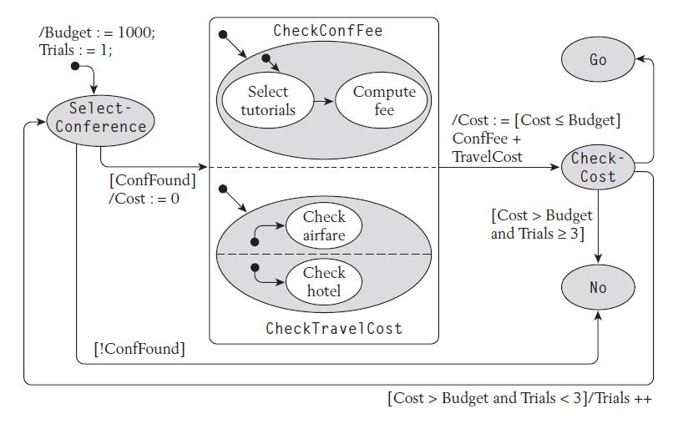
Example: Travel Planning Workflow

Slide 14
Introduction
1.1 Application Examples
1.2 System Paradigms
1.3 Virtues of Transactions
1.4 Architecture of Database Servers
1.5 Lessons Learned

Slide 15
3-Tier System Architectures
Clients:
presentation (GUI, Internet browser)
Application server:
  application programs (business objects, servlets)
  request brokering (TP monitor, ORB, Web server)
based on middleware (CORBA, DCOM, EJB, SOAP, etc.)
Data server:
database / (ADT) object / document / mail / etc. servers
Specialization to 2-Tier Client-Server Architecture:
Client-server with “fat” clients (app on client + ODBC)
Client-server with “thin” clients (app on server, e.g., stored proc)

Slide 16
3-Tier Reference Architecture
Users
. . .
Clients
Request
Reply
Application
Server
Application
Program 1
Application
Program 2
...
Request
Reply
encapsulated
data
exposed
data
Data
Server
Objects
...
Stored
Data
(Pages)

Slide 17
System Federations
Users
. . .
Clients
Application
Servers
...
Data
Servers
...

Slide 18
Introduction
1.1 Application Examples
1.2 System Paradigms
1.3 Virtues of Transactions
1.4 Architecture of Database Servers
1.5 Lessons Learned

Slide 19
ACID Properties of Transactions
Atomicity:
all-or-nothing effect,
simple (but not completely transparent) failure handling
Consistency-preservation:
transaction abort upon consistency violation
Isolation:
only consistent data visible as if single-user mode,
concurrency is masked to app developers
Durability (persistence):
committed effects are failure-resilient
Transaction programming interface (“ACID contract”)
begin transaction
commit transaction (“commit work” in SQL)
rollback transaction (“rollback work” in SQL)

Slide 20
Requirements on Transactional Servers
Server components:
Concurrency Control
guarantees isolation
Recovery:
guarantees atomicity and durability
Performance:
high throughput (committed transactions per second)
short response time
Reliability:
(almost) never lose data despite failures
Availability:
very short downtime
almost continuous, 24x7, service

Slide 21
Introduction
1.1 Application Examples
1.2 System Paradigms
1.3 Virtues of Transactions
1.4 Architecture of Database Servers
1.5 Lessons Learned

Slide 22
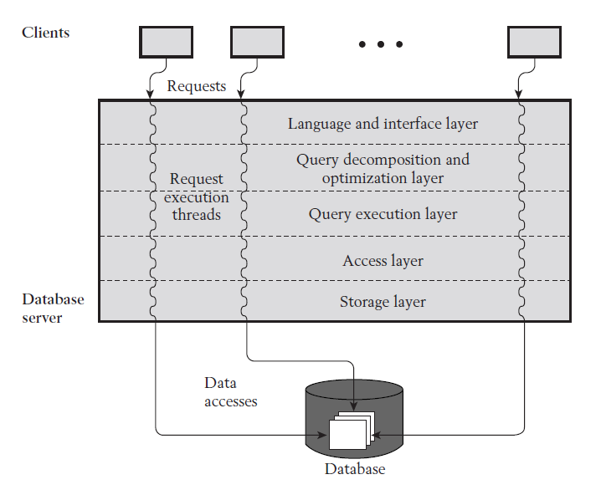
Database System Layers

Slide 23
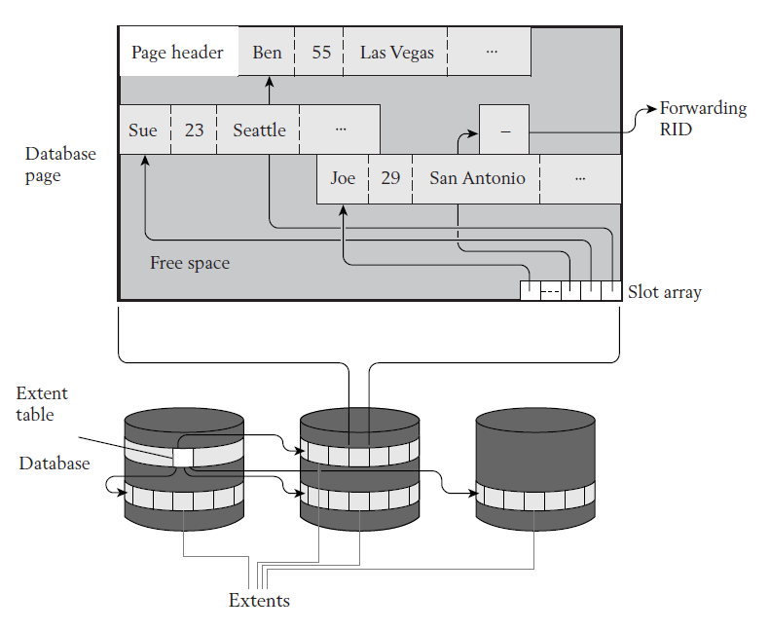
Storage Structures

Slide 24
Access Structures
Root Node
Bob
Eve
Tom
B+-tree
Adam
Bill
Bob
Dick
Eve
Hank
Jane
Jill
Tom
Leaf Nodes
RIDs
Search tree interface:
lookup <index> where <indexed field> = <search key>
lookup <index> where <indexed field>
between <lower bound> and <higher bound>

Slide 25
Query Execution Plans
Select Name, City, Zipcode, Street
From Person
Where Age < 30
And City = "Austin"
Projection
Projection
Filtering
RID Access
RID List
Intersection
RID Access
Index Scan
on AgeIndex
Index Scan
on CityIndex
Fetch Person
Record
Index Scan
on CityIndex
Fetch Person
Record

Slide 26
Introduction
1.1 Application Examples
1.2 System Paradigms
1.3 Virtues of Transactions
1.4 Architecture of Database Servers
1.5 Lessons Learned

Slide 27
Lessons Learned
Benefits of ACID contract:
  For users: federation-wide data consistency
  For application developers: ease of programming
Server obligations:
  Concurrency control
  Recovery

Slide 28
2. Computational Models
2.1 Ingredients
2.2 Page Model
2.3 Object Model

Slide 29
Reminder: Database System Layers

Slide 30
Ingredients
Elementary operations
Transactions (i.e., transaction program executions)
Histories and schedules
Characterization of correct schedules
Protocols (i.e., rules for online algorithms)

Slide 31
2. Computational Models
2.1 Ingredients
2.2 Page Model
2.3 Object Model

Slide 32
Math concepts (partial and total order relations)
Definition (Partial Order): Let A be an arbitrary set. A
relation R ⊆ A x A is a partial order on A if the following
conditions hold for all elements a, b, c ∈ A:
(a, a) ∈ R (reflexivity)
(a, b) ∈ R and (b, a) ∈ R ⇒ a=b (antisymmetry)
(a, b) ∈ R and (b, c) ∈ R ⇒ (a, b) ∈ R (transitivity)
A total order relation has the additional requirement that for
any two distinct a, b ∈ A, either (a, b) ∈ R or (b, a) ∈ R.

Slide 33
Page Model
“Syntax”:
Definition (Page Model Transaction):
A transaction t is a partial order of steps (actions) of the form
r(x) or w(x), where x ∈ D and reads and writes as well as multiple
writes applied to the same object are ordered.
We write t = (op, <)
for transaction t with step set op and partial order <.
Example: r(s) w(s) r(t) w(t)
“Semantics”:
Interpretation of j^{th} step, p_{j}, of t:
If p_{j}=r(x), then interpretation is assignment v_{j} := x to local variable v_{j}
If p_{j}=w(x) then interpretation is assignment x := f_{j} (v_{j1}, ..., v_{jk}).
with unknown function f_{j} and j₁, ..., j_{k} denoting t‘s prior read steps.

Slide 34
2. Computational Models
2.2 Ingredients
2.3 Page Model
2.4 Object Model

Slide 35
Object Model
Definition (Object Model Transaction):
A transaction t is a (finite) tree of labeled nodes with
the transaction identifier as the label of the root node,
the names and parameters of invoked operations as labels of
inner nodes, and
page-model read/write operations as labels of leaf nodes,
along with a partial order < on the leaf nodes such that
for all leaf-node operations p and q with p of the form w(x)
and q of the form r(x) or w(x) or vice versa, we have p<q ∨ q<p
Special case: layered transactions
(all leaves have same distance from root)
Derived inner-node ordering: a < b if
all leaf-node descendants of a precede all leaf-node descendants of b

Slide 36
Example: DBS Internal Layers
t₁
Search (“Austin”)
Fetch(x)
Fetch(y)
Store(z)
r (r)
r (l)
r (p)
r (q)
r (f)
r (p)
w (p)
r (r)
r (l)
w (l)

Slide 37
Example: Business Objects
t₂
Withdraw (x, 1000)
Deposit (y, 1000)
Append (h, ...)
Search (...)
^
^
^
^
Fetch (x)
Modify (x)
Fetch (a)
Fetch (d)
Store (e)
Modify (d)
Modify (a)
Search (...)
Fetch (y)
Modify (y)
r (r)
r (l)
r (p)
r (p)
w (p)
r (s)
r (t)
r (t)
w (t)
r (t)
w (t)
r (s)
w (s)
r (r)
r (l)
r (q)
r (q)
w (q)

