Slide 1


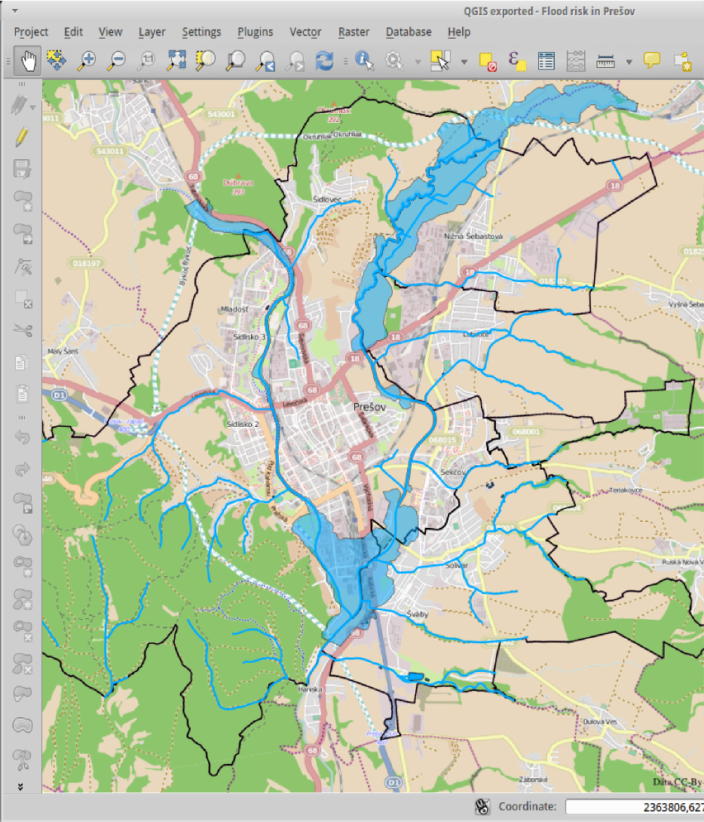
Mgr. Ivan Minčík
Mgr. Miloslav Michalko, PhD.
Mgr. Jana Kormaníková

Slide 2

What does it take
to build a small GIS office?
Conditions
12 people staff with equipment
Server and client hardware
No software installed
All hardware connected to LAN

Slide 3

What does it take
to build a small GIS office?
Requirements
Office suite
Desktop GIS software for technical staff (data processing, analysis)
Web GIS software for non-technical staff (map browsing, queries)
Central file data storage and sharing
Central GIS vector and raster data storage and sharing
Collaboration tools
Central backup
Quick hardware failure recovery

Slide 4
How to do it?

Slide 5
How to do it?
Legacy approach
Server
Server operating system
Central authentication
Internet connection (DNS, proxy)
File storage and sharing
Email
Geo-database
Mapserver (WMS, WFS)
Web GIS application
Backup and recovery

Slide 6
How to do it?
Legacy approach
Workstations
Desktop operating system (Win 8 or Win 7?)
Security
User account
Desktop environment customization
Office suite
Email, chat
GIS software

Slide 7
How to do it?
Legacy approach
? days, weeks, months
? EUR

Slide 8
How to do it?
GIS.lab approach
One command to install server and clients
20 minutes
0 EUR

Slide 9
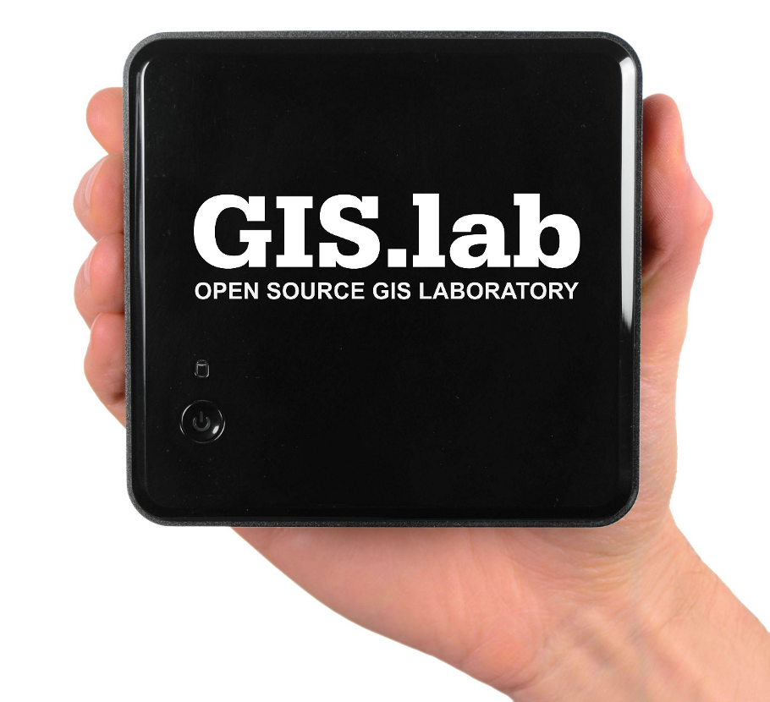
How to do it?
GIS.lab Unit approach
Plug-and-play
0 minutes
450 EUR

Slide 10
GIS.lab
How it works

Slide 11
GIS.lab
GIS.lab
client
How it works
GIS.lab
client
Boot from LAN
Mount system
Mount data
GIS.lab
server
GIS.lab
client
GIS.lab
client
Server acts as file server
Client runs at full hardware speed

Slide 12
GIS.lab
How it works
Empty
computer
Physical
GIS.lab
client
Empty
computer
Windows
computer
Physical
GIS.lab
client
Windows
computer
before
after
Any computer can be GIS.lab client

Slide 13
GIS.lab
How it works
Windows
computer
Windows
with virtual
GIS.lab
client
Windows
computer
before
after
Any computer can be GIS.lab client

Slide 14
GIS.lab
Features and benefits
Open Source software (GNU GPL 3)
Plug-and-play solution GIS.lab Unit
No hard dependency on any other Internet service
(with exception on OSM and Google maps)
General usage platform (not limited to GIS)

Slide 15
GIS.lab
Features and benefits
Extremely low maintenance costs
+ zero time to install new client machine
+ central distribution of client systems with rollback
+ rapid recovery from hardware failure
High performance client systems (opposite of thin client)

Slide 16
GIS.lab
Features and benefits
Server services
+ Internet connection sharing
+ central authentication
+ file storage and sharing
+ central data backup and recovery

Slide 17
GIS.lab
Features and benefits
Office suite
+ text documents, tables and presentations processor
+ Internet browser
+ email and chat client
+ images and video viewer and editor

Slide 18
GIS.lab
Features and benefits
GIS features
+ OpenStreetMap, Google base maps
+ GIS data editor (desktop and web)
+ GIS analysis tools
+ print composer
+ GIS data storage and sharing (geo-database)
+ OWS services (WMS, WFS)
+ instant export to WebGIS application from all GIS projects

Slide 19
GIS.lab
Use case
Teaching and studying platform for GIS and Unix technologies
Production environment for small GIS businesses
GIS software development environment
Supercomputing

Slide 20
GIS.lab
Example work flow
Task
Create map of possible free time activities
in neighbourhood of our local community
meeting.

Slide 21
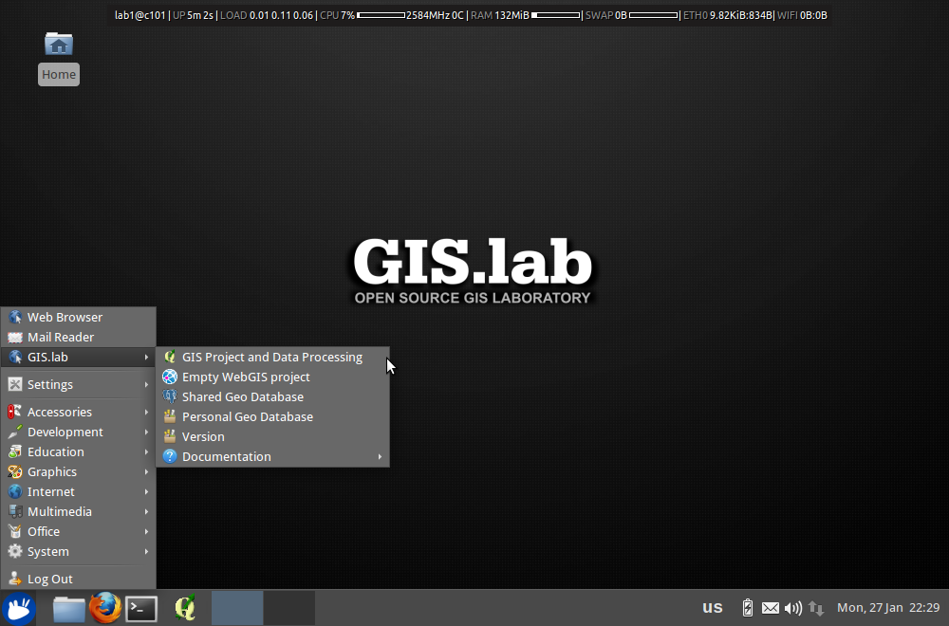
0. GIS.lab client desktop

Slide 22
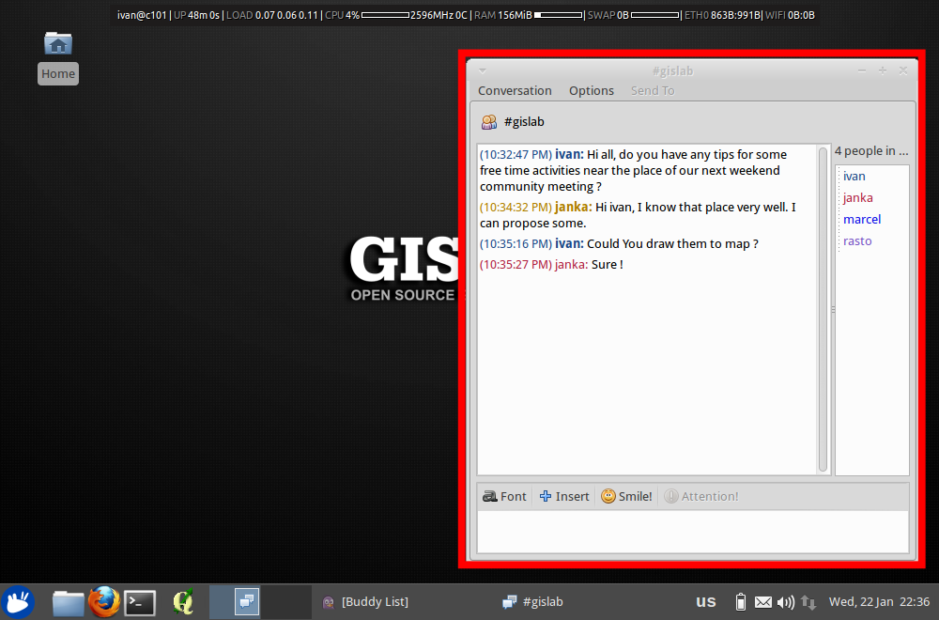
1. Ivan: Ask people to propose some tips of interesting places and activities near the place of our meeting using built-in chat.

Slide 23
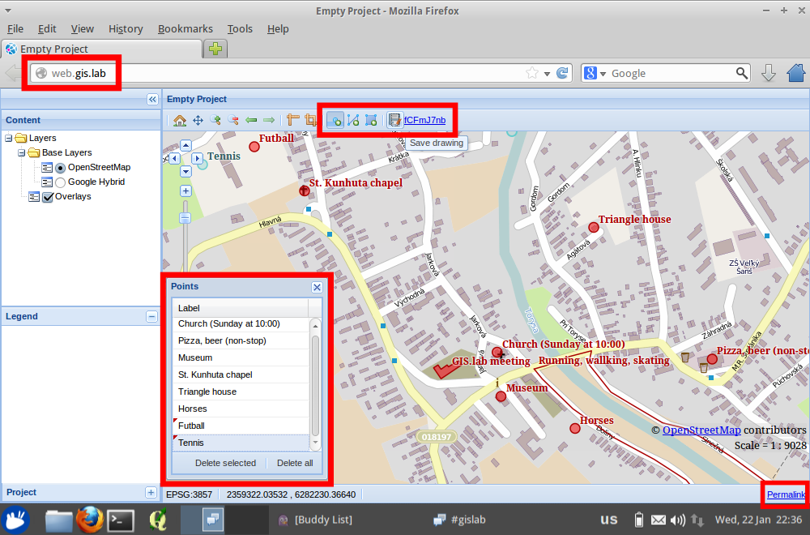
2. Janka: Draw map of proposals using WebGIS vector drawing tools.

Slide 24
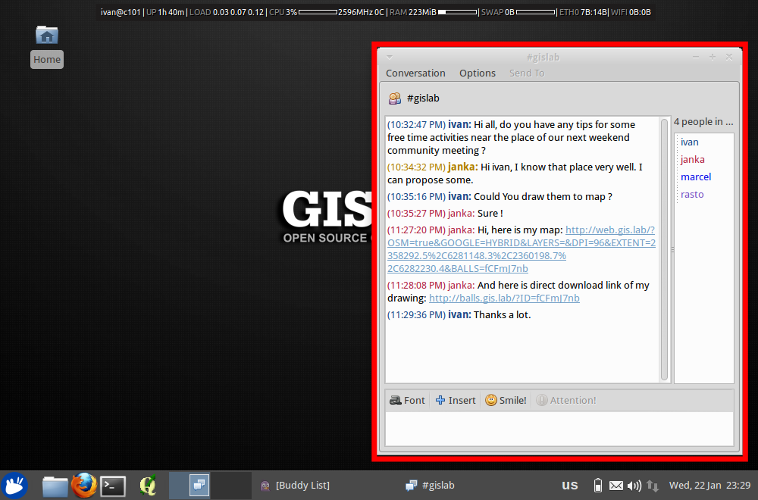
3. Janka: Publish map of proposals and direct link to download drawn data using chat.

Slide 25
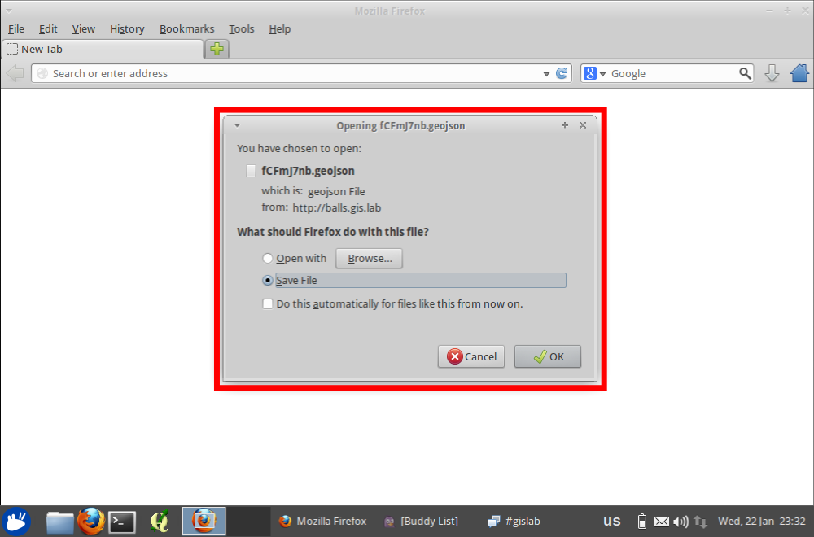
4. Ivan: Download data drawn by Janka.

Slide 26
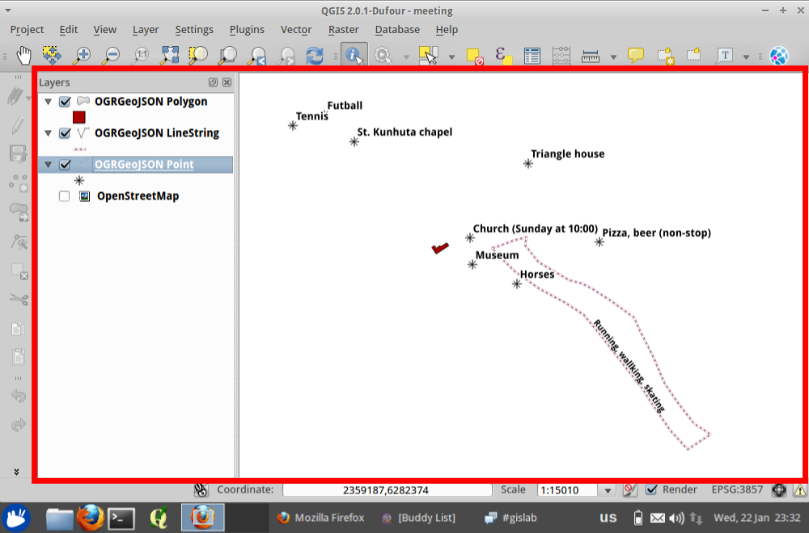
5. Ivan: Load data in new QGIS project.

Slide 27
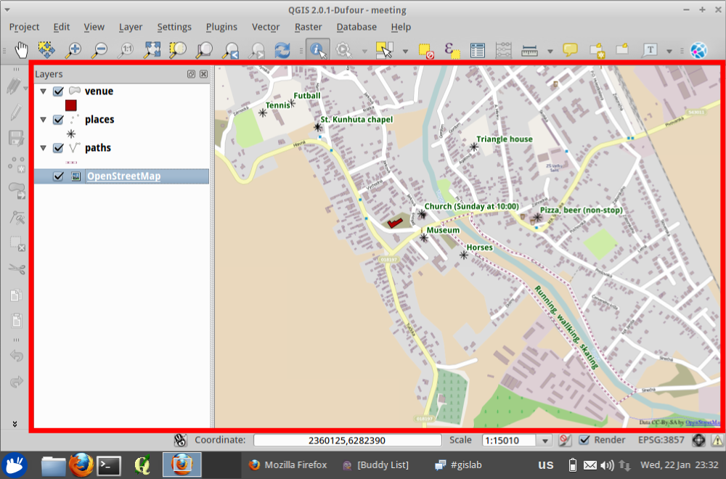
6. Ivan: Create map project from loaded data.

Slide 28
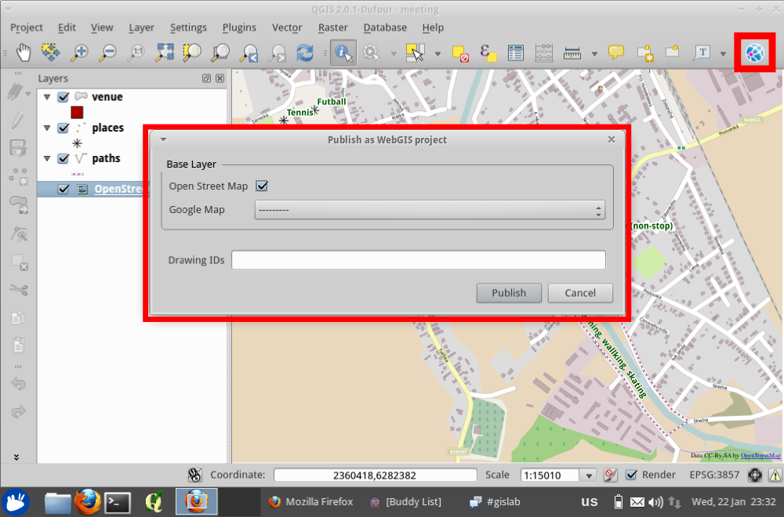
7. Ivan: Publish final map as WebGIS project.

Slide 29
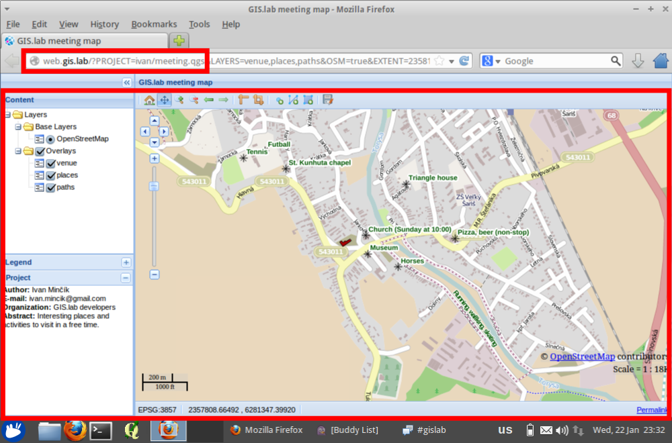
8. Ivan: Final map.

Slide 30


Development state: in active development
Authors: Ivan Minčík, Marcel Dancák
Sponsor: GISTA s.r.o. www.gista.sk
Partner: University of Prešov in Prešov, www.unipo.sk
Credits: developers of Linux, Debian, Ubuntu, Xubuntu, VirtualBox,
Vagrant, LTSP, PostgreSQL, PostGIS, PgAdmin, SpatiaLite,
QGIS, GRASS GIS and tons of other Open Source software
Home page: http://imincik.github.io/gis-lab
License of this presentation: CC BY-SA

Slide 31
GIS.lab
Technologies

Slide 32
GIS.lab
Server technologies
Host machine requirements
Operating System - Linux or Windows or Mac OS X
Virtualization software - VirtualBox or VMWare or LXC containers
Provisioning software - Vagrant
Software and Services
Boot from LAN tool chain - TFTP, DHCP, LTSP
DNS - BIND
File sharing - NFS
Database - PostgreSQL/Postgis
Mapping server and web GIS - Apache, QGIS Mapserver,
GIS.lab WebGIS
Chatting server - IRC

Slide 33
GIS.lab
Client technologies
Host machine requirements
Nothing
or
Operating System Linux or Windows or Mac OS X
Software and Services
Office suite - LibreOffice, Firefox, Thunderbird, Pidgin, GIMP, VLC ...
GIS software - QGIS, GRASS, Spatialite, PgAdmin
Developer tools - Git, QtCreator, Python, GIS libraries

Slide 34


