Slide 2
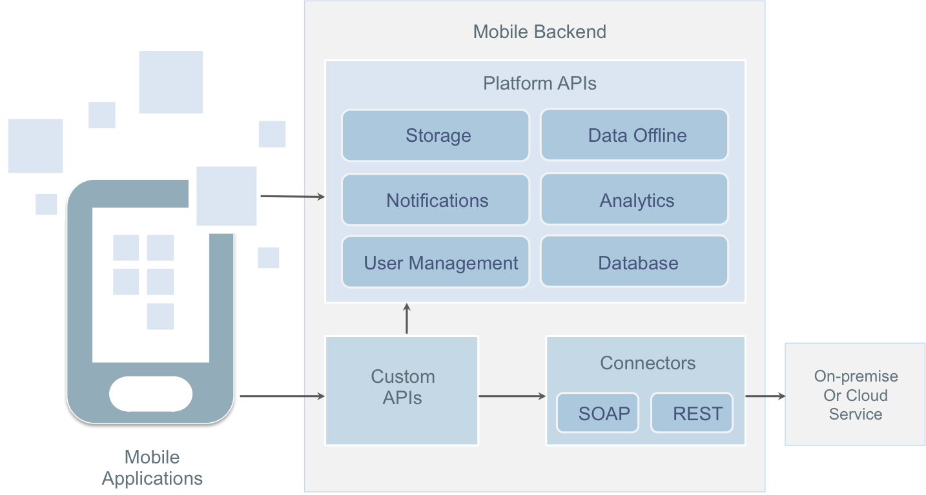
Oracle Mobile Cloud Service API

Slide 3
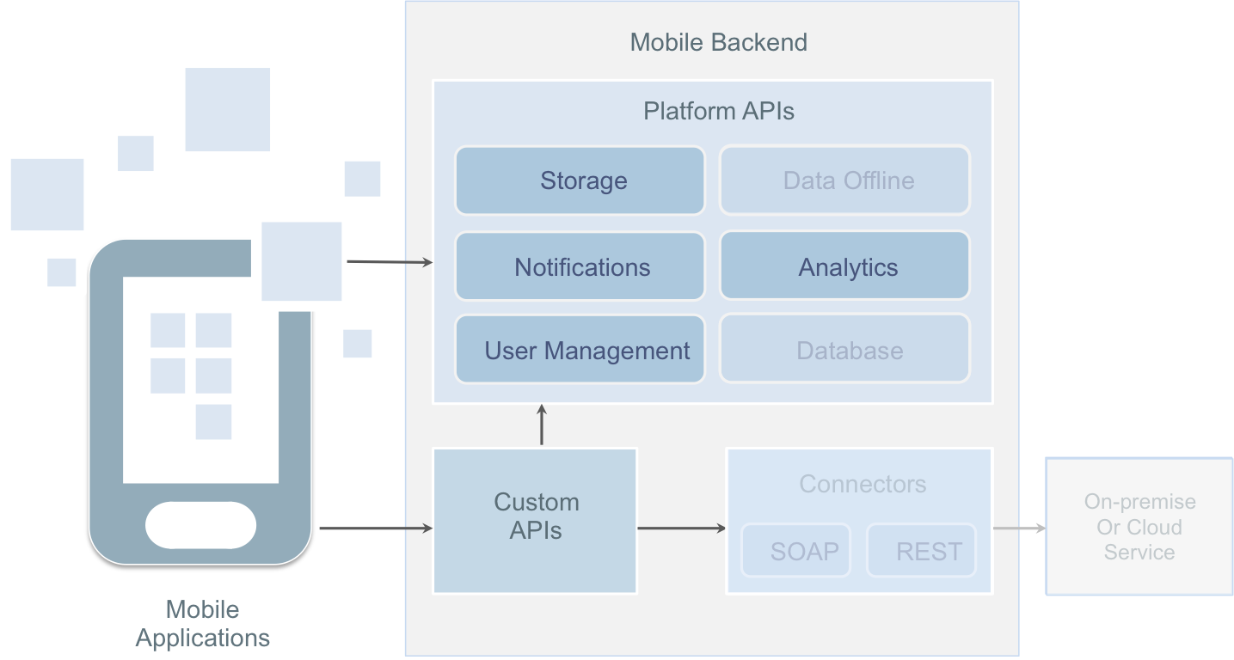
MAF MCS Utility Support

Slide 4
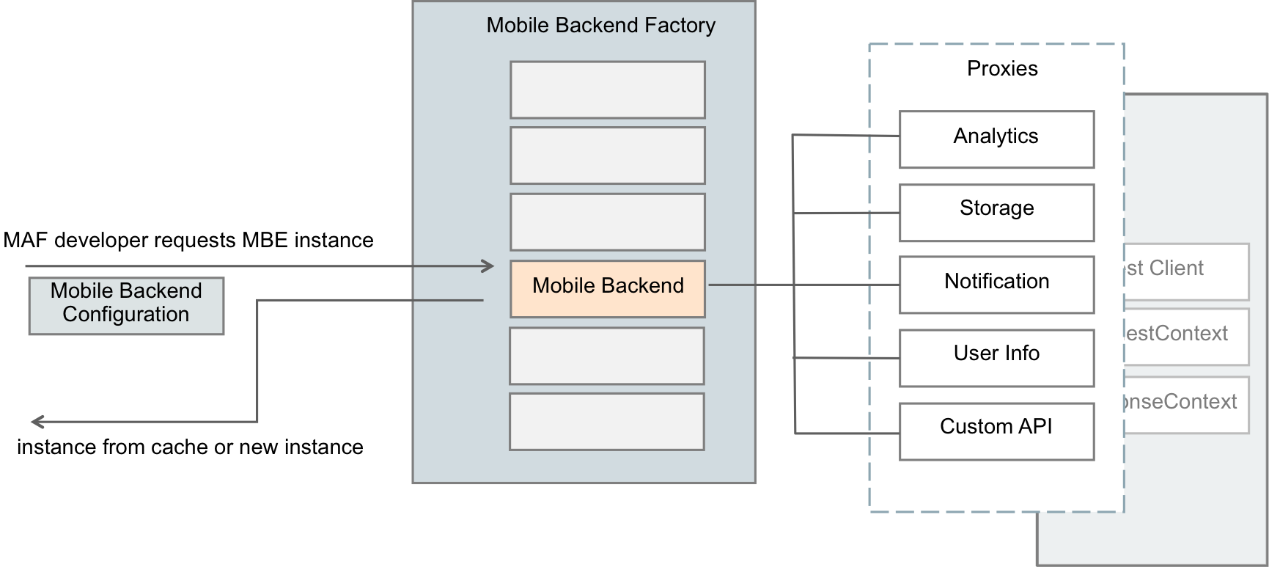
MAF MCS Utility Architecture

Slide 5
More Resources
Mobile Application Framework
http://www.oracle.com/technetwork/developer-tools/maf/overview/index.html
Datasheet
Tutorial
Demos
Discussion
Oracle MAF Blog – https://blogs.oracle.com/mobile/
Twitter.com/JDeveloper
Facebook.com/JDeveloper

