Slide 1
新制度经济学在西方经济史 学科中的应用
中南财经政法大学文澜学院
杨荷

Slide 2
讲座大纲 Roadmap
什么是制度分析？
制度分析如何嵌入经济史的研究传统？
制度分析在西方经济史当中的几个经典课题
制度分析在美国经济史学科当中的代表人物和代表作
五个典型的分析框架
案例分析
小结

Slide 3
什么是制度分析? (institutional analysis)
制度：人类经济活动和社会交往的规则和约束（the rules of the game）
制度分析包括： 个人和群体如何建构制度？具体某种制度如何操作实践？不同制度之间的彼此关联如何？制度对于个人行为，群体行为和社区的影响如何？
制度分析的方法在整个社会科学当中都有一定影响力。
擅长中等层次的论证以及微观层面的。

Slide 4
制度分析如何嵌入经济史研究传统？
“That institutions affect the performance of economies is hardly controversial. That the differential performance of economies over time is fundamentally influenced by the way institutions evolve is also not controversial. Yet neither current economic theory nor cliometric history shows many signs of appreciating the role of institutions in economic performance because there as yet has been no analytical framework to integrate institutional analysis into economics and economic history. The objective of this book is to provide such an underlying framework.”
—— Douglas North （1990）

Slide 5
制度分析在西方经济史的经典课题
农业史：敞田制(the open field system)，奴隶制 (slavery)
工业史：包买商制（the putting-out system）, 工厂制(the factory system)
商业史：行会制度 (the guild system)，学徒制（apprenticeship）

Slide 6
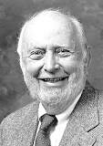
经济史领域的新制度经济学 NIE in Economic History
创始人 Douglass North
制度变迁理论，国家理论等
代表作：
- Institutions and economic growth: An historical introduction
-《西方世界的兴起》

Slide 7

制度分析在农业史的成就
Deirdre McCloskey
http://www.deirdremccloskey.com/
讲风险等经济学概念开创性地运用到农业史
代表作：
The Prudent and Faithful Peasant

Slide 8

制度分析在商业史中的深化
Naomi Lameraux
将交易成本，协调成本等概念应用于市场组织，公司组织，企业组织，产业组织。
“Beyond Markets and Hierarchies: Toward a New Synthesis of American Business History”

Slide 9

制度分析与经济学理论模型的结合
Avner Greif
侧重于利用严格的经济理论模型分析历史案例，探讨政治制度，制度演化，社会规范和非正式制度与经济增长
Family Structure, Institutions, and Growth. American Economic Review. 2006
With Lynne Kiesling and John Nye (eds). Institutions, Innovation, and Industrialization: Essays in Economic History and Development. 2015

Slide 10
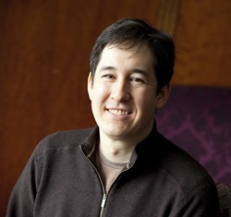
制度分析与发展经济学结合
Nathan Nunn
将经济史与发展经济学结合起来，擅长探讨文化制度和技术，战争等因素对长期经济增长表现的影响。
Historical Development. In: Aghion P, Durlauf S. Handbook of Economic Growth.

Slide 11
五个典型分析框架
I. 诺思的分析框架
The Northian Framework: Institutional Arrangements+ Institutional Change+ Price Theory （North and Thomas, ）
II. 麦克劳斯基的分析框架
McCloskey’ Framework and the persistence of institutions
III. 钱德勒分析框架
The Chandelarian Framework (经Naomi Lamereaux修改)
IV. 分析性叙事框架
Analytic Narratives: integrate institutional analysis with more traditional theory (见Avner Grief等的著作)
V. 历史发展经济学框架
Historical development (见Nathan Nunn等的著作)

Slide 12
麦克劳斯基的分析框架
从史料出发，挖掘出制度的特征，分析制度安排的效率问题。
Summarizing institutional characteristics and efficiency based on original materials
从制度经济学或法律经济学的理论出发，找到反常识的特征事实
Interpret the facts that give insights against conventional wisdom
用经济学的建模方法进行机制分析并用实证的方法进行检验。
Economic modeling and empirical test

Slide 13
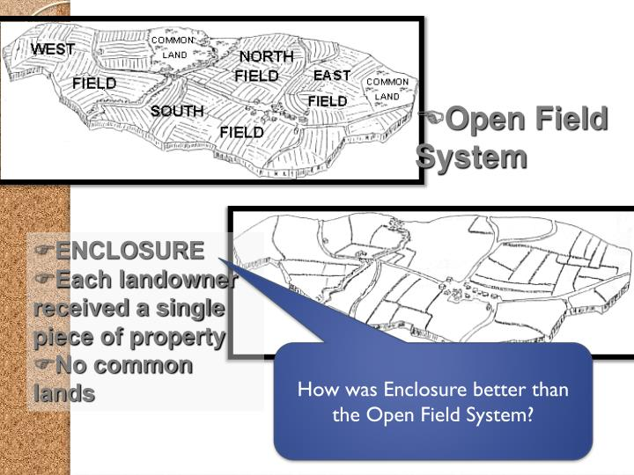
敞田制—> 圈地 （open-field system->enclosure）

Slide 14
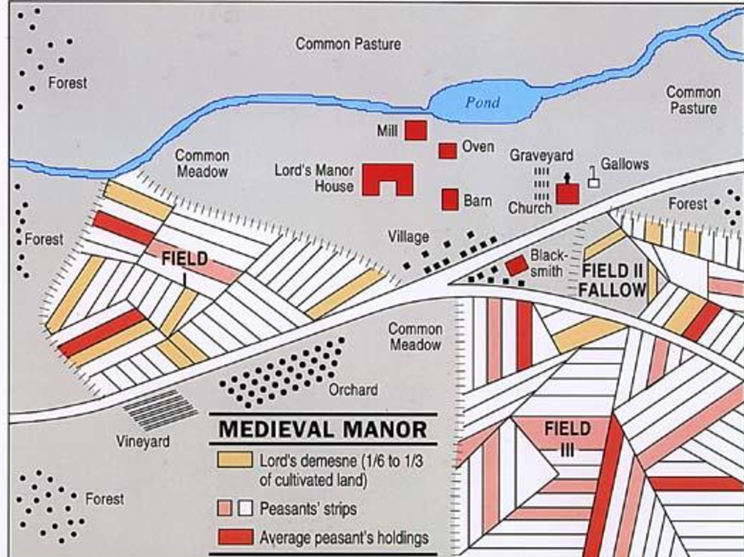
英国的敞田制 (the British Open-field System)

Slide 15
敞田制的历史背景 Historical background of the system
从中世纪欧洲开始一直到20世纪的某些地区
The open-field system was the prevalent agricultural system in much of Europe during the Middle Ages and lasted into the 20th century in parts of western Europe, Russia, and Iran.

Slide 16
敞田制的地权结构 Structure of Property Right
三块大田的轮作
In the mature open-field system, villagers raised grain in a system of three-course crop rotation on fields of several hundred acres each.
农民的共同放牧
At the same time, the villagers raised animals, which grazed not only on common land but also on whichever fields lay fallow as part of the crop rotation.
田地被分割为细长的小条状。
Arable land belonging to a manor was divided into many long narrow furlongs for cultivation.
农民的地不是一整块，而是呈长条状分散分布于各区域。
The peasant’s holdings in any field were not a single continuous plot but took the form of narrow strips scattered all over the fields.

Slide 17
关于敞田制历史起源的假说 (1) hypotheses about the origin of the Open-field System
平等主义
A Spirit of Eqalitarianism
“And whence, we must ask, comes that system of intermixed ‘strip-holding’ that we find in our English fields? Who laid out those fields? The obvious answer is that they were laid out by men who would sacrifice economy and efficiency at the shrine of equality”. （Maitland）

Slide 18
关于敞田制历史起源的假说 (2) hypotheses about the origin of the Open-field System
可分割的继承制
The operation of inheritance laws
（partible inheritance）
When land was continually subdivided in estates, it could end up in the form of small scattered holding (Thirsk 1964).

Slide 19
敞田制下制度安排的效率问题 Inefficiencies of the system
与圈地后相比，敞田制的效率损失为13%左右
McCloskey: “ I have elsewhere used the typical increase in the rent of land after enclosure to estimate that the proportion of a village’s output loss in the seventeenth and eighteenth centuries was on the order of 13 percent……. Yet why would a malnourished peasant throw away a tenth of his output?”
(反常识)

Slide 20
敞田制的经济解释 Economic Interpretation of the System
农民风险规避，分散持有条形地分散风险
Plots were scattered to insure against disaster,that is to say, risk aversion. (Don’t put all your eggs in one basket.)
英国农地的产出波动性
Within a single English village there was enough variability in the yield of land in different locations and under different crops to make it desirable to hold a diversified portfolio of plots.
英国气候的不确定性
The land and weather of England is notoriously variable, even over the two miles square of the typical village.

Slide 21
麦客劳斯基的框架的使用
地权结构的特征
Characteristics of the two systems
地权结构的起源
Origins and persistence of the two systems
地权结构下制度安排的效率问题
Inefficiencies of the two systems
地权结构制的经济解释
Economic interpretation of the two systems
实证研究
Empirical studies

Slide 22
两种分割地权结构的特征 Characteristics of the two systems
一田二主制度
The Dual Owner System
敞田制
The Open Field System
田地被分割为细长的小条状。
Arable land belonging to a manor was divided into many long narrow furlongs for cultivation.
农民的地不是一整块，而是呈长条状分散分布于各区域。
The peasant’s holdings in any field were not a single continuous plot but took the form of narrow strips scattered all over the fields.
一田二主制度将土地所有权划分为田面权和田底权
Dual landownership divided property right to land into topsoil right and subsoil right.
田底权一般由税负较低的士绅持有，田面权一般由税负较重的农户持有。
Subsoil tended be owned by lightly taxed gentry households who took the responsibility of paying the land tax. Topsoil tended to be owned by heavily-taxed peasant households who managed day-to-day farming.

Slide 23
两种分割地权结构的起源假说 Origins of the two systems
敞田制
The Open Field System
一田二主制度
The Dual Owner System
初始分配土地的平均主义考虑
A Spirit of Eqalitarianism (Homans 1941)
多子均分继承制度下的土地细碎分散化
The operation of inheritance laws (Thirsk 1964)
耕犁的解释
The plough argument
无主荒地上初始划分
the initial partition of property rights over uncultivated land
贫困压力下农民典卖田底
the financial stress hypothesis
押租- 欠租- 丧失田底
the rent default hypothesis

Slide 24
两种分割地权结构下制度安排的效率 Inefficiencies of the two systems
敞田制
The Open Field System
一田二主制度
The Dual Owner System
分散的所有权结构，在今天看来，是非常没有经济效率的。
“...its peculiarity of straggling or scattered ownership, regarded from a modern agricultural point of view, was absurdly uneconomical. ” （Seebohm 1905）
一个村庄损失的效率大概为产出的13%
A village’s output loss in the seventeenth and eighteenth centuries was on the order of 13 percent. （McCloskey 1983)
一田二主制导致了传统农业的衰落
Dual Ownership caused the relative decline of Chinese agriculture. (Brenner and Isett 2002, Macauley 2009)
传统的复杂地权制度对于农业投资起到阻碍作用。
Customary land tenure systems are obstacles to agricultural investment. (Besley 1995, Yoo and Steckel 2010)

Slide 25
两种分割地权结构分布的时间和区域 The persistence and distribution of the two systems
一田二主制度
The Dual Owner System
敞田制
The Open Field System
16世纪到20世纪初期中国比较流行的一种田制
a key feature of the Chinese land market from the late 16th century to the early 20th century.
分布于全国，在经济发达的区域尤其盛行（长三角和珠三角）
The dual owner system spread all over the country and was especially popular in the advanced areas, including the Yangzi delta and the Pearl River Delta.
中世纪一直到20世纪西欧，俄国和伊朗等区域
prevalent agricultural system in much of Europe during the Middle Ages and lasted into the 20th century in parts of western Europe, Russia, and Iran.

Slide 26
没有效率的制度安排为何得到持续？ Why did inefficient institutions persist?
制度的长期持续，理解产权结构的均衡状态比初始分割时的状态更加重要（科斯定理）。
Regardless of the initial assignment of property rights, as long as TC is low and negotiation is allowed, property rights will be allocated in an efficient way.
“如果不将初始产权分配与它的延续结合起来考虑，研究敞田制的起源问题只是一种好古癖。” (麦克劳斯基）
McCloskey: “… studying the origin of open fields or of anything else is antiquarianism unless it is accompanied by evidence connecting the origin with persistence.”

Slide 27
两种分割地权结构的经济解释 Economic interpretation of the two systems
敞田制
The Open Field System
一田二主制度
The Dual Owner System
分散的地权结构是为了降低农业生产中的风险。
Plots were scattered to insure against disaster,that is to say, risk aversion.
损失的经济效率相当于为了降低农业风险的保险金。
The inefficiencies of the open fields were payments on an insurance premium in a milieu in which agricultural yields were low and unpredictable and in which the costs of a shortfall were high.
一田二主制是税负较重的农民和税负较轻的士绅为了最大化土地收益而进行的契约安排。
Dual ownership acted as a tax shelter for heavily taxed peasants who colluded with lightly taxed gentry to maximize the value of land.

Slide 28
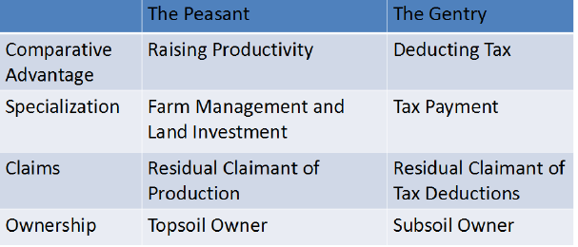
制度机制 The Mechanism

Slide 29
两个推论 Two Propositions
农民在农地经营方面的比较优势越大，土地所有权越可能分割为田底权和田面权。
Landownership should be increasingly divided into topsoil and subsoil as peasants’ comparative advantage in farm management increases.
士绅地主在税收减免方面的比较优势越大，土地所有权越有可能分割为田底权和田面权。
Landownership should be increasingly divided into topsoil and subsoil as the gentry’s comparative advantage in tax deduction increases.

Slide 30
实证研究:利用孔府的地权数据 Empirical Test: Dual Landownership on Confucius's Manors
麦豆轮种制度对于一田二主制度的影响
The Impact of Double Cropping on Dual Ownership (Proposition 1)
税收变革（摊丁入亩）对于一田二主制度的影响
The Impact of Tax Reforms on Dual Ownership (Proposition 2)

Slide 31
数据 Data
主要来源：已出版的孔府档案汇编
Main source: Extensive archives of The Mansion of Confucius
- 土地交易记录 Land Transaction Records
来自11 个庄园租簿的田块层次的数据（1759-1901）
Plot-level data (1759-1901) from the rent collection archives, pooled cross sectional data from 11 manors (Over a thousand obs. )

Slide 32
回归分析 Estimation
Probit model
Dependent variable: Dual Ownership
Independent variables
- Doublecropping
- TaxReduction
Control Variables
IV: Wheat Price
- Wheat price was a determinant of double cropping.
- Wheat price was not a determinant of ownership.

Slide 33
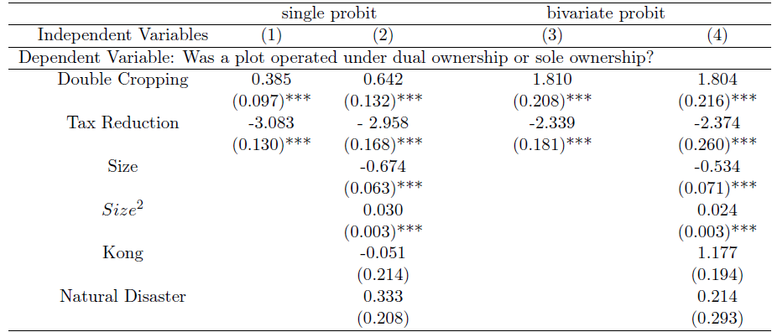
Bivariate Probit Estimation Results

Slide 34
小结
经济史当中的制度分析多采用新制度经济学的研究概念和分析范式分析
可以尝试用制度分析的范式分析中国制度史中的问题（晋商研究，企业史研究当中已取得很多成果）
通过提炼中国制度史当中的分析方法，丰富制度分析的范式。

