Slide 1

实用数据库开发 (9)
数据湖三剑客与Pixels数据读取
中国人民大学信息学院
教师：卞昊穹
助教：王浩哲，耿东杨，尹佳
2024-11-12

Slide 2
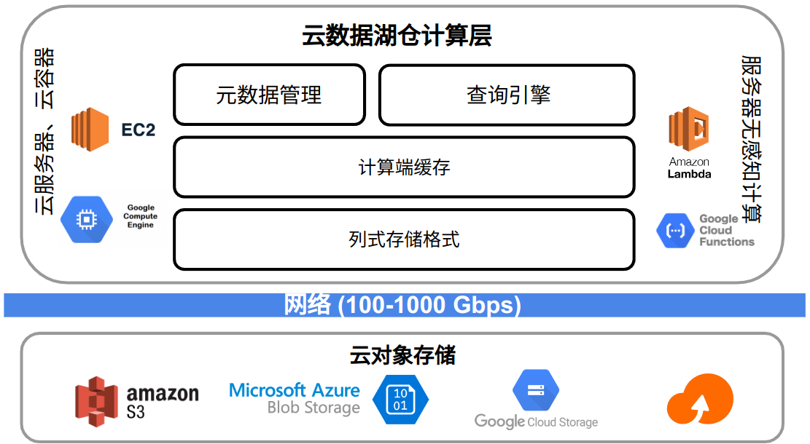
数据湖架构

Slide 3
数据湖Table Storage
在open file format基础之上，进一步提供相对完整的数据管理功能
Catalog， schema evolution，data ingestion，data update…
数据湖逐渐回归数据仓库

Slide 4






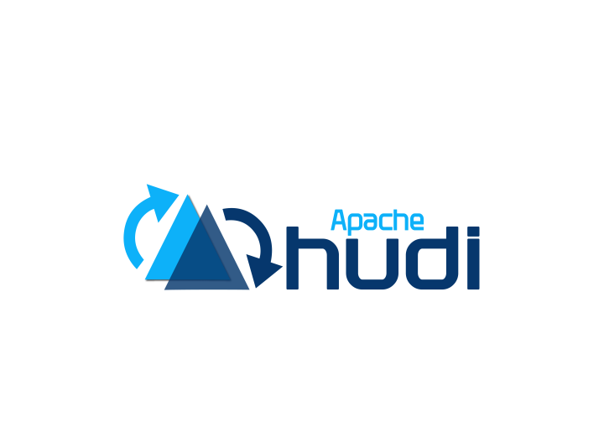




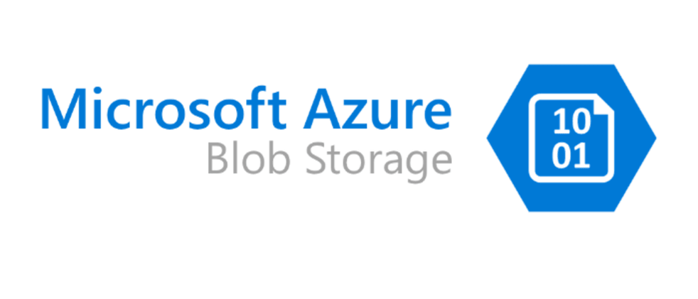
Table Storage
Table storage is very similar to the table space in DBMSs.
Query Engine
Table Storage
File Storage
All table metadata, including schema, catalog, cache, and index, are maintained in table storage.

Slide 5
Performant and Mutable Table Storage
底层存储只能提供单个文件或Object上的一致性保证
但一个Table往往会包含多个文件或Object
例如：一个查询从所有文件中删除某个用户的订单记录，其他查询可能会看到不一致的状态
metadata访问也有一致性和性能问题
人们越来越怀念Data Warehouse

Slide 6


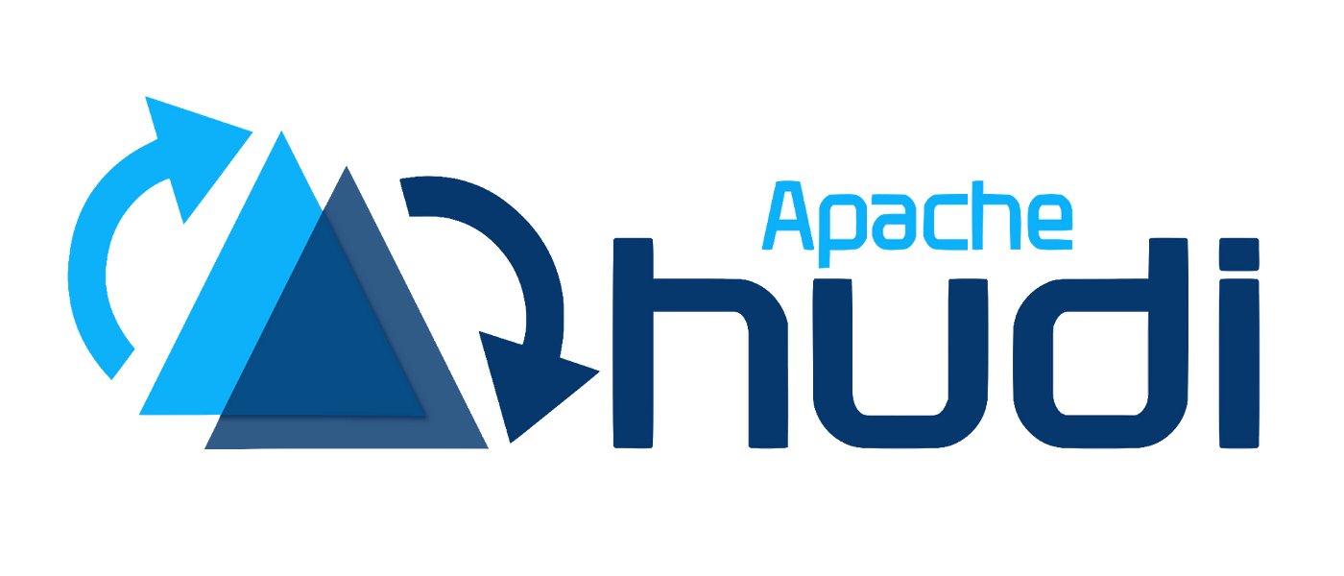
数据湖三剑客

Slide 7

Table Storage简史
When industry people say ‘data lake’, they are very likely talking about the ‘table storage’.
2019,
Databricks partially opensourced a Delta Lake to compete with Iceberg and Hudi.
2020,
Databricks proposed lakehouse concept to compete with Snowflake.
2022,
Databricks fully opensourced Delta Lake to compete with Iceberg and Hudi.
2017, Databricks launched Delta Lake to replace the lambda architecture.
2017-2018,
Netflix opensourced Iceberg;
Uber opensourced Hudi.
They support more queries engines.
2020-now,
Everyone is talking about ‘lakehouse’, but most people went to build their own lakehouse on Iceberg or Huidi.
Record update is one of the most important feature for a table storage.

Slide 8
Delta Lake
VLDB’ 20, Delta Lake: High-Performance ACID Table Storage over Cloud Object Stores
Object Storage Service (S3) 逐渐成为海量数据存储和大数据分析的事实标准
S3上采用ORC等列存储格式进行数据存储，但这只能解决基本都数据读写问题

Slide 9
Delta Lake
Maintain information about which objects are part of a Delta table in an ACID manner, using a write-ahead log that is itself stored in the cloud object store.
Delta Lake中的log记录了对object（文件）的修改操作，也记录了一些文件中的统计信息
Log本身也写入object sotrage，先存成json格式，定期合并成parquet格式

Slide 10
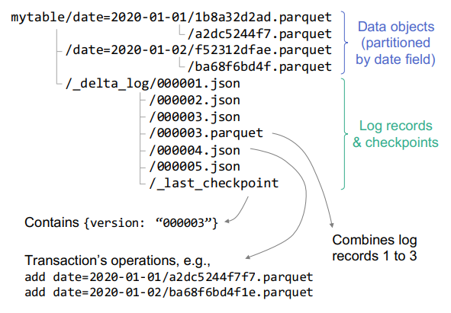
Delta Lake

Slide 11
Delta Lake中的Update实现
INSERT INTO t1 SELECT * FROM t2
table data
metadata
new data records
json log
new data records
json log
…
…
new data records
json log
Queries first read the metadata file to find the data files.
compact
compact
Parquet data file
Parquet log file + checkpoint
这其实是一种mini-batch update

Slide 12
支持的操作
Delta Lake通过WAL可以支持文件级别的可串行化事务
因此，可以实现：
对多个objects的ACID操作，如upsert, delete, merge
用户可以更小的粒度的CDC或streaming ingestion
后台可以优化数据的数据布局(data layout)，而对client没有正确性的影响
Schema evolution
time travel

Slide 13
Iceberg中的Update实现
INSERT INTO t1 SELECT * FROM t2
table data
metadata
delete file
data file
manifest file
metadata file +
manifest list
data file
…
delete file
…
Queries first read the metadata file to find the data files.
Delete marks are stored in separate files.
data file
manifest file
compact
data file

Slide 14
Hudi中的Update实现
Supports index on tables (could be stored in Hbase).
INSERT INTO t1 SELECT * FROM t2
base data file
append log
Partition 1
compact
New data is contained in the append log.
base data file
append log
…
…
base data file
append log
Partition 2
Single point update的性能会更好

Slide 15
总结
支持对数据表中数据和元数据的修改是主要的目标
目前主要支持mini-batch方式的修改，而不是单条数据的修改
借鉴了传统数据库中的WAL技术，但不完全一样

Slide 16
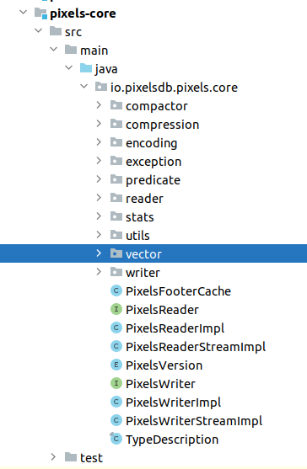
PixelsReader
PixelsReader中定义了读取Pixels文件的基本接口
PixelsReaderImpl是PixelsReader的一个实现

Slide 17
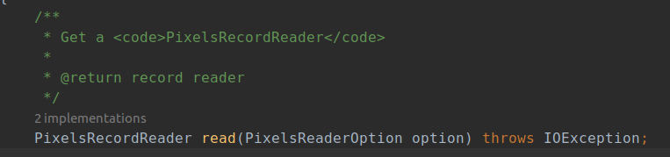
PixelsReader
PixelsReader中关键的方法是read，该方法创建一个PixelsRecordReader的实例

Slide 18
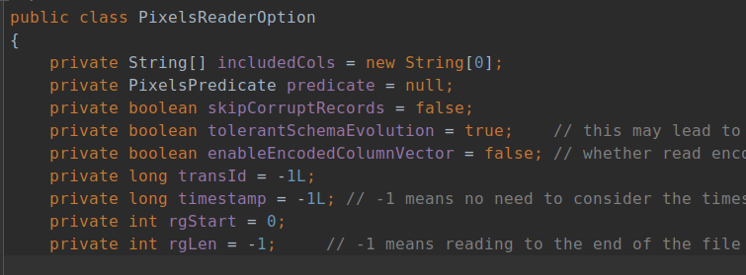
PixelsReaderOption
PixelsReaderOption作为read方法的参数，保存了打开Pixels文件的一些必要参数，如文件路径、要读取的row group、要读取的列、过滤条件等

Slide 19
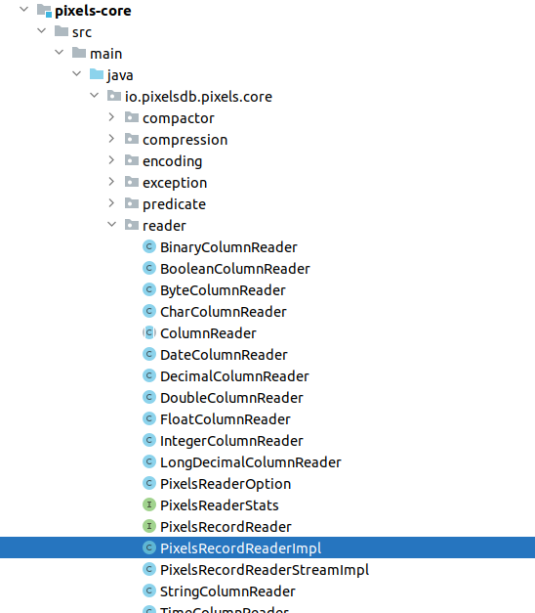
PixelsRecordReader
定义和实现了对Pixels文件的具体读取方式

Slide 20
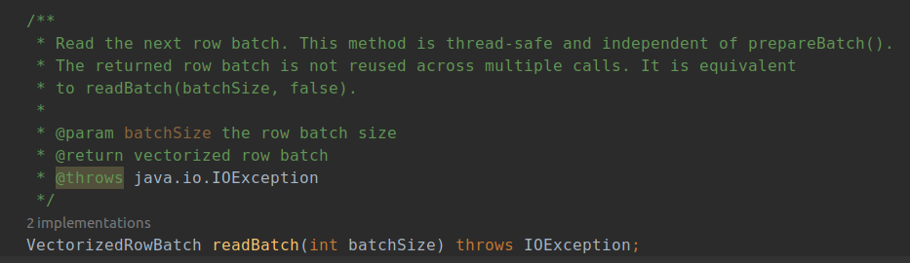
PixelsRecordReader
其中最重要的方法是readBatch

