Slide 1
程序的机器级表示（6）
柴云鹏
2024.11

Slide 2
Buffer Overflow

Slide 3
Out-of-Bounds Memory References
1 /* Implementation of library function gets() */
2 char *gets(char *s)
3 {
4 int c;
5 char *dest = s;
6 int got_char = 0 ; /Has at least one character been read? */
7 while ((c = getchar()) != ’\n’ && c != EOF) {
8 *dest++ = c; /* No bounds checking */
9 gotchar = 1;
10 }
11 *dest++ = ’\0’; /* Terminate String */
12 if (c == EOF && !gotchar)
13 return NULL; /* End of file or error */
14 return s;
15 }

Slide 4
Out-of-Bounds Memory References
14 /* Read input line and write it back */
15 void echo()
16 {
17 char buf[8]; /* Way too small ! */
18 gets(buf);
19 puts(buf);
20 }

Slide 5
Out-of-Bounds Memory References
Return address
Saved %ebp
Saved %ebx
[7] | [6] | [5] | [4]
[3] | [2] | [1] | [0]
Stack frame
for caller
%ebp
Stack frame
for echo
buf

Slide 6
Out-of-Bounds Memory References
Return address
Saved %ebp
[11] | [10] | [9] | [8]
[7] | [6] | [5] | [4]
[3] | [2] | [1] | [0]
Stack frame
for caller
%ebp
Stack frame
for echo
buf

Slide 7
Out-of-Bounds Memory References
Return address
[15] | [14] | [13] | [12]
[11] | [10] | [9] | [8]
[7] | [6] | [5] | [4]
[3] | [2] | [1] | [0]
Stack frame
for caller
%ebp
Stack frame
for echo
buf

Slide 8
Out-of-Bounds Memory References
[19] | [18] | [17] | [16]
[15] | [14] | [13] | [12]
[11] | [10] | [9] | [8]
[7] | [6] | [5] | [4]
[3] | [2] | [1] | [0]
Stack frame
for caller
%ebp
Stack frame
for echo
buf

Slide 9
Malicious Use of Buffer Overflow
Stack
after call to gets()
void foo(){
bar();
...
}
return
address
A
foo stack frame
void bar() {
char buf[64];
gets(buf);
...
}
B
data
written
by
gets()
pad
exploit
code
bar stack frame
B

Slide 10
The Famous Internet Worm of November 1988
To gain access to many of the computers across the Internet
  4 different ways
  One was a buffer overflow attack on the fingerd
Hundreds of machines were effectively paralyzed
The author of the worm was caught and prosecuted. He was sentenced to
  3 years probation
  400 hours of community service
  and a $10,500 fine

Slide 11

Morris Worm
Robert Tappan Morris
  born November 8, 1965
他的父亲罗伯特·莫里斯（Robert Morris）为贝尔实验室计算机安全专家
他16岁上初中时，发现UNIX系统漏洞
1983年考入哈佛大学，拿到了文学学士（A.B.）学位
1988年成为康奈尔大学研究生
1988年散布了“莫里斯蠕虫”，造成约6000个系统瘫痪，给这些用户总共带来约200万到6000万美元的损失。
现为麻省理工学院教授 (2006 tenure, 2015 ACM Fellow)
MIT 6.824 Distributed Systems
https://www.bilibili.com/video/BV1qk4y197bB?from=search&seid=7720468517381990376

Slide 12
Stack Randomization
1 int main() {
2 int local;
3 printf("local at %p\n", &local);
4 return 0;
5 }
Running the code 10,000 times on a Linux (maybe 2.6.16) machine in 32-bit mode
the addresses ranged from
  0xff7fa7e0 to 0xffffd7e0
  A range of around 2²³
无法确定目标代码的绝对地址

Slide 13
Stack Randomization
Running in 64-bit mode on the newer machine
The addresses ranged from
  0x7fff00241914 to 0x7ffffff98664
  A range of nearly 2³²
Address-space layout randomization (ASLR)
  each time a program is run
  different parts of the program are loaded into different regions of memory
    code, data, heap data, library code, stack

Slide 14
Stack Randomization
Nop sled
  a program “slides” through a long sequence of “nop”
Nop
  no operation instruction
Include a “nop sled” before the actual exploit code
  If insert 256-byte nop sled
  Need to guess 2¹⁵ starting addresses (no too much) for 32-bit machine （23-8=15）
  Still have too many 2²⁴ for 64-bit machine

Slide 15
Stack Corruption Detection（栈破坏检测）
Return address
Saved %ebp
Saved %ebx
Canary（金丝雀）
[7] | [6] | [5] | [4]
[3] | [2] | [1] | [0]
Stack frame
for caller
%ebp
Stack frame
for echo
buf

Slide 16
Stack Corruption Detection
1 echo:
2 pushl %ebp
3 movl %esp, %ebp
4 pushl %ebx
5 subl $20, %esp
6 movl %gs:20, %eax Retrieve canary
7 movl %eax, -8(%ebp) Store on stack
8 xorl %eax, %eax Zero out register
9 leal -16(%ebp), %ebx Compute buf as %ebp-16
10 movl %ebx, (%esp) Store buf at top of stack
11 call gets Call gets
12 movl %ebx, (%esp) Store buf at top of stack
13 call puts Call puts

Slide 17
Stack Corruption Detection
14 movl -8(%ebp), %eax Retrieve canary
15 xorl %gs:20, %eax Compare to stored value
16 je .L19 If =, goto ok
17 call __stack_chk_fail Stack corrupted!
18 .L19: ok:
19 addl $20, %esp Normal return ...
20 popl %ebx
21 popl %ebp
22 ret
%gs:20
  Segmented addressing which appeared in 80286 and seldom used today
  It is marked as read only

Slide 18
Limiting Executable Code Regions
Page
  4k bytes
  As a protected unit by OS
  Should be marked as “readable”, “writable” and “executable”
    3 bits are required
Originally Intel merged the “readable” and “executable” into one
  The exploit code in the stack can be executed
AMD introduced “NX” in X86-64
  Now there 3 bits

Slide 19
Code Reuse Attack
Return-oriented Programming
  Find code gadgets in existed code base (e.g. libc)
  Push address of gadgets on the stack
  Leverage ‘ret’ to connect code gadgets
  No code injection
Solutions
  Return-less kernels
  Heuristic means
Address C
Address B
Address A
return addr
0101011010
saved ebp
A
0101011010
B
0101011010
C
0101011010

Slide 20
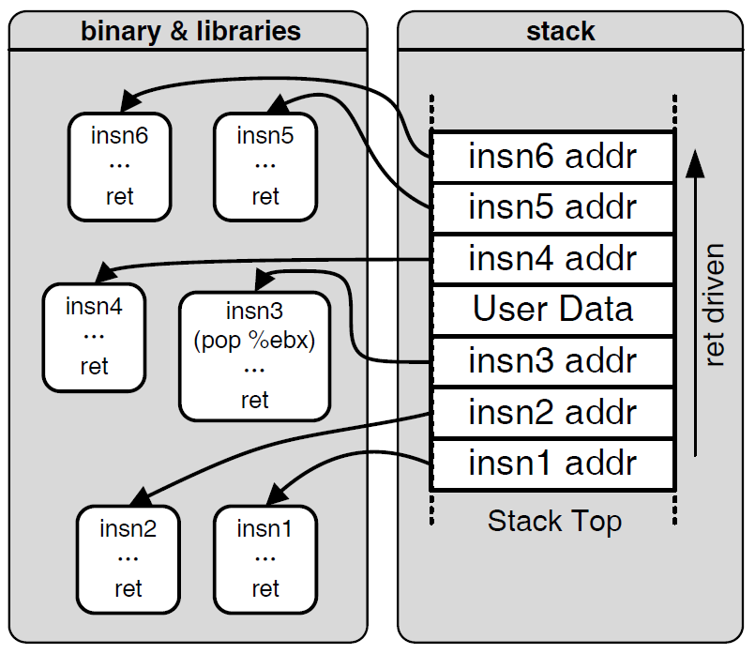

Motivation: Code Reuse Attack

Slide 21
Heterogeneous Data Structures & Alignment

Slide 22
Outline
Struct
Union
Alignment

Slide 23
Structures
Group objects into a single object
struct rect {
int llx; /* X coordinate of lower-left corner */
int lly; /* Y coordinate of lower-left corner */
int color; /* Coding of color */
int width; /* Width (in pixels) */
int height; /* Height (in pixels) */
};

Slide 24
Structure
Each object is referenced by name
struct rect r;
r.llx = r.lly = 0;
r.color = 0xFF00FF;
r.width = 10;
r.height = 20;

Slide 25
Structure
int area (struct rect *rp)
{
return (*rp).width * (*rp).height;
}
void rotate_left (struct rect *rp)
{
/* Exchange width and height */
int t = rp->height;
rp->height = rp->width;
rp->width = t;
}

Slide 26
Structures
Memory layout
  All the components are stored in a contiguous region of memory
  A pointer to a structure is the address of its first byte （最低/最小地址）

Slide 27
Structure
struct rec {
int i;
int j;
int a[3];
int *p;
} *r;
Offset
0
4
8
20
Contents
i
j
a[0]
a[1]
a[2]
p

Slide 28
Structure
References to structure elements
  Using offsets as displacements
r->j = r->i (Copy element r->i to element r->j)
r is in register %edx.
1 movl (%edx), %eax Get r->i
2 movl %eax, 4(%edx) Store in r->j
Offset
0
4
8
20
Contents
i
j
a[0]
a[1]
a[2]
p

Slide 29
Structure
&(r->a[i])
r in %eax, i in %edx：
1 leal 8(%eax,%edx,4),%ecx Generate &r->a[i]
Offset
0
4
8
20
Contents
i
j
a[0]
a[1]
a[2]
p

Slide 30
Structure
r->p = &r->a[r->i + r->j];
r in register %edx:
1 movl 4(%edx), %eax Get r->j
2 addl (%edx), %eax Add r->i
3 leal 8(%edx,%eax,4),%eax Compute &r->a[r->i + r->j]
4 movl %eax, 20(%edx) Store in r->p
Offset
0
4
8
20
Contents
i
j
a[0]
a[1]
a[2]
p

Slide 31
Unions
两个/多个部分，同一段内存有不同的解读方式
A single object can be referenced by using different data types
The syntax of a union declaration is identical to that for structures, but its semantics are very different
Rather than having the different fields reference different blocks of memory, they all reference the same block

Slide 32
Unions
struct S3 {
char c;
int i[2];
double v;
};
union U3 {
char c;
int i[2];
double v;
};
The offsets of the fields, as well as the total size of data types S3 and U3, are:
Type | c | i | v | size
S3 | 0 | 4 | 12 | 20
U3 | 0 | 0 | 0 | 8

Slide 33
Unions
struct NODE {
struct NODE *left;
struct NODE *right;
double data;
};
union NODE {
struct {
union NODE *left;
union NODE *right;
} internal;
double data;
};

Slide 34
Unions
struct NODE {
int is_leaf;
union {
struct {
struct NODE *left;
struct NODE *right;
} internal;
double data;
} info;
};

Slide 35
Unions
1 unsigned float2bit(float f)
2 {
3 union {
4 float f;
5 unsigned u;
6 } temp;
7 temp.f = f;
8 return temp.u;
9 }
1 movl 8(%ebp), %eax

Slide 36
Unions
1 unsigned copy (unsigned u)
2 {
3 return u;
4 }
1 movl 8(%ebp), %eax

Slide 37
Alignment
Alignment restrictions
  The address for some type of object must be a multiple of some value k (typically 2, 4, or 8)
  Simplify the hardware design of the interface between the processor and the memory system
  是否对齐一般不影响正确性
  但影响效率（可能两次访问内存，例如1个double）

Slide 38
Alignment
In IA32
  hardware will work correctly regardless of the alignment of data
  Aligned data can improve memory system performance

Slide 39
Alignment
Linux alignment restriction
  1-byte data types are able to have any address
  2-byte data types must have an address that is multiple of 2
  Any larger data types must have an address that is multiple of 4

Slide 40
Alignment
Windows
  长度为K的数据类型，开头地址一定是K的整数倍
  空间换时间，效率较高

Slide 41
Alignment
malloc()
  Returns a generic pointer that is void *
  Its alignment requirement is 4
Linux memalign family
  如void *memalign (size_t alignment, size_t size);
  分配size大小内存，alignment的整数倍作为首地址，返回这个首地址，其中alignment必须是2的整数倍
  http://man7.org/linux/man-pages/man3/posix_memalign.3.html
Notes:
本身C是没有对malloc做对齐的；不过 编译器一般会做优化也就是 malloc得到的数据都是4字节或者8字节对齐的。

Slide 42
如何实现对齐分配和释放内存？
void* aligned_malloc(size_t required_bytes, size_t alignment) {
void* p1; // original block
void** p2; // aligned block
int offset = alignment - 1 + sizeof(void*); //对齐最远偏移alignment-1
if ((p1 = (void*)malloc(required_bytes + offset)) == NULL) {
return NULL;
}
p2 = (void**)(((size_t)(p1) + offset) & ~(alignment - 1));
p2[-1] = p1;
return p2;
}
void aligned_free(void *p) {
free(((void**)p)[-1]);
}

Slide 43
Alignment
Structure data type
  may need to insert gaps in the field allocation
  may need to add padding to the end of the structure
  Structure的对齐规则=其最大元素的对齐规则

Slide 44
Simple Example
struct xxx {
int i;
char c;
double d;
};
struct xxx x[2];
0x00
&x[0].i
0x04
&x[0].c
0x08
&x[0].d
0x0C
0x10
&x[1].i
0x14
Struct整体对齐规则
由其中最大的元素决定
（此例为8字节）

Slide 45
Complex Example
0x00
&x[0].s
struct xxx {
short s;
char c0;
int i;
long l;
char c1;
char a[2];
double d;
char c2;
};
struct xxx x[2];
&x[0].c0
0x04
&x[0].i
0x08
&x[0].l
0x0C
&x[0].c1
&x[0].a[0]
&x[0].a[1]
0x10
&x[0].d
0x14
0x18
&x[0].c2
0x1C
0x20
&x[1].s

Slide 46
Array
struct ccc {
char c1;
char a[3];
char c2;
};
struct ccc c[2];
0x00
&c[0].c1
&c[0].a[0]
0x04
&c[0].c2
&c[1].c1
&c[1].a[0]
0x08
&c[1].c2
0x0C
0x10
0x14

Slide 47
Array
struct ccc {
char c1;
short a[3];
char c2;
};
struct sss s[2];
0x00
&s[0].c1
&s[0].a[0]
0x04
0x08
&s[0].c2
&s[1].c1
0x0C
&s[1].a[0]
0x10
&s[1].c2
0x14

Slide 48
Array
struct iii {
char c1;
int a[3];
char c2;
};
struct iii i[2];
0x00
&s[0].c1
0x04
&x[0].i
0x08
0x0C
0x10
&s[0].c2
0x14
&s[1].c1

Slide 49
Homework8
一周时间

Slide 50
Summary
期中之后的主要内容
  缓冲区溢出
    栈图
  复杂数据结构的底层表示
    struct
    union
    alignment, byte order

