Slide 1
程序的机器级表示（2）
柴云鹏
2024.10

Slide 2
C and Assembly Language

Slide 3
Characteristics of the high level programming languages
抽象
  语句表达能力强（指令型/描述性）
  可靠
类型检查
像手写底层代码一样高效
能够编译，并在不同的机器上执行

Slide 4
Characteristics of the assembly programming languages
直接管理内存
低层次指令来进行计算
高度机器相关：
  特定CPU硬件->特定指令集（机器语言）->特定汇编语言
  例如x86汇编，MIPS汇编
  Intel在PC和服务器领域占绝对统治地位
    AMD也是x86架构
    IBM等大型机已经式微（只在金融等领域应用）
    ARM在嵌入式领域应用还是很广泛，不过汇编大同小异

Slide 5
Why should we understand the assembly code
理解编译器的优化能力
  不能过于贬低：比绝大多数人工强
  也不能过于夸大：
    有些看似简单的地方，为了避免bug，不敢优化
    有些复杂问题还是很难优化（例如并行编译）
分析代码中低效的部分，以便提升程序性能
  汇编与性能直接对应

Slide 6
From writing assembly code to understand assembly code
直接写汇编程序
  熟悉汇编语言
  习惯汇编的思维方式（可以直接操控硬件）
  建立高级语言（C）和汇编之间的联系
逆向工程
  从C翻译到汇编
  理解在系统中程序到底做了什么
  帮助找出bug
  帮助找出程序的安全隐患
  帮助找出性能差的环节

Slide 7
Turning C into Object Code
  Code in files p1.c p2.c
  Compile with command: gcc –Og p1.c p2.c -o p
    Use basic optimizations (-Og) [New to recent versions of GCC]
    Put resulting binary in file p
text
C program (p1.c p2.c)
Compiler (gcc –Og -S)
text
Asm program (p1.s p2.s)
Assembler (gcc or as)
Static libraries (.a)
binary
Object program (p1.o p2.o)
Linker (gcc or ld)
binary
Executable program (p)

Slide 8
Compiling Into Assembly
C Code (sum.c)
Generated x86-64 Assembly
long plus(long x, long y);
void sumstore(long x, long y,
long *dest)
{
long t = plus(x, y);
*dest = t;
}
sumstore:
pushq %rbx
movq %rdx, %rbx
call plus
movq %rax, (%rbx)
popq %rbx
ret
Obtain (on shark machine) with command
  gcc –Og –S sum.c
Produces file sum.s
Warning: Will get very different results on other machines (Andrew Linux, Mac OS-X, …) due to different versions of gcc and different compiler settings.
Notes:
1.-O，-O1：
这两个命令的效果是一样的，目的都是在不影响编译速度的前提下，尽量采用一些优化算法降低代码大小和可执行代码的运行速度。
2. -O2
该优化选项会牺牲部分编译速度，除了执行-O1所执行的所有优化之外，还会采用几乎所有的目标配置支持的优化算法，用以提高目标代码的运行速度。
3. -O3
该选项除了执行-O2所有的优化选项之外，一般都是采取很多向量化算法，提高代码的并行执行程度，利用现代CPU中的流水线，Cache等。
４. -Os
这个优化标识和-O3相近，但两者的目标不一样，-O3的目标是宁愿增加目标代码的大小，也要拼命的提高运行速度，但是这个选项是在-O2的基础之上，尽量的降低目标代码的大小，这对于存储容量很小的设备来说非常重要。
5. -Ofast:
该选项将不会严格遵循语言标准，除了启用所有的-O3优化选项之外，也会针对某些语言启用部分优化。
6.-Og:
如果想用调试器执行一个可执行文件， 在用gcc编译时必须加上-g选项
该标识会精心挑选部分与-g选项不冲突的优化选项，当然就能提供合理的优化水平，同时产生较好的可调试信息和对语言标准的遵循程度。

Slide 9
Disassembling Object Code
Disassembled
0000000000400595 <sumstore>:
400595: 53 push %rbx
400596: 48 89 d3 mov %rdx,%rbx
400599: e8 f2 ff ff ff callq 400590 <plus>
40059e: 48 89 03 mov %rax,(%rbx)
4005a1: 5b pop %rbx
4005a2: c3 retq
Disassembler
  objdump –d sum
  Useful tool for examining object code
  Analyzes bit pattern of series of instructions
  Produces approximate rendition of assembly code
  Can be run on either a.out (complete executable) or .o file

Slide 10
Alternate Disassembly
Object
Disassembled
0x0400595:
0x53
0x48
0x89
0xd3
0xe8
0xf2
0xff
0xff
0xff
0x48
0x89
0x03
0x5b
0xc3
Dump of assembler code for function sumstore:
0x0000000000400595 <+0>: push %rbx
0x0000000000400596 <+1>: mov %rdx,%rbx
0x0000000000400599 <+4>: callq 0x400590 <plus>
0x000000000040059e <+9>: mov %rax,(%rbx)
0x00000000004005a1 <+12>:pop %rbx
0x00000000004005a2 <+13>:retq
Within gdb Debugger
  gdb sum
  disassemble sumstore
  Disassemble procedure
  x/14xb sumstore
  Examine the 14 bytes starting at sumstore

Slide 11
What Can be Disassembled?
% objdump -d WINWORD.EXE
WINWORD.EXE: file format pei-i386
No symbols in "WINWORD.EXE".
Disassembly of section .text:
30001000 <.text>:
30001000: 55 push %ebp
30001001: 8b ec mov %esp,%ebp
30001003: 6a ff push $0xffffffff
30001005: 68 90 10 00 30 push $0x30001090
3000100a: 68 91 dc 4c 30 push $0x304cdc91
Reverse engineering forbidden by
Microsoft End User License Agreement
Anything that can be interpreted as executable code
Disassembler examines bytes and reconstructs assembly source

Slide 12
Code Examples
//C code int accum = 0; int sum(int x, int y) { int t = x+y; accum += t; return t; }

Slide 13
Code Examples
instruction
//C code int accum = 0; int sum(int x, int y) { int t = x+y; accum += t; return t; } | _sum: pushl %ebp movl %esp,%ebp movl 12(%ebp),%eax addl 8(%ebp),%eax addl %eax, accum movl %ebp,%esp popl %ebp ret
Obtain with command gcc –O2 -S code.c Assembly file code.s
addl 8(%ebp),%eax

Slide 14
From C Codes to Assembly codes
Instruction
  Performs a very elementary operation only
Add two signed integers
  C code:
    int t = x+y;
  Assembly code:
    addl 8(%ebp),%eax
    Add 2 4-byte integers
    Similar to expression x +=y

Slide 15
Operands
In high level languages
  Either constants
  Or variable
Example
  A = A + 4
variable
constant

Slide 16
Assembly Code
Operands:
  x: Register %eax
  y: Memory M[%ebp+8]
  4: Immediate $4

Slide 17
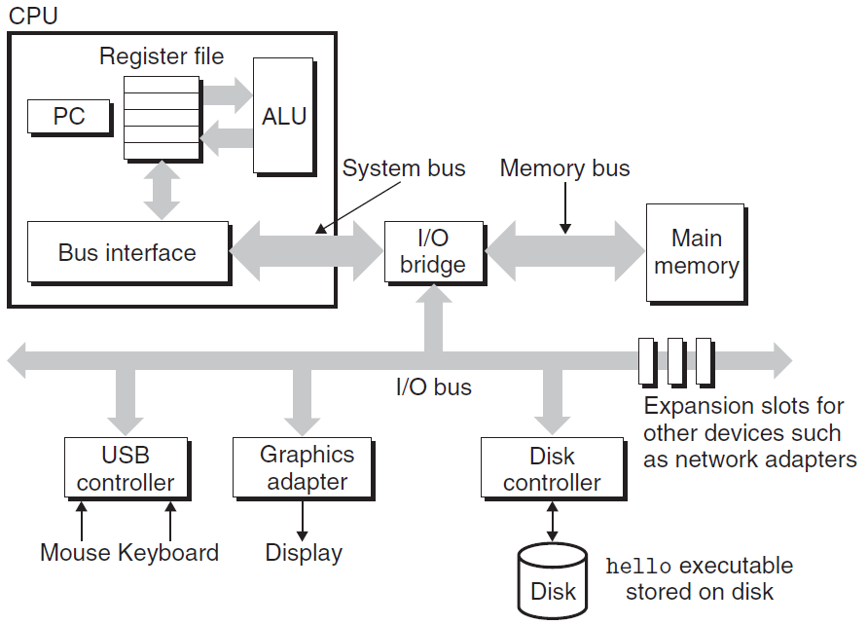
IA-32
Register
Memory
  The fastest storage units in computer systems, 32-bit long
Disk

Slide 18
READ/WRITE operations
Two important concepts
  Name and value
WRITE(name, value) value ← READ(name)
WRITE operation specifies
  a value to be remembered
  a name by which one can recall that value in the future
READ operation specifies
  the name of some previous remembered value
  the memory device returns that value

Slide 19
Registers vs. Virtual Memory
How to name registers
  Using specific names,
  For example, in IA-32
    %eax, %ecx, %edx, %ebx, %esi, %edi, %esp, %ebp
How to name virtual memory
  Using address as we have studied
What’s the difference
  Accessing values in Registers is fast
  Number of the registers is small
  Most modern instructions can access registers only（RISC）

Slide 20
Where are the variables? — registers & Memory
0xffffffff
0xfffffffe
0x2
0x1
0x0
… … …
%eax
%edx
contents
addresses
%ecx
%ebx
%esi
%edi
%esp
%ebp

Slide 21
Operands
Counterparts in assembly languages
  Immediate ( constant )
  Register ( variable )
  Memory ( variable )
Example
  movl 8(%ebp), %eax
  addl $4, %eax
memory
register
immediate

Slide 22
Express Operands in Assembly (Addressing Mode)
Immediate
  represents a constant
  The format is $imm ($4, $0xffffffff)
Registers
  Register mode E_{a}
    %eax
    The value stored in the register %eax
      Noted as R[E_{a}] (R[%eax])

Slide 23
Virtual spaces
A linear array of bytes
  each with its own unique address (array index) starting at zero
0xffffffff
0xfffffffe
0x2
0x1
0x0
… … … …
contents
addresses

Slide 24
Memory References
The name of the array is annotated as M
If addr is a memory address
M[addr] is the content of the memory starting at addr
addr is used as an array index
How many bytes are there in M[addr]?
  It depends on the context

Slide 25
Indexed Addressing Mode
An expression for
  a memory address (or an array index)
Most general form
  Imm(E_{b}, E_{i}, s)
  Constant “displacement” Imm: 1, 2 or 4 bytes
  Base register E_{b}: Any of 8 integer registers
  Index register E_{i} : Any, except for %esp
  S: Scale: 1, 2, 4, or 8
  实际访问Eb+Ei*s+Imm

Slide 26
Memory Addressing Mode（寻址方式）
The address represented by the above form
  imm + R[E_{b}] + R[E_{i}] * s
It gives the value
  M[imm + R[E_{b}] + R[E_{i}] * s]

Slide 27
Addressing Mode（寻址方式）
Type | Form | Operand value | Name
Immediate | $Imm | Imm | Immediate
Register | E_{a} | R[E_{a}] | Register
Indexed | Imm | M[Imm] | Absolute
Indexed | (E_{a}) | M[R[E_{a}]] 寄存器读出来的是内存地址 | Indirect
Indexed | Imm(E_{b}) | M[Imm+ R[E_{b}]] | Base+displacement
Indexed | (E_{b}, E_{i}) | M[R[E_{b}]+ R[E_{i}]] | Indexed
Indexed | Imm(E_{b}, E_{i}) | M[Imm+ R[E_{b}]+ R[E_{i}]] | Scaled indexed
Indexed | (, E_{i}, s) | M[R[E_{i}]*s] | Scaled indexed
Indexed | (E_{b}, E_{i}, s) | M[R[E_{b}]+ R[E_{i}]*s] | Scaled indexed
Indexed | Imm(E_{b}, E_{i}, s) | M[Imm+ R[E_{b}]+ R[E_{i}]*s] | Scaled indexed

Slide 28
Address | Value
0x100 | 0xFF
0x104 | 0xAB
0x108 | 0x13
0x10C | 0x11
Register | Value
%eax | 0x100
%ecx | 0x1
%edx | 0x3
Operand
Value
%eax
0x100
(%eax)
0xFF
$0x108
0x108
0x108
0x13
260(%ecx,%edx)
(0x108)0x13
(%eax,%edx,4)
(0x10C)0x11

Slide 29
Understanding Machine Execution

Slide 30
Outline
Machine states
Machine execution
Virtual Memory Layout

Slide 31
Assembly Programmer’s View
Memory
FFFFFFFF
%eax
Addresses
%edx
%ecx
C0000000
BFFFFFFF
Stack
%ebx
Data
%esi
80000000
Heap
%edi
Instructions
7FFFFFFF
%esp
%ebp
40000000
DLLs
CPU
3FFFFFFF
Heap
%eip
%eflag
Data
08000000
Text
00000000

Slide 32
Programmer-Visible States
Program Counter(%eip)
  Address of the next instruction
Register File
  Heavily used program data
  Integer and floating-point

Slide 33
Programmer-Visible States
Conditional code register (%eflags)
  Hold status information about the most recently executed instruction
  Implement conditional changes in the control flow
Virtual Memory

Slide 34
Operations in Assembly Instructions
Instruction
  Performs only a very elementary operation
Program
  is a sequence of instructions
Sequential execution mode
  Normally one by one in sequential
  Conditionally branch to a new instruction address
Typically operates data stored in registers
Transfers data between memory and a register
_sum: pushl %ebp movl %esp,%ebp movl 12(%ebp),%eax addl 8(%ebp),%eax addl %eax, accum movl %ebp,%esp popl %ebp ret

Slide 35
Understanding Machine Execution
Where the sequence of instructions are stored?
  In virtual memory
  Code area
How the instructions are executed?
  %eip stores an address of memory,
  from the address, machine can read a whole instruction once
  then execute it
  increase %eip
    %eip is also called program counter (PC)
55 89 e5 8b 45 0c 03 45 08 01 05 00 00 00 00 89 ec 5d c3 | Obtain with command gcc –O2 -c code.c Relocatable object file code.o

Slide 36
Code Layout
0xffffffff
memory invisible to
user code
kernel virtual memory
0xc0000000
Linux/x86
process
memory
image
Read/write data
Read only data
Read only code
%eip
0x08048000
forbidden

Slide 37
Sequential execution
f()
{
int i = 3 ;
}
kernel virtual memory
08048390 <_f>:
90: 55 push %ebp
91: 89 e5 mov %esp,%ebp
93: 83 ec 14 sub $0x14,%esp
96: c7 45 fc movl $03, -0x4(%ebp)
9d: c9 03 00 00 00 leave
9e: c3 ret
Read/write data
Read only data
Read only code
%eip
0x08048000
forbidden
Notes:
LEAVE指令是将栈指针指向帧指针，然后POP备份的原帧指针到%EBP

Slide 38
Sequential execution
PC
08 04 83 9e
 | c3 | ret
 | c9 | leave
9c | 00
 | 00
 | 00
 | 03
98 | fc
 | 45
 | c7 | movl $0x3,-0x4(%ebp)
 | 14
94 | ec
 | 83 | sub $0x14,%esp
 | e5
 | 89 | mov %esp,%ebp
90 | 55 | push %ebp
00000000 <_f>:
0: 55 push %ebp
1: 89 e5 mov %esp,%ebp
3: 83 ec 14 sub $0x14,%esp
6: c7 45 fc 03 00 00 00
movl $0x3,-0x4(%ebp)
d: c9 leave
e: c3 ret
PC
08 04 83 9d
PC
08 04 83 96
PC
08 04 83 93
PC
08 04 83 91
PC
08 04 83 90

Slide 39
Code Layout
0xffffffff
memory invisible to
user code
kernel virtual memory
0xc0000000
Linux/x86
process
memory
image
Read/write data
Read only data
Read only code
%eip
0x08048000
forbidden

Slide 40
Data layout
Object model in assembly
  A large, byte-addressable array
  No distinctions even between signed or unsigned integers
  Code, user data, OS data
  Run-time stack for managing procedure call and return
  Blocks of memory allocated by user

Slide 41
Data Layout
0xffffffff
memory invisible to
user code
kernel virtual memory
0xc0000000
Stack
Downward growth
%esp
Read/write data
Linux/x86 process
memory image
Read only data
Read only code
%eip
0x08048000
forbidden

Slide 42
Example (C Code)
#include <stdio.h>
int accum = 0;
int sum(int x, int y)
{
int t = x + y;
accum += t;
return t;
}
int main()
{
int s;
s = sum(4,3);
printf(" %d %d \n", s, accum);
return 0;
}

Slide 43
Example (object Code)
08048360 <sum>:
8048360: 55 push %ebp
8048361: 89 e5 mov %esp,%ebp
8048363: 8b 45 0c mov 0xc(%ebp),%eax
8048366: 8b 55 08 mov 0x8(%ebp),%edx
8048369: 5d pop %ebp
804836a: 01 d0 add %edx,%eax
804836c: 01 05 f0 95 04 08 add %eax, 0x80495f0
8048372: c3 ret

Slide 44
Example (object Code)
08048360 <sum>:
8048360: 55 push %ebp
8048361: 89 e5 mov %esp,%ebp
8048363: 8b 45 0c mov 0xc(%ebp),%eax
8048366: 8b 55 08 mov 0x8(%ebp),%edx
8048369: 5d pop %ebp
804836a: 01 d0 add %edx,%eax
804836c: 01 05 f0 95 04 08 add %eax, 0x80495f0
8048372: c3 ret

Slide 45
Example (object Code)
08048360 <sum>:
8048360: 55 push %ebp
8048361: 89 e5 mov %esp,%ebp
8048363: 8b 45 0c mov 0xc(%ebp),%eax
8048366: 8b 55 08 mov 0x8(%ebp),%edx
8048369: 5d pop %ebp
804836a: 01 d0 add %edx,%eax
804836c: 01 05 f0 95 04 08 add %eax, 0x80495f0
8048372: c3 ret

Slide 46
Organization of an Assembly Program

Slide 47
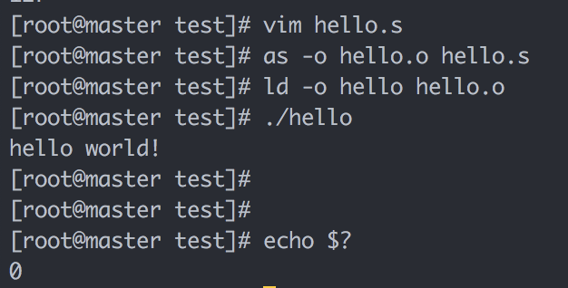
Example 1
$ as hello.s -o hello.o
$ ld hello.o -o hello
$ ./hello
$ echo $? #打印返回值
.data
msg : .string "hello world!\n"
len = . – msg
.text
.global _start
_start:
movq $len, %rdx ;第4个参数，字符串长度
movq $msg, %rcx ;第3个参数，字符串地址
movq $1, %rbx ;第2个参数，1指定标准输出（0-标准输入）
movq $4, %rax ;第1个参数，4为系统调用号：sys_write
int $0x80 ;80中断，系统调用
movl $0, %ebx ;参数1，退出代码，指定的返回值
movl $1, %eax ;1号系统调用：sys_exit
int $0x80

Slide 48
语法
X86汇编
  AT&T格式
    寄存器%
    常量、变量$
    寄存器参数：src, dst (→)
    Len = . - msg
  Intel格式
    寄存器参数： dst, src (←)
    Len equ $ - msg
    Len = $ - msg
  gcc –O1 –S –masm=intel code.c，可以生成intel风格的汇编代码
加长度后缀
  movb传送字节
  movw传送字
  movl传送双字(long word)
  movq传送四字

Slide 49
语法
.data 数据段
  全局变量
  常量
.text 程序段
.stack 堆栈段

Slide 50
常量vs变量
符号常量
  符号常量使用标识符表达一个数值
  Len = . – msg
  在变为机器代码时会直接替换为对应的值
变量
  本质是(临时)拥有一段内存，变量即内存的地址
  在变为机器代码时会直接替换为对应内存段的首地址
  .ascii 字符串
  .short 短整型 16位2字节
  .int .long 长整型 32位4字节 (同一平台C语言中long 为8字节）
  .byte 一个字节
  .float 浮点单精度
  .double 浮点双精度

Slide 51
工具
汇编器
  as, gcc依赖的汇编器
链接器
  ld
调试器
  Gdb
  将在bomblab时详细讲解

Slide 52
Example 2
查询CPU的厂商ID
.data
output: .ascii "The processor Vendor ID is 'xxxxxxxxxxxx'\n"
.text
.global _start
_start:
movl $0, %eax
cpuid
movl $output, %edi
movl %ebx, 28(%edi)
movl %edx, 32(%edi)
movl %ecx, 36(%edi)
movl $4, %eax
movl $1, %ebx
movl $output, %ecx
movl $42, %edx
int $0x80
movl $1, %eax
movl $0, %ebx
int $0x80

Slide 53
课堂练习
.data
  byte1 .byte 10110111b
  byte2 = . – byte1
  byte3 BYTE 61+1
  word1 .short -9
  dword1 .int 2274h
  word2 .short 2274q
假设是8086，DS=2000H，要求画出内存状态图
  Hint: intel系列CPU采用小端方式

