Slide 1
程序的机器级表示（4）
柴云鹏
2024.11

Slide 2
Control

Slide 3
Outline
Jump instructions
  PC-relative Address
Translate Control constructs in C to assembly
  Goto、Branch、Loop
Conditional Move
Translate switch in C to assembly

Slide 4
Control
Two of the most important parts of program execution
  Data flow (Accessing and operating data)
  Control flow (control the sequence of operations)

Slide 5
Control
Sequential execution is default
  the instructions are executed in the order they appear in the program
Chang the control flow
  Jump instructions
  分支语句对性能有一定影响，分支预测失败会有较大的惩罚（根源在于内存访问速度远低于CPU运算速度）

Slide 6
Jump Instructions
1 xorl %eax, %eax Set %eax to 0
2 jmp .L1 Goto .L1
3 movl (%eax), %edx Null pointer dereference
4 .L1:
5 popl %edx

Slide 7
Unconditional jump
Jumps unconditionally
Direct jump: jmp label
  jmp .L
Indirect jump: jmp *Operand
  jmp *%eax
  jmp *(%eax)

Slide 8
Conditional jump
或者跳转，或者继续顺序执行
  取决于一定的condition codes
  Jz(je), jnz(jne)
  Js, jns
  有符号数：jl(jnge), jg(jnle), jle(jng), jge(jnl)
  无符号数：ja(jnbe), je(jnae), jae(jnb), jbe(jna)
都是direct jump类型

Slide 9
Jump Instructions
jle .L2
.L5:
movl %edx, %eax
sarl $1, %eax
subl %eax, %edx
Leal (%edx, %edx, 2), %edx
testl %edx, %edx
jg .L5
9 .L2:
10 movl %edx, %eax
这个结构的程序
是在做什么？

Slide 10
Jump Targets in Binary
Two forms to represent a jump target
PC-relative (direct jump)
  实质上是在指令中记录下来：跳转的目标地址（标号所在地址）与当前指令下一条指令的差值（可正可负）
  由于硬件每执行完一条指令，都会自动将Pc执行当前指令的下一条指令。如果决定跳转，只需要PC += 指令中的offset即可
Absolute address (indirect jump)
  Jump target is an absolute address

Slide 11
Example
jle .L2
.L5:
movl %edx, %eax
sarl $1, %eax
subl %eax, %edx
Leal (%edx, %edx, 2), %edx
testl %edx, %edx
jg .L5
9 .L2:
10 movl %edx, %eax

Slide 12
PC-relative in the Relocatable Object
8: 7e 0d jle 17<silly+0x17>
a: 89 d0 mov %edx, %eax dest1:
3 c: c1 f8 sar %eax
e: 29 c2 sub %eax, %edx
10: 8d 14 52 lea (%edx, %edx, 2), %edx
6 13: 85 d2 test %edx, %edx
15: 7f f3 jg a<silly+0x10>
17: 89 d0 movl %edx, %eax dest2:
d+a = 17
17+f3(-d) =a

Slide 13
PC-relative in the Executable Object
804839: 7e 0d jle 17<silly+0x17>
804839e: 89 d0 mov %edx, %eax dest1:
3 80483a0: c1 f8 sar %eax
80483a2: 29 c2 sub %eax, %edx
80483a4: 8d 14 52 lea (%edx, %edx, 2), %edx
6 80483a7: 85 d2 test %edx, %edx
80483a9: 7f f3 jg a<silly+0x10>
80483ab: 89 d0 movl %edx, %eax dest2:
d+804849e = 80483ab
80483ab+f3(-d) = 804839e

Slide 14
Outline
Jump instructions
Translate Control constructs in C to assembly
  Goto, Branch, Loops
Conditional Move
Translate switch in C to assembly

Slide 15
Control Constructs in C
Gotos
  goto L
  break
  continue
Branch
  if () { } else if () { } else { }
  switch () {case }

Slide 16
Control Constructs in C
Loop
  while () { }
  do { } while ()
  for (init; test; incr) { }

Slide 17
Translating Conditional Branches
t = test-expr ;
if ( t )
goto true ;
else-statement
goto done
true:
then-statement
done:
if ( test-expr )
then-statement
else
else-statement

Slide 18
Translating Conditional Branches
int absdiff(int x, int y)
{
if (x < y)
return y – x;
else
return x – y;
}
int absdiff(int x, int y)
{
int rval ;
if (x < y)
goto less
rval = x – y ;
goto done;
less:
rval = y – x;
done:
return rval;
}

Slide 19
Jump Instructions
movl 8(%ebp), %edx # get x
movl 12(%ebp), %eax # get y
cmpl %eax, %edx # cal x - y
jl .L3 # if x < y goto less
subl %eax, %edx # compute x - y
movl %edx, %eax # set return val
jmp .L5 # goto done
.L3: # less:
subl %edx, %eax # compute y – x
.L5: # done: Begin Completion code

Slide 20
Do-while Translation
do
body-statement
while (test-expr)
loop:
body-statement
t = test-expr;
if ( t )
goto loop ;

Slide 21
Do-while Translation
.L6:
lea (%ebx, %edx), %eax
movl %edx, %ebx
movl %eax, %edx
incl %ecx
cmpl %esi, %ecx
jl .L6
movl %ebx, %eax
int fib_dw(int n)
{
int i = 0;
int val = 0 ;
int nval = 1 ;
do {
int t = val + nval ;
val = nval ;
nval = t ;
i++;
} while ( i<n) ;
return val ;
}
register | value | initially
%ecx | i | 0
%esi | n | n
%ebx | val | 0
%edx | nval | 1
%eax | t | -

Slide 22
While Loop Translation
while (test-expr)
body-statement
loop: if ( !test-expr)
t = test-expr goto done;
if ( !t ) do
goto done; body-statement
body-statement while(test-expr)
goto loop; done:
done:

Slide 23
While Loop Translation
int fib_w_goto(int n)
{
int val=1;
int nval=1;
int nmi, t ;
if ( val >= n )
goto done ;
nmi = n-1;
loop:
t=val+nval ;
val = nval ;
nval = t ;
nmi--;
if ( nmi )
goto loop
done:
return val
}
int fib_w(int n)
{
int i=1;
int val=1;
int nval=1;
while ( i<n ) {
int t=val+nval ;
val = nval ;
nval = t ;
i++;
}
return val ;
}

Slide 24
While Loop Translation
Register usage
movl 8(%ebp), %eax
movl $1, %ebx
movl $1, %ecx
cmpl %eax, ebx
jge .L9
lea –1(%eax), %edx
.L10:
lea (%ecx, %ebx), %eax
movl %ecx, %ebx
movl %eax, %ecx
decl %edx
jnz .L10
.L9:
Register
Variable
Initially
%edx
nmi
n-1
%ebx
val
1
%ecx
nval
1

Slide 25
For Loop Translation
For Version
for (Init; Test; Update )
Body
While Version
Init;
while (Test ) {
Body
Update;
}

Slide 26
“For” Loop Do-While Conversion
C Code
Goto Version
long pcount_for_goto_dw
(unsigned long x) {
size_t i;
long result = 0;
i = 0;
if (!(i < WSIZE))
goto done;
loop:
{
unsigned bit =
(x >> i) & 0x1;
result += bit;
}
i++;
if (i < WSIZE)
goto loop;
done:
return result;
}
long pcount_for
(unsigned long x)
{
size_t i;
long result = 0;
for (i = 0; i < WSIZE; i++)
{
unsigned bit =
(x >> i) & 0x1;
result += bit;
}
return result;
}
Init
!Test
Body
Update
Test
Initial test can be optimized away

Slide 27
多判断条件的短路性
while (sum < 1000) and (count ≤ 24) loop
... { body of loop }
end while;
两个条件必须都成立<==>任一个不成立都退出
逻辑与运算
whileSum: cmpw $1000, $sum ; sum < 1000 ?
jnl endWhileSum ; exit if not
cmpw $24, %cx ; count <= 24 ?
jnle endWhileSum ; exit if not
. . . ; body of loop . .
jmp whileSum ; go check condition again
endWhileSum:

Slide 28
多判断条件的短路性
while (sum < 1000) or (flag=1) loop
... { body of loop }
end while;
逻辑或运算
whileSum: cmpw $1000, $sum ; sum < 1000 ?
jl body ; execute body if so
cmpb $1, %dh ; flag=1 ?
jne endWhileSum ; exit if not
body: . . . ; body of loop . .
….
jmp whileSum ; go check condition again
endWhileSum:

Slide 29
Loop 指令实现 for 循环
LOOP label
  利用 ECX 计数器自动减1，方便实现计数循环的程序结构。
  ECX ← ECX－1 ;dec ecx
  如果 ECX≠0，转标号 label 继续循环 ;jnz label
  否则继续执行循环指令下面的语句
  操作数 label 采用相对短转移寻址方式，及向后128个字节或向前127个字节。

Slide 30
使用“loop”的80x86汇编代码
  for count := 20 downto 1 loop
  ... { body of loop }
  end for
movl $20, %ecx ; number of iterations
forCount: . . . ; body of loop
. . .
loop forCount ; repeat body 20 times
movl $number, %ecx ; number of iterations
forIndex: . . . ; body of loop
. . .
loop forIndex ; repeat body number times

Slide 31
可靠的 for 循环
当ecx中的值为0时，循环不会执行
movl $number, %ecx ; number of iterations
cmpl $0, %ecx ; number = 0 ?
jle endFor ; skip loop if number = 0
forIndex: . . . ; body of loop
. . .
loop forIndex ; repeat body number times
endFor:
movl $number, %ecx ; number of iterations
jecxz endFor ; skip loop if number = 0
forIndex: . . . ; body of loop
. . .
loop forIndex ; repeat body number times
endFor:

Slide 32
Outline
Jump instructions
Translate Control constructs in C to assembly
  Goto, Branch, Loops
Conditional Move
Translate switch in C to assembly

Slide 33
Conditional Move
为什么需要Conditional Move
  例子：求x和y之间差值的绝对值
  1 int absdiff(int x, int y) {
  2 return x < y ? y-x : x-y;
  3 }
  正常思路：采用分支if/else
  挑战：一旦分支预测失败，代价较大
    因为需要从内存加载指令，很慢；而预测成功时，可以从很快的cache中加载指令（指令预取）
    破坏CPU流水线

Slide 34
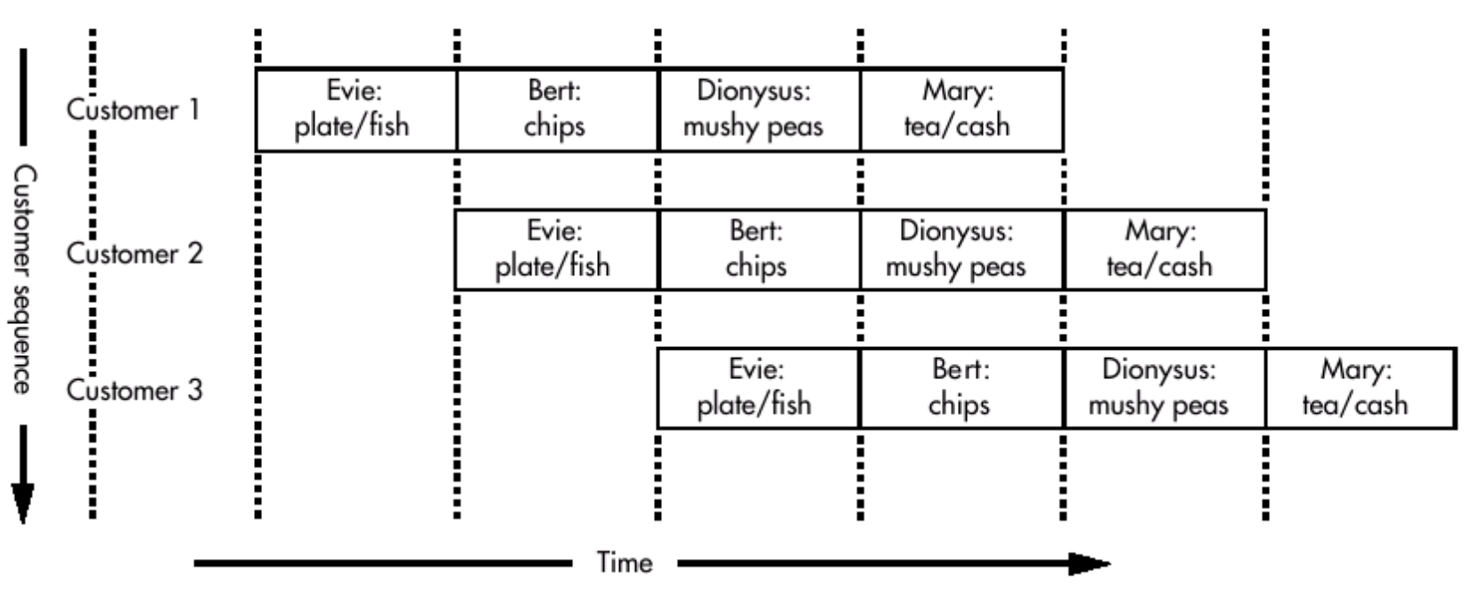
流水线（pipeline）
Evie炸鱼店
  提供：炸鳕鱼、炸薯片、豌豆粥、茶
  排队问题
  加长柜台，排队移动中依次得到各种食物

Slide 35
流水线（pipeline）
优点
  资源充分利用，减少排队时间
  每个工人的工作简单，容易培训，成本低，不容易出错
挑战：
  Mary一边倒茶，一边找零钱，成为4个环节中的瓶颈（拆分）
  Daphne和Lola一起来，Daphne不买茶，则Lola不买薯片。所以Lola驻足观望Daphne是否买茶（气泡）
  对信誉不好的Cyril，要等Mary点完钱，Evie才给他盛炸鱼（Cyril要用前面三个顾客用的资源—Mary，资源冲突）

Slide 36
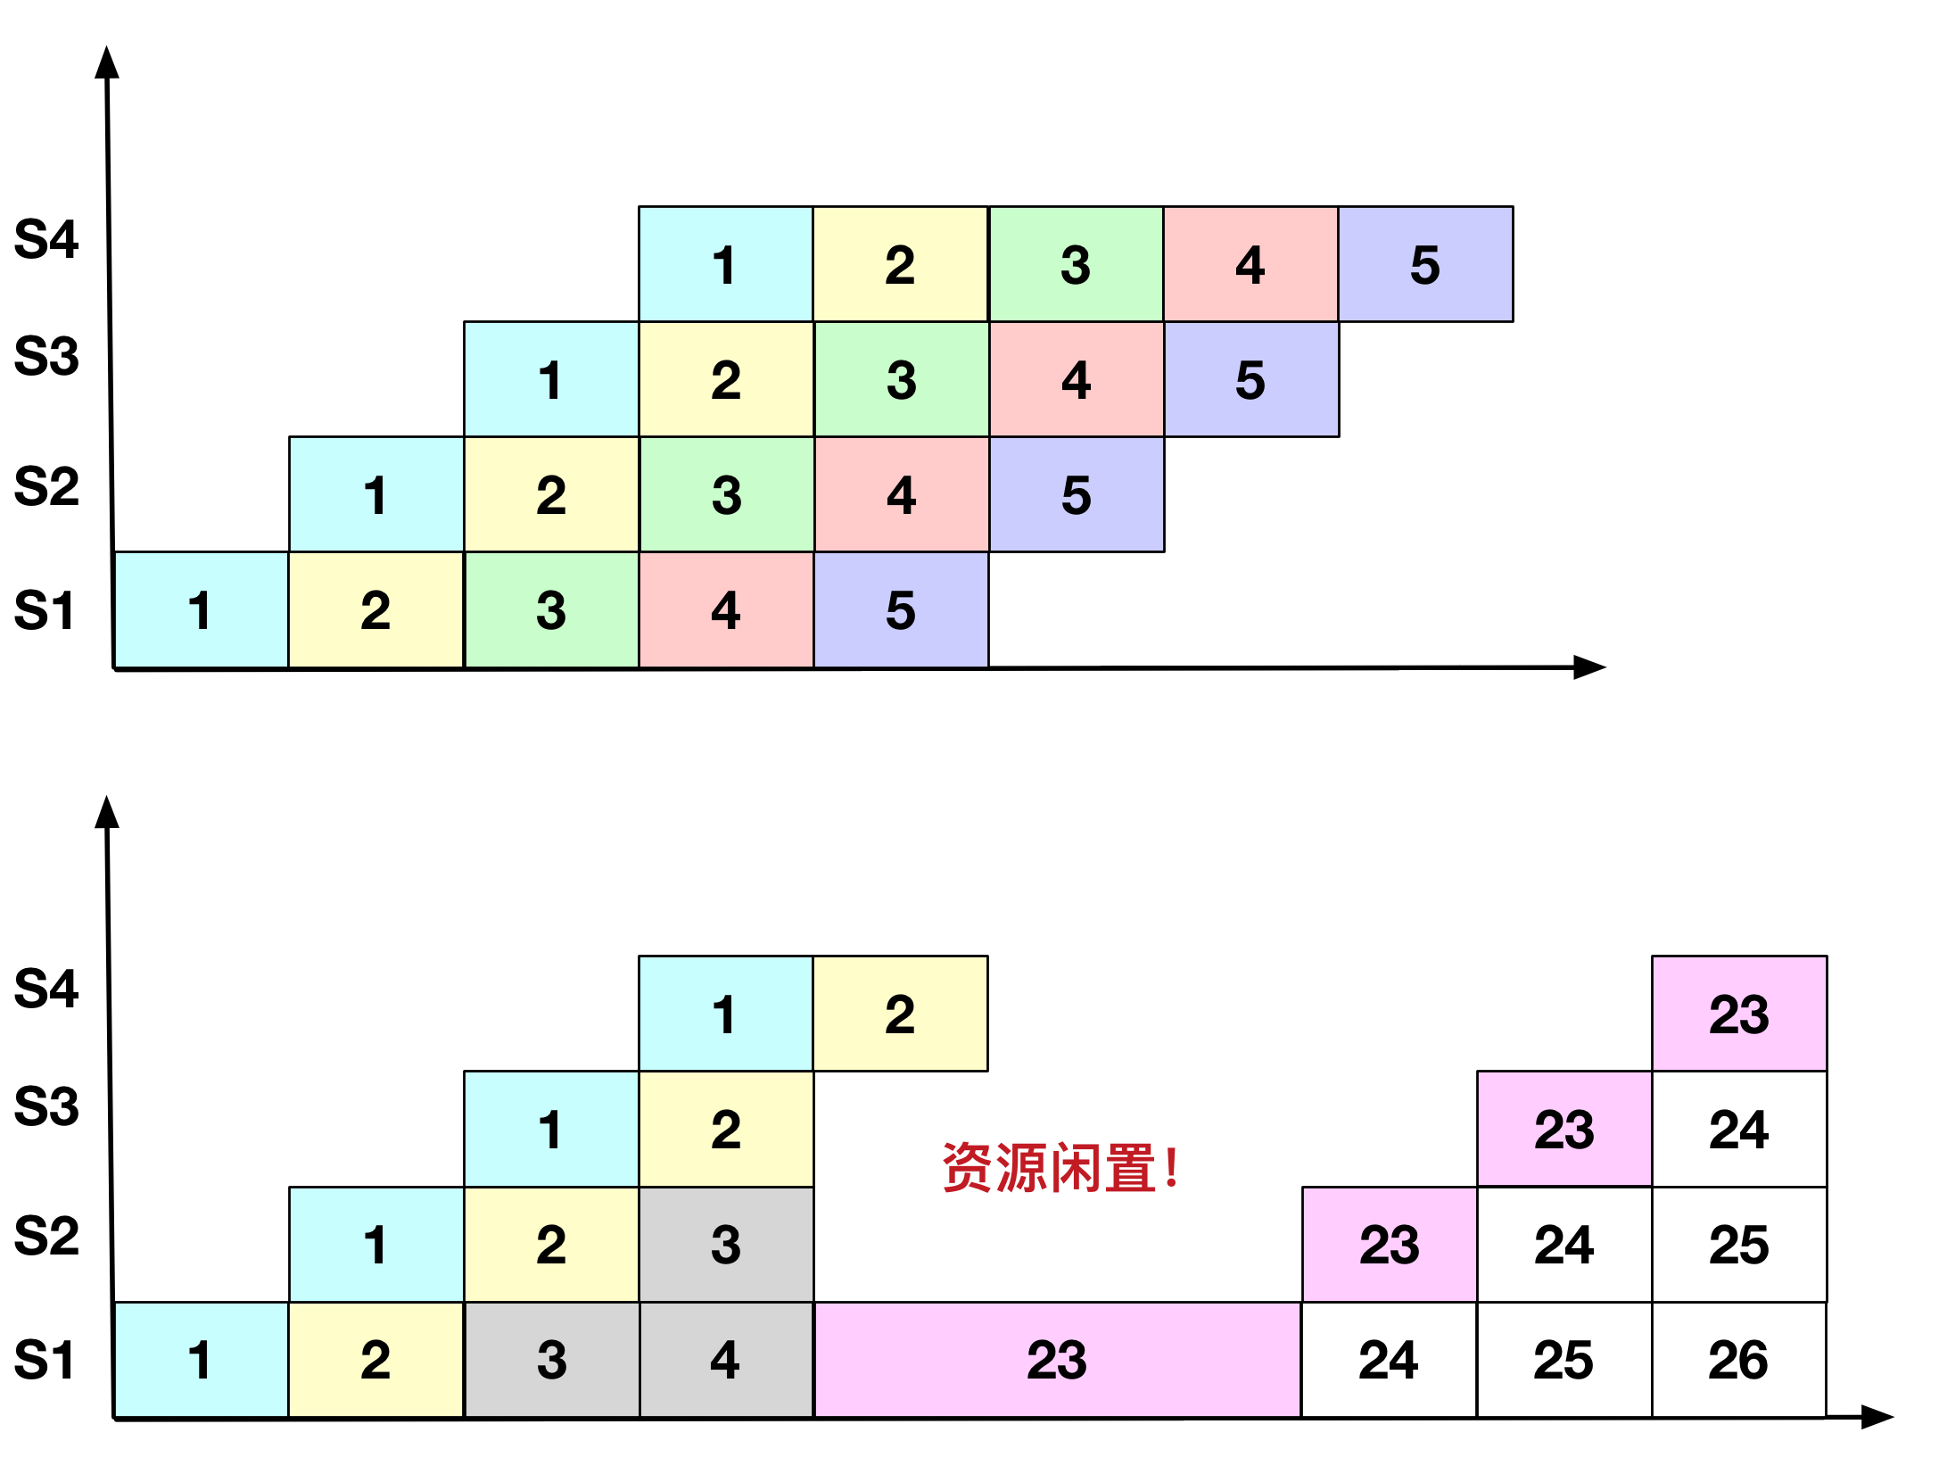
流水线（pipeline）
如果分支预测失败
  需要再去加载新的指令，很长时间内，流水线各个环节没有指令需要运行，处于空闲状态，性能下降

Slide 37
Conditional Move
Original C code
1 int absdiff(int x, int y) {
2 return x < y ? y-x : x-y;
3 }
(b) Implementation using conditional assignment
1 int cmovdiff(int x, int y) {
2 int tval = y-x;
3 int rval = x-y;
4 int test = x < y;
5 /* Line below requires
6 single instruction: */
7 if (test) rval = tval;
8 return rval;
9 }

Slide 38
Conditional Move
(c) Generated assembly code
(x at %ebp+8, y at %ebp+12)
movl 8(%ebp), %ecx Get x
movl 12(%ebp), %edx Get y
movl %edx, %ebx Copy y
subl %ecx, %ebx Compute y-x
movl %ecx, %eax Copy x
subl %edx, %eax Compute x-y and set as return value
cmpl %edx, %ecx Compare x:y
cmovl %ebx, %eax If < , replace return value with y-x
%ecx x
%edx y
%ebx y-x
%eax x-y

Slide 39
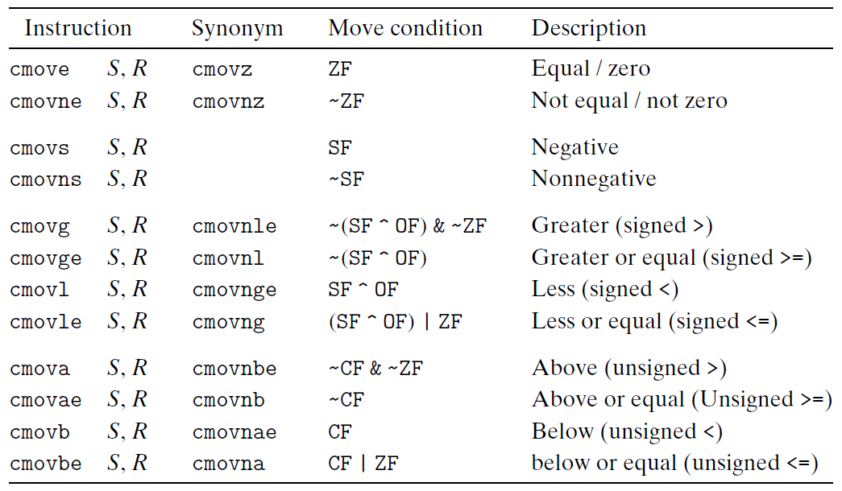
Conditional Move
Properties of Switch Construct
  Integer testing
  Multiple outcomes (may be a large number)
  Improve the readability of the source code

Slide 40
Conditional Move
Conditional Move的问题
  与真正的分支语句相比，Conditional Move需要实现对两个分支情况都求值，然后根据情况选择一个
  而分支语句只需要对其中一个进行求值
  所以，等某个分支语句有“副作用”（会修改某个寄存器或变量的值）时，不能使用Conditional Move

Slide 41
Invalid Situation
  int cread(int *xp) {
  return (xp ? *xp : 0);
  }
  如果使用conditional move，翻译的汇编为：
  # xp@%rdi
  1 cread:
  2 movq (%rdi), %rax # v=*xp
  3 testq %rdi, %rdi # xp==0?
  4 movl $0, %edx
  5 cmove %rdx, %rax # if xp==0, return 0
  6 ret
如果xp=0, 那么第2行用NULL指针寻址出现错误

Slide 42
Outline
Jump instructions
Translate Control constructs in C to assembly
  Goto, Branch, Loops
Conditional Move
Translate switch in C to assembly

Slide 43
Switch Construct
Properties of Switch Construct
  Integer testing
  Multiple outcomes (may be a large number)
    如果采用if/elseif分支，分支很多，需要做多次判断，产生计算开销（cmp）
    一次性处理所有分支，效率更高！
  Improve the readability of the source code

Slide 44
Switch Statements
int switch_eg(int x, int n)
{
int result = x ;
switch ( n ) {
case 100:
result *= 13 ;
break ;
case 102:
result += 10 ;
/* fall through */
case 103
result += 11;
break ;
case 104: case 106:
result *= result ;
break ;
default:
result = 0 ;
}
return result ;
}
Multiple cases
Integer testing

Slide 45
Switch Form
switch(op) {
case val_0:
Block 0
case val_1:
Block 1
• • •
case val_n-1:
Block n–1
}

Slide 46
Jump Table
高效的实现方式
避免很多if-else语句
标准
  Case的数量，以及case值的分布
    Case数量太少，还是用if-else方便
    Case值分布太广、太稀疏，jump table开销过大

Slide 47
From Cases to Targets
switch(op) {
case val_0:
Block 0
case val_1:
Block 1
• • •
case val_n-1:
Block n–1
}
Targ0:
Code Block 0
Targ1:
Code Block 1
Targ2:
Code Block 2
•
•
•
Targn-1:
Code Block n–1

Slide 48
Construct a Jump Table
Jump Table
Jump Targets
jtab:
Targ0
val_0
Targ0:
Code Block 0
.
.
Targ1
val_1
Targ1:
Code Block 1
.
.
Targ2
val_2
Targ2:
Code Block 2
•
•
•
•
•
•
Targn-1
val_n-1
Targn-1:
Code Block n–1

Slide 49
Implement the Switch
Approx. Translation
Jump Targets
target = JTab[op];
goto *target;
Targ0:
Code Block 0
Jump Table
Targ1:
Code Block 1
jtab:
Targ0
val_0
Targ2:
Code Block 2
………
Targ1
val_1
………
•
•
•
Targ2
val_2
•
•
•
Targn-1:
Code Block n–1
Targn-1
val_n-1

Slide 50
Switch Statement Example
long switch_eg
(long x, long y, long z)
{
long w = 1;
switch(x) {
case 1:
w = y*z;
break;
case 2:
w = y/z;
/* Fall Through */
case 3:
w += z;
break;
case 5:
case 6:
w -= z;
break;
default:
w = 2;
}
return w;
}
Multiple case labels
  Here: 5 & 6
Fall through cases
  Here: 2
Missing cases
  Here: 4

Slide 51
Jump Table Structure
Switch Form
Jump Table
Jump Targets
switch(x) {
case val_0:
Block 0
case val_1:
Block 1
• • •
case val_n-1:
Block n–1
}
jtab:
Targ0
Targ0:
Code Block
0
Targ1
Targ2
Targ1:
Code Block
1
•
•
•
Targ2:
Code Block
2
Targn-1
•
•
•
Translation (Extended C)
goto *JTab[x];
Targn-1:
Code Block
n–1

Slide 52
Switch Statement Example
long switch_eg(long x, long y, long z)
{
long w = 1;
switch(x) {
. . .
}
return w;
}
Setup:
Register | Use(s)
%rdi | Argument x
%rsi | Argument y
%rdx | Argument z
%rax | Return value
switch_eg:
movq %rdx, %rcx
cmpq $6, %rdi # x:6
ja .L8
jmp *.L4(,%rdi,8)
Note that w not initialized here

Slide 53
Switch Statement Example
long switch_eg(long x, long y, long z)
{
long w = 1;
switch(x) {
. . .
}
return w;
}
Jump table
.section .rodata
.align 8
.L4:
.quad .L8 # x = 0
.quad .L3 # x = 1
.quad .L5 # x = 2
.quad .L9 # x = 3
.quad .L8 # x = 4
.quad .L7 # x = 5
.quad .L7 # x = 6
Setup:
switch_eg:
movq %rdx, %rcx
cmpq $6, %rdi # x:6
ja .L8 # Use default
jmp *.L4(,%rdi,8) # goto *JTab[x]
Indirect
jump

Slide 54
Code Layout
0xffffffff
memory invisible to
user code
kernel virtual memory
0xc0000000
Linux/x86
process
memory
image
Read/write data
Read only data
Read only code
%eip
0x08048000
forbidden

Slide 55
Assembly Setup Explanation
Table Structure
  Each target requires 8 bytes
  Base address at .L4
Jumping
  Direct: jmp .L8
  Jump target is denoted by label .L8
  Indirect: jmp *.L4(,%rdi,8)
  Start of jump table: .L4
  Must scale by factor of 8 (addresses are 8 bytes)
  Fetch target from effective Address .L4 + x*8
    Only for 0 ≤ x ≤ 6
Jump table
.section .rodata
.align 8
.L4:
.quad .L8 # x = 0
.quad .L3 # x = 1
.quad .L5 # x = 2
.quad .L9 # x = 3
.quad .L8 # x = 4
.quad .L7 # x = 5
.quad .L7 # x = 6

Slide 56
Jump Table
Jump table
switch(x) {
case 1: // .L3
w = y*z;
break;
case 2: // .L5
w = y/z;
/* Fall Through */
case 3: // .L9
w += z;
break;
case 5:
case 6: // .L7
w -= z;
break;
default: // .L8
w = 2;
}
.section .rodata
.align 8
.L4:
.quad .L8 # x = 0
.quad .L3 # x = 1
.quad .L5 # x = 2
.quad .L9 # x = 3
.quad .L8 # x = 4
.quad .L7 # x = 5
.quad .L7 # x = 6

Slide 57
Code Blocks (x == 1)
switch(x) {
case 1: // .L3
w = y*z;
break;
. . .
}
.L3:
movq %rsi, %rax # y
imulq %rdx, %rax # y*z
ret
Register | Use(s)
%rdi | Argument x
%rsi | Argument y
%rdx | Argument z
%rax | Return value

Slide 58
Handling Fall-Through
long w = 1;
. . .
switch(x) {
. . .
case 2:
w = y/z;
/* Fall Through */
case 3:
w += z;
break;
. . .
}
case 2:
w = y/z;
goto merge;
case 3:
w = 1;
merge:
w += z;

Slide 59
Code Blocks (x == 2, x == 3)
.L5: # Case 2
movq %rsi, %rax
cqto
idivq %rcx # y/z
jmp .L6 # goto merge
.L9: # Case 3
movl $1, %eax # w = 1
.L6: # merge:
addq %rcx, %rax # w += z
ret
long w = 1;
. . .
switch(x) {
. . .
case 2:
w = y/z;
/* Fall Through */
case 3:
w += z;
break;
. . .
}
Register | Use(s)
%rdi | Argument x
%rsi | Argument y
%rdx | Argument z
%rax | Return value

Slide 60
Code Blocks (x == 5, x == 6, default)
switch(x) {
. . .
case 5: // .L7
case 6: // .L7
w -= z;
break;
default: // .L8
w = 2;
}
.L7: # Case 5,6
movl $1, %eax # w = 1
subq %rdx, %rax # w -= z
ret
.L8: # Default:
movl $2, %eax # 2
ret
Register | Use(s)
%rdi | Argument x
%rsi | Argument y
%rdx | Argument z
%rax | Return value

