Slide 1

FinGenie AI
Your Personal Financial Brain – Smarter Payments, Safer Plans, Simpler Life

Slide 2
Team – Coding Wizard
Member 1 – Ishan Grover
Member 2 – Sayak Mitra Majumder
Member 3 – Nikhil Dwivedi

Slide 3
Problem Statement & Scope of Innovation
Problem Statement
Build an AI-powered solution that enhances any aspect of the payments ecosystem — from payment optimization and fraud detection to personalized rewards, budgeting, or innovative payment experiences. The goal is to make payments smarter, more efficient, and user-centric for individuals or businesses.
Scope of Innovation:
We propose an AI-powered autonomous financial assistant — a “FinGenie AI” for payments — that:
Learns spending behavior
Optimizes EMI plans
Routes payments for maximum benefit
Automates financial decisions under user supervision
It enhances budgeting, rewards optimization, and financial health management — making payments smarter, personalized, and proactive.

Slide 4
Customer-Centric Approach (Working Backwards)
Target Users:
Primary: Gen Z & Millennials with multiple digital payment modes (UPI, Amazon Pay, EMI, BNPL)
Secondary: Salaried individuals managing multiple EMI/credit obligations
Tertiary: Freelancers or gig workers with irregular income patterns
Customer Pain Points:
Missed EMIs or penalties due to oversight
Suboptimal usage of credit cards and reward systems
Confusing financial decisions with no guidance
No single assistant to automate routine financial tasks
Working Backwards:
“Can I have an AI that ensures I never miss a payment, always choose the best card to pay, and guides me like a financial guardian?”

Slide 5
Our Solution: FinGenie AI
Our Solution = 3 Modules Combined into One App
Core Module 1: PaySense AI – Autonomous Financial Brain
Reads SMS/emails from banks, UPI, Amazon Pay
Learns spending & goals → suggests budgets
Executes tasks: “Pay electricity bill”, “Cancel Amazon Prime”
LLM + RAG-based personalized financial planner
Core Module 2: Cognitive EMI Optimizer
Predicts EMI defaults before they occur
Recommends actions: refinance, adjust spending
Uses LSTM/Prophet for income-spend prediction
Adds BNPL/Amazon Pay Later where needed
Core Module 3: Smart Wallet Routing Engine
Chooses optimal payment method per transaction
Credit card with best cashback, EMI for large purchases, UPI for small
Works like Razorpay routing — but for consumers

Slide 6
Our MVP: What We’ll Build by June 22
We will deliver a working prototype of:
PaySense AI Lite
Reads mock SMS/email transactions
LLM+RAG answers queries like “Can I afford this?”
Smart Wallet Router (basic rule engine)
Chooses cheapest payment option using dummy API logic
React Native App
User login, transaction parsing, chat bot, payment suggestion screen
Tech Stack:
LLM Model + LangChain
Python/Flask for logic
React Native frontend
Firebase for auth/mock data

Slide 7
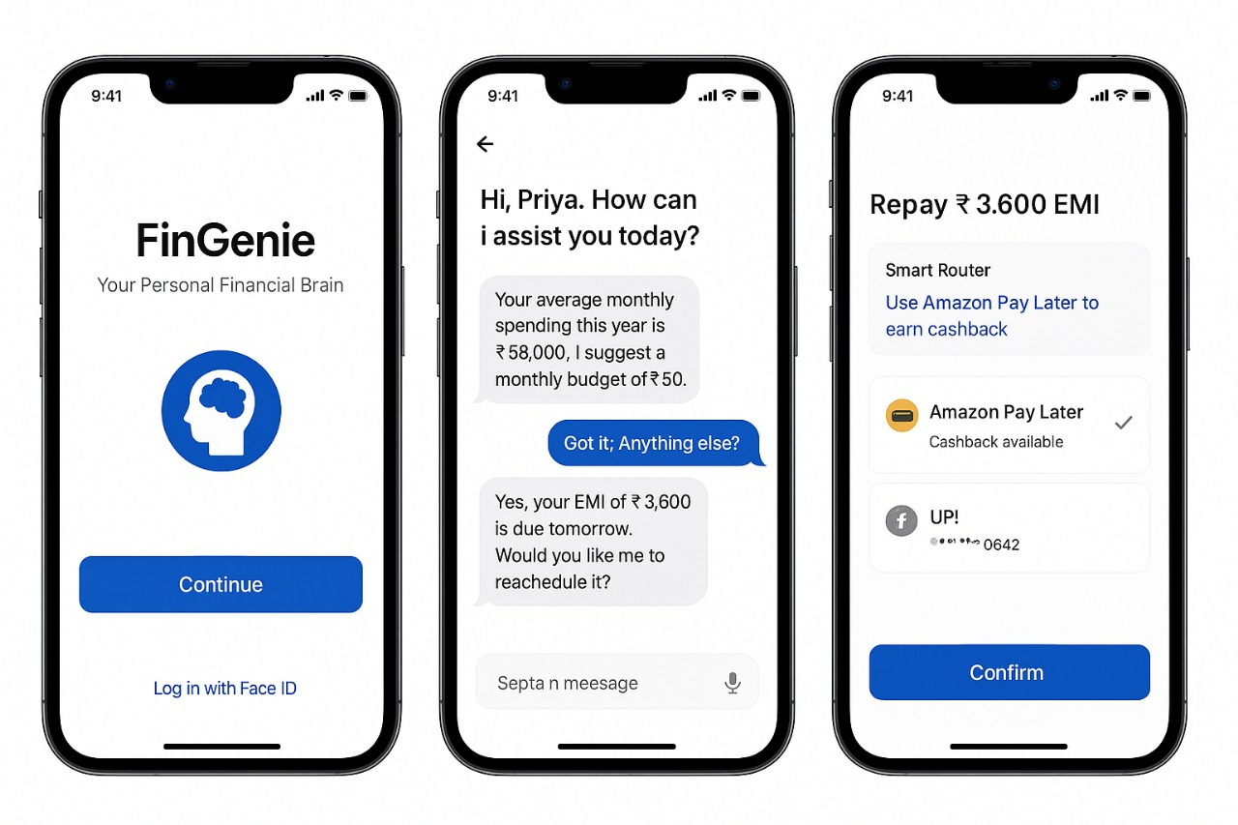
User Journey & App Mockup
Step 1: User logs in → FinGenie syncs mock transactions Step 2: LLM suggests budget plan + alerts EMI due Step 3: Router recommends payment via Amazon Pay Later Step 4: User confirms with one tap
Your average monthly spending this year is 32,000. I suggest monthly budget of ₹20,000.
Got it, Anything else?
Yes. your EMI of ₹3,600 is due tomorrow. Would you like me reschedule it?

Slide 8
Competitive Edge: Why FinGenie Is Unique
Feature | FinGenie AI | CRED | Fi Money | Walnut
Autonomous Payment Routing | ✅ | ❌ | ❌ | ❌
Personalized Advisor | ✅ | ❌ | ❌ | ❌
EMI Default Prediction | ✅ | ❌ | ❌ | ❌
Multi-source Data Reading | ✅ | ❌ | ✅ | ✅
Built for Amazon Ecosystem | ✅ | ❌ | ❌ | ❌

Slide 9
Success Metrics & Impact
Success Metrics:
Reduction in missed EMI payments (target: 90% reduction)
Monthly savings via rewards optimization (target: 5-15%)
Financial score generated by AI (tracking improvement)
High NPS (>80%) for ease of use and trust
Impact:
Financial empowerment for non-experts
Simplifies complex decision-making
Prevents defaults → improves credit scores
Builds trust in the payments ecosystem

Slide 10
Scalability & Expansion
Scalability:
Expand to integrate with banking partners, NBFCs, and credit bureaus
Onboard via secure consent-based APIs (e.g., Account Aggregator)
Marketplace Expansion:
Offer PaySense as a plugin within Amazon Pay
Monetize via premium features or financial product referrals
Scale to support small businesses for cashflow optimization
Global Expansion:
Adapt solution for other digital payment ecosystems (e.g., U.S. BNPL, Europe SEPA, etc.)

Slide 11



Architecture Diagram
Smart Payment Optimization
Security & Compliance Overlay
AES – 256 Encryption
OAuth 2.0 + OpenID
TLS 1.3
GDPR – RBI Guidelines Compliant
Biometric Authentication
User Device Layer
Data Ingestion Layer
SMS/Email Parsers
UPI APIs
Amazon Order History
Bank APIs (AA Framework)
Processing & Intelligence Layer
Natural Language Interface
LLM Model
Smart Wallet Optimizer
Action Layer
PIN
Budget Suggestion Engine
Cognitive EMI Optimizer
Verification Layer
PIN
2FA
WhatsApp & SMS Notification
Notification & Feedback Layer
In-App Alert
WhatsApp & SMS

Slide 12
Data Security & Privacy
User-Level Security
Biometric Authentication (FaceID/Fingerprint) for app access
PIN Verification before executing financial transactions
Two-Factor Authentication (2FA) for sensitive actions (e.g. linking new bank account)
Data Encryption
AES-256 Encryption for data at rest (stored data in databases)
TLS 1.3 for data in transit (API calls, SMS parsing, email scanning)
End-to-End Encryption on user-device communication for voice inputs
Secure Data Access
OAuth 2.0 + OpenID Connect for integration with third-party APIs (Amazon Pay, banks)
Role-Based Access Control (RBAC) for microservices (Al Engine, Router Engine)
Access Tokens with limited scope & expiration for API access
Regulatory Compliance
GDPR & RBI Guidelines compliant data storage practices
Data Minimization: Only essential data is collected and processed
User Consent Management: All financial access is opt-in with explicit consent

Slide 13
Amazon Synergy: Why FinGenie Fits
Smartly reroutes payments to Amazon Pay or Amazon Pay Later
Offers GPT-based support inside Amazon Pay app
Can be deployed as API or plug-in into existing Amazon Pay infra
Encourages financially healthy behaviors → increases Amazon Pay retention

Slide 14
Others (Bonus Add-ons)
Security-first design: Biometric/verbal approval needed for any money movement.
Browser extension prototype for Smart Routing during checkout.
Integration-ready APIs for banks, cards, UPI providers.
Gamified financial health score to increase engagement.

