Slide 1

ITCS 6112 Fall 2017 Automatic Playlist Recommender
Elizabeth Thomas, Priyanka Sharma, Indrajeet Mishra, Sairam Rajagopalan, Dhiksha Ramkumar

Slide 2
Description
Project Description:
The goal of our project is to create a website that recommends a set of playlists to the active user. The playlists are suggested using most listened songs in the users’ listening history and user can also get a related songs playlist for a particular song. Automatic Playlist Recommender provides a web application that users can interact with, to receive recommendations based on the user listening behavior.

Slide 3
Constraints and Assumptions
Constraints
In order to receive personalized recommendations, users will need to have stored listening history in the project database. Otherwise, the playlist recommendations will be purely popularity-based.
The application is accessible at any time.
The data in the database must be secured from exposure.
Assumptions
Assume the user is internet literate and has sufficient connectivity.

Slide 4
Functional Requirements: Natural Language
Scenarios:
User who has a listening history with the system will log in and receive a list of recommendations based on his or her listening history.
New user will register and then be able to log in.
A user will be able to search for recommendations based on a particular track name.
System Participants:
Potential participants include fitness instructors, teachers, therapists, and anyone who enjoys listening and discovering new music.
Functional Requirements:
The system shall provide recommendations that are relevant to the user, based on that users’ history. If the user has no listening history, the system shall provide recommendations based using a popularity-based scheme. The system shall recommend songs by a specific track to users who have performed a search.

Slide 5
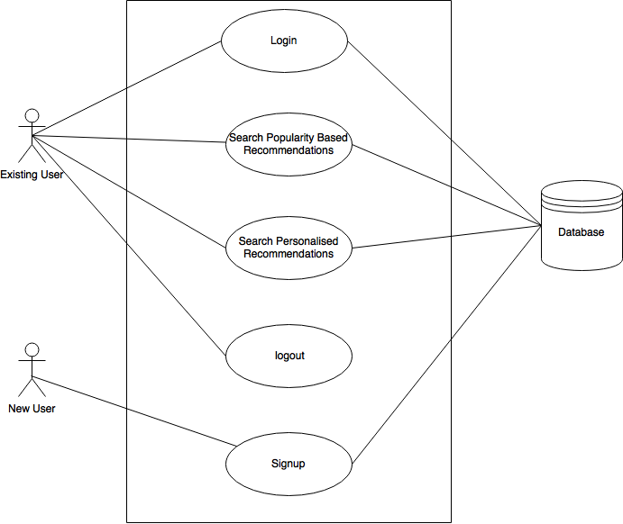
Functional Requirements: Use Cases

Slide 6
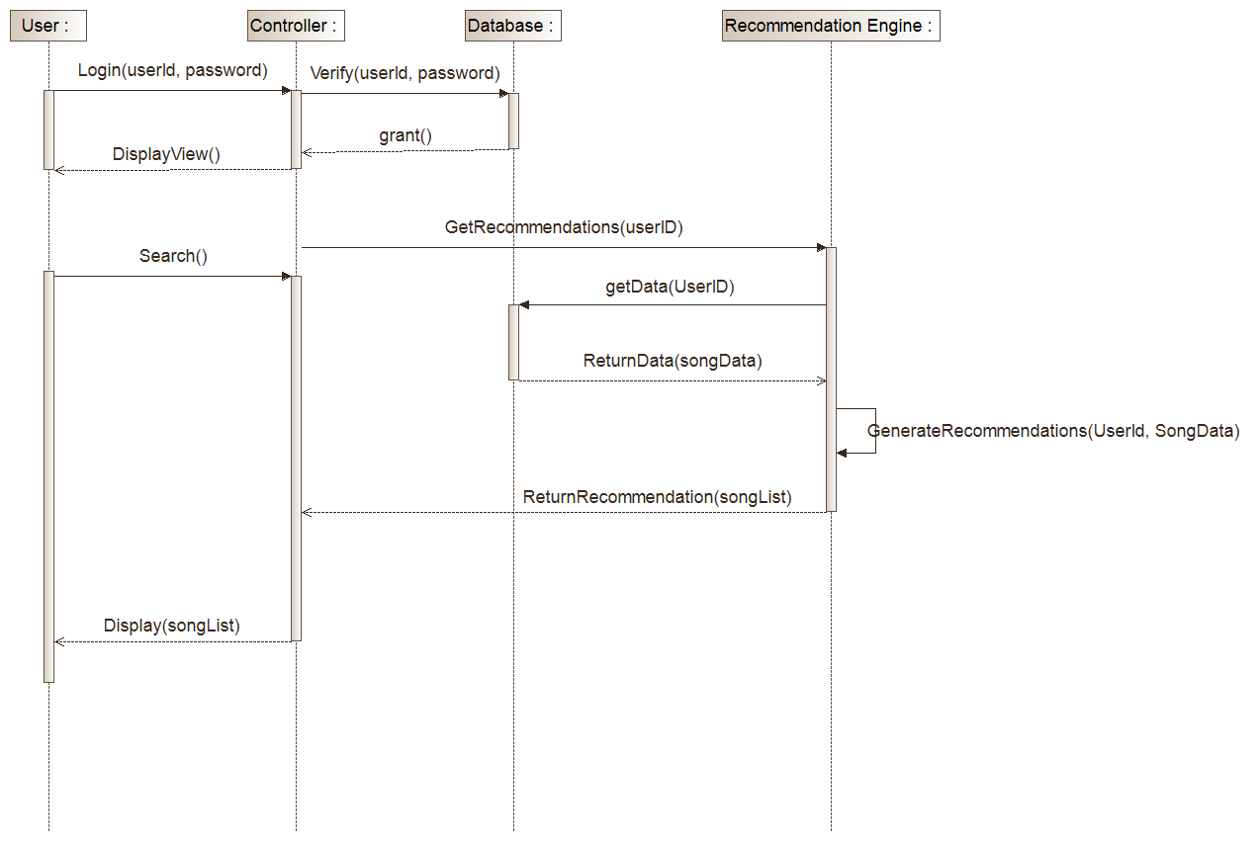
Functional Requirements: Sequence Diagram

Slide 7
Non-Functional Requirements
Security
Maintainability and Growth Potential
Performance
Ease of Use, Look and Feel

Slide 8
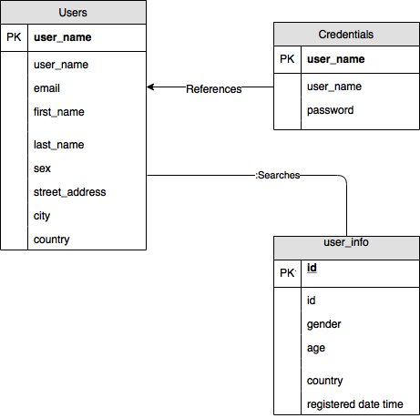
Database Logic

Slide 9
Development and Implementation Tools
1) Eclipse Oxygen 4.7.0
2) Java JDK and JRE 1.8
3) MySQL 5.7
4) Struts (2.5.13)
5) apache-log4j(1.2.17)
6) Jersey 2
7) Python 3.6
8) Anaconda 4
9) Pandas 0.21.0
10) Scikit Learn 0.19.1
11) Numpy 1.11.3
12) Flask (0.12.2)

Slide 10
APR Component
The application has two below components
1. APRSystem (Recommender System)
2. APRWebApplication

Slide 11
APRSystem (Recommender System)
This application creates two recommendation model which are as follows:
Popularity based recommendation: This model generates the recommendation based on the most popular songs in the database which means the song with the highest listen counts.
Personalized recommendation: This model generates the recommendation using collaborative filtering algorithm which takes the users listening behavior into consideration for generating recommendation.

Slide 12
PlaylistRecommenderAPI
This is a web service that APRSystem exposes to be consumed by other application to get the recommendations from the APR system.
This is a flask web API that takes the json data from the request and calls the recommendation engine to generate the recommendations which it sends as response to the consumer application.

Slide 13
APRWebApplication
This is the web application which users interact with, to get the playlist recommendations. This application consumes the PlaylistRecommenderAPI webservice and displays the recommended playlists to user.
This web application has been developed using struts2 framework and use jersey client to communicate with the recommendation web API.
The application uses a mysql database to store the all the user data including credentials.

Slide 14
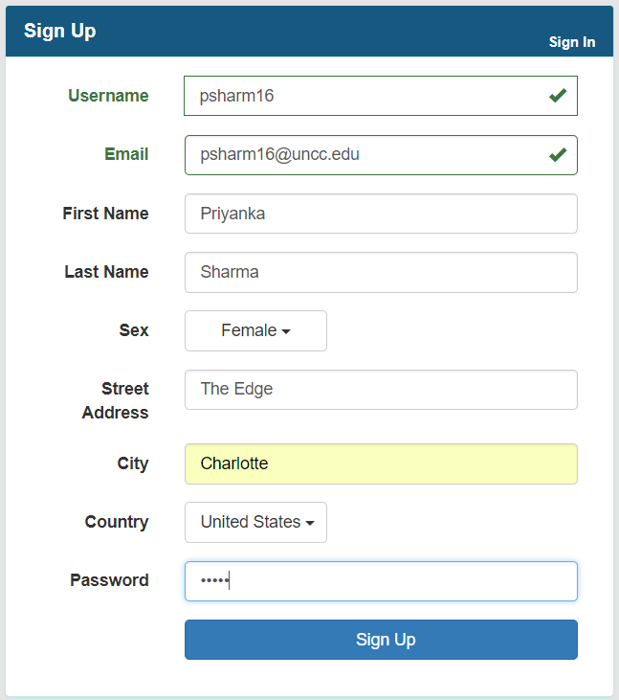
Web Interface-Signup

Slide 15
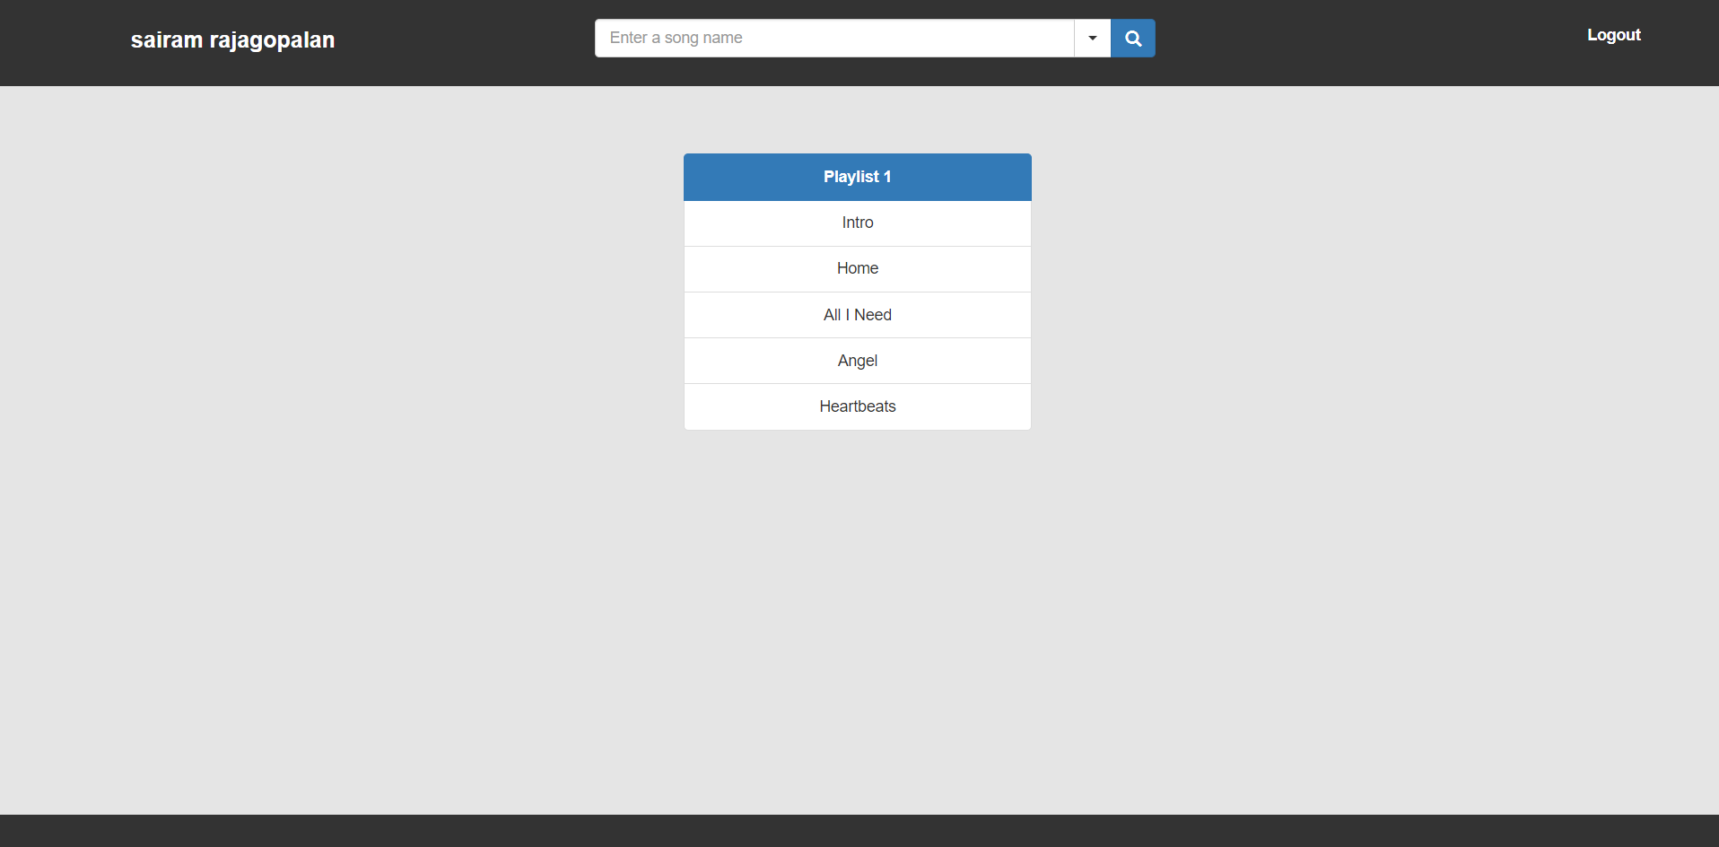
Web Interface-New User

Slide 16
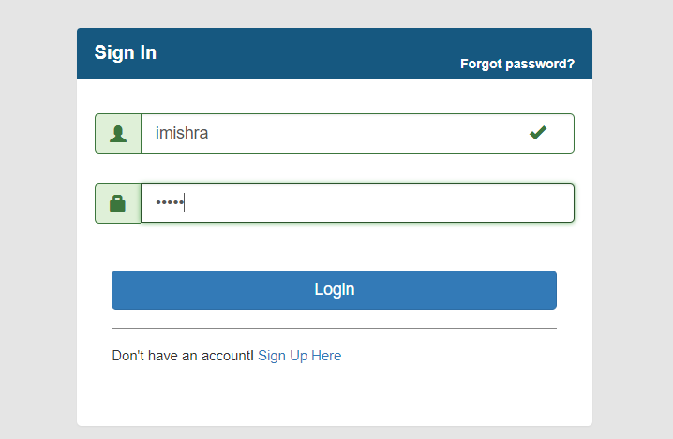
Web Interface-Login

Slide 17
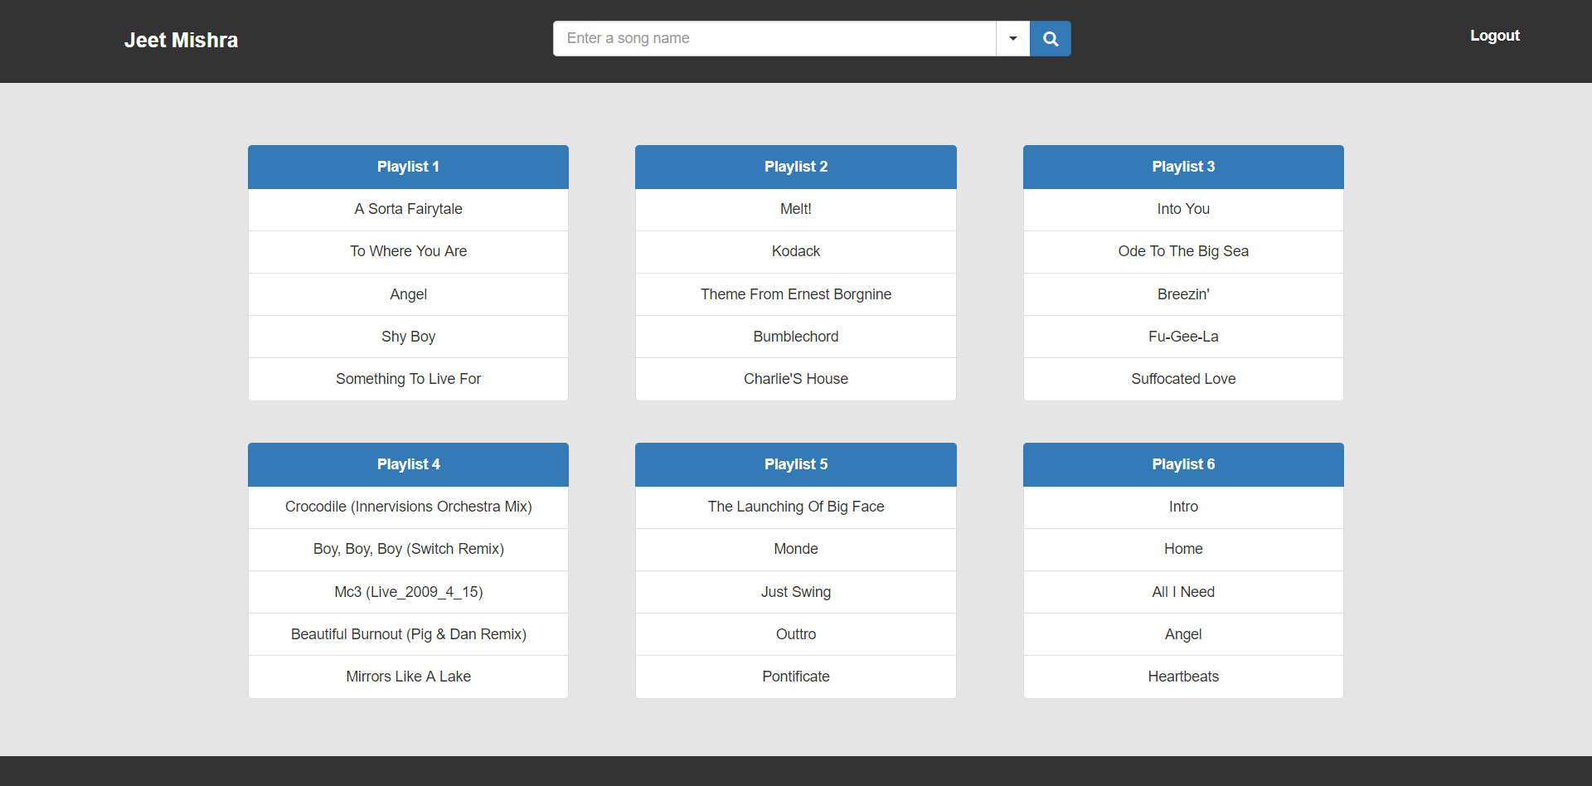
Web Interface-Home

Slide 18
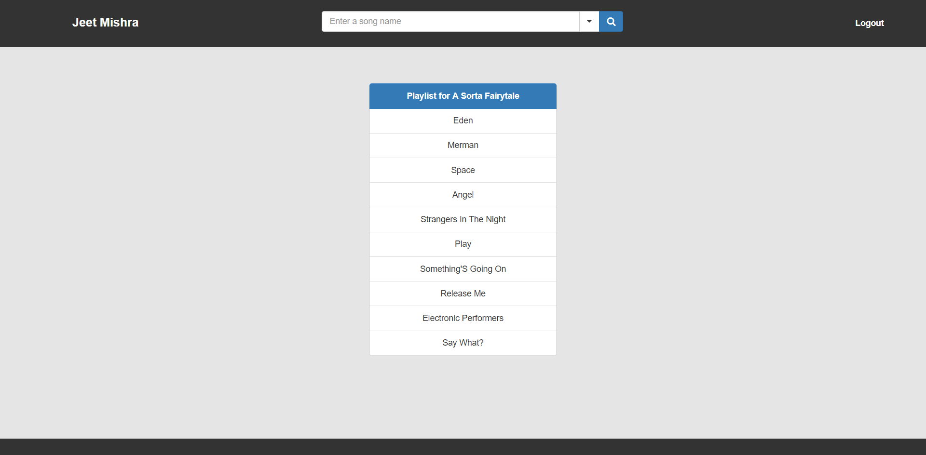
Web Interface-Playlist similar to a song

Slide 19
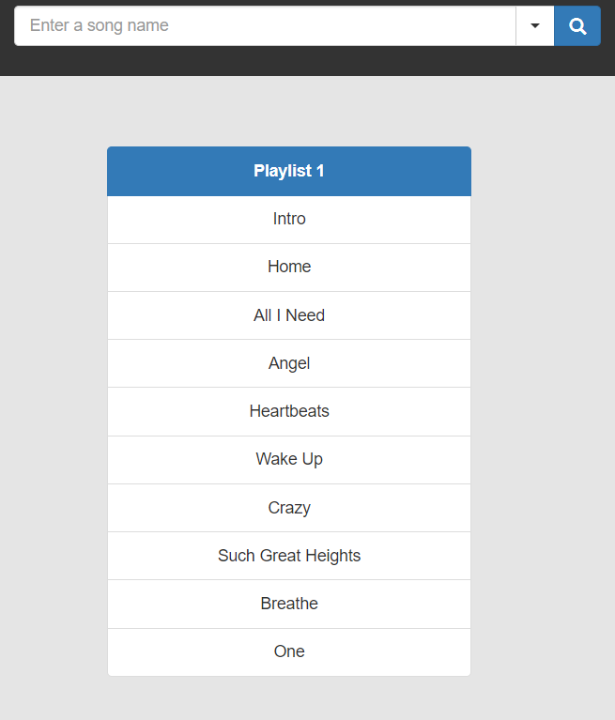
Web Interface-Most popular Songs

Slide 20
Password Encryption
The APRWebApplication uses SHA-256 encryption algorithm to encrypt the passwords.
A text is being added to the user’s password to created a salted password before doing the encryption in order to give the paswords an extra layer of security.

Slide 21
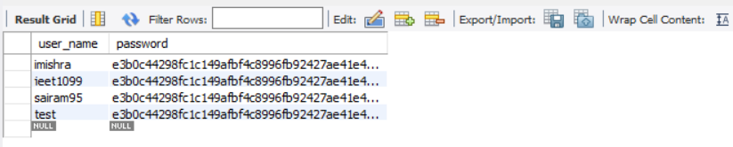
Password Encryption

Slide 22
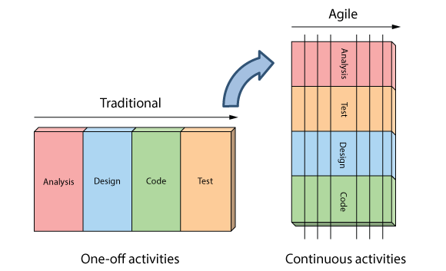
Development Process: Agile Model
Agile: Iterative approach to software development, in which interleaves the phases of software design.
Sprints: phases of development.
Important Principles:
Working software over heavy documentation
People over process
Anticipation of change
Image source: Agile in a Nutshell

Slide 23
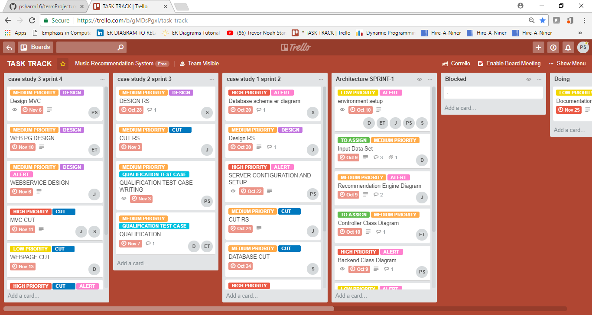
Development Process: Trello

Slide 24
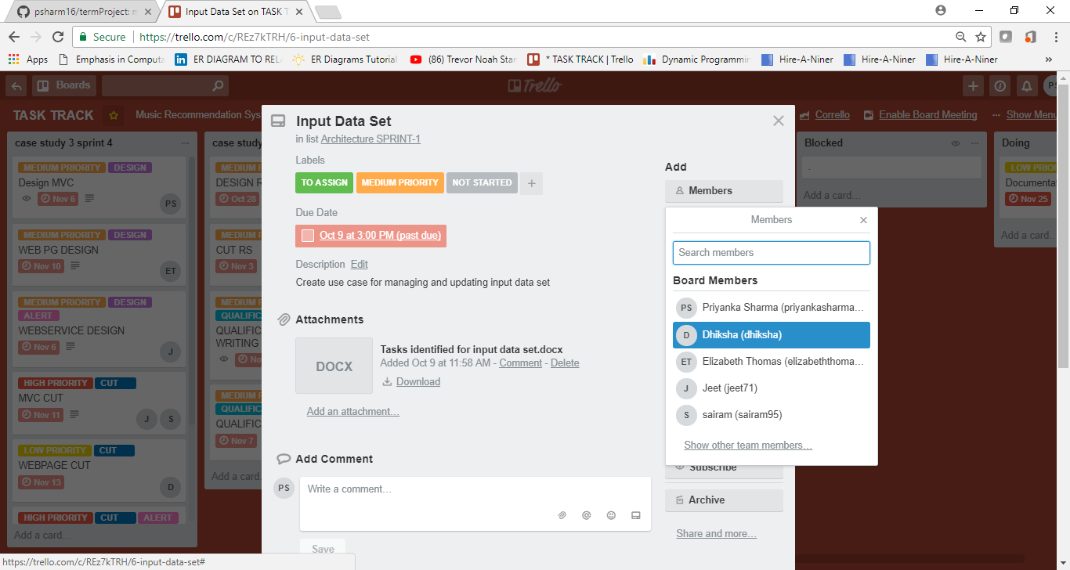
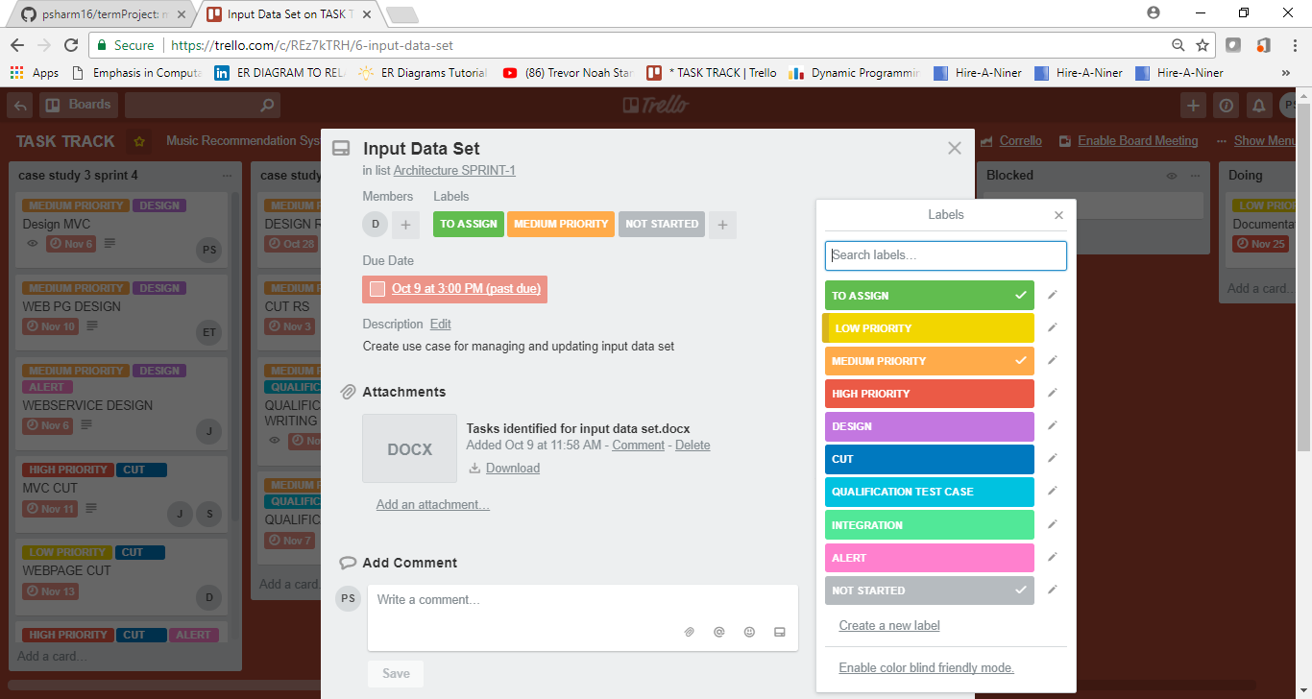

Slide 25
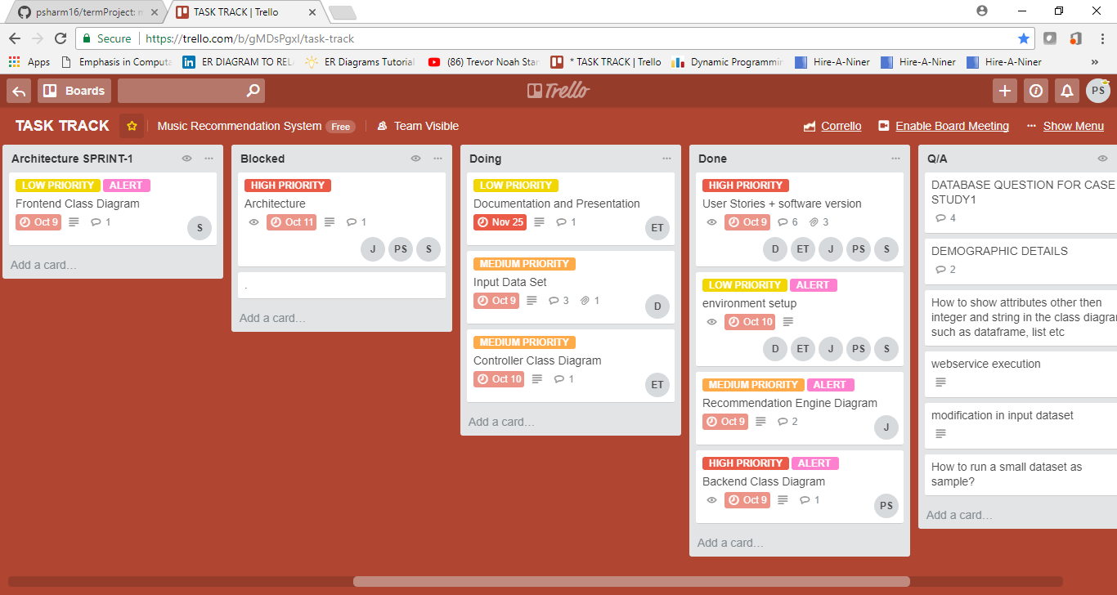

Slide 26
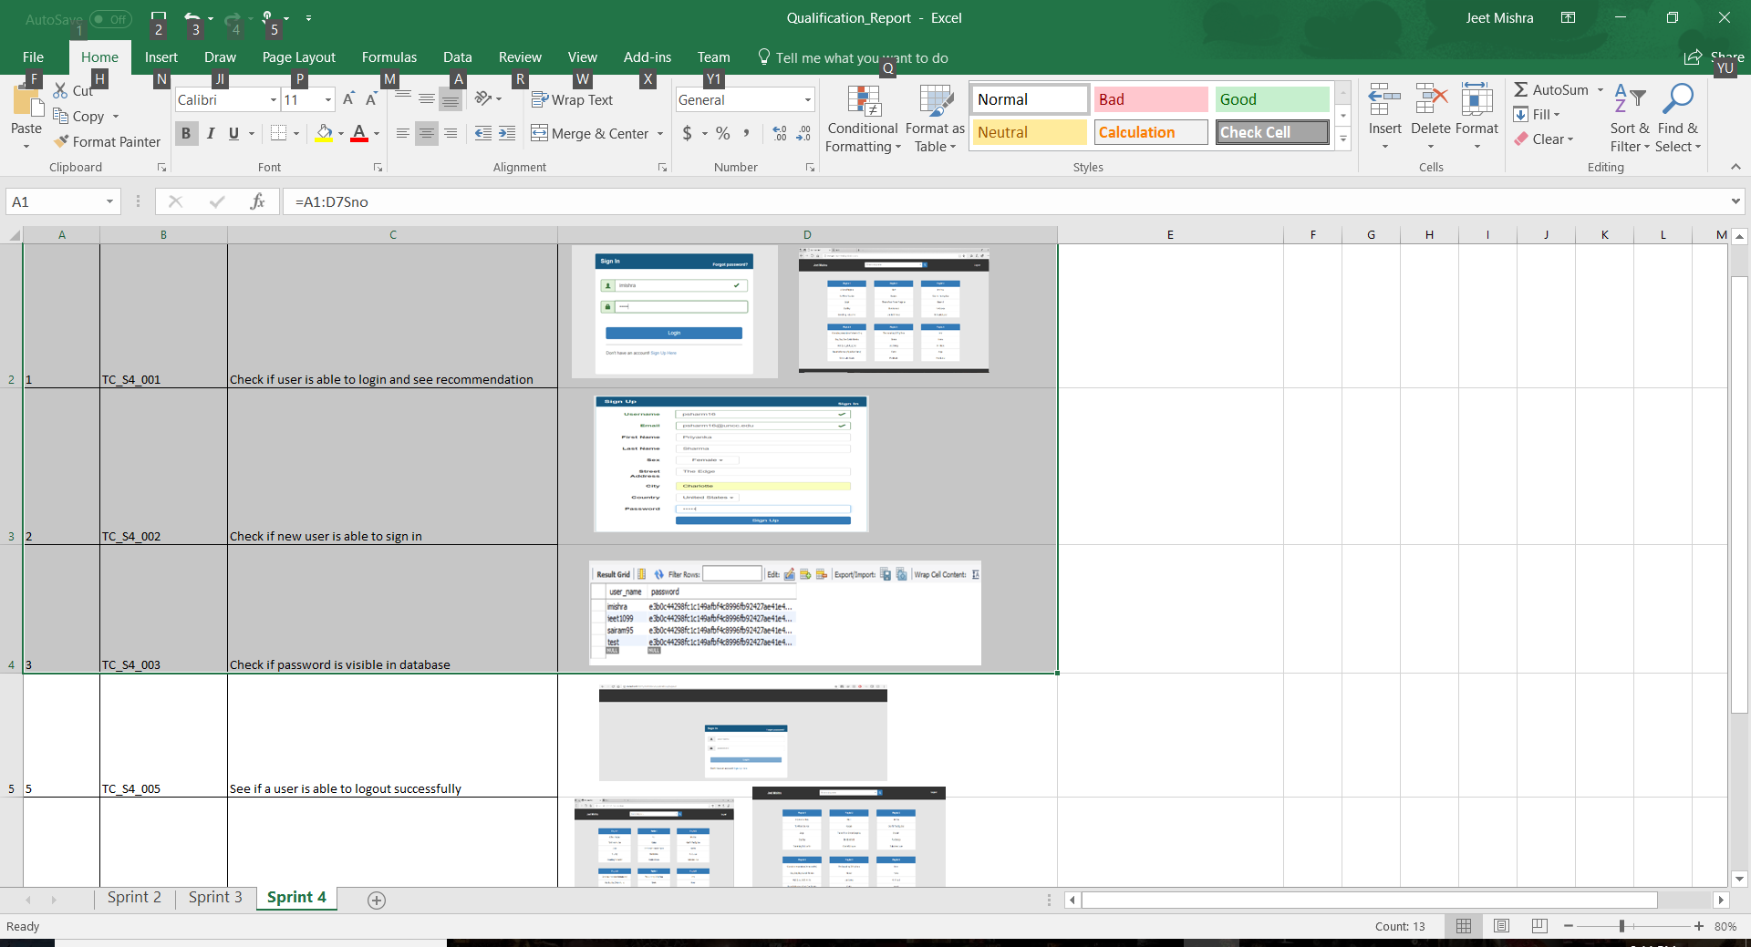
Qualification Tests

Slide 27
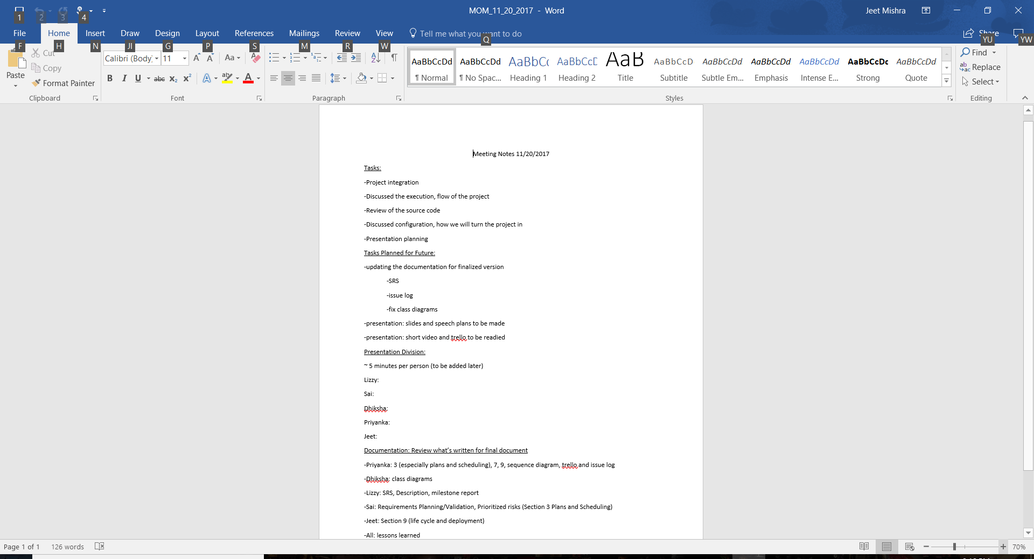
Minutes of Meeting

Slide 28
Developmental Process: Lessons Learned
Importance of strong communication when working in agile framework.
Usefulness of virtual tools, such as Slack, Trello, and Skype, to integrate all of our team members.
Time management
Importance of being specific when defining requirements
Usefulness of small group (paired programming) meetings
Productivity greatly aided by having a team leader.

Slide 29
Future Goals and Growth Plan
By using agile, our system is a dynamic project, which will be able to evolve with future versions.
Our ideal is that the system someday be integrated with a music listening system, which can dynamically update the users’ music listening history in the database.
Additionally, we had a few initial ideas initially that were unable to be accomplished due to time constraints:
Adding functionality for an administrator to be able to log in to the system and access a control view, where he or she could add or remove songs and users from the database. Perhaps this could even allow the administrator to view statistics about the recommendations and site-activity.
Adding a “subscribe to an artist” feature, which would allow users to receive playlists designed around a particular artist.

Slide 30
Conclusion:
Thus, this project is efficiently built to recommend songs to the user based on users’ listening behavior.
The user can choose if he wants the recommendations based on his personal interest or if he would like to recommendation for most trending songs.
This project can be further extended by adding online learning which can use the recommender system to keep training itself based on the new data it sees as users listens to new songs. In addition, an admin can be added to the application so that new songs can be added to the application.

Slide 31
DEMO

Slide 32
Questions?

