Slide 1
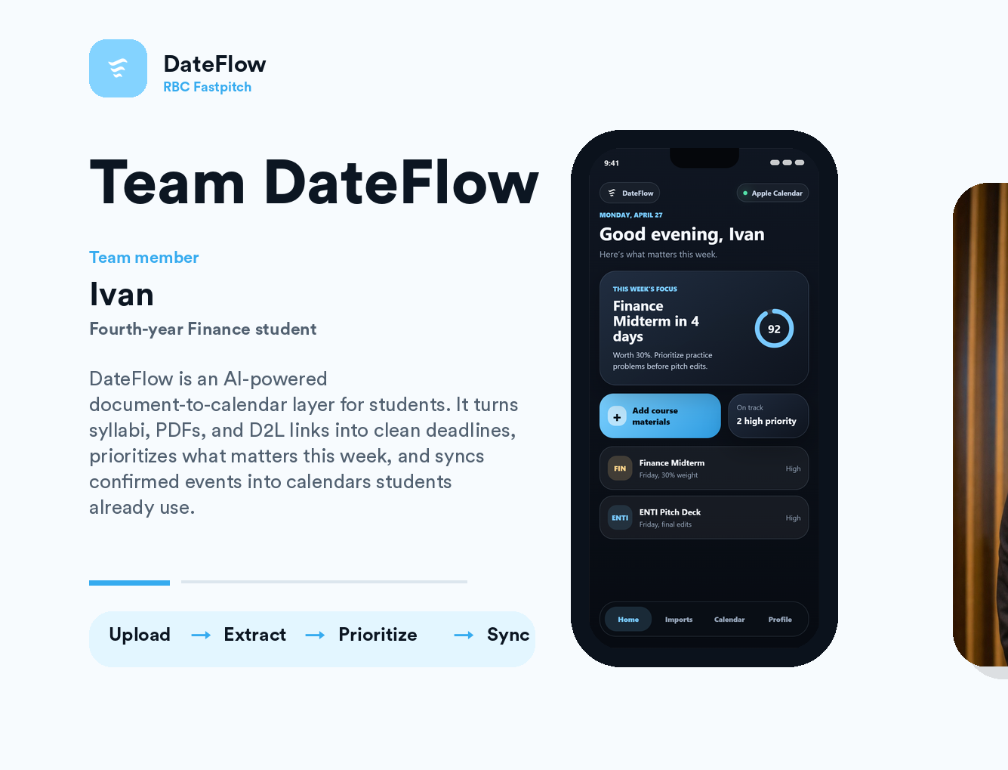
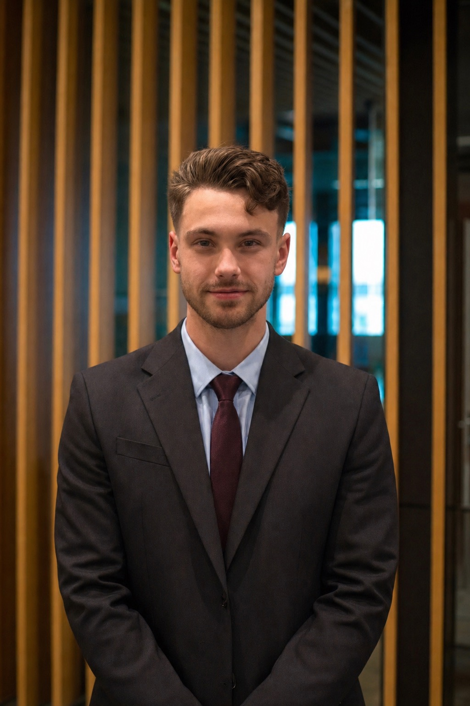
Good evening, Steve
Upload, Extract, Prioritize, & Sync

