Slide 1
DevOps: Dockers, Kubernetes & Jenkins
Imad Ali Abbasi

Slide 2
Tools Installation
Docker
Kubectl
Helm

Slide 3
Dev --------------------------------------> Ops
Development
Operations

Slide 4
DevOps
IaaS -> PaaS -> SaaS
Plays an essential role in agile environment
Continious Delivery / Continious Integration
When does it end … ?

Slide 5
“Tools R Lyf3”
- Every DevOps Engineer Ever

Slide 6
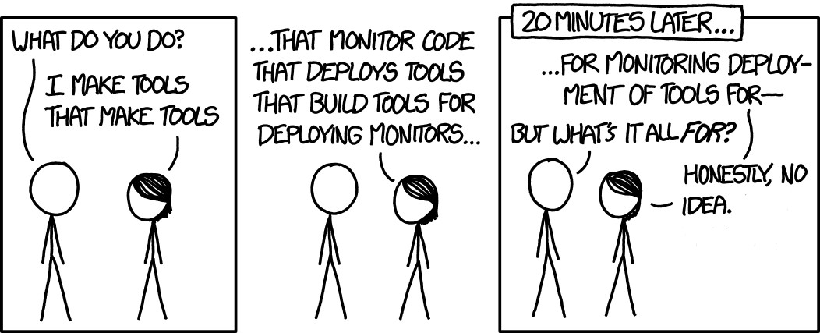
Tools
Configuration
Build
Deployment
Orchestrator
Monitoring

Slide 7
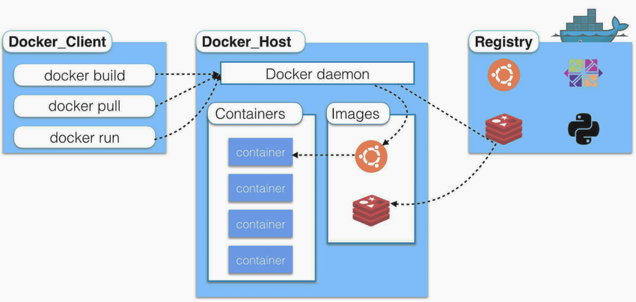
Docker
Notes:
https://github.com/wsargent/docker-cheat-sheet

Slide 8
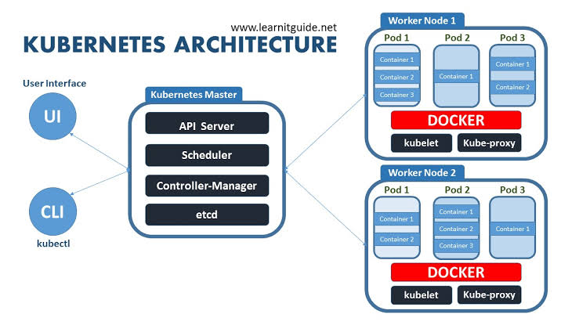
Kubernetes
Notes:
https://github.com/wsargent/docker-cheat-sheet

Slide 9
Hands on...

Slide 10
Questions?

