Slide 1
Review: Bayesian learning and inference
Suppose the agent has to make decisions about the value of an unobserved query variable X based on the values of an observed evidence variable E
Inference problem: given some evidence E = e, what is P(X | e)?
Learning problem: estimate the parameters of the probabilistic model P(X | E) given a training sample {(e₁,x₁), …, (e_{n},x_{n})}

Slide 2
Example of model and parameters
Naïve Bayes model:
Model parameters:
Likelihood
of spam
Likelihood
of ¬spam
prior
P(w₁ | spam)
P(w₂ | spam)
…
P(w_{n} | spam)
P(w₁ | ¬spam)
P(w₂ | ¬spam)
…
P(w_{n} | ¬spam)
P(spam)
P(¬spam)

Slide 3
Example of model and parameters
Naïve Bayes model:
Model parameters (θ):
Likelihood
of spam
Likelihood
of ¬spam
prior
P(w₁ | spam)
P(w₂ | spam)
…
P(w_{n} | spam)
P(w₁ | ¬spam)
P(w₂ | ¬spam)
…
P(w_{n} | ¬spam)
P(spam)
P(¬spam)

Slide 4
Learning and Inference
x: class, e: evidence, θ: model parameters
MAP inference:
ML inference:
Learning:
(MAP)
(ML)

Slide 5
Probabilistic inference
A general scenario:
Query variables: X
Evidence (observed) variables: E = e
Unobserved variables: Y
If we know the full joint distribution P(X, E, Y), how can we perform inference about X?
Problems
Full joint distributions are too large
Marginalizing out Y may involve too many summation terms

Slide 6
Bayesian networks
More commonly called graphical models
A way to depict conditional independence relationships between random variables
A compact specification of full joint distributions

Slide 7
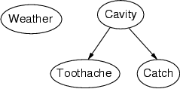
Structure
Nodes: random variables
Can be assigned (observed) or unassigned (unobserved)
Arcs: interactions
An arrow from one variable to another indicates direct influence
Encode conditional independence
Weather is independent of the other variables
Toothache and Catch are conditionally independent given Cavity
Must form a directed, acyclic graph

Slide 8
Example: N independent coin flips
Complete independence: no interactions
…
X₁
X₂
X_{n}

Slide 9
Example: Naïve Bayes spam filter
Random variables:
C: message class (spam or not spam)
W₁, …, W_{n}: words comprising the message
C
…
W₁
W₂
W_{n}

Slide 10
Example: Burglar Alarm
I have a burglar alarm that is sometimes set off by minor earthquakes. My two neighbors, John and Mary, promised to call me at work if they hear the alarm
Example inference task: suppose Mary calls and John doesn’t call. Is there a burglar?
What are the random variables?
Burglary, Earthquake, Alarm, JohnCalls, MaryCalls
What are the direct influence relationships?
A burglar can set the alarm off
An earthquake can set the alarm off
The alarm can cause Mary to call
The alarm can cause John to call

Slide 11
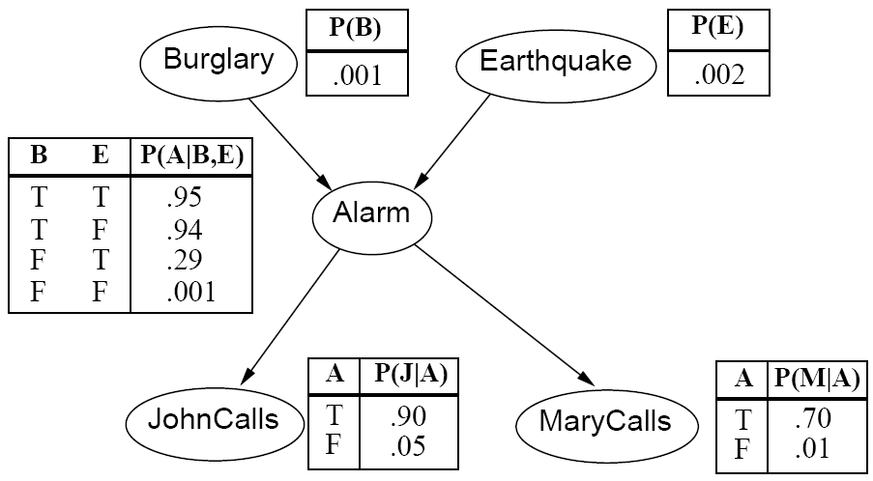
Example: Burglar Alarm
What are the model parameters?

Slide 12
Conditional probability distributions
To specify the full joint distribution, we need to specify a conditional distribution for each node given its parents: P (X | Parents(X))
…
Z₁
Z₂
Z_{n}
X
P (X | Z₁, …, Z_{n})

Slide 13
Example: Burglar Alarm

Slide 14
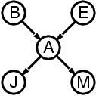
The joint probability distribution
For each node X_{i}, we know P(X_{i} | Parents(X_{i}))
How do we get the full joint distribution P(X₁, …, X_{n})?
Using chain rule:
For example, P(j, m, a, ¬b, ¬e)
= P(¬b) P(¬e) P(a | ¬b, ¬e) P(j | a) P(m | a)

Slide 15
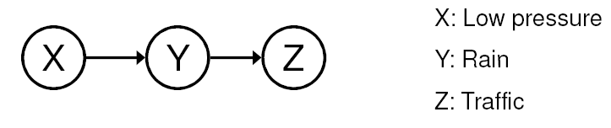
Conditional independence
Key assumption: X is conditionally independent of every non-descendant node given its parents
Example: causal chain
Are X and Z independent?
Is Z independent of X given Y?

Slide 16
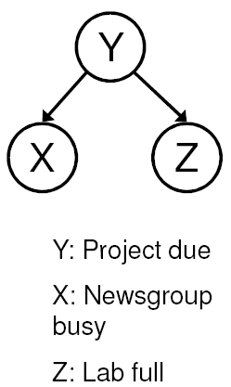
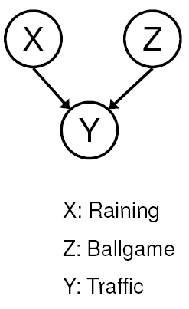
Conditional independence
Common cause
Are X and Z independent?
No
Are they conditionally independent given Y?
Yes
Common effect
Are X and Z independent?
Yes
Are they conditionally independent given Y?
No

Slide 17
Compactness
Suppose we have a Boolean variable X_{i} with k Boolean parents. How many rows does its conditional probability table have?
2^{k} rows for all the combinations of parent values
Each row requires one number p for X_{i} = true
If each variable has no more than k parents, how many numbers does the complete network require?
O(n · 2^{k}) numbers – vs. O(2^{n}) for the full joint distribution
How many nodes for the burglary network?
1 + 1 + 4 + 2 + 2 = 10 numbers (vs. 2⁵-1 = 31)

Slide 18
Constructing Bayesian networks
Choose an ordering of variables X₁, … , X_{n}
For i = 1 to n
add X_{i} to the network
select parents from X₁, … ,X_{i-1} such that P(X_{i} | Parents(X_{i})) = P(X_{i} | X₁, ... X_{i-1})

Slide 19
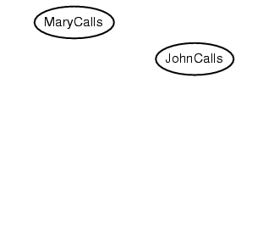
Example
Suppose we choose the ordering M, J, A, B, E
P(J | M) = P(J)?

Slide 20
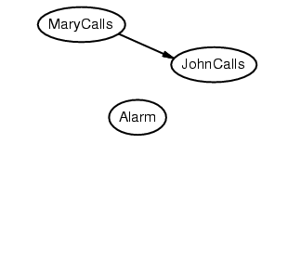
Example
Suppose we choose the ordering M, J, A, B, E
P(J | M) = P(J)? No

Slide 21
Example
Suppose we choose the ordering M, J, A, B, E
P(J | M) = P(J)? No
P(A | J, M) = P(A)?
P(A | J, M) = P(A | J)?
P(A | J, M) = P(A | M)?

Slide 22
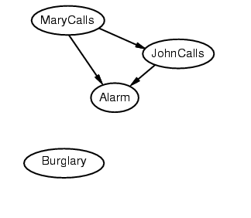
Example
Suppose we choose the ordering M, J, A, B, E
P(J | M) = P(J)? No
P(A | J, M) = P(A)? No
P(A | J, M) = P(A | J)? No
P(A | J, M) = P(A | M)? No

Slide 23
Example
Suppose we choose the ordering M, J, A, B, E
P(J | M) = P(J)? No
P(A | J, M) = P(A)? No
P(A | J, M) = P(A | J)? No
P(A | J, M) = P(A | M)? No
P(B | A, J, M) = P(B)?
P(B | A, J, M) = P(B | A)?

Slide 24
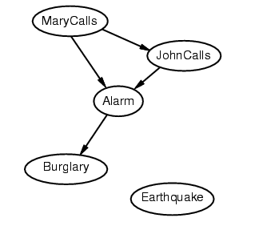
Example
Suppose we choose the ordering M, J, A, B, E
P(J | M) = P(J)? No
P(A | J, M) = P(A)? No
P(A | J, M) = P(A | J)? No
P(A | J, M) = P(A | M)? No
P(B | A, J, M) = P(B)? No
P(B | A, J, M) = P(B | A)? Yes

Slide 25
Example
Suppose we choose the ordering M, J, A, B, E
P(J | M) = P(J)? No
P(A | J, M) = P(A)? No
P(A | J, M) = P(A | J)? No
P(A | J, M) = P(A | M)? No
P(B | A, J, M) = P(B)? No
P(B | A, J, M) = P(B | A)? Yes
P(E | B, A ,J, M) = P(E)?
P(E | B, A, J, M) = P(E | A, B)?

Slide 26
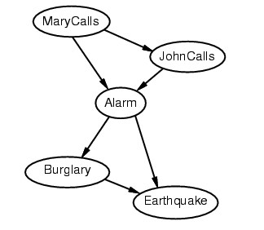
Example
Suppose we choose the ordering M, J, A, B, E
P(J | M) = P(J)? No
P(A | J, M) = P(A)? No
P(A | J, M) = P(A | J)? No
P(A | J, M) = P(A | M)? No
P(B | A, J, M) = P(B)? No
P(B | A, J, M) = P(B | A)? Yes
P(E | B, A ,J, M) = P(E)? No
P(E | B, A, J, M) = P(E | A, B)? Yes

Slide 27
Example contd.
Deciding conditional independence is hard in noncausal directions
The causal direction seems much more natural
Network is less compact: 1 + 2 + 4 + 2 + 4 = 13 numbers needed

Slide 28
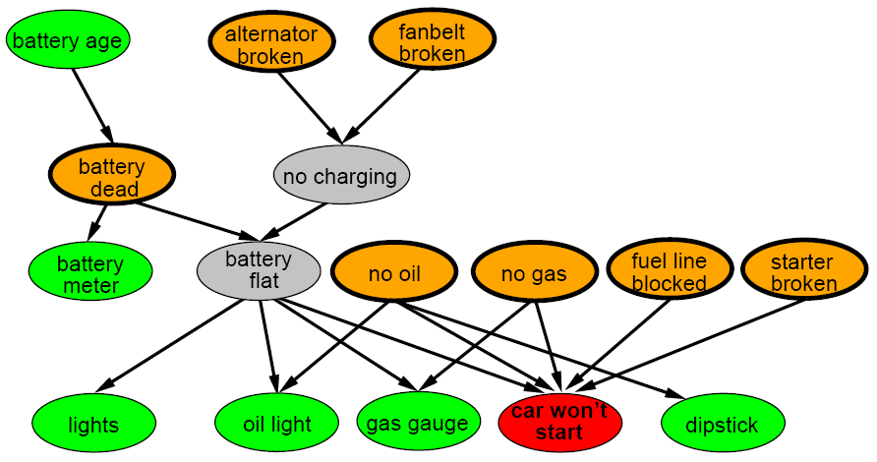
A more realistic Bayes Network: Car diagnosis
Initial observation: car won’t start
Orange: “broken, so fix it” nodes
Green: testable evidence
Gray: “hidden variables” to ensure sparse structure, reduce parameteres

Slide 29
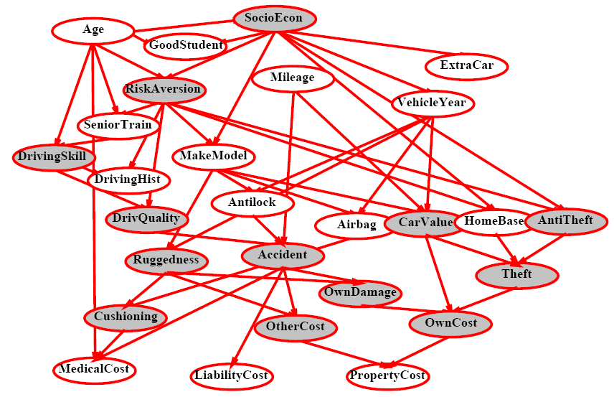
Car insurance

Slide 30
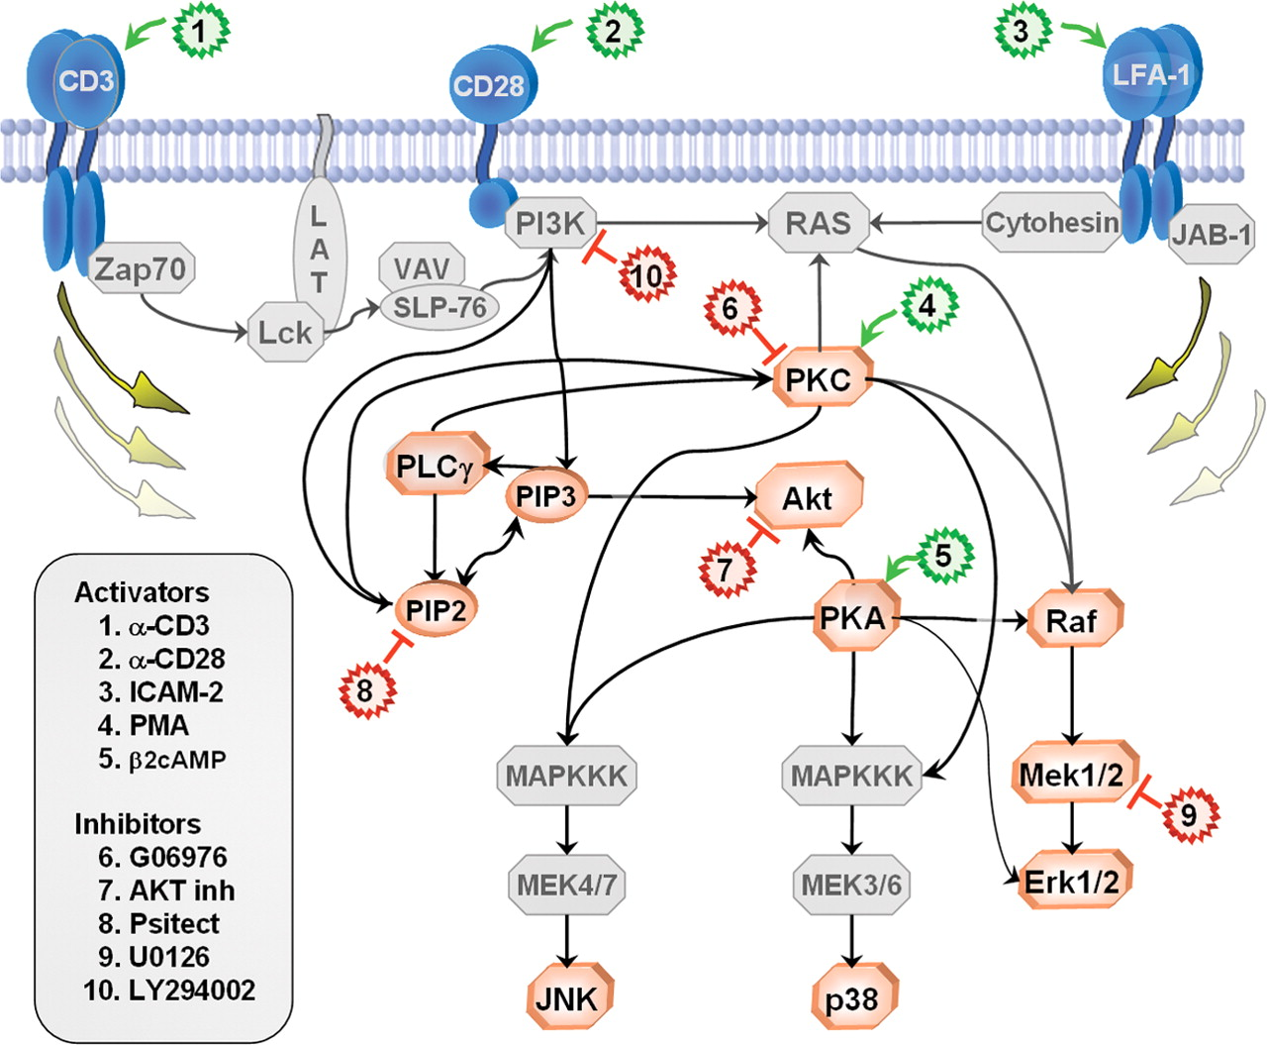
In research literature…
Causal Protein-Signaling Networks Derived from Multiparameter Single-Cell Data
Karen Sachs, Omar Perez, Dana Pe'er, Douglas A. Lauffenburger, and Garry P. Nolan
(22 April 2005) Science 308 (5721), 523.

Slide 31
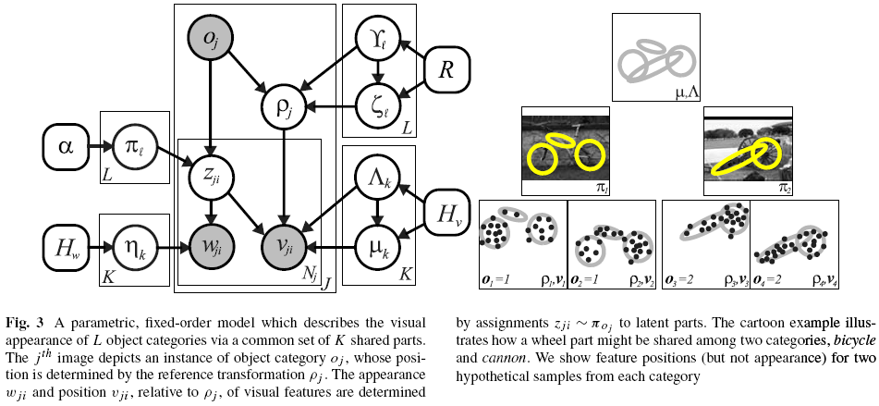
In research literature…
Describing Visual Scenes Using Transformed Objects and Parts
E. Sudderth, A. Torralba, W. T. Freeman, and A. Willsky.
International Journal of Computer Vision, No. 1-3, May 2008, pp. 291-330.

Slide 32
Summary
Bayesian networks provide a natural representation for (causally induced) conditional independence
Topology + conditional probability tables
Generally easy for domain experts to construct

