Slide 1
Human Activity Recognition using Smartphone Data (HAR)
CS 4661 – Project
By:
Jay Patel | Dhruval Variya
Kunal Kapadnis | Nishkami Patel
Geeth Chadalwada

Slide 2
Overview
Introduction
Data
Goal
Implementation
Results
Conclusion

Slide 3
Introduction
UCI has performed an experiment with a group of 30 volunteers within an age bracket of 19-48 years
Each person performed six activities (WALKING, WALKING_UPSTAIRS, WALKING_DOWNSTAIRS, SITTING, STANDING, LAYING) wearing a smartphone (Samsung Galaxy S II) on the waist
Using its embedded accelerometer and gyroscope, they captured 3-axial linear acceleration and 3-axial angular velocity at a constant rate of 50Hz

Slide 4
Data
Dataset has been randomly partitioned into two sets,
70% of the volunteers was selected for generating the training data and 30% the test data
The sensor signals (accelerometer and gyroscope) were pre-processed by applying noise filters and transformed before recording into the dataset
All the features are normalized between [-1,1]
Train and Test data is stored separately in a txt file

Slide 5
Data
Total 10299 data records are provided
Each record has 561 features in it
All the features are scaler
Label vector consists of the values from the set of actions encoded as numbers
{ 1: WALKING,
2: WALKING_UPSTAIRS,
3: WALKING_DOWNSTAIRS,
4: SITTING,
5: STANDING,
6: LAYING }

Slide 6
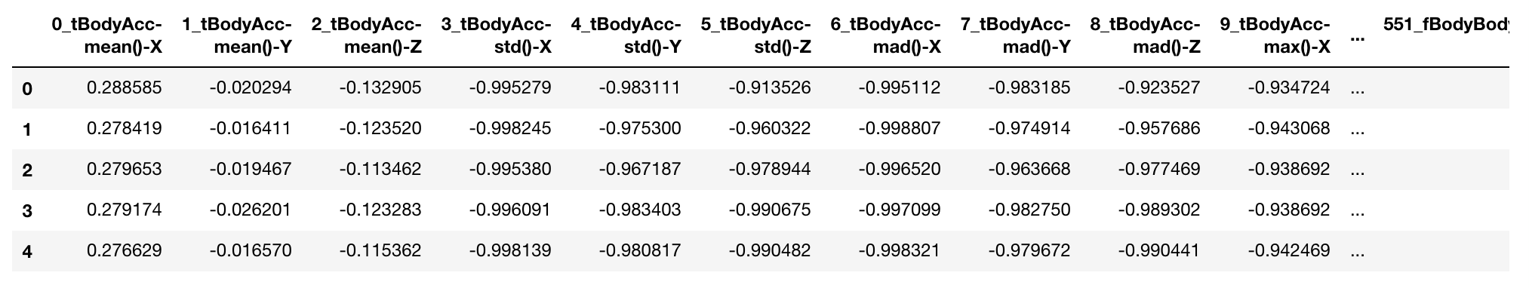
Data
Features Structure

Slide 7
Goal
To Predict the User Activity from one of the six category
To reduce the number of features to be trained
It takes a while to fit and predict using all 561 features
Apply different methods of classification algorithms
Evaluate and compare using ROC and AUC

Slide 8
Implementation
Used Python 3 and Jupyter Notebook
Used scikit-learn, pandas, numpy and matplotlib

Slide 9
Algorithms
Decision Tree Classifier
Logistic Regressor
Random Forest Tree Classifier
K-Neighbors Classifier

Slide 10
PCA

Slide 11
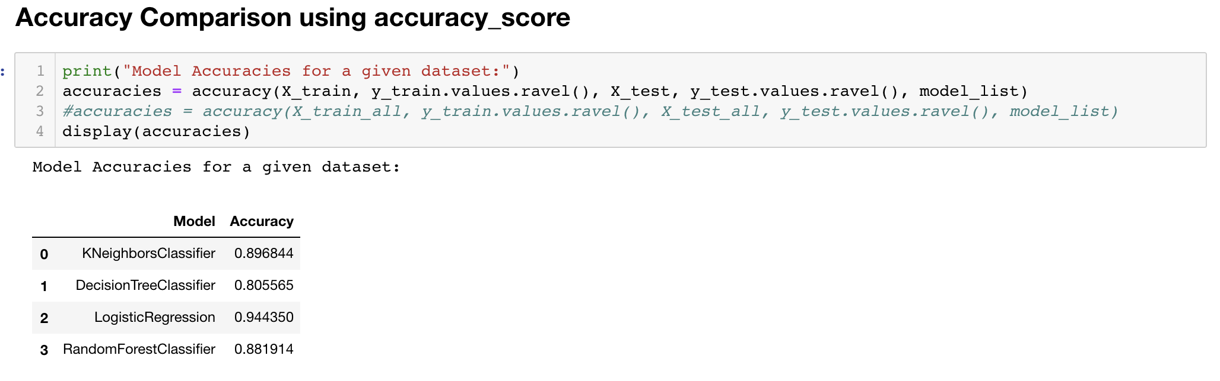
Accuracy Comparison

Slide 12
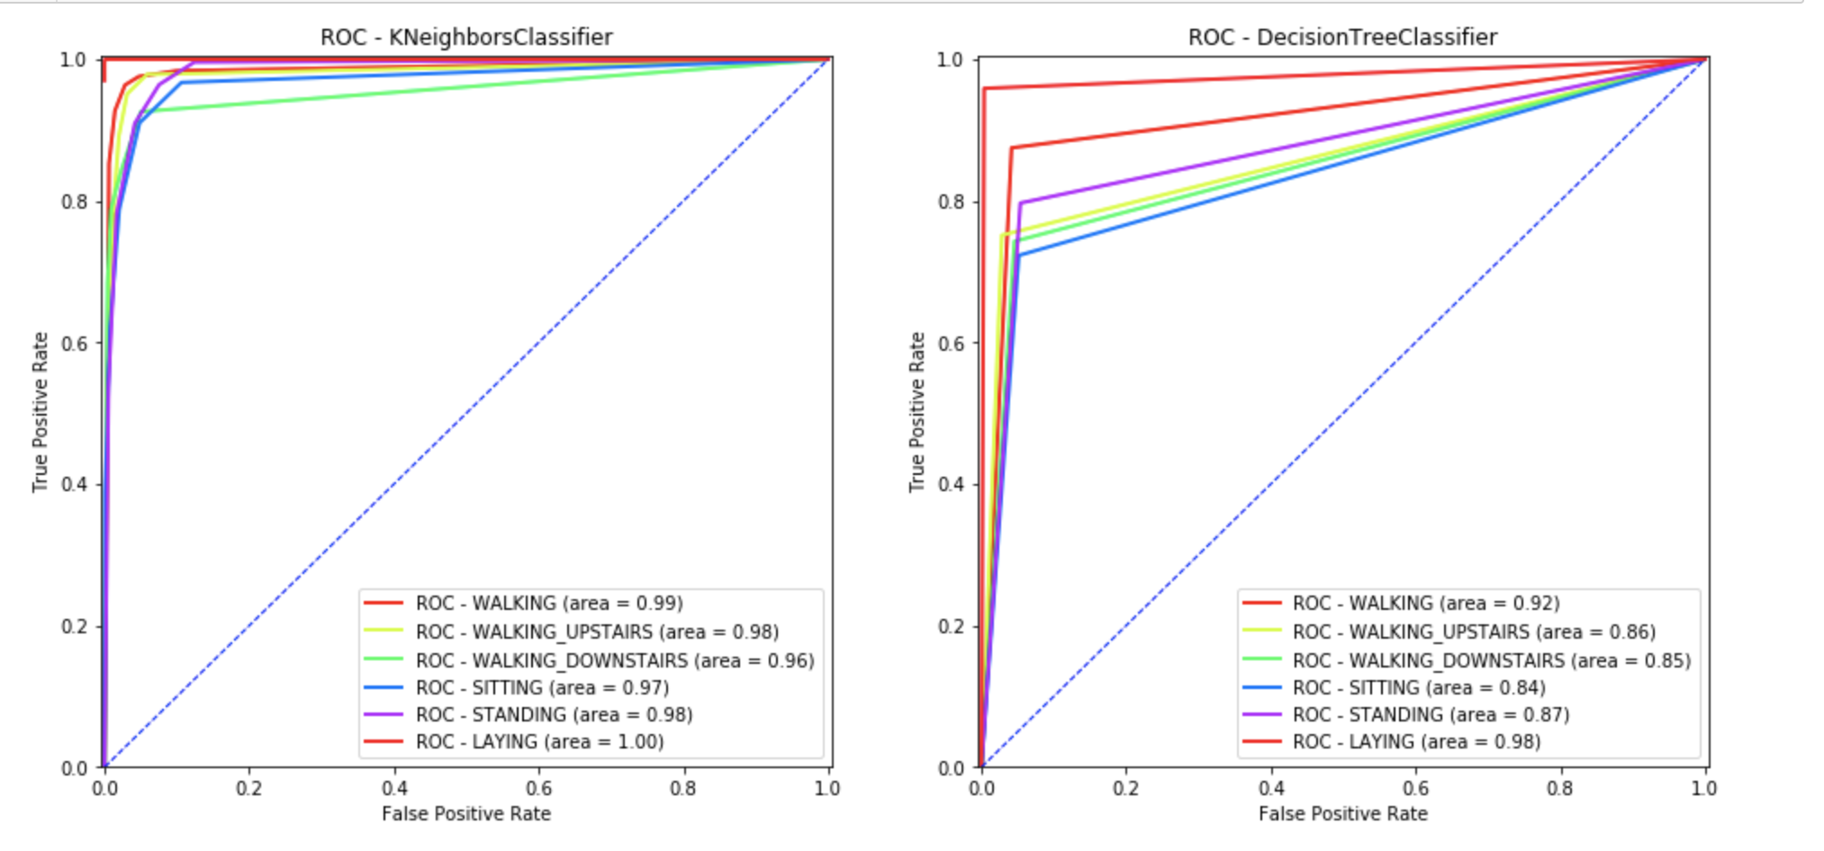
ROC

Slide 13
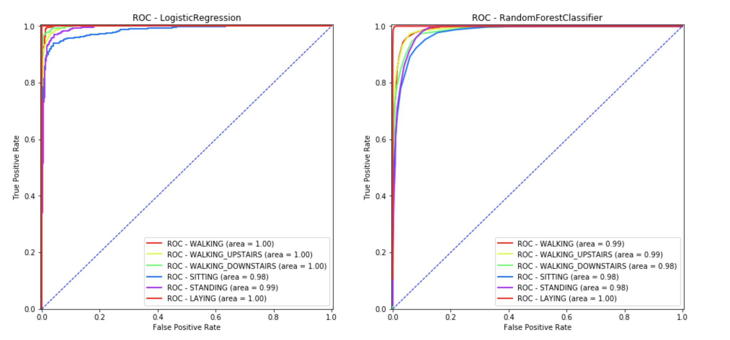
ROC

Slide 14
Conclusion
Activity can be predicted significantly faster with up to 94% of accuracy using just about 14% of the features
Among all 4 methods, Logistic Regressor performed the best
Model | Accuracy
Logistic Regressor | 0.94
KNeighbors Classifier | 0.90
Random Forest Classifier | 0.89
Decision Tree Classifier | 0.80

