Slide 1
Corporate goodness and shareholders wealth

Slide 2
Outline
Data：KLD
Event study methodology A. Regression against CAR B. Controlling explicitly
Analysis A. Overall event B. Agency-motivated and offsetting CSR C. Textual Analysis

Slide 3
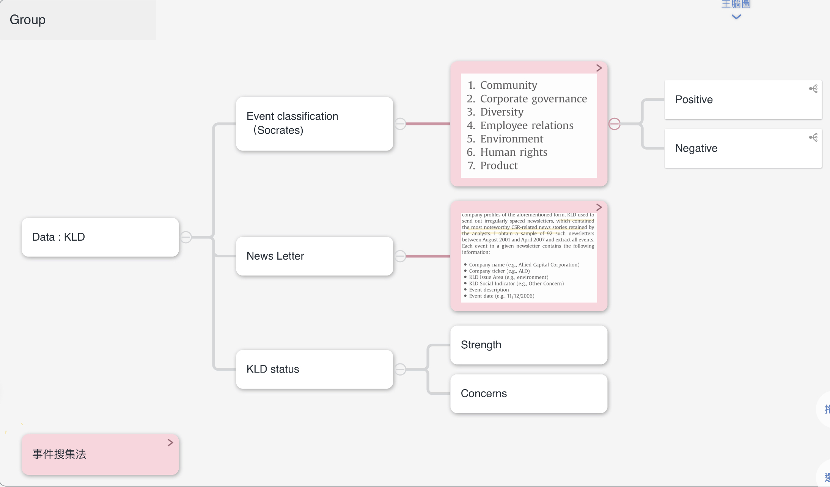
1. Data
Notes:
Sorcrates : 含有公司profile 的資料庫，以及公司的事件與分類(KLD公司自行整理的)
News Letter : 重大新聞直接寄過來
KLD status(under socartes) : 根據newspaper articles, Non-governmental organization (NGO) reports, regulatory reports, or company rankings來作為根據

Slide 4
Outline
Data：KLD
Event study methodology A. Regression against CAR B. Controlling explicitly
Analysis A. Overall event B. Agency-motivated and offsetting CSR C. Textual Analysis (unfinshed)
Notes:
用KLD資料的時間來定義異常事件，並收集一定時間區間內的累積異常報酬

Slide 5
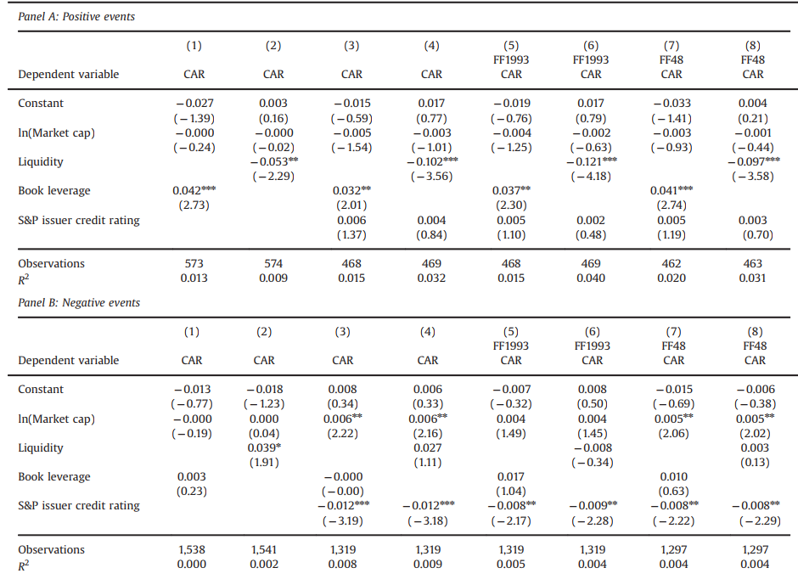
2. Event Study methodology (Regression)
Notes:
篩選掉模糊時間點，並比對新聞變成public available 的時間點，並對該時間的前後 t-h, t+h 區間計算累積異常報酬(CARs)

Slide 6
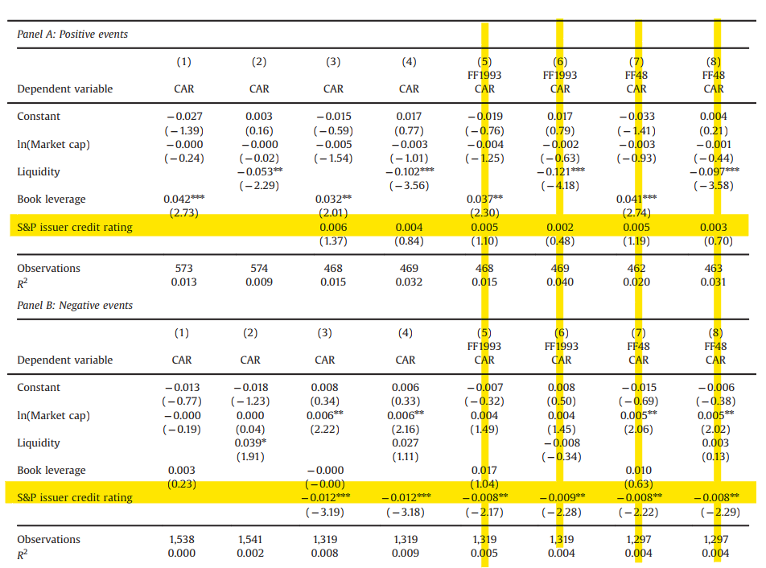
2. Event Study methodology (Controlling explicitly )
Notes:
5~8 的CAR 是被Asset pricing model 整過的CAR 為了 {to role out size value growth industry}

Slide 7
Outline
Data：KLD
Event study methodology A. Regression against CAR B. Controlling explicitly
Analysis A. Overall event B. Agency-motivated and offsetting CSR C. Textual Analysis (unfinshed)
Notes:
Overall event只說 他只看正面與副面消息在七個領域的累積異常報酬是否為統計顯著

Slide 8
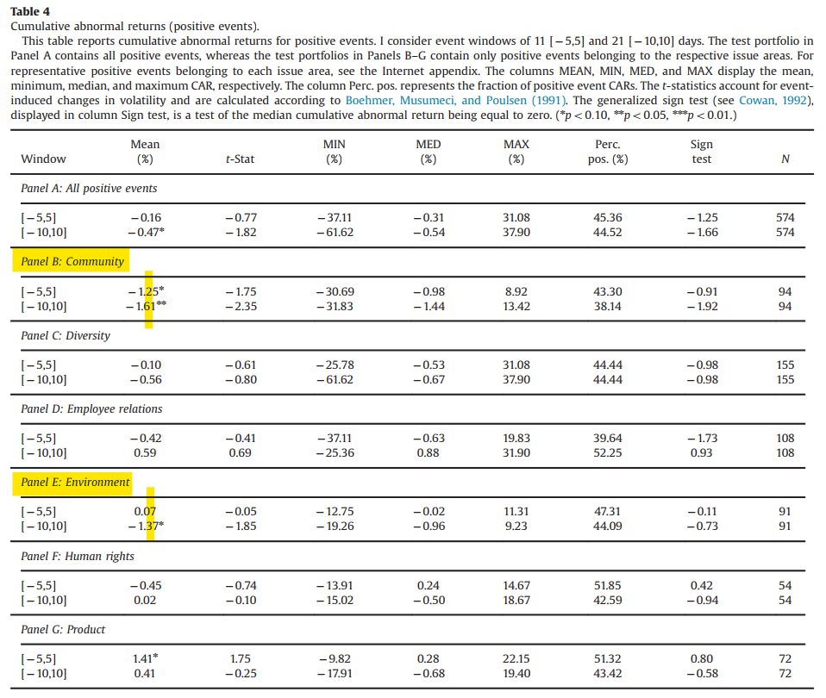
3. Overall event – Positive
Conclusion : Positive CSR news has slightly negative effect on CAR
Note : But Positive in some scenario see 3.B
Notes:
每個領域的累積異常報酬是否顯著大於或小於0

Slide 9
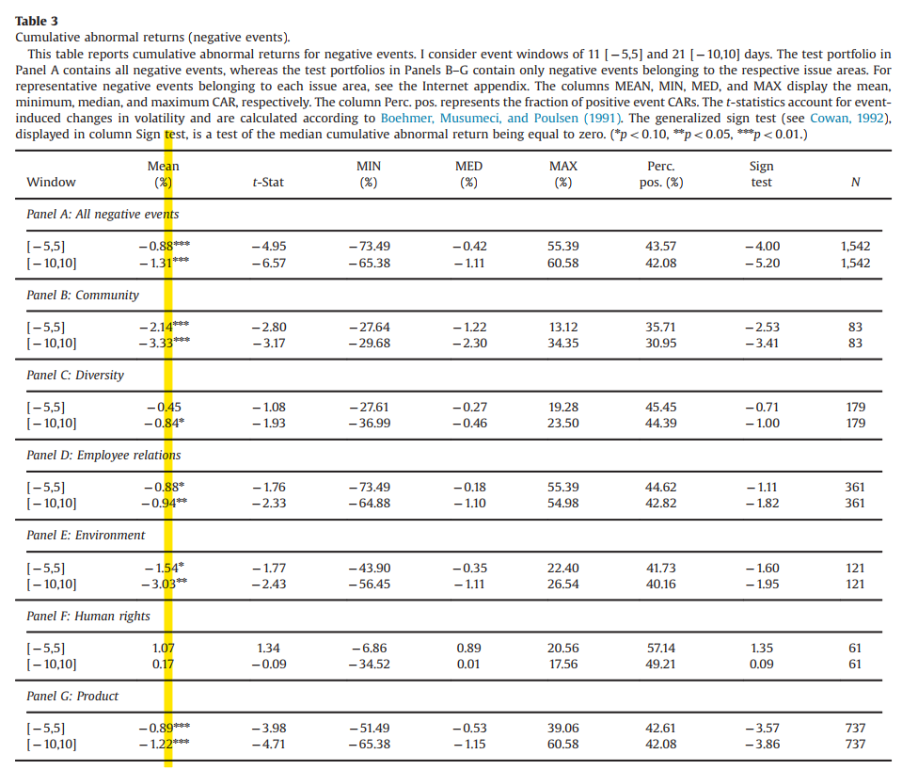
3. Overall event –Negative
Conclusion : Negative CSR news has strong negative effect on CAR

Slide 10
Outline
Data：KLD
Event study methodology A. Regression against CAR B. Controlling explicitly
Analysis A. Overall event B. Agency-motivated and offsetting CSR (AM-OC) C. Textual Analysis (unfinshed)

Slide 11
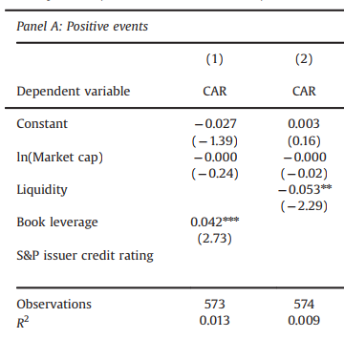

3. AM-OC – Positive – AM
Measurement (Book Leverage & Liquidity) : High Leverage & Low Liquidity → low agency problem
Assumption : Less Agency Problem → More favorable return
Formula :
Conclusion : High Liquidity → low return High Leverage → Favorable return
Notes:
透過Book Leverage & Liquidity來衡量 firm 是否存在 agency problem ，公司在面對財務壓力的時候不會亂花錢(agency problem)
Low agency problem 的公司因為做CSR的動機較純所以會有更好的報酬
3. 有Agency problem 的公司 return 較少

Slide 12
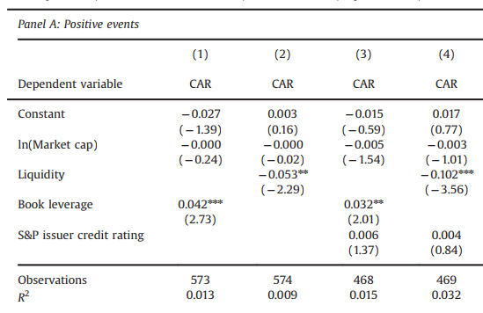

3. AM-OC – Positive – AM (Externality Control)
Credit Rating (to avoid financial distress)
Assumption : May Cause overact of the market
Formula :
Conclusion : No effect to the previous conclusion
Notes:
消費者可能會對在financial distress 下的公司的good news overact, 造成該firm 表現較好的原因就與CSR無關，而是與過度反應有關

Slide 13
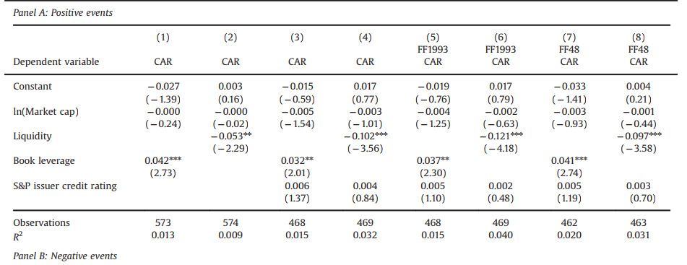
3. AM-OC – Positive – AM (Externality Control )
Non-event characteristic (e.g value, growth etc.)
Assumption : May have effect on the CAR
Formula (FF1993 CAR) : Value-weighted industry return
Conclusion : No effect to the previous conclusion
Notes:
排除其他非該事件所造成的影響

Slide 14
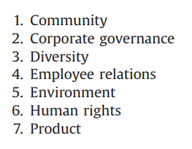

3. AM-OC – Positive – OC
Measurement (Sorcates + KLD status) : 7 categories (strength or concern) →
Assumption (motivation of doing CSR): Offsetting CSR Driven→ Less favorable return
Formula :
Conclusion : Offsetting CSR Driven → More return Agency-motivated CSR → Less return
Notes:
作者是用CSR news 出來當年 企業的CSR表現作為參考依據
Offsetting CSR : motivation , willingness / 沒有明顯動機做CSR → agency problem (節具象)
這邊探討 企業offsetting CSR的動機 (Positive Events 但是regress with concern)

Slide 15
3. AM-OC – Positive – OC
Measurement (Sorcates + KLD status) : 7 categories
Assumption (motivation of doing CSR): Offsetting CSR Driven→ Less favorable return
Formula :
Conclusion : Offsetting CSR Driven → More return Agency-motivated CSR → Less return
Notes:
Table5的部分

Slide 16
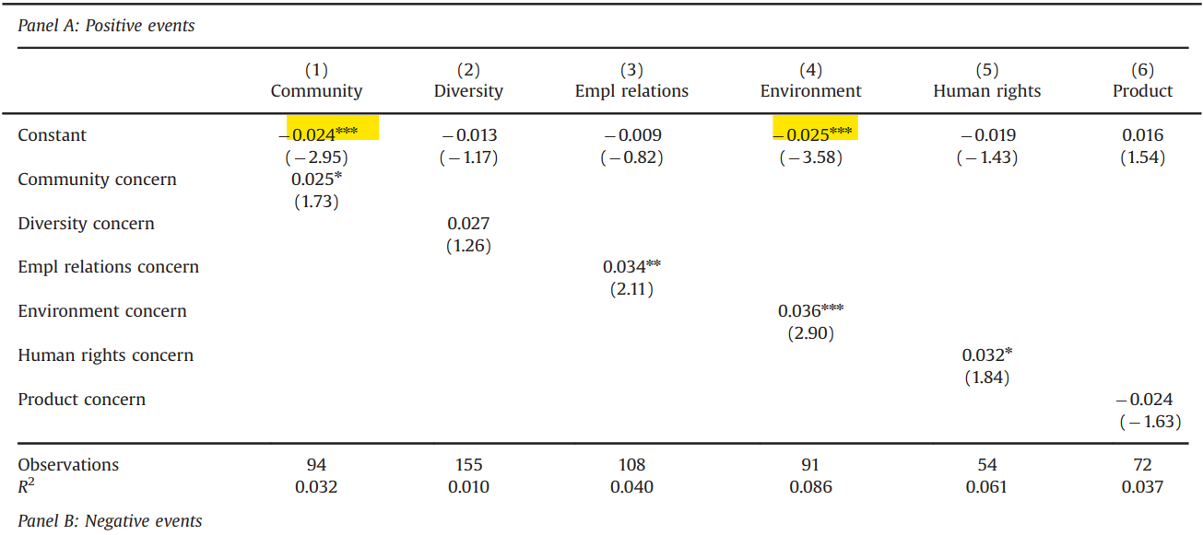
3. AM-OC – Positive – OC
Measurement (KLD status) : 7 categories
Assumption (motivation of doing CSR): Offsetting CSR Driven→ Less favorable return
Formula :
Conclusion : Offsetting CSR Driven → More return Agency-motivated CSR → Less return
Notes:
沒有明顯動機做CSR → agency problem (節具象，當firm沒有其他concern突然做CSR 被作者歸類為 agency problem )

Slide 17
3. AM-OC – Positive – OC

Slide 18
3. AM-OC – Positive – OC (with Agency Problem)
Interpretation (Intercept ): community and environment issue areas concerning firms in which agency problems are more likely to be present
Conclusion : investors distinguish between positive news about CSR—more likely to be the result of a firm's desire to offset prior corporate irresponsibility—and positive CSR news more likely to be the result of agency problems.
Notes:
沒有明顯動機做CSR → agency problem (節具象，當firm沒有其他concern突然做CSR 被作者歸類為 agency problem )

Slide 19

3. AM-OC – Positive – OC (Externality Control)
Externality (Firm Size)
Formula :
Conclusion : no effect → CSR generates a more positive stock market reaction independent of whether a firm is small or large Agency-motivated CSR → phenomenon of large firm (excluding small firm)
Notes:
Offsetting CSR : motivation , Agency problem 並不是完全出於廠商的意願

Slide 20
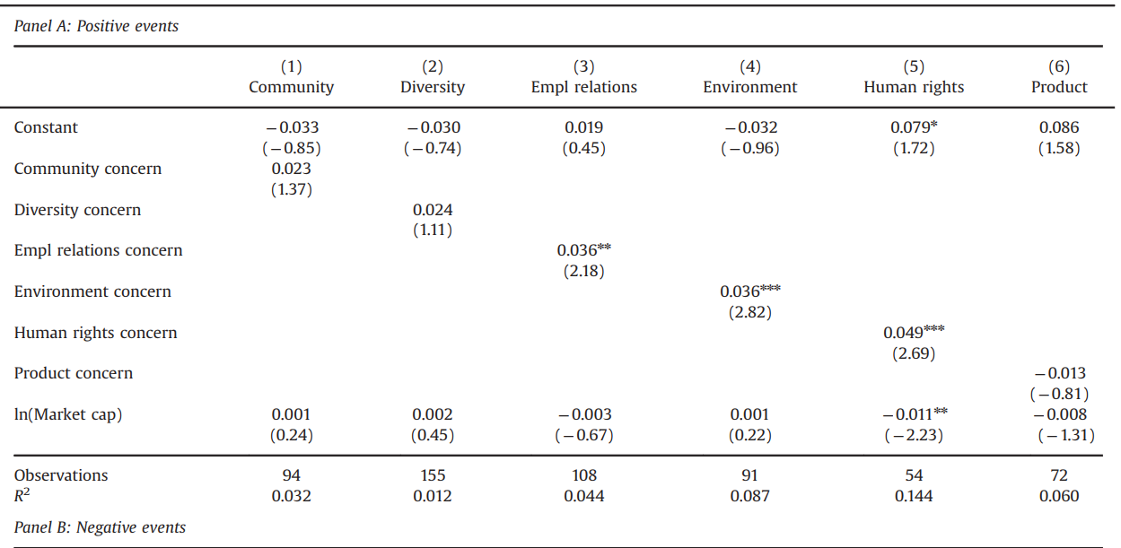
3. AM-OC – Positive – OC (Externality Control)
Notes:
引入大小好後，由agency problem 造成的negative intercept 變成不顯著 → this result seems quite plausible as agency problems are likely to be more pronounced in larger firms
More costly for large firms to become corporate citizens in the field of human rights

Slide 21

3. AM-OC – Positive – OC (subsequent strength)
Assumption : firms sometimes offset weaknesses in one of KLD's issue areas with subsequent strengths in others.
Formula :
Conclusion : True in area (human rights), but mainly firms may focus on the specific area
Notes:
大部分的企業都會針對對之前做不好的領域去改善

Slide 22
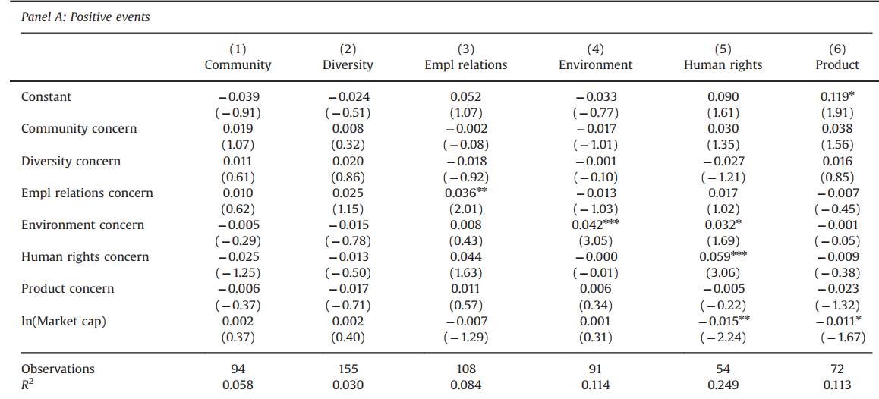
3. AM-OC – Positive – OC (subsequent strength)
Notes:
企業在環境領域做不好，加強在人權領域上面的表現

Slide 23
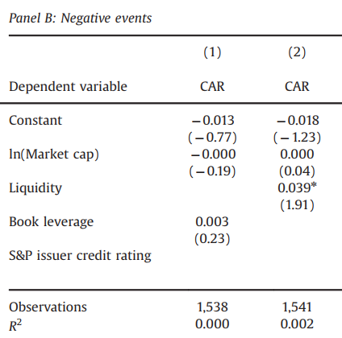

3. AM-OC –Negative–AM
Formula :
Conclusion : investors regard companies with higher cash reserves as being in a better position to shoulder the negative cashflow implications of negative events
Notes:
這邊進到 負面消息的部分，消費者對因財務問題爆出負面新聞的公司比較有容忍度
liquidity 在 負面的消息下有顯著的影響影響

Slide 24

3. AM-OC –Negative–AM
Formula :
Conclusion : Firms with high credit ratings tend to suffer stronger shock from negative events. Consistent with previous conclusion (Larger firms should take on more responsibility)
Notes:
作者與先前一樣，引入了credit rating進行外部性的控制
得到的結論為，信用評等高的公司在負面的消息傳出後，對股價有相當大的負面影響

Slide 25
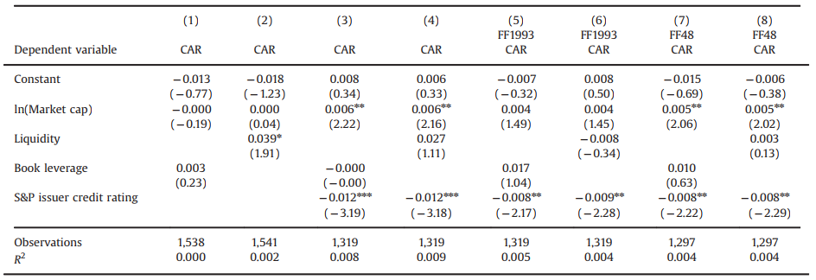
3. AM-OC –Negative–AM
Formula :
Conclusion : Firms with high credit ratings tend to suffer stronger shock from negative events. Larger firms should take on more responsibility

Slide 26
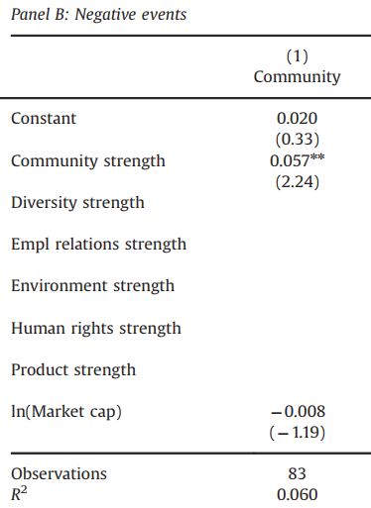


3. AM-OC –Negative–OC
Formula :
Conclusion : 1. All variables are insignificant except community → Firm with strong community relation suffer less-pronounced Negative stock price decline 2. After introducing firm size, result remains unchanged
Notes:
在負面的新聞事件中，曾經有良好的社區關係的公司股價下跌較不明顯

Slide 27
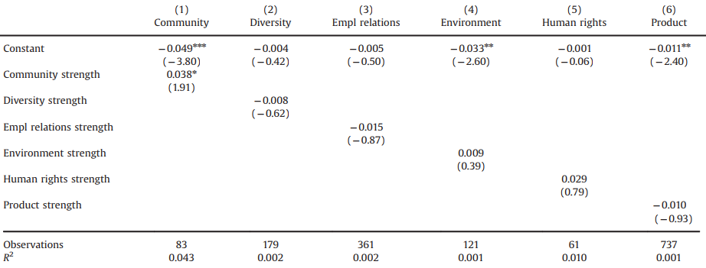
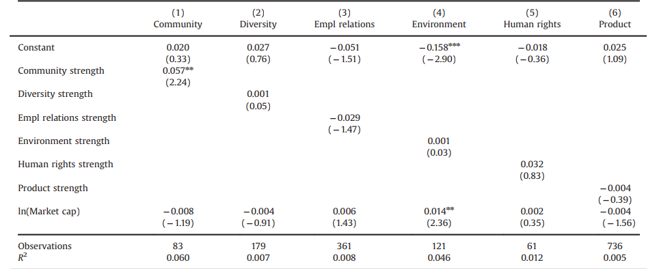
3. AM-OC –Negative–OC(Externality Control)
No firm size :
With firm size :
Notes:
企業在A領域做不好，加強BC領域

Slide 28
3. AM-OC – Selection Bias (Positive v.s Negative)
Methodology (KS test) : Testing weather two empirical distribution differs
Conclusion : Positive and Negative event comes from the same distribution → less concern of selection bias

Slide 29
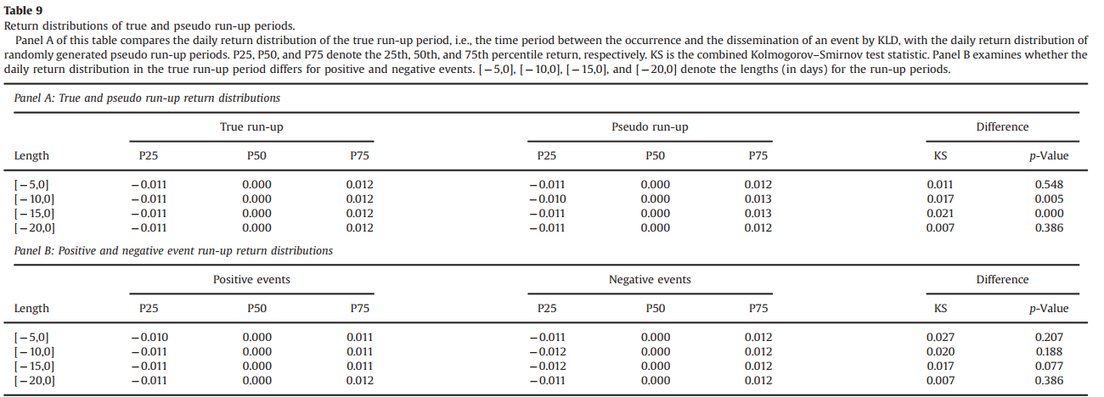
3. AM-OC – Selection Bias (Positive v.s Negative)

Slide 30
Outline
Data：KLD
Event study methodology A. Regression against CAR B. Controlling explicitly
Analysis A. Overall event B. Agency-motivated and offsetting CSR (AM-OC) C. Textual Analysis

Slide 31
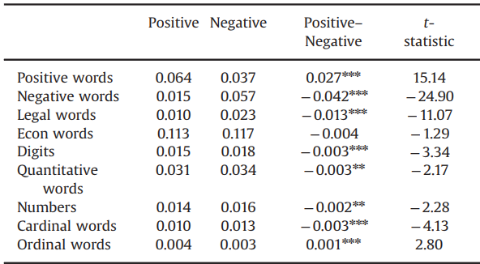
3. Textual Analysis
Indicator ( 6 word categories from Harvard dictionary ) : 1. Positive 2. Negative 3. legal 4. Econ 5. Quan (Assessment of quantity) 6. Numbers (cardinal/ordinal)
Methodology : 1. Difference in terms 2. terms and CAR

Slide 32
3. Difference in Terms – All events
Description :
Weather the proportion of terms being used in Positive or Negative events differs.
Conclusion : 1. Negative Event → legal Terms 2. Economic Event →Equally important
Notes:
負面新聞的法律用語比較多
經濟用語在正反面事件都一樣重要

Slide 33
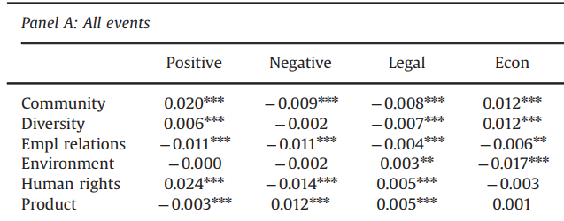
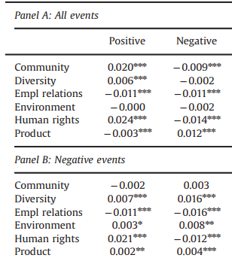
3. Difference in Terms – By Issue Area
Conclusion : 1. Product-, human rights-, and environment- related events are characterized by strong legal language. 2. Product, environment, and above all—the diversity issue areas are mainly “strongly” negative. → KLD analysts perceive these terms to be particularly harmful
Notes:
作者一共得出4點結論
第一點為，在Product-, human rights-, and environment這些領域中，法律的用詞明顯比不分領域(all event)的法律用詞多很多。
在負面新聞中，p/e/d 比其他領域負面用詞明顯較多//代表KLD推斷，當firm在p/e/d 這三個領域造成的損害後果特別嚴重(negative event中p/e/d 比其他領域負面用詞明顯較多)
Kld 用很多負面字詞來描述這個負面event

Slide 34
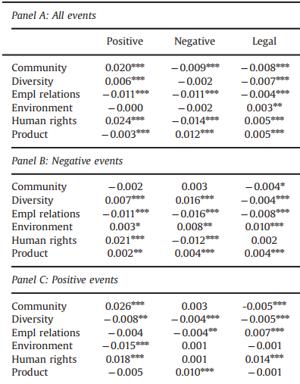
3. Difference in Terms – By Issue Area
Conclusion : 3. Positive events from both human rights and the employee relations issue areas are subject to above average legal language
Implication :
KLD attaches great importance to legal rights (e.g., respect of labor or human rights treaties) when determining whether a company is a good corporate citizen with respect to human rights- and employee- related issues
Notes:
第三點結論為：正面CSR新聞中，法律用詞在Empl 與 human rights 類別中顯著多於其他領域
所以作者推斷當KLD 在探討 Empl/ human rights 有關的正面新聞中，特別注重法律上面的權益

Slide 35
3. Difference in Terms – By Issue Area
Conclusion : 4. Employee-related event are subject to above average use of digits, suggesting that the information content of employee relations events is of quantitative nature
Possible explanation : 1. Positive : sometimes related to corporate ranking 2. Negative : related to payment and fines
Notes:
第四個結論為 digi用詞在Employee related events 特別多，不論是正面新聞還是負面新聞
可能是因為 ranking (正面) 罰款(負面)

Slide 36
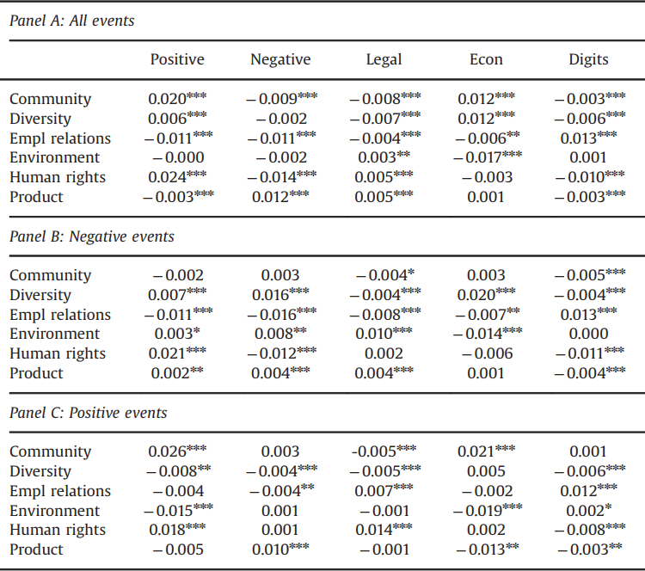
3. Difference in Terms – By Issue Area
Conclusion : 4. Employee-related event are subject to above average use of digits, suggesting that the information content of employee relations events is of quantitative nature
Possible explanation : 1. Positive : sometimes related corporate ranking 2. Negative : related to payment and fines

Slide 37


3. Negative/Positive Language
Formula :
Textual variables : 1. Textual → Fraction of words in each category 2. High textual (not sure) → top decile of the respective textual variable for positive or negative events in a given issue area
Notes:
剛剛作者觀察玩了字詞在不同領域的差異後，現在觀察news用字遣詞(這張投影片為正面和負面字詞)對異常報酬所產生的影響
# High textual 可能是取6類詞語中佔文章比例前10%高的(E.G這篇新聞是不是HIGH TEXTUAL)
http://www.wjh.harvard.edu/~inquirer/Legal.html

Slide 38
3. Negative/Positive Language
Question : Will different magnitude of words trigger different stock market reaction ?
Conclusion : 1. weakly negative events (community/diversity) → more positively worded negative events, generate a less negative stock market reaction 2. Strong negative events (Product) → stock prices decrease more strongly for strongly negatively worded product events
Notes:
負面消息採用正面用語 → 對市場報酬的負面衝擊較小
負面消息負面用語 → 對市場報酬衝擊大

Slide 39
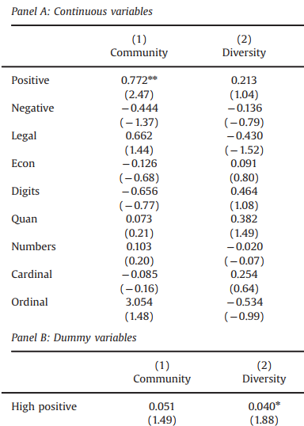
3. CARs & Textual –Negative/Positive Language
Conclusion : 1. weakly negative events (community/diversity) → more positively worded negative events, generate a less negative stock market reaction
Notes:
正的顯著，會offset 一些負的異常報酬

Slide 40
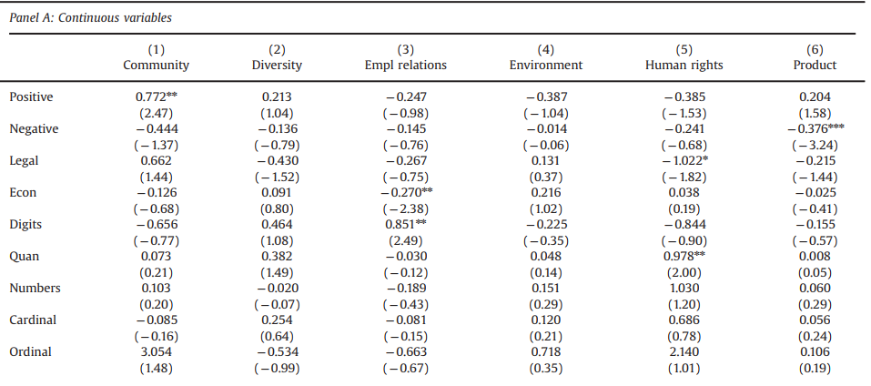
3. CARs & Textual –Negative /Positive Language
Conclusion : 2. Strong negative events (Product) → stock prices decrease more strongly for strongly negatively worded product events
Notes:
消費者會對事情的嚴重性進行反應

Slide 41
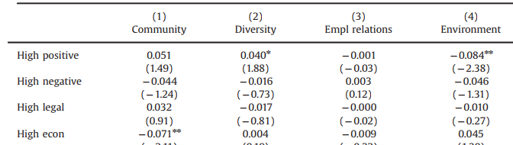
3. CARs & Textual –Negative /Positive Language
Caution : KLD's analysts and investors sometimes disagree over the severity of events
Example : the most positively worded negative environment events generate a significantly more negative stock market reaction
Notes:
作者在做分析的時候發現(kld分析與投資者)對事件嚴重程度看法的一致性

Slide 42
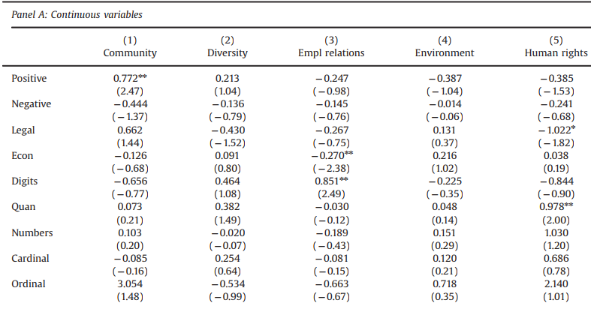
3. CARs & Textual – Legal language
Conclusion : 1. negative human rights/product area events with more legal information content generate a more negative stock market reaction
Caution : significant level not high might caused by nose
Notes:
作者在法律上的用詞共做出了兩點推論。
第一點為如果，人權與產品相關的負面新聞中含有較多法律用語，報酬是會下降的

Slide 43
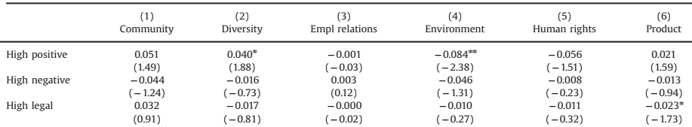
3. CARs & Textual – Legal language
Conclusion : 1. negative human rights/product area events with more legal information content generate a more negative stock market reaction
Caution : significant level not high might caused by nose
Notes:
可能是因為bias

Slide 44
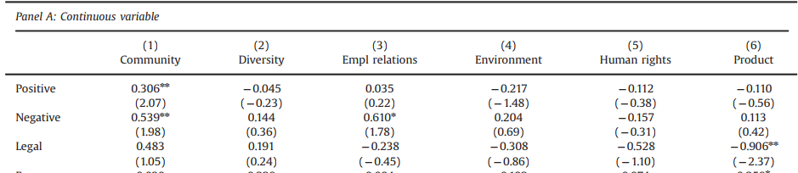
3. CARs & Textual – Legal language
Conclusion : 2. positive product events with stronger legal information content result in a more negative stock market reaction
Possible explanation : Good news for customer, bad news for firms (substantial financial burden )
Notes:
作者在LEGAL LANGAUGE 上得出的第二點結論為 正面新聞之中，如果出現法律用詞，公司的異常報酬會下降。
作者認為造成這種現象的成因可能為 雖然是正面新聞，但是其實對廠商來說是壞消息，因為法規增多了，會造成公司額外的financial burden

Slide 45
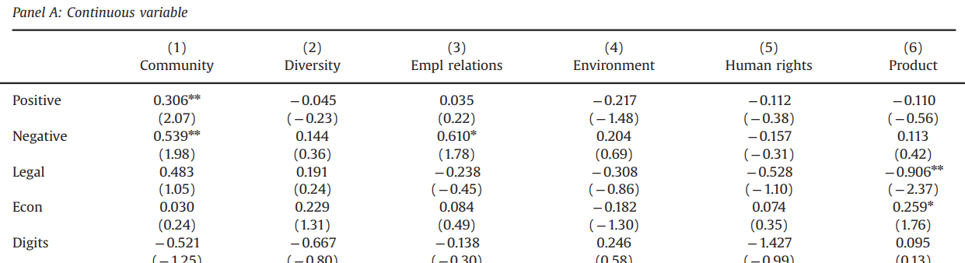
3. CARs & Textual –Economic language
Conclusion : positive events from the product issue area with strong economic information content result in a higher CAR
Supported to other views : stock markets react more strongly to CSR events that are more strongly related to economic issues
Notes:
作者在經濟相關用字得出的結論為，當poduct 領域的正面新聞出現後，經濟相關用詞會使報酬上升。
這邊有跳一點
negative employee relations events with strong economic information content: the coefficient estimate for Econ is significantly negative (t-statistic¼ 2.38). I observe similar patterns for negative community (t-statistic of 2.11) and human rights events (t-statistic¼ 1.66) with the highest economic information content (see columns 1 and 5, Panel B, Table 12).

Slide 46
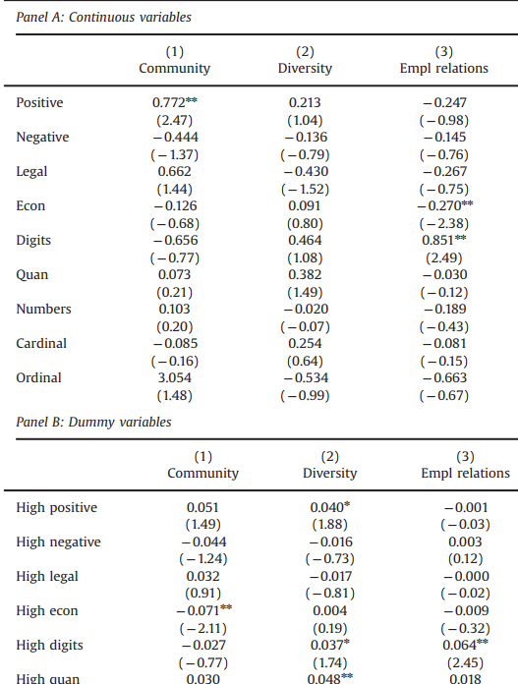
3. CARs & Textual –Digits
Conclusion : negative events from the employee relations issue area with a high incidence of digits generate a more positive stock market reaction
Possible Explanation : containing a high fraction of digits are related to payments of fines and/or the settlement of legal issues thus Stock prices should go up as a result of such negative news if investors had anticipated the charges to be more severe than they actually turn out to be
Notes:
作者在數字用字得出的結論為，在employee relation 的負面新聞之下，文章中的數字越多，報酬越高。
作者認為可能是因為投資者可能在新聞還沒出來之前以為罰款更重，但實際上新聞出來罰款比較輕，因此股價會些微上漲

Slide 47
3. CARs & Textual – Quantitative Language
Conclusion : significantly positive coefficient estimates for High quan regarding negative diversity and negative human rights events
Possible Explanation : Same as digits, the expectation of market
Notes:
消費者可能以為罰款更重，但新聞出來比較輕，因此股價會些微上漲

Slide 48
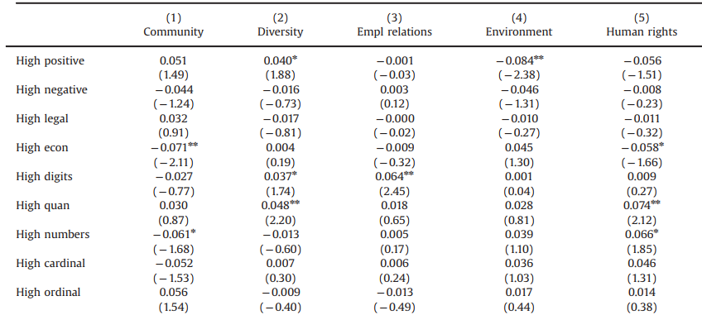
3. CARs & Textual – Quantitative Language
Conclusion : significantly positive coefficient estimates for High quan regarding negative diversity and negative human rights events
Possible Explanation : Same as digits, the expectation of market
Notes:
消費者可能以為罰款更重，但新聞出來比較輕，因此股價會些微上漲

