Slide 1
Sustainable Investing in Equilibrium

Slide 2
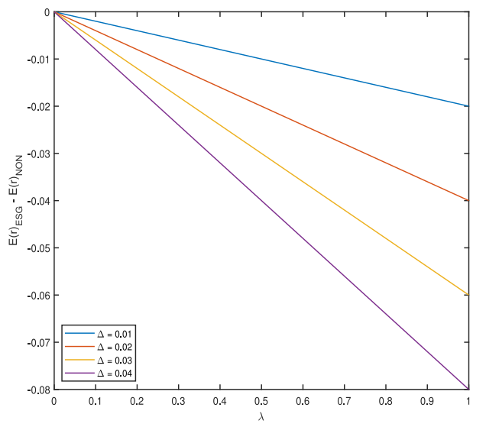

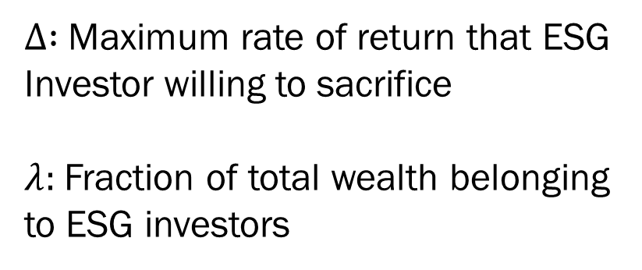
1. ESG v.s non-ESG expected portfolio return
$∆ :$ Maximum rate of return that ESG
Investor willing to sacrifice
$λ:$Fraction of total wealth belonging to ESG investors
Notes:
$∆$: 為了擁有自己偏好的投資組合，而犧牲的return
Lambda : ESG 偏好投資者所擁有的財富比例

Slide 3
1. ESG v.s non-ESG expected portfolio return
Implication :
ESG investors earn significantly lower return than non-ESG investors
As λ increases, investors must pay more for the green stocks they desire
Notes:
1. ESG投資者的報酬比 non-ESG投資者的報酬率低很多，特別是紫色的線。
2. 當ESG投資者擁有的財富增加，ESG投資者就必須付出更多來購買(increase in demand需求增加報酬下降)

Slide 4
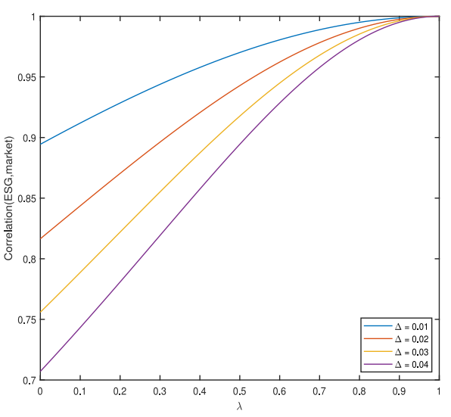

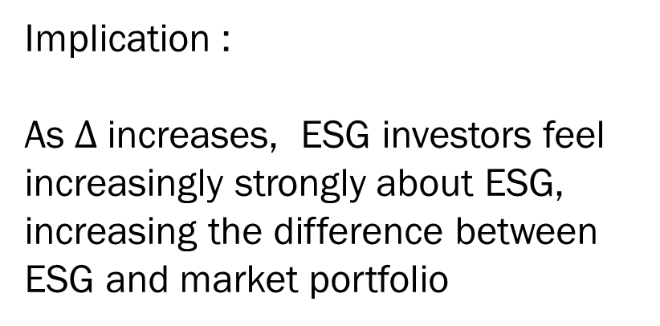
2. ESG v.s non-ESG expected portfolio return
Implication :
As $∆$increases, ESG investors feel increasingly strongly about ESG, increasing the difference between ESG and market portfolio
Notes:
Delta 上升，投資者願意投資更多在ESG上時，會擴大 market portfolio 和 ESG portfolio 的差距使相關係數 下降

Slide 5
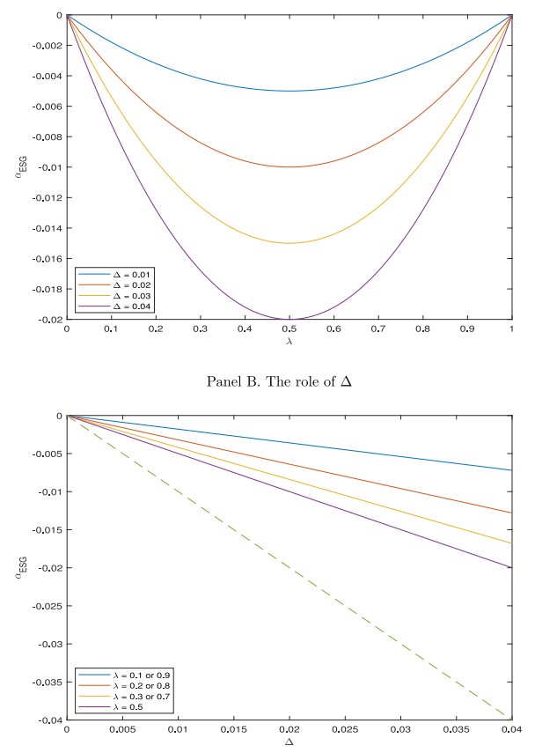
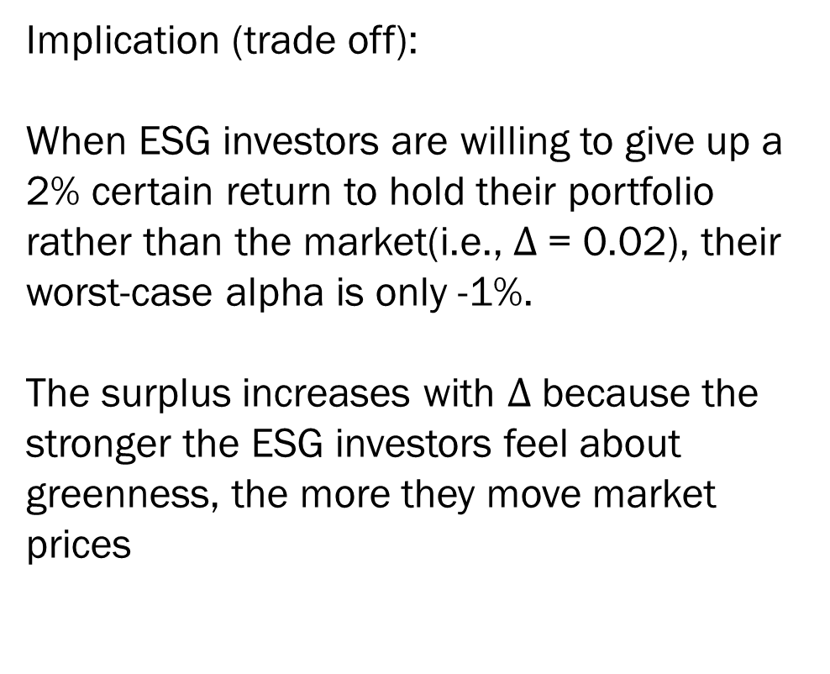
3. Alpha-ESG & Investor surplus
Implication (trade off):
When ESG investors are willing to give up a 2% certain return to hold their portfolio rather than the market(i.e., $∆$= 0.02), their worst-case alpha is only -1%.
The surplus increases with $∆$because the stronger the ESG investors feel about greenness, the more they move market prices
Investor surplus
Notes:
這篇在探討異常報酬與投資者剩餘的關係
Panel A 指出，當ESG投資人放棄的return (delta= -2%) 它們損失的報酬(alpha = -1%) 是小於她們付出的成本
Panel B 則是把ESG函數用不同的座標代換，並得出遞增的investor surplus->(直覺)願意為ESG放棄的return 越多，剩餘就越大

Slide 6
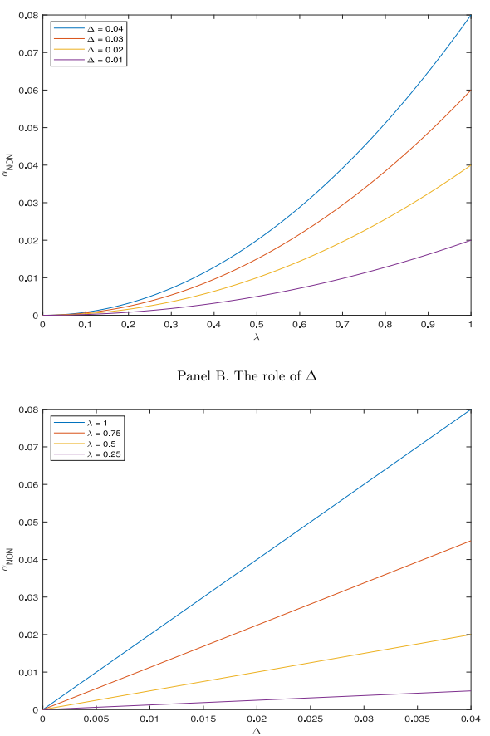
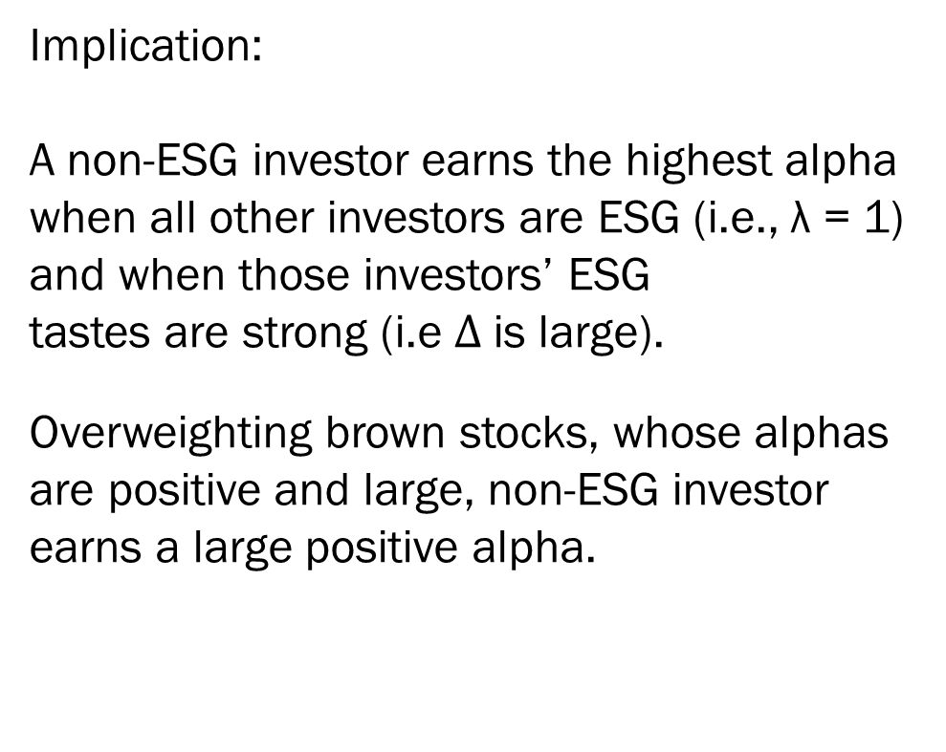
3. Alpha-ESG & Investor surplus
Implication:
A non-ESG investor earns the highest alpha when all other investors are ESG (i.e., λ = 1) and when those investors’ ESG tastes are strong (i.e $∆$is large).
Overweighting brown stocks, whose alphas are positive and large, non-ESG investor earns a large positive alpha.
Notes:
這邊則是說 無ESG偏好的投資人能穩賺更多的報酬，因為此篇文章模型推導出ESG stock的return 較低 (equa 10-11)
所以投資者可投入更高獲利的股票

Slide 7



4. Size of ESG industry
Implication:
ESG tastes lead green firms to invest more and brown firms to invest less. ESG tastes reduce green firms’ expected returns and hence their costs of capital. Green firms’ lower costs of capital increase their projects’ NPVs, so green firms invest more
Notes:
# Lambda = 1 & 0, tilt = 0, because all investors hold market protofolio
Agenet 的ESG 偏好taste (S_(Dbar))會產生社會影響 (當taste上升/廠商投資會增加) ，因此以 snd-sn0來作圖衡量 (不太清)
因為ESG taste 會降低return (公式10 & 11)因此會帶來較低的cost of capital(舉債成本) ，所以green frims可享受更高的NPV與進行更多的投資

Slide 8
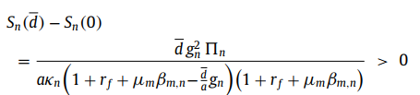

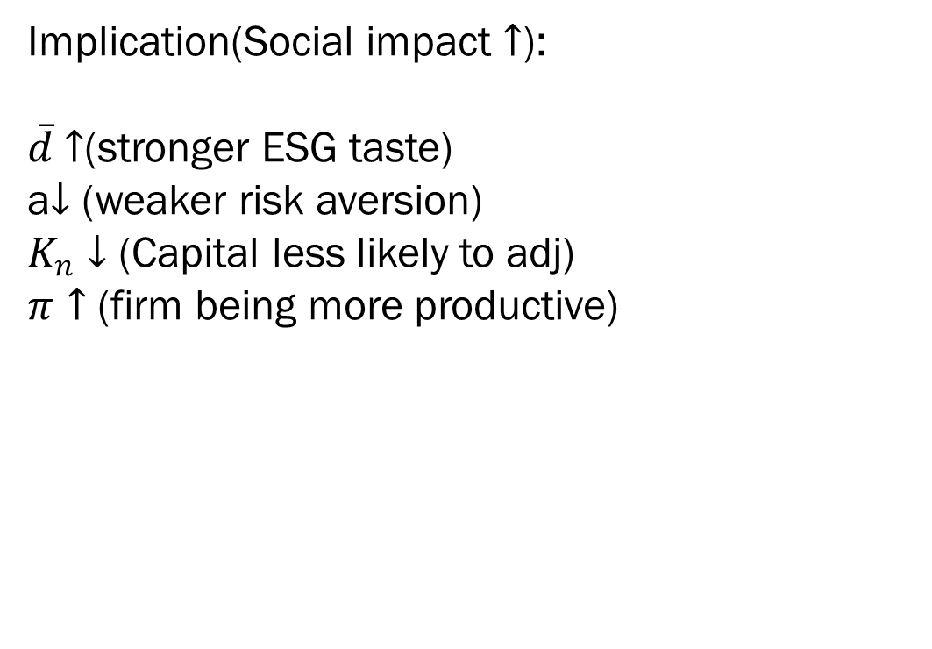
5. Green firms invest more, brown firms less
Implication(Social impact $↑$):
$\overline{d}$ $↑$(stronger ESG taste)
a$↓$ (weaker risk aversion)
$K_{n}↓$ (Capital less likely to adj)
$π↑$ (firm being more productive)
Notes:
A 下降/of firms. The impact is also larger when risk aversion is weaker (i.e., a is smaller) because less risk-averse agents(比較沒有風險趨避的人) tilt their portfolios more to accommodate their tastes(X_i)反映在股票投資上面, again resulting in larger price effects
Kn 小，廠商改變投資策略容易
Pi 上升/ cost of capital has larger effect on the investment 當firm 賺的錢變多，多出來的可用來投資的利潤就變多了，所以social impact 就變大ㄌ

Slide 9


5. Empirical Evidence
Implication :
investors’ ESG tastes tilt real investment from brown to green firms because those tastes generate alphas, which affect the cost of capital, which in turn affects investment
Baker and Wurgler (2012) : Negative relation between alpha and Investment
Notes:
ESG品味上升/消費者轉換投資偏好d上升，所以產生alpha下降(generate negative alpha ) (圖2) 讓報酬下降，所以造成cost of capital 的壁畫，影響投資。

Slide 10
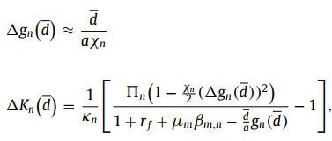
6. Firms become greener
Implication:
When d > 0, expected returns decrease so firms’ market values increase. Managers who wish to maximize market value therefore make their firms greener (i.e, gn > 0)
Notes:
當廠商可以改變公司的性質i.e g_n 時，在廠商追求maximum firm value 下廠商會變得更綠。
因為 gn上升會使 return 下降 -> cost of capital 下降 -> firm value 上升

Slide 11
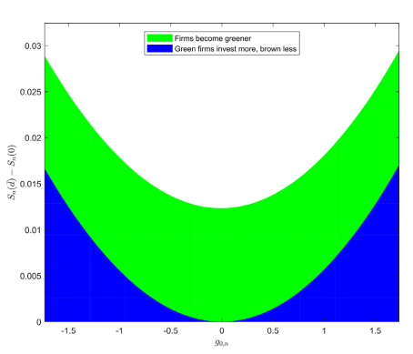


6. Firms become greener
Implication:
A larger dispersion deepens the cost-of-capital differentials between green and brown firms, leading to larger investment differentials. With green firms investing more and brown firms investing less, aggregate social impact increases.
Notes:
Lambda = 1 & 0, tilt = 0, because all investors hold market protofolio
Kn 小，廠商改變投資策略容易
Pi 上升/ cost of capital has larger effect on the investment
Sd – s0 的直觀解釋: 投資人esg 品味造成的社會影響

Slide 12
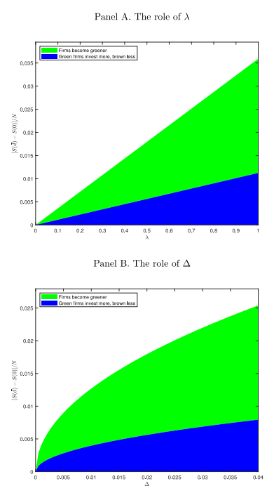
6. Firms become greener
Implication:
Social impact increases as ESG taste increases
Notes:
Lambda = 1 & 0, tilt = 0, because all investors hold market protofolio
Kn 小，廠商改變投資策略容易
Pi 上升/ cost of capital has larger effect on the investment
Sd – s0 的直觀解釋: 投資人esg 品味造成的社會影響

