Slide 1
Sustainable Investing in Equilibrium
JFE 2021/2/14

Slide 2
Outline
1. ESG portfolio return/ Alpha & Investor surplus
Portfolio return
Correlation
Alpha & investor surplus
2. Introducing Climate Risk
Green Stocks as climate hedges (Decomposing alpha)
3. Social Impact
Notation
Green firms invest more
Firms become greener
Notes:
簡報將把內論文內容拆解成3個部分進行報告
第一個部分在描述ESG 的報酬，和ESG alpha值和投資者剩餘的關係
第二個部分主要是在現有架構下引入氣候相關變數並探討氣候變遷與Alpha值的關聯
第三個部分主要是在說 給定起始條件下，廠商的投資行為與社會影響力是如何隨著某些變數變化的

Slide 3
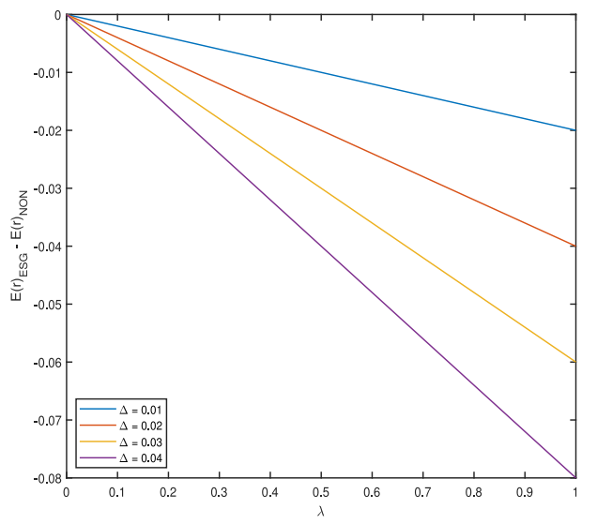

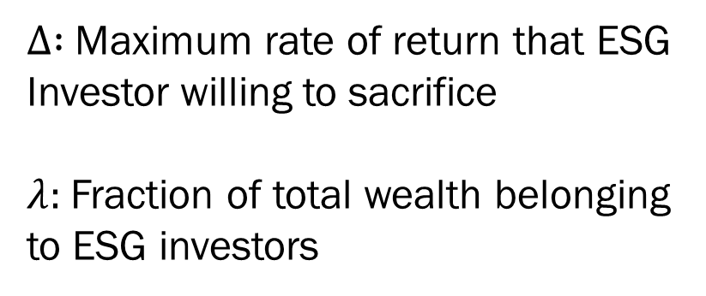
1. ESG v.s non-ESG expected portfolio return
$∆ :$ Maximum rate of return that ESG
Investor willing to sacrifice
$λ:$Fraction of total wealth belonging to ESG investors
Notes:
這邊主要對作者定義的一些變數做一些說明
$∆$: 為了擁有自己偏好的投資組合，而犧牲的return ，換言之當$∆$越大，投資者對ESG的喜好程度越高
Lambda : ESG 偏好投資者所擁有的財富比例 ，換言之lambda = 1時，市場上的投資人全部都是在乎的ESG的

Slide 4
1. ESG v.s non-ESG expected portfolio return
Implication :
ESG investors earn significantly lower return than non-ESG investors
As λ increases, investors must pay more for the green stocks they desire
Notes:
1. ESG投資者的報酬比 non-ESG投資者的報酬率低很多，特別是紫色的線。
2. 當ESG投資者擁有的財富增加，ESG return 就越小(slope<0)與$∆$無關，ESG投資者就必須付出更多來購買(increase in demand需求增加報酬下降)

Slide 5
Outline
1. ESG portfolio return/ Alpha & Investor surplus
Portfolio return
Correlation
Alpha & investor surplus
2. Introducing Climate Risk
Green Stocks as climate hedges (Decomposing alpha)
3. Social Impact
Notation
Green firms invest more
Firms become greener

Slide 6
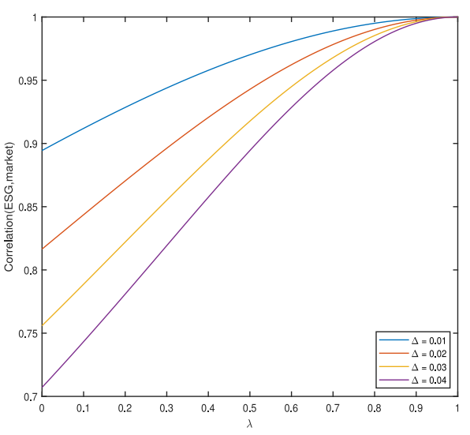

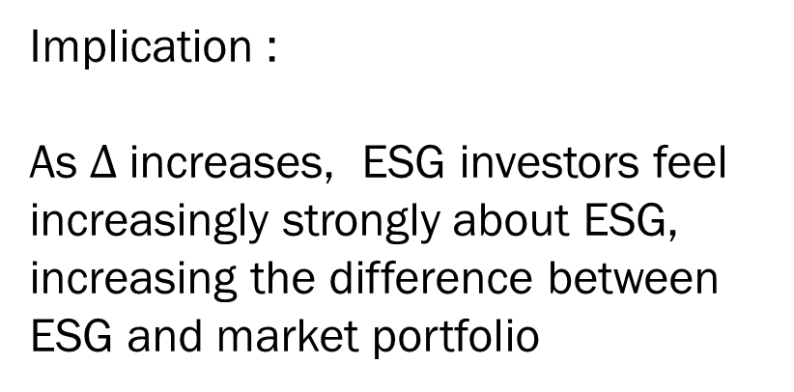
1. ESG v.s non-ESG return Correlation
Implication :
As $∆$increases, ESG investors feel increasingly strongly about ESG, increasing the difference between ESG and market portfolio
Notes:
Delta 上升，投資者願意投資更多在ESG上時，會擴大 market portfolio 和 ESG portfolio 的差距使相關係數 下降

Slide 7
Outline
1. ESG portfolio return/ Alpha & Investor surplus
Portfolio return
Correlation
Alpha & investor surplus
2. Introducing Climate Risk
Green Stocks as climate hedges (Decomposing alpha)
3. Social Impact
Notation
Green firms invest more
Firms become greener
Notes:
作者要探討為什麼低的Return負的alpha 投資人還會買呢?其原因在於investor surplus

Slide 8
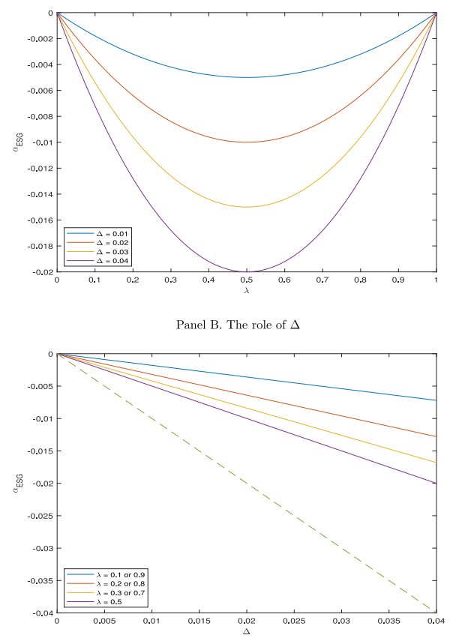
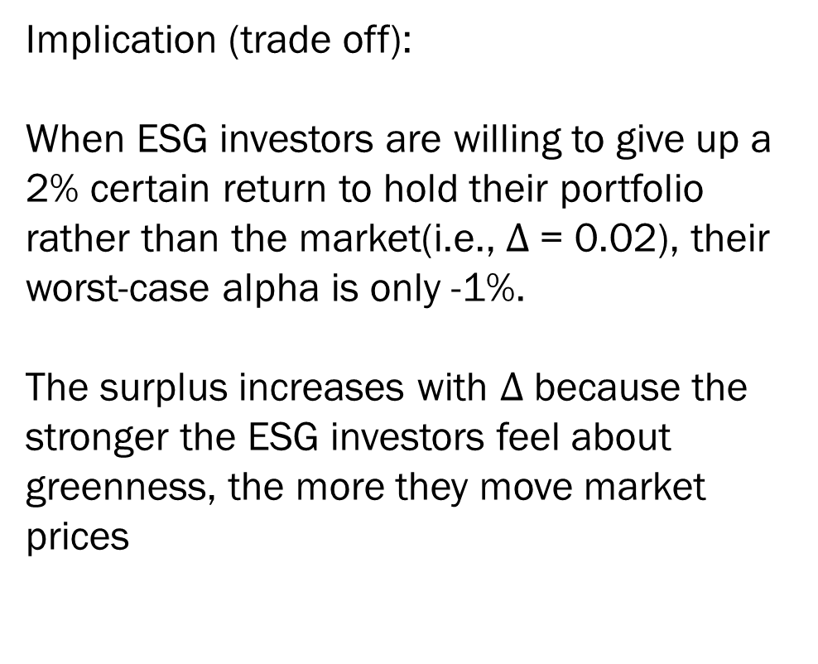
1. Alpha-ESG & Investor surplus
Implication (trade off):
When ESG investors are willing to give up a 2% certain return to hold their portfolio rather than the market(i.e., $∆$= 0.02), their worst-case alpha is only -1%.
The surplus increases with $∆$because the stronger the ESG investors feel about greenness, the more they move market prices
Investor surplus
Notes:
這篇在探討異常報酬與投資者剩餘的關係
Panel A 指出，當ESG投資人放棄的return (delta= -2%) 它們損失的報酬(alpha = -1%) 是小於她們付出的成本
Panel B 與Panel A是相同公式不同座標得出的結果，這樣做的原因主要為更值觀的看出investor surplus，並得出遞增的investor surplus->(直覺)願意為ESG放棄的return 越多，剩餘就越大

Slide 9
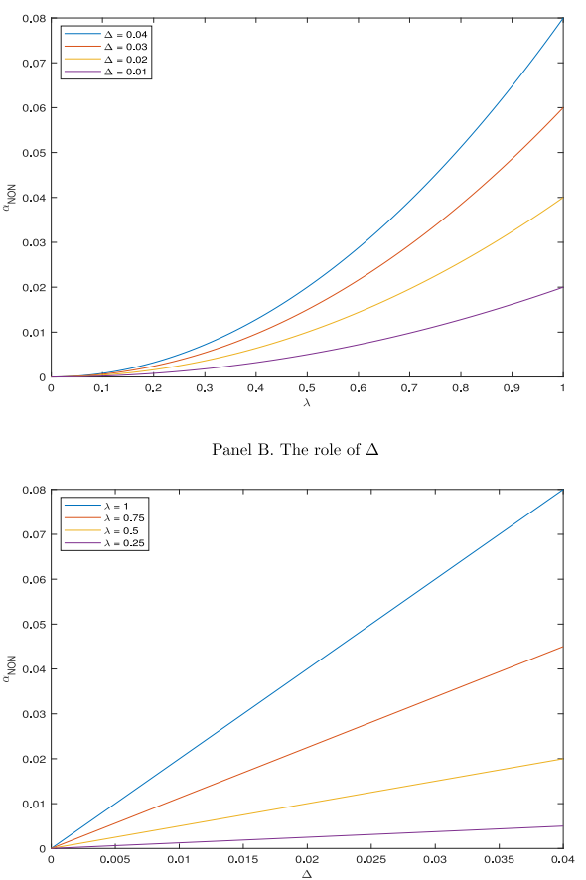
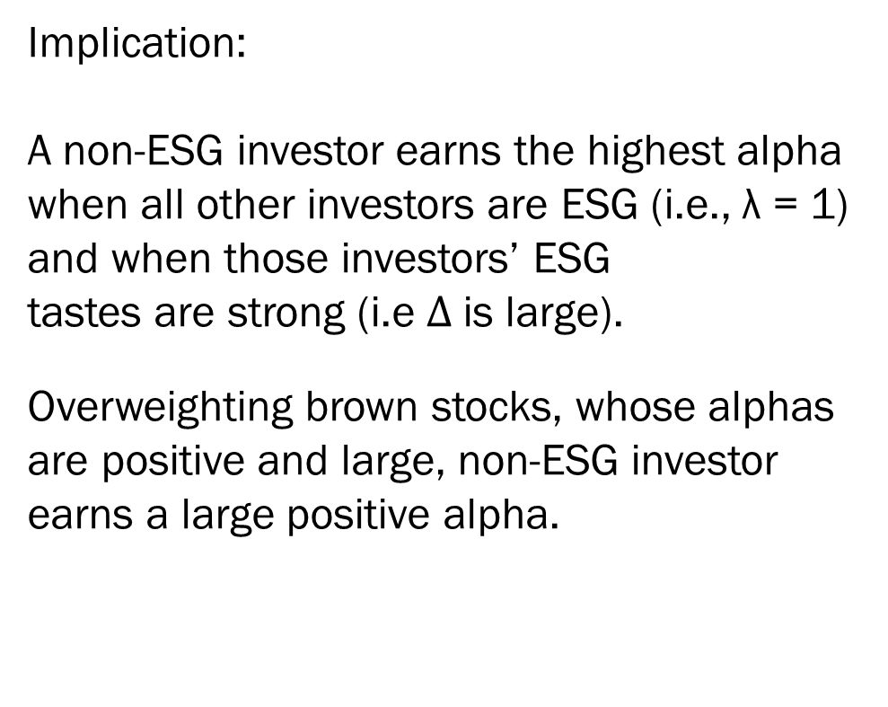
1. Alpha-ESG & Investor surplus
Implication:
A non-ESG investor earns the highest alpha when all other investors are ESG (i.e., λ = 1) and when those investors’ ESG tastes are strong (i.e $∆$is large).
Overweighting brown stocks, whose alphas are positive and large, non-ESG investor earns a large positive alpha.
Notes:
這邊則是說 無ESG偏好的投資人能穩賺更多的報酬，因為此篇文章模型推導出ESG stock的return 較低 (equa 10-11)
所以投資者可投入更高獲利的股票

Slide 10
Outline
1. ESG portfolio return/ Alpha & Investor surplus
Portfolio return
Correlation
Alpha & investor surplus
2. Introducing Climate Risk
Green Stocks as climate hedges (Decomposing alpha)
3. Social Impact
Notation
Green firms invest more()
Firms become greener
Notes:
Sustainable investing is motivated in part by concerns about climate change.

Slide 11

2. Decomposing Alpha
Implication:
Greener stocks now have lower CAPM alphas not only because of investors’ tastes for green holdings, but also because of greener stocks’ ability to better hedge climate risk
Notes:
ESG 報酬率的低alpha值除了來自於投資者的偏好外，也來自於對ESG 資產對氣候變遷所產生的避險價值

Slide 12
Outline
1. ESG portfolio return/ Alpha & Investor surplus
Portfolio return
Correlation
Alpha & investor surplus
2. Introducing Climate Risk
Green Stocks as climate hedges (Decomposing alpha)
3. Social Impact
Notation
Green firms invest more()
Firms become greener

Slide 13



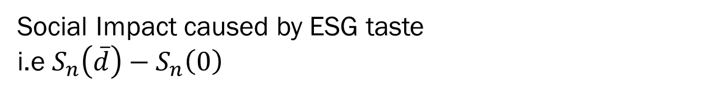
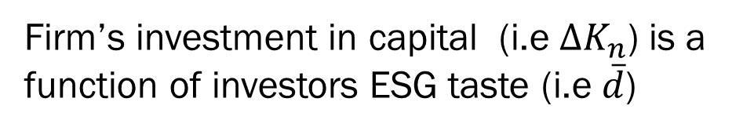
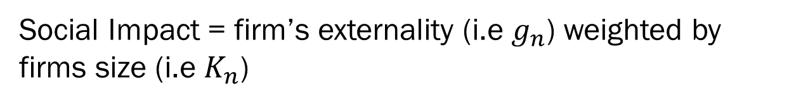
3. Notation
Social Impact = firm’s externality (i.e $g_{n}$) weighted by firms size (i.e $K_{n}$)
Firm’s investment in capital (i.e ${∆K}_{n}$) is a function of investors ESG taste (i.e $\overline{d}$)
Social Impact caused by ESG taste
i.e $S_{n}\left(\overline{d}\right)−S_{n}\left(0\right)$
Notes:
Gn代表產商產生的外部性
個人認為會選擇以formula 3 來作圖的原因是因為作者希望衡量消費者的ESG品味與firm behavior (gn 和 kn )造成的Social impact 的交互影響，因此需以有ESG品味與無ESG品味作圖

Slide 14
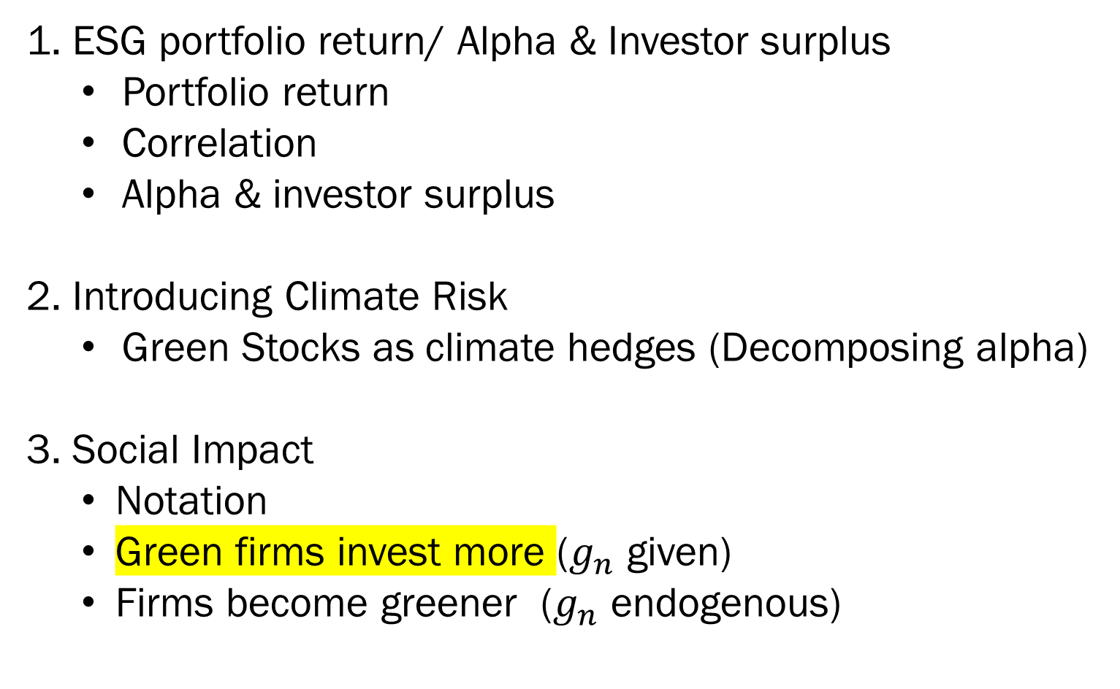
Outline
1. ESG portfolio return/ Alpha & Investor surplus
Portfolio return
Correlation
Alpha & investor surplus
2. Introducing Climate Risk
Green Stocks as climate hedges (Decomposing alpha)
3. Social Impact
Notation
Green firms invest more ($g_{n}$ given)
Firms become greener ($g_{n}$ endogenous)

Slide 15
3. Greener Firms Invest more
Implication:
ESG tastes lead green firms to invest more and brown firms to invest less. ESG tastes reduce green firms’ expected returns and hence their costs of capital. Green firms’ lower costs of capital increase their projects’ NPVs, so green firms invest more
Notes:
# Lambda = 1 & 0, tilt = 0, because all investors hold market protofolio
Agenet 的ESG 偏好taste (S_(Dbar))會產生社會影響 (當taste上升/廠商投資會增加) ，因此以 snd-sn0來作圖衡量 (不太清)
因為ESG taste 會降低return (公式10 & 11)因此會帶來較低的cost of capital(舉債成本) ，所以green frims可享受更高的NPV與進行更多的投資

Slide 16
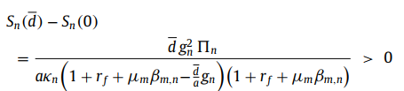

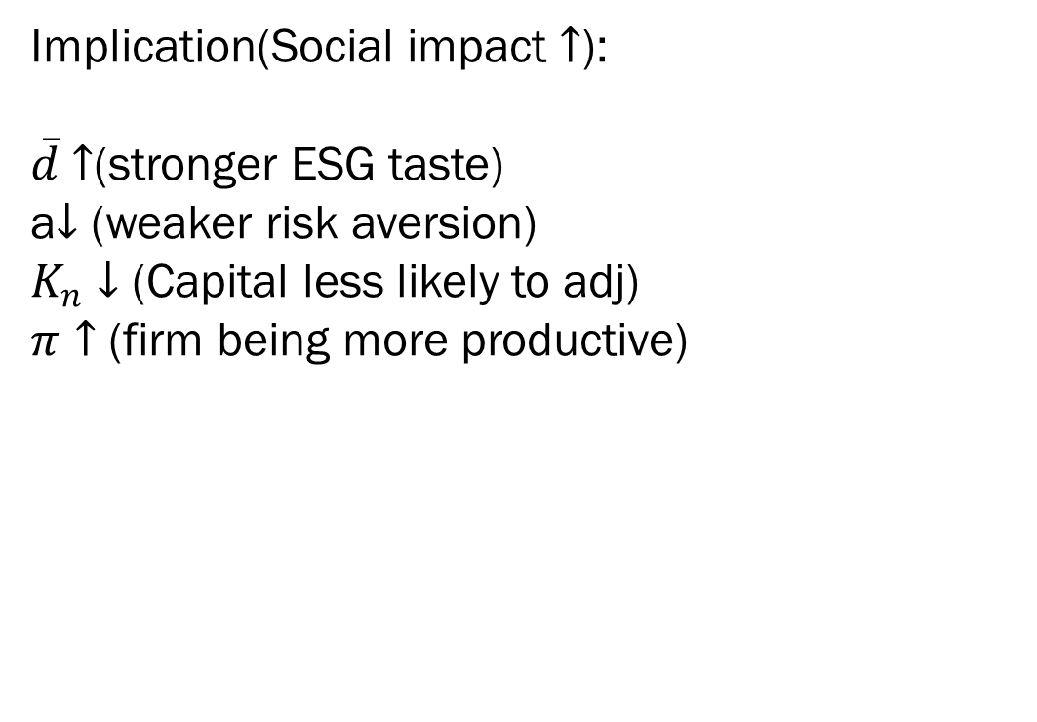
3. Greener Firms Invest more (Social Impact)
Implication(Social impact $↑$):
$\overline{d}$ $↑$(stronger ESG taste)
a$↓$ (weaker risk aversion)
$K_{n}↓$ (Capital less likely to adj)
$π↑$ (firm being more productive)
Notes:
A 下降/of firms. The impact is also larger when risk aversion is weaker (i.e., a is smaller) because less risk-averse agents(比較沒有風險趨避的人) tilt their portfolios more to accommodate their tastes(X_i)反映在股票投資上面, again resulting in larger price effects
Kn 小，廠商改變投資策略容易
Pi 上升/ cost of capital has larger effect on the investment 當firm 賺的錢變多，多出來的可用來投資的利潤就變多了，所以social impact 就變大ㄌ

Slide 17


3. Greener Firms Invest more (Empirical Evidence)
Implication :
investors’ ESG tastes tilt real investment from brown to green firms because those tastes generate alphas, which affect the cost of capital, which in turn affects investment
Baker and Wurgler (2012) : Negative relation between alpha and Investment
Notes:
ESG品味上升/消費者轉換投資偏好d上升，所以產生alpha下降(generate negative alpha ) (圖2) 讓報酬下降，所以造成cost of capital 的壁畫，影響投資。

Slide 18
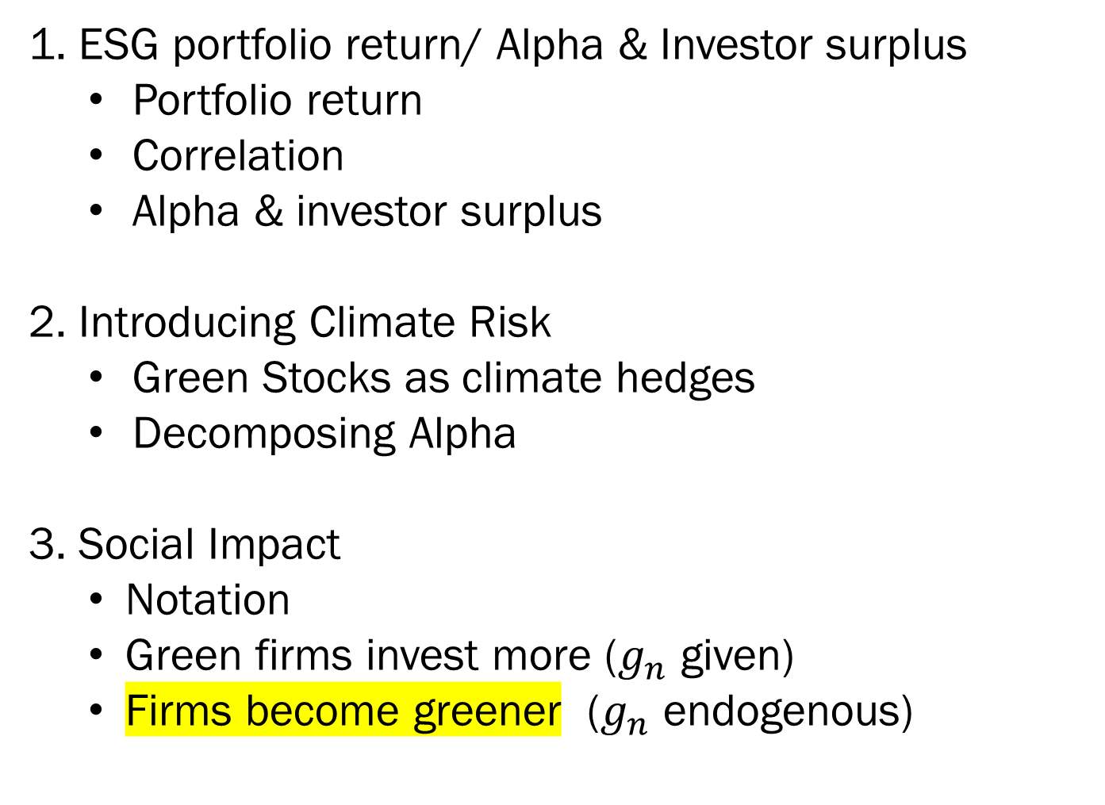
Outline
1. ESG portfolio return/ Alpha & Investor surplus
Portfolio return
Correlation
Alpha & investor surplus
2. Introducing Climate Risk
Green Stocks as climate hedges
Decomposing Alpha
3. Social Impact
Notation
Green firms invest more ($g_{n}$ given)
Firms become greener ($g_{n}$ endogenous)

Slide 19
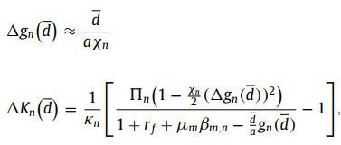
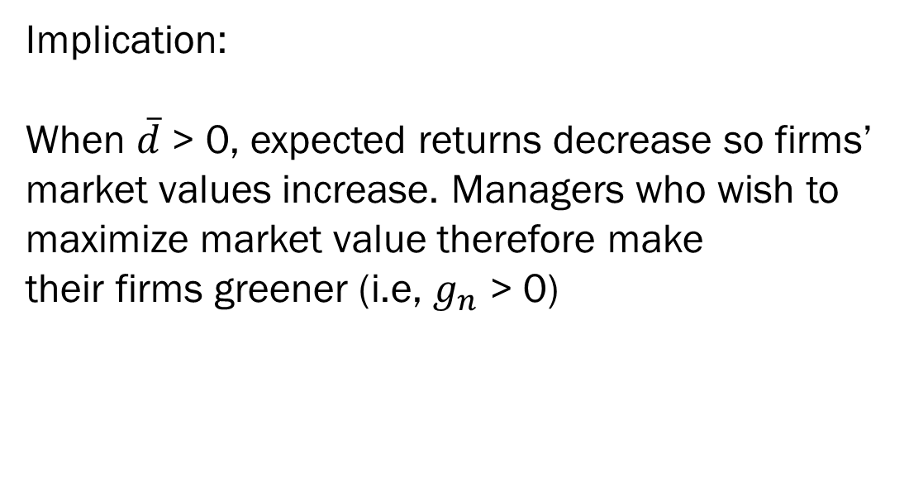
3. Firms become greener
Implication:
When $\overline{d}$ > 0, expected returns decrease so firms’ market values increase. Managers who wish to maximize market value therefore make their firms greener (i.e, $g_{n}$ > 0)
Notes:
當廠商可以改變公司的性質i.e g_n 時，在廠商追求maximum firm value 下廠商會變得更綠。
因為 gn上升會使 return 下降 -> cost of capital 下降 -> firm value 上升

Slide 20
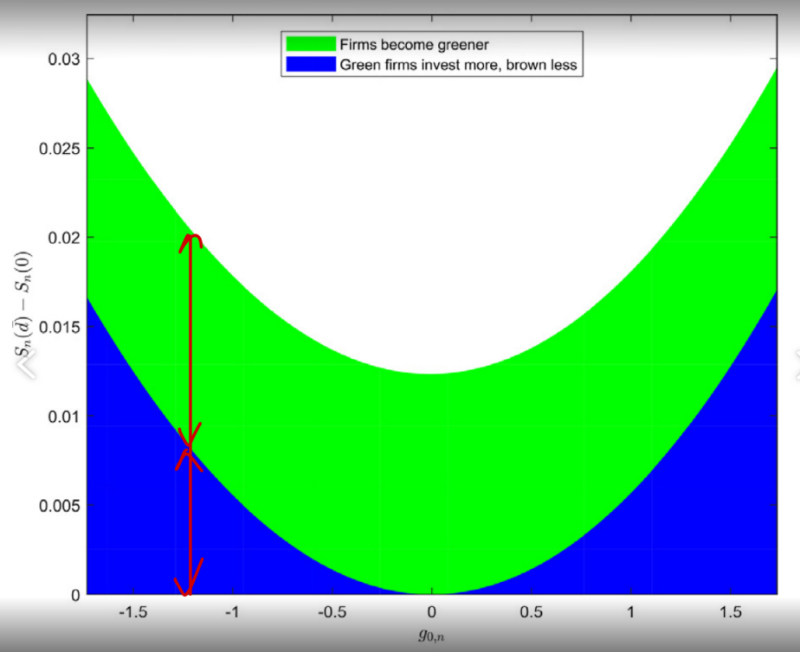
3. Firms become greener (Social Impact)
Implication:
Social impact Comes from two parts, the first part is the extra investment of greener firms (Higher NPV), and the second part is the firm additional investment in order to going green (Increasing Firm value)
Notes:
Social impact 可由兩個部分組成/
1. 廠商因為lower cost of capital 創造出來的正向NPV 使投資增加
2. 渴望變換保的廠商所做的投資(delta gn ) 例如 化學工廠買淨水設備

Slide 21
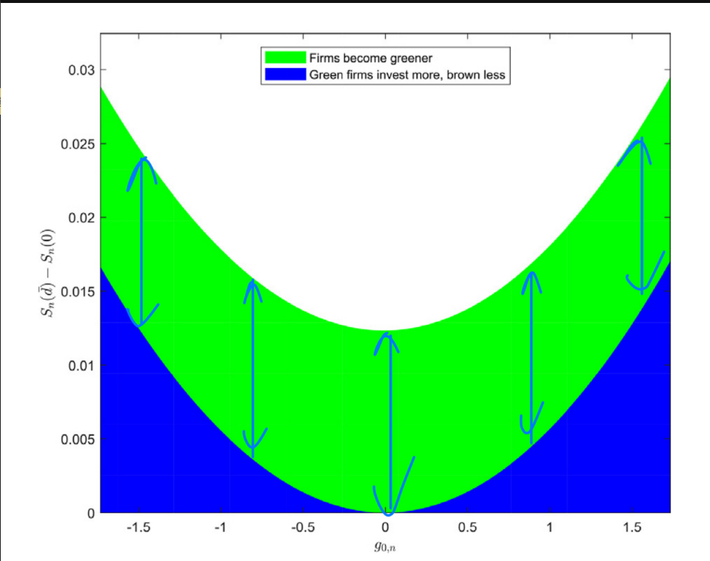
3. Firms become greener (Social Impact)
Implication:
Social impact brought by firms willingness to become greener is roughly the same
Notes:
不環保的廠商為了使firm value 上升時所付出的投資所造成的社會影響在不同g0起始直時並無顯著的影響

Slide 22
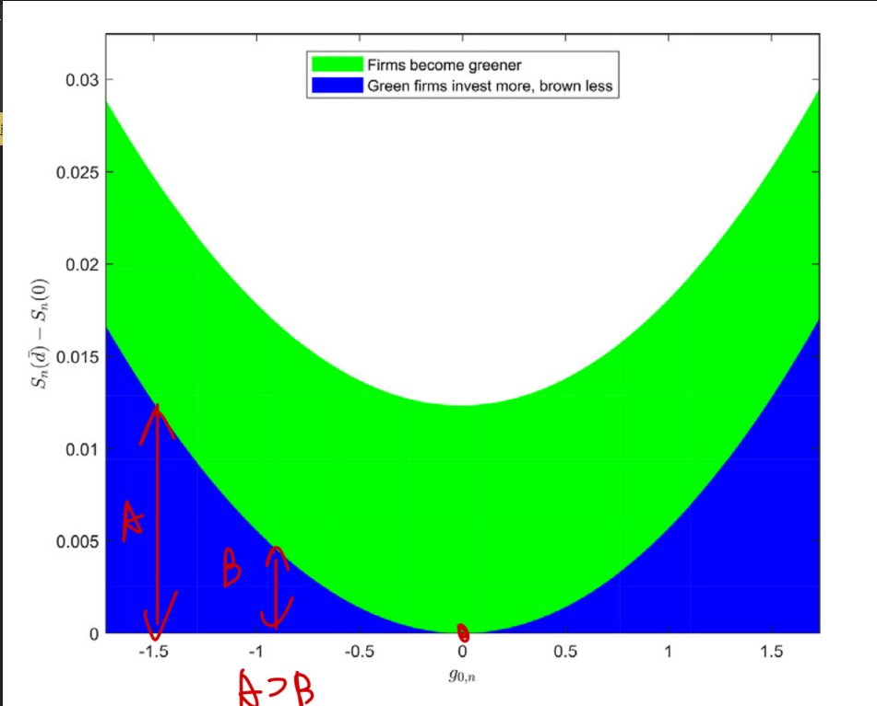
3. Firms become greener (Social Impact)
Implication:
tilting investment toward green firms, is zero for an ESG-neutral firm, but it is large for very green or very brown firms, which experience the largest shifts in investment (bottom blue region)

Slide 23
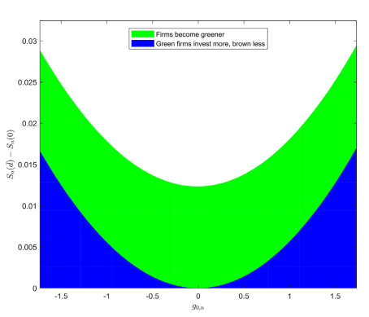
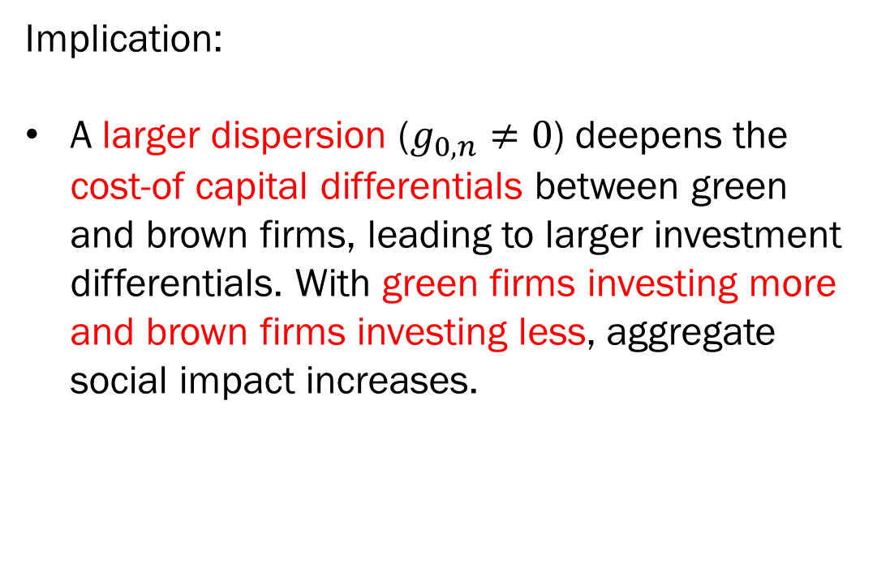
3. Firms become greener (Social Impact)
Implication:
A larger dispersion ($g_{0,n}≠0$) deepens the cost-of capital differentials between green and brown firms, leading to larger investment differentials. With green firms investing more and brown firms investing less, aggregate social impact increases.
Notes:
Lambda = 1 & 0, tilt = 0, because all investors hold market protofolio
Kn 小，廠商改變投資策略容易
Pi 上升/ cost of capital has larger effect on the investment
Sd – s0 的直觀解釋: 投資人esg 品味造成的社會影響

Slide 24
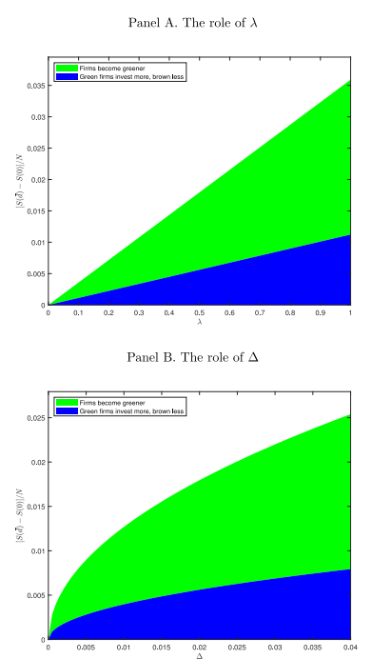
3. Firms become greener
Implication:
Social impact increases as ESG taste increases
Notes:
Lambda = 1 & 0, tilt = 0, because all investors hold market protofolio
Kn 小，廠商改變投資策略容易
Pi 上升/ cost of capital has larger effect on the investment
Sd – s0 的直觀解釋: 投資人esg 品味造成的社會影響

