Slide 1
Reappearing dividend
JFE 2022 Roni Michaely / Amani Moin

Slide 2
Main Topic for Discussion
Why the fraction of dividend-paying firms falls from 73% in 1978 to 23% in 2000 and then increases to 36% in 2018 ? What causes firms to change their behavior ?

Slide 3
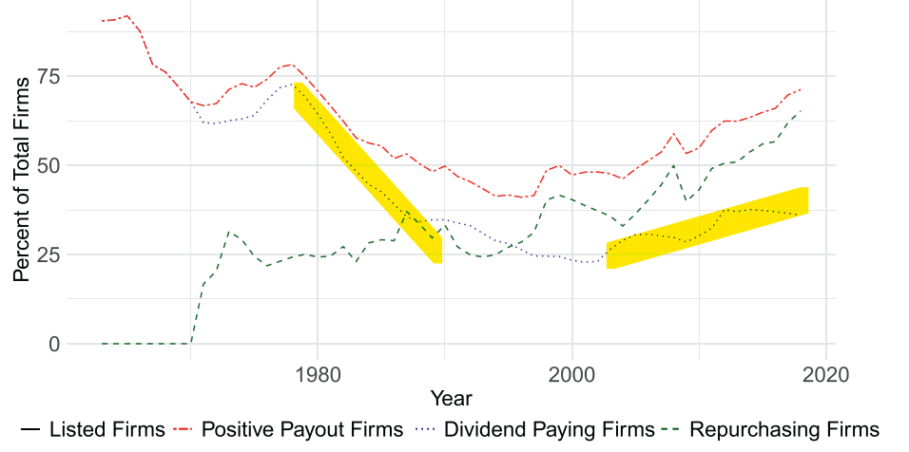
Main Topic for Discussion

Slide 4
Hypothesis to Test
There are a change in the relation between the fundamental characteristics and the decision to pay dividends (e.g. decrease in proclivity to pay dividends )
changes in the distributions of fundamental characteristics, such as profitability and earnings volatility (e.g. Firm with specific characteristic experience a change in number )
examine changes in market conditions (e.g. Change in SEC rule)

Slide 5
Changes in Firm Characteristics & Proclivity Paying Dividends
Earnings volatility has the largest impact on firm characteristics disappearing-dividends period
profitability contributes significantly to the dividend disappearance
A Large shift in firm characteristics between each period
Earnings volatility is the only characteristic that contributes materially to the reappearing dividends phenomenon

Slide 6
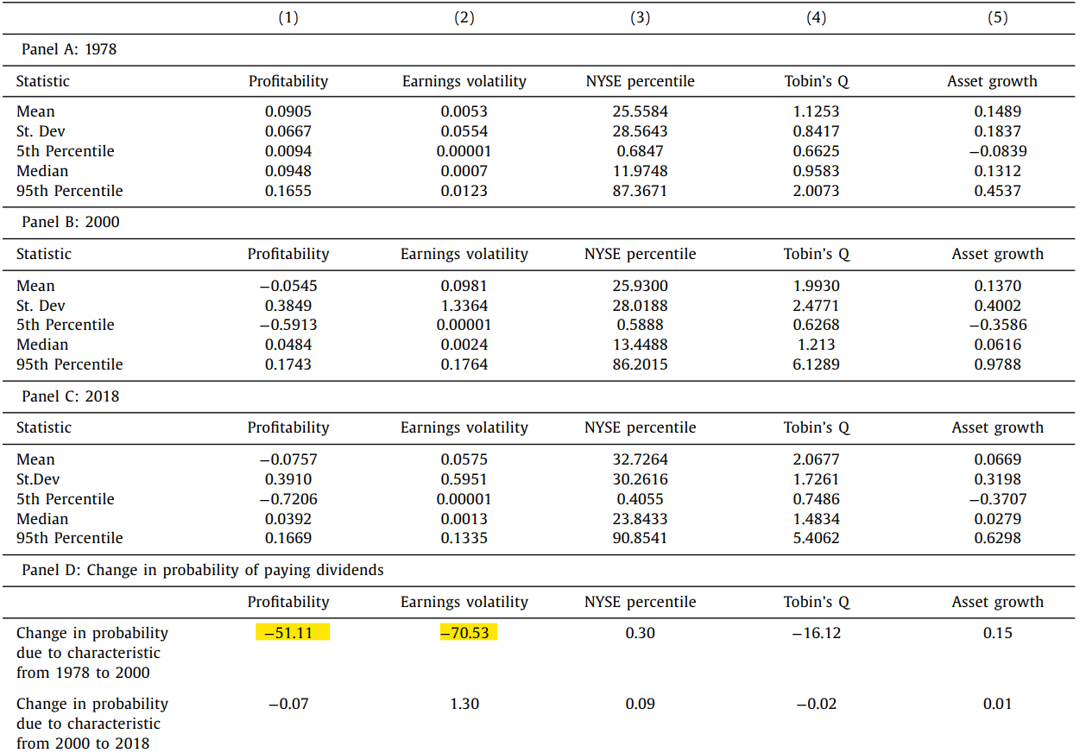
Changes in Firm Characteristics & Proclivity Paying Dividends

Slide 7
Contribution of Firm Characteristics and Proclivity of paying dividends to the changes in payout policy
Contribution made by each factor In 2000’s : Changes in Firm Characteristics : 52% Changes in Proclivity of paying dividends : 47.38 %
Contribution made by each factor In 2018 : Changes in Firm Characteristics : 18.28% Changes in Proclivity of paying dividends : 81.72 %

Slide 8
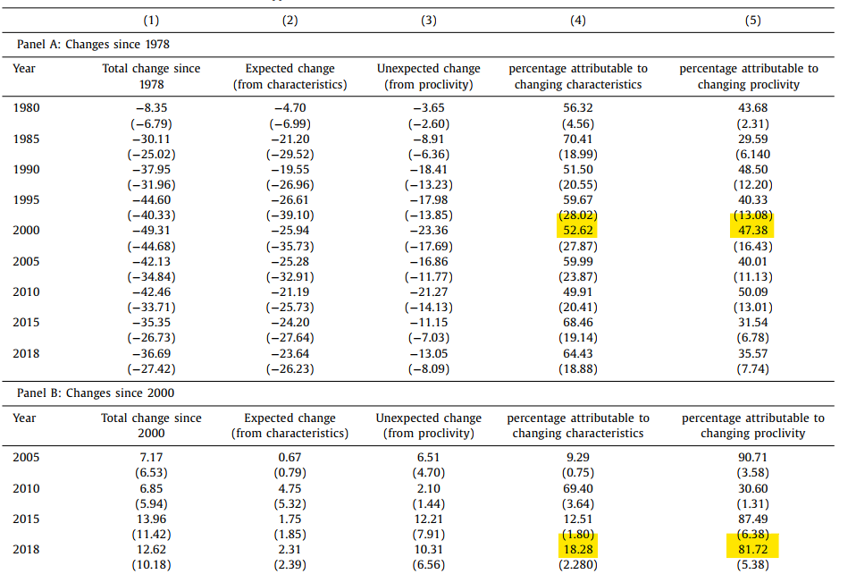
Contribution of Firm Characteristics and Proclivity of paying dividends to the changes in payout policy

Slide 9
When we Dig Deeper Into the Changes in Proclivity of paying dividends
There are two main source of Changes in Proclivity of paying dividends : 1. Change in Regulatory structure 2. Firm Delisting

Slide 10
Relationship Between Regulatory structure & Pay Out
Regulatory structure : SEC rule 10b-18(1982) making firms easier to repurchase shares instead of paying dividends
Evidence : The firms overall payout is gradually higher even while dividend reappear

Slide 11
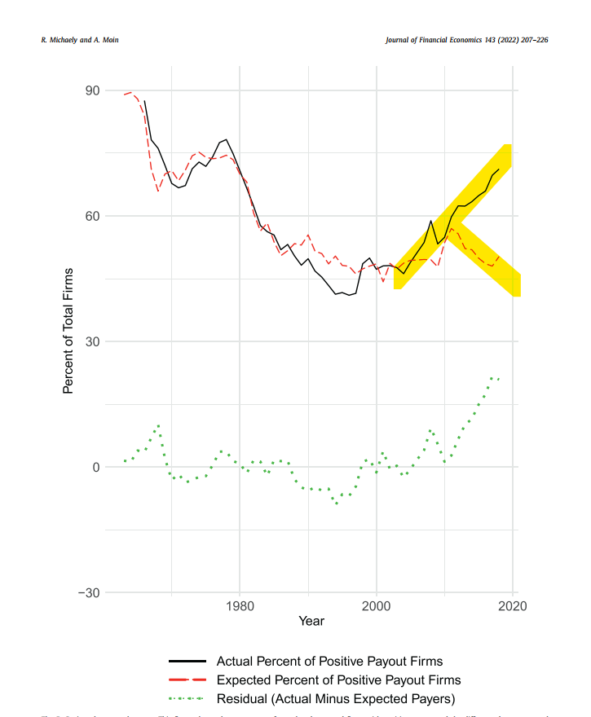
Relationship Between Regulatory structure & Pay Out

Slide 12
Likely Explanation of Reappearing Dividends
Firm Delisting (Technology Firms): In previous study, high earnings volatility firm could be reluctant to pay dividend. So technology bubble might cause dividend reappearing. Yet little technology firms where forced to delist meaning that reoccurring dividend may not occur due to the technology bubble .

Slide 13
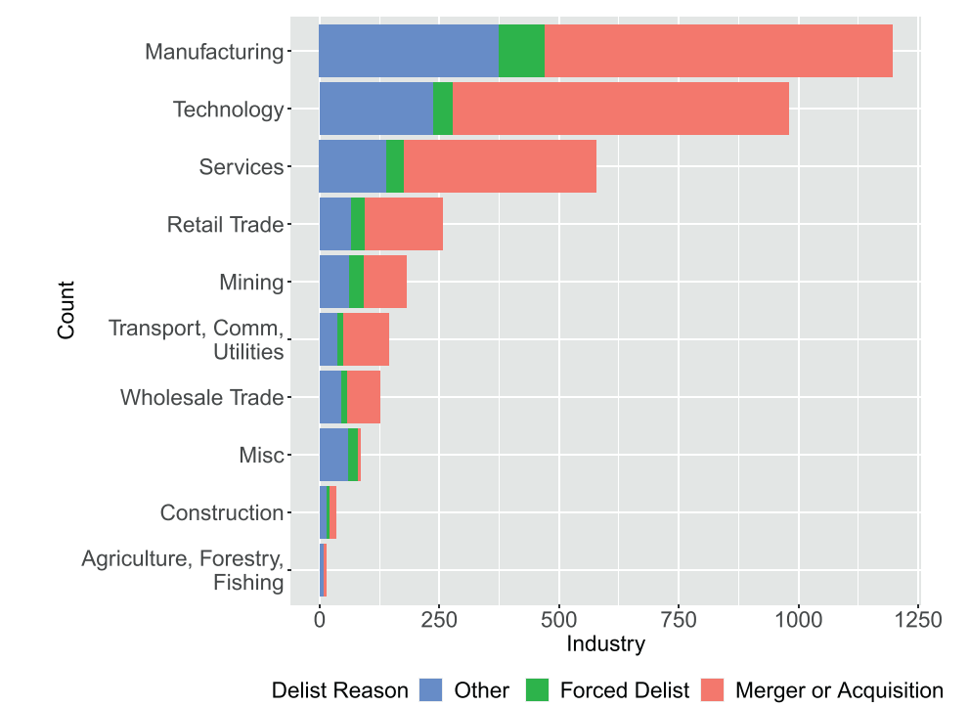
Likely Explanation of Reappearing Dividends

Slide 14
Likely Explanation of Reappearing Dividends
Firm Delisting (Merger or Acquisition): mergers and acquisitions account for approximately two-thirds of the reappearing-dividends phenomenon

Slide 15
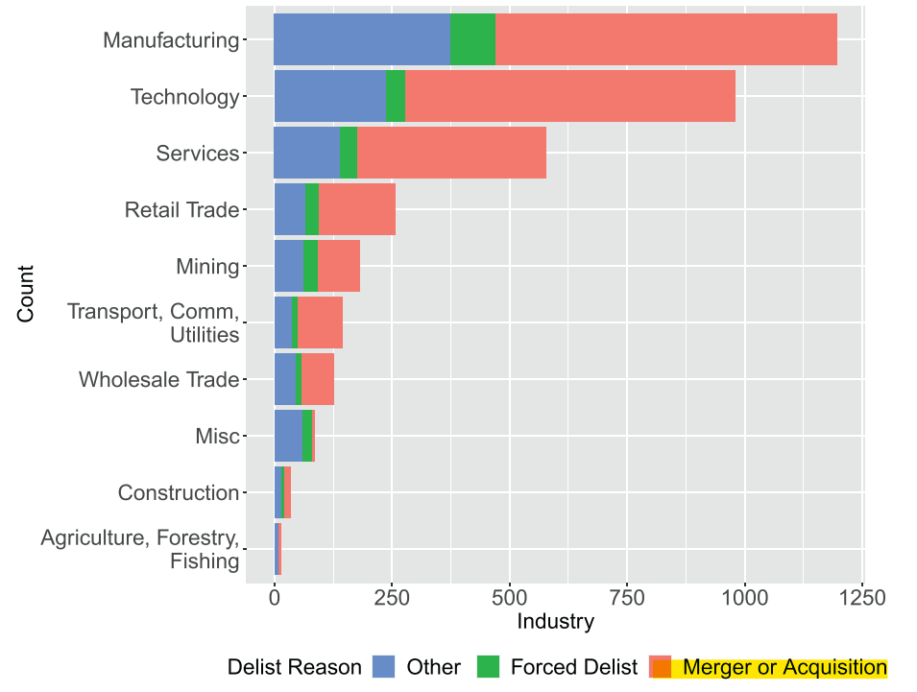
Likely Explanation of Reappearing Dividends

Slide 16
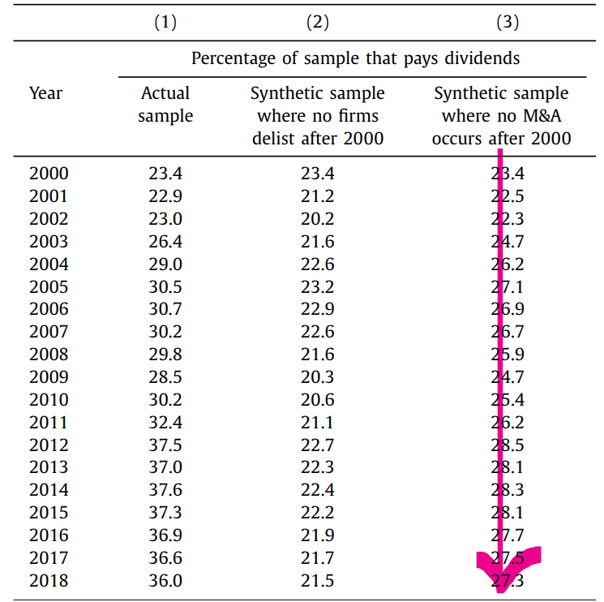
Likely Explanation of Reappearing Dividends

Slide 17
Summary
Disappearing Dividend (2000’s) |  |  | Reappearing Dividend (2018’s)
 | Firm Characteristics | Proclivity of paying dividends | Firm Characteristics | Proclivity of paying dividends
Contribution | 52% | 47.38 % | 18.28% | 81.72 %
Source |  |  |  | Firm Delisting
 |  |  |  | Change in Regulatory structure

Slide 18
High payout in 2000
JFE 2021 Kathleen Kahle/ René M. Stulz

Slide 19
Main Topic for Discussion
Why pay out are so high in 2000s?

Slide 20
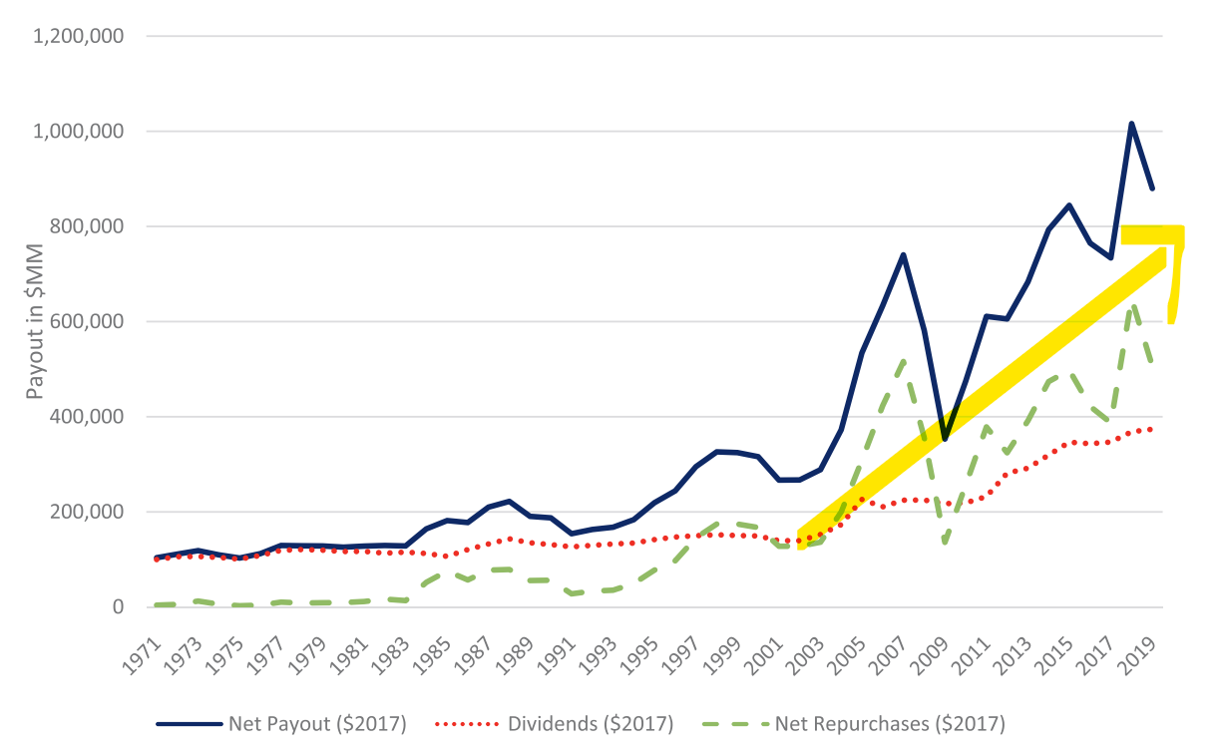
Main Topic for Discussion

Slide 21
Hypothesis to Test
What causes payout?
Will change in firm characteristic explain the increase in payout rate?
How much of the increase in payouts can be explained by changes in firm characteristics?
Other factors besides firm characteristic influencing firm payout

Slide 22

What causes payout?
Operating income → 37%
Payout Rate → 63%

Slide 23
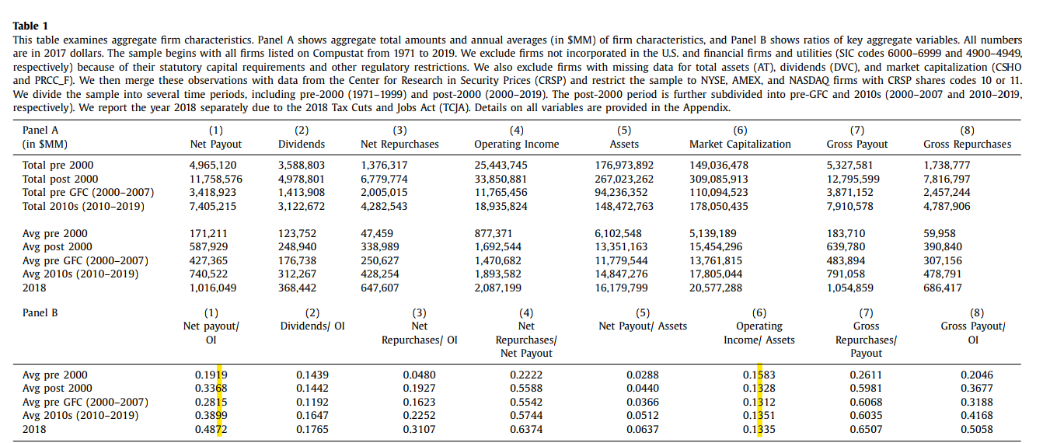
What causes payout?

Slide 24
Can Macroeconomic Factor Explain Payout?
The change in Macroeconomic factor might cause the operating income to fluctuate leading to a change in Payout
The study Include Macroeconomic factor such as GDP & Baa bond yield
The study has shown that macroeconomic variables do not help predict aggregate payouts once one accounts for aggregate earnings

Slide 25
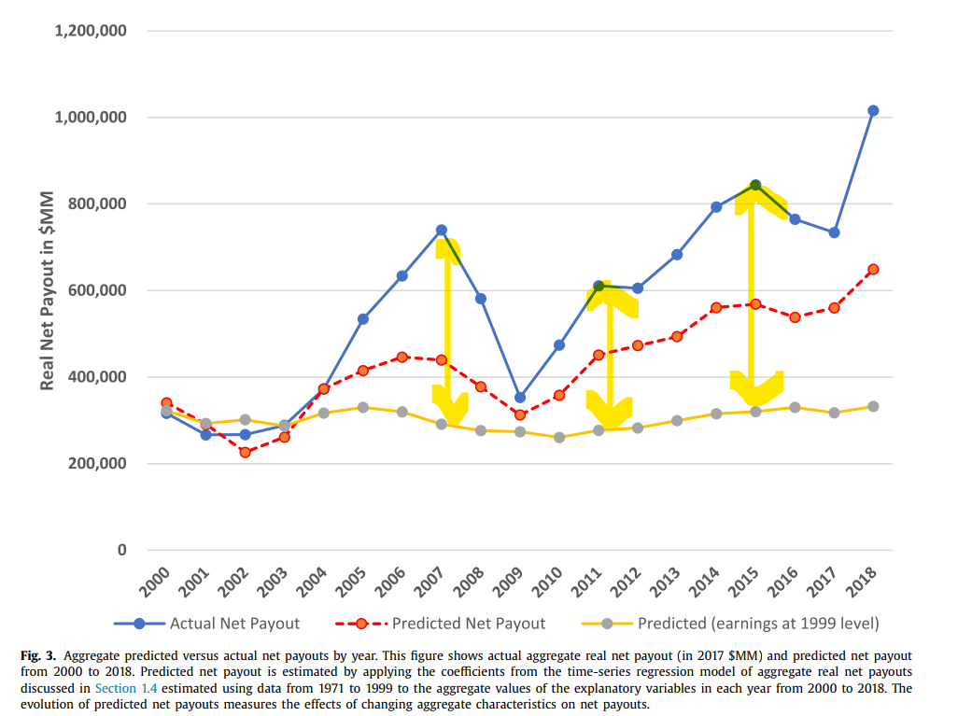
Can Macroeconomic Factor Explain Payout?
Freezing earnings in 1999 level leaving the change cause by Baa bound and GDP

Slide 26
Firm characteristic difference between Top Payers & Payers
 | Top Payers | Payers
Operating Cash Flow & Free Cash flow | High | Low
Capital Investment | Decrease | Decrease

Slide 27
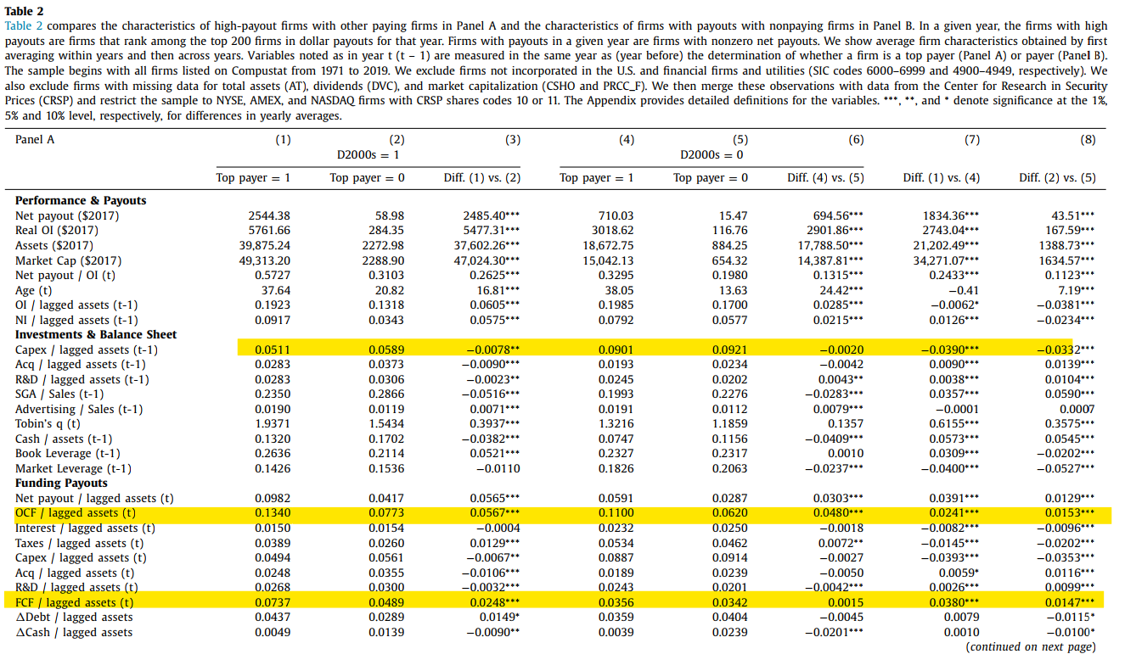
Firm characteristic difference between Top Payers & Payers
Decrease in capital spending
OCF & FCF difference between payers

Slide 28
Firm characteristic difference between Payers & Non Payers
 | Payers | Non Payers
Fund (from decrease in investment ) Usage | Payout | Increase in R&D (Research and Development )
Possible Explanation | Older firms already Built much intangible Assets | New firms building intangible Assets

Slide 29
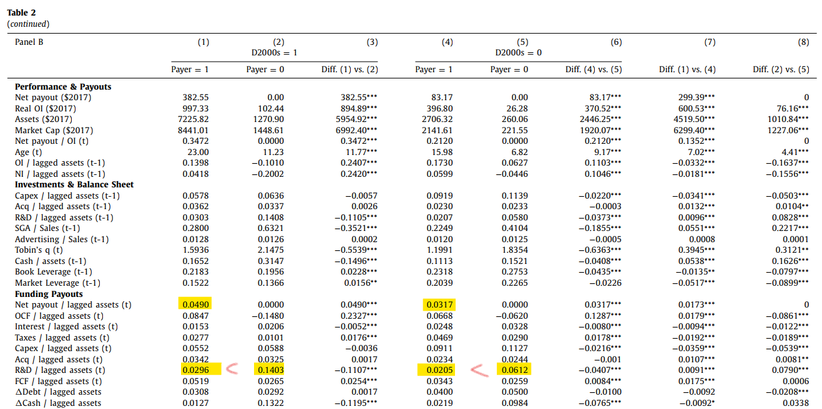
Firm characteristic difference between Payers & Non Payers

Slide 30
How much can change in firm characteristic explain the increase in payout rate?
After discussing the difference in firm characteristics, this study then measures the impact brought by firm characteristics.
The study shown that 56.79% of the increase in increasing payout rate can be explained by firm characteristics
The impact is measured by regression coefficient multiplying the rate of change

Slide 31
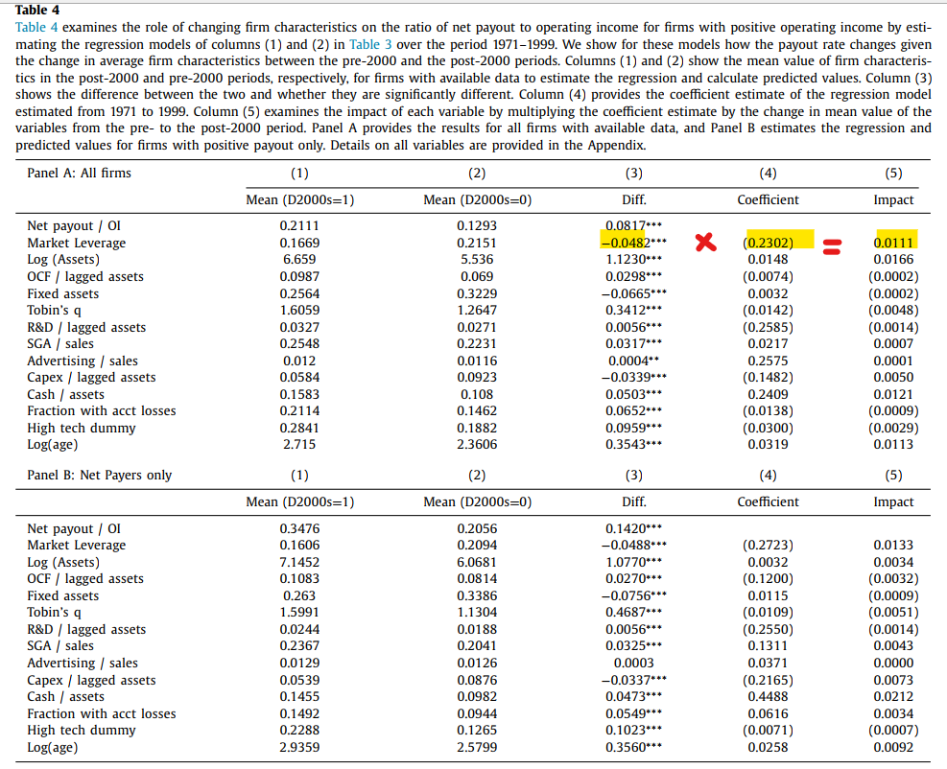
How much can change in firm characteristic explain the increase in payout rate?

Slide 32
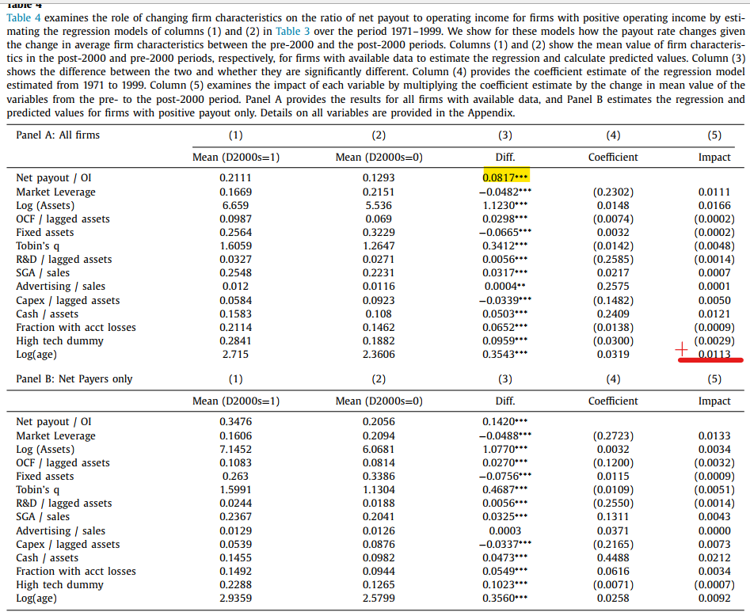
How much can change in firm characteristic explain the increase in payout rate?
0.0817/0.0465 = 0.5679
0.0465

Slide 33
Besides Firm Characteristics, Firms are more Sensitivity to Determinants of Payout in 2000s
By performing regressing payout rate on free cash flow and it’s interaction term of time (2000ss dummy ) the study shown that firms sensitivity to determinants of Payout occurs in the 2000s
In the model with firm fixed effects, an increase in FCF from 0% to 10% increases payouts from 1.7% to 1.702%. The same change in the 2000s increases payouts to 2.76%. It thus follows that the sensitivity of payouts to FCF is much higher in the 2000s

Slide 34
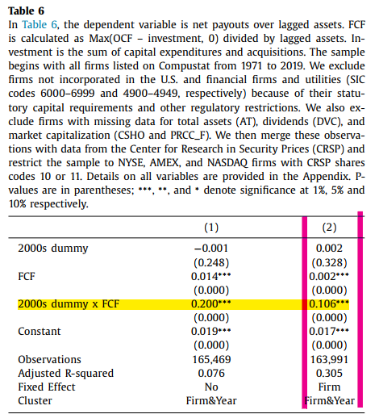
Besides Firm Characteristics, Firms are more Sensitivity to Determinants of Payout in 2000s

Slide 35
Besides Firm Characteristics, Firms are more Sensitivity to Determinants of Payout in 2000s

Slide 36
Summary
What causes more payout? → Firm characteristics (e.g. cash flow / capital expenditure / leverage etc.) + Firms Sensitivity to Determinants of Payout

