Slide 1


Citi mobile vs icbc mobile
Presented by JJ (Junjie Du)
For Citi Group Business Analyst
position

Slide 2
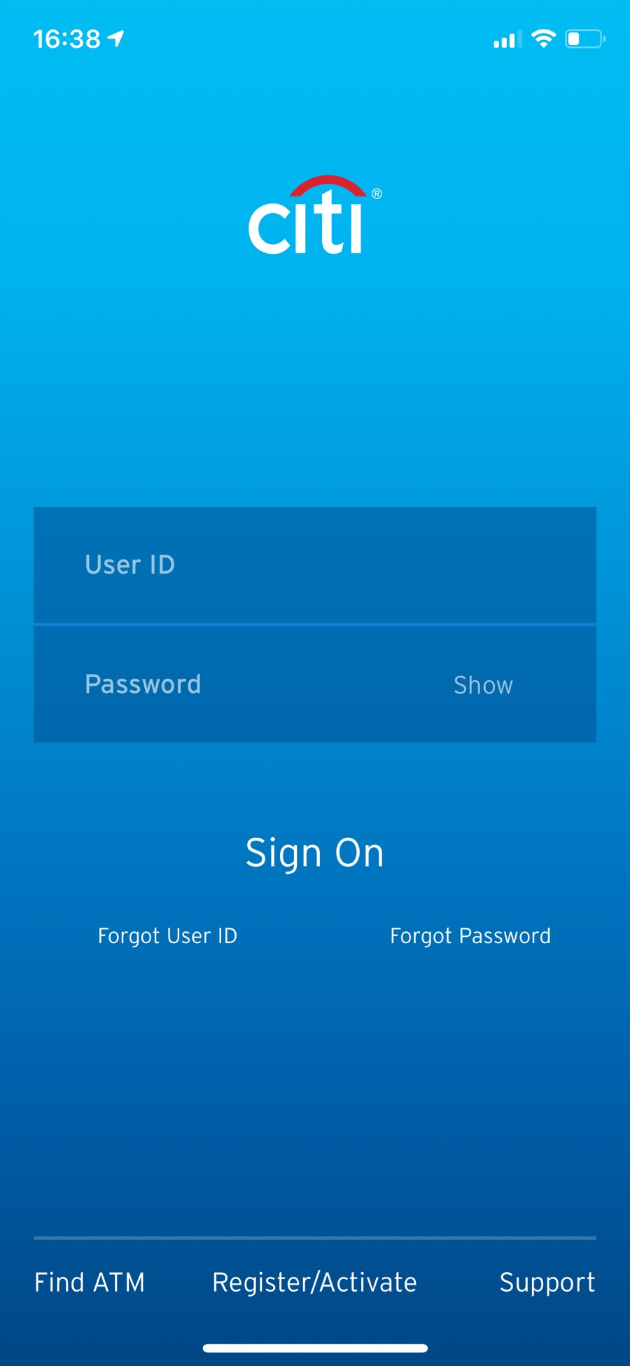
Login Page
Functions by CITI
User ID
Password (Show/Hide)
Forgot User ID/Password
Find ATM machine nearby
Activate account/card
Support/customer service

Slide 3
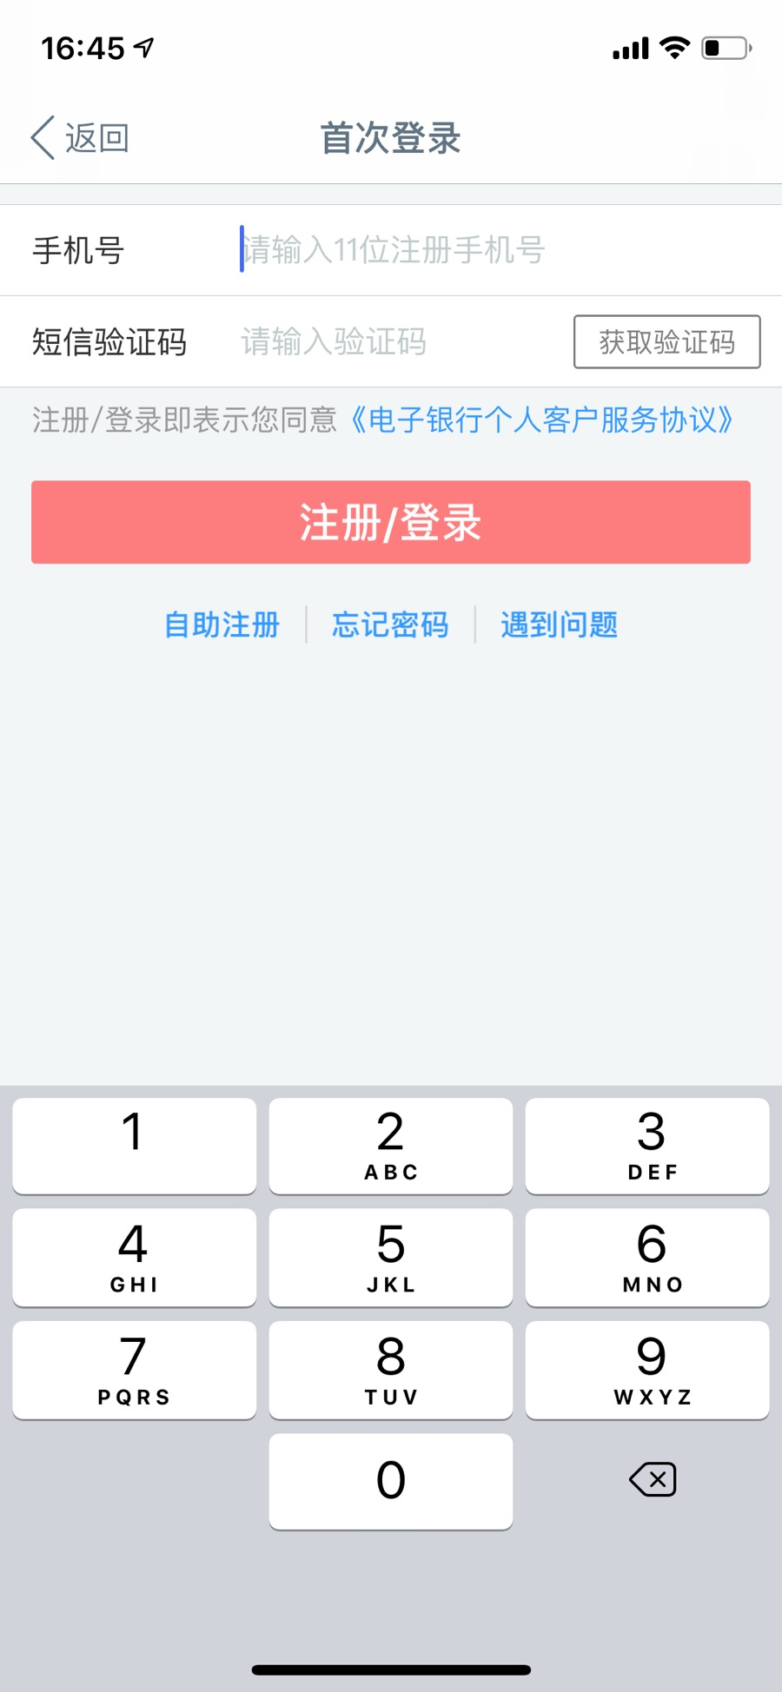
Login Page
Functions by ICBC
Phone# login
Verification by message
Activate account
Forgot Password
Support/customer service

Slide 4
Login Page comparison
Similarity:
Forgot password
Support/customer service
Unique:
User ID login VS Phone# login
Password VS Verification message
Activate card VS Open new account

Slide 5
Facts & causes
Consumption Habit: mobile (phone#) login is common in China due to mobile payment
Safety/Security VS Quick/Easy Login
Traditional credit card activation VS
Mobile e-account registration
Which better suits our customer and value？

Slide 6
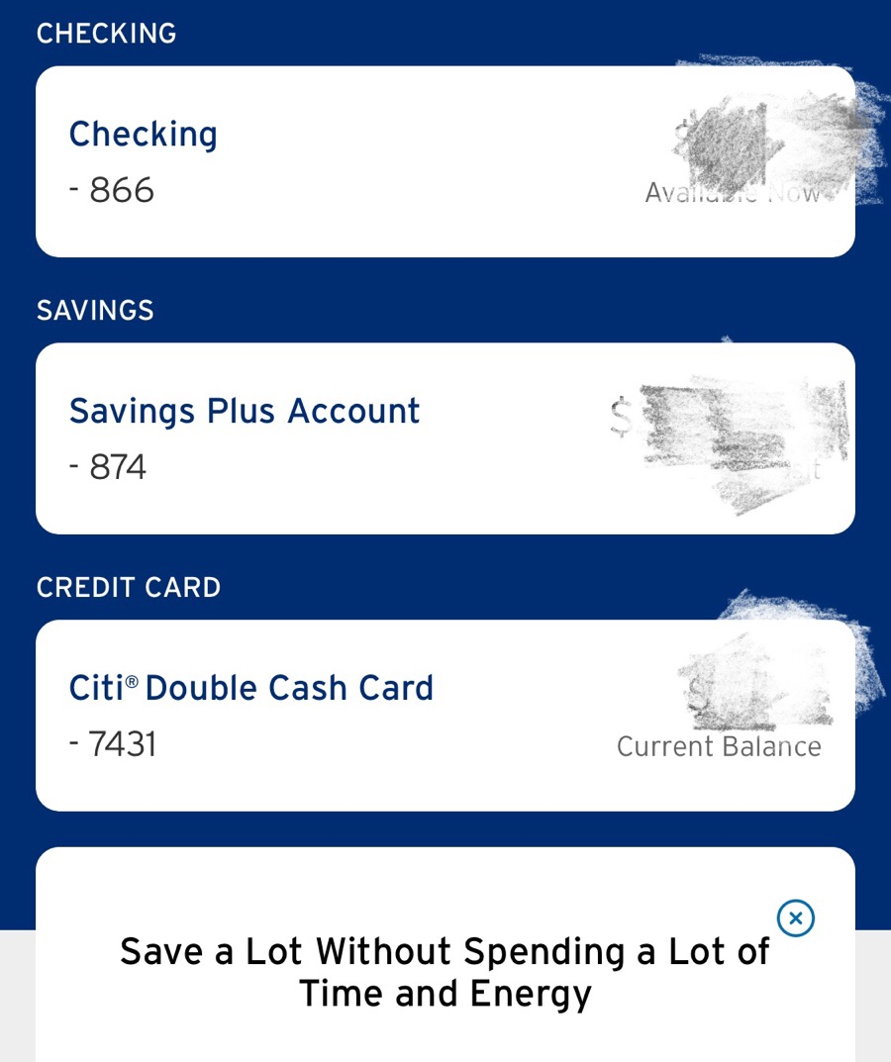
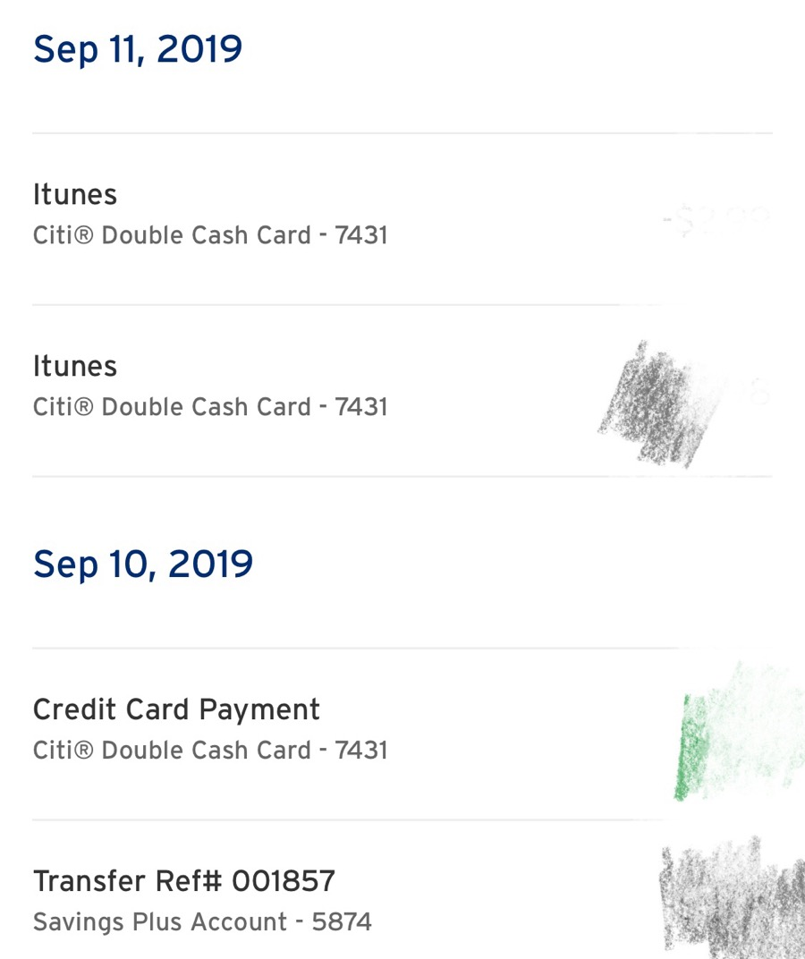
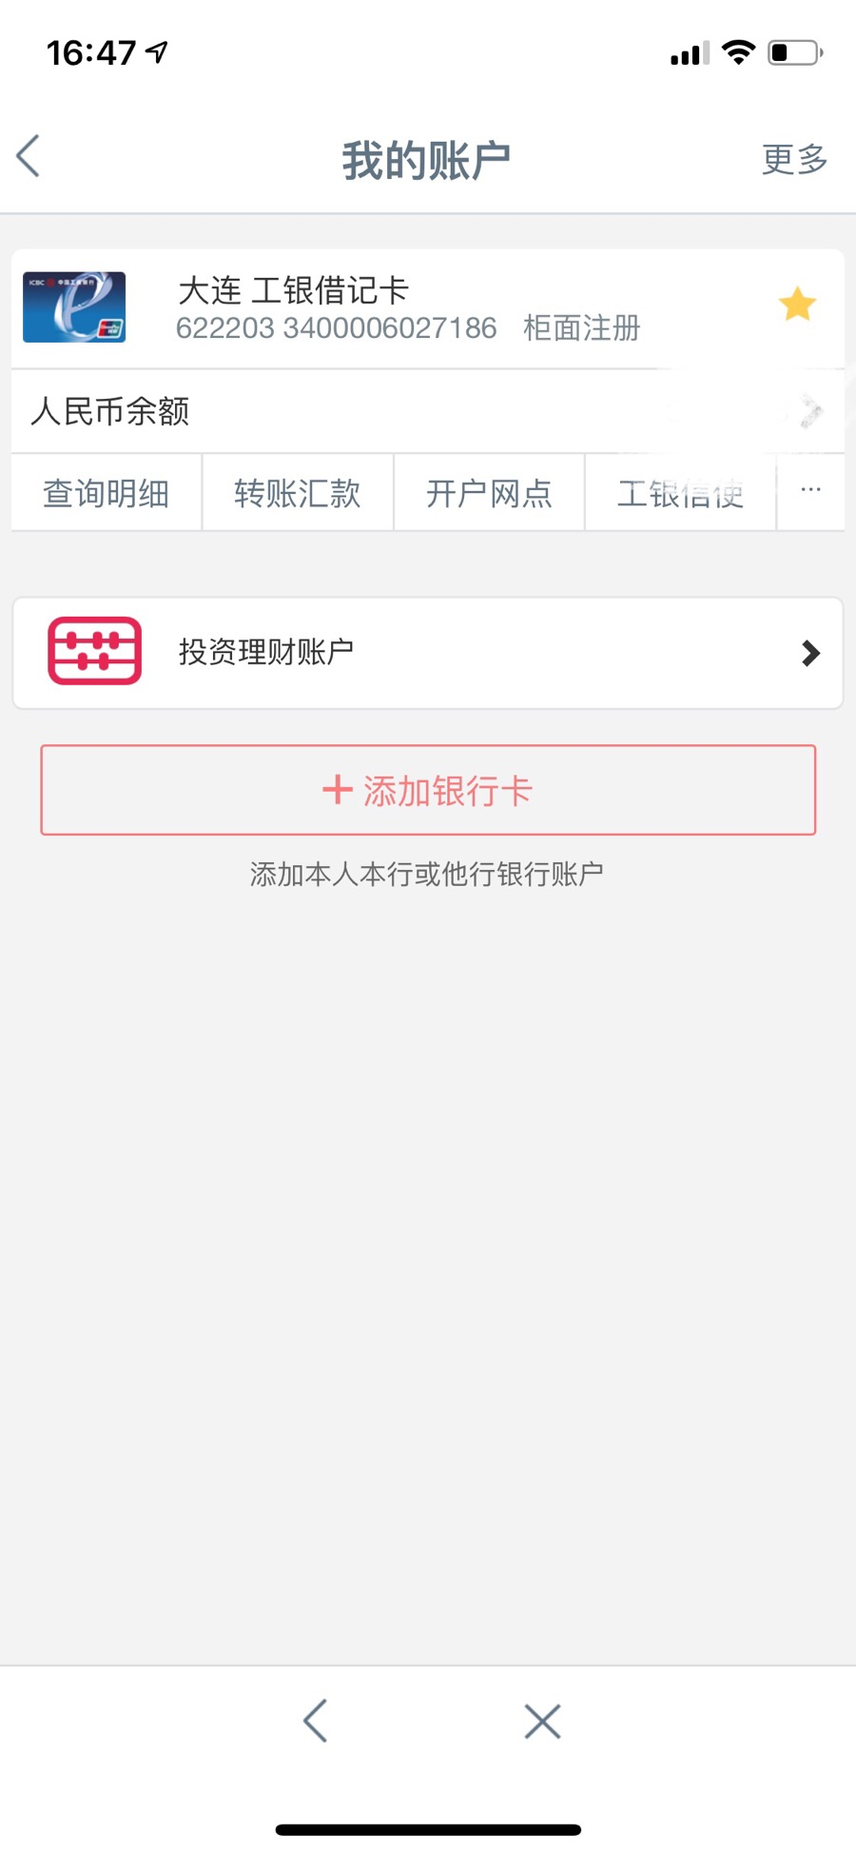
Functions & services

Slide 7
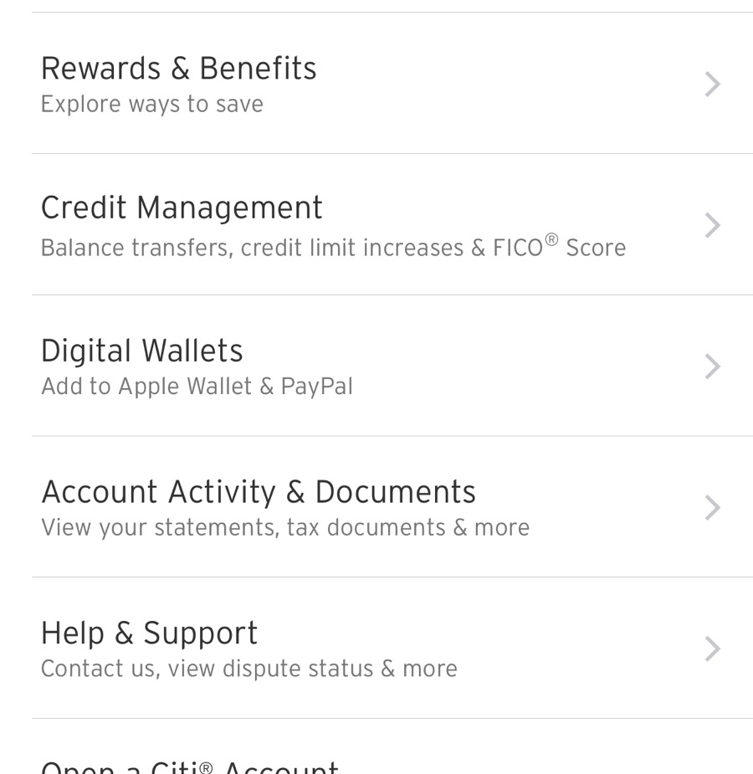
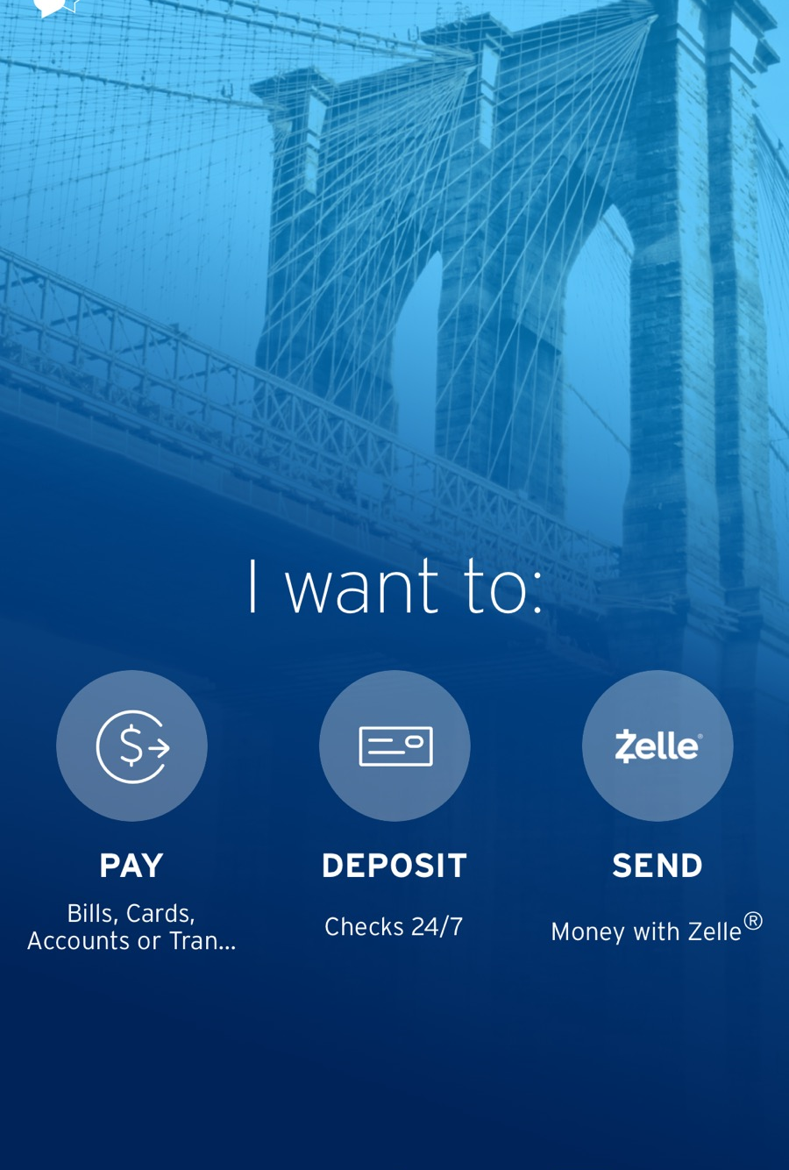
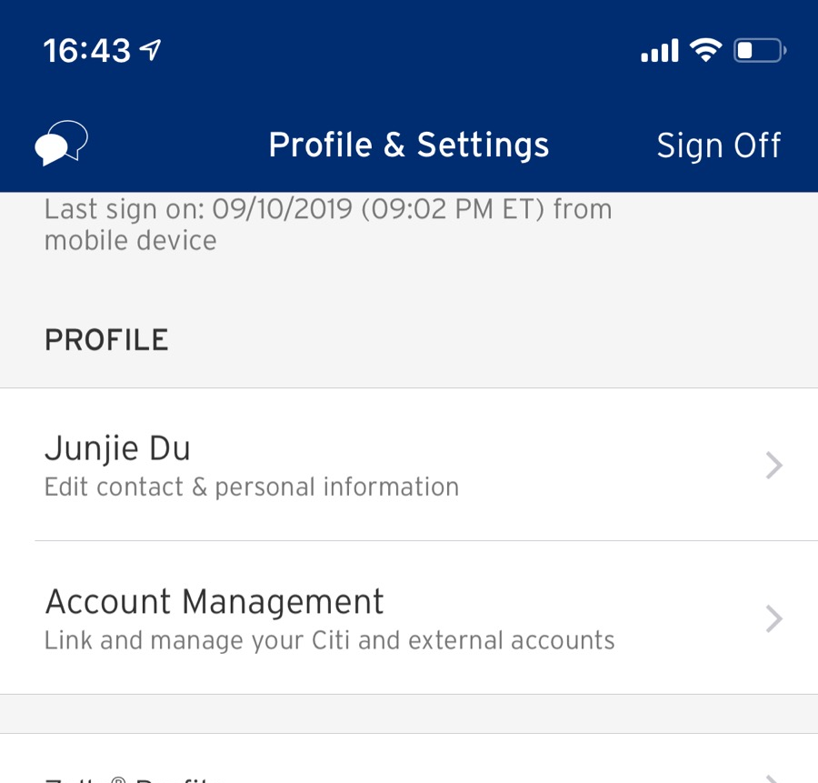
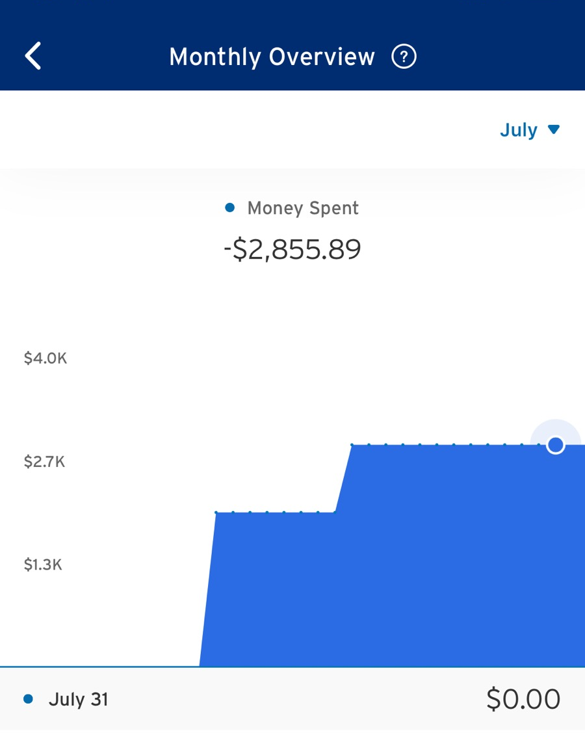
Citi mobile app
Citi Mobile put effort on credit management
Credit limit increase & FICO
Credit card rewards & benefit
Account transfer between internal accounts
Pay attention to user experience on credit card services
Monthly spent analysis on credit card
Recent transactions with credit card
Online dispute status on credit card
Encourage you to apply new credit card service online (easy apply)

Slide 8
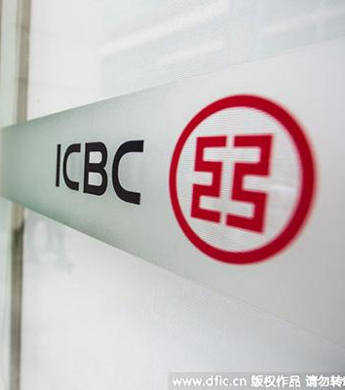
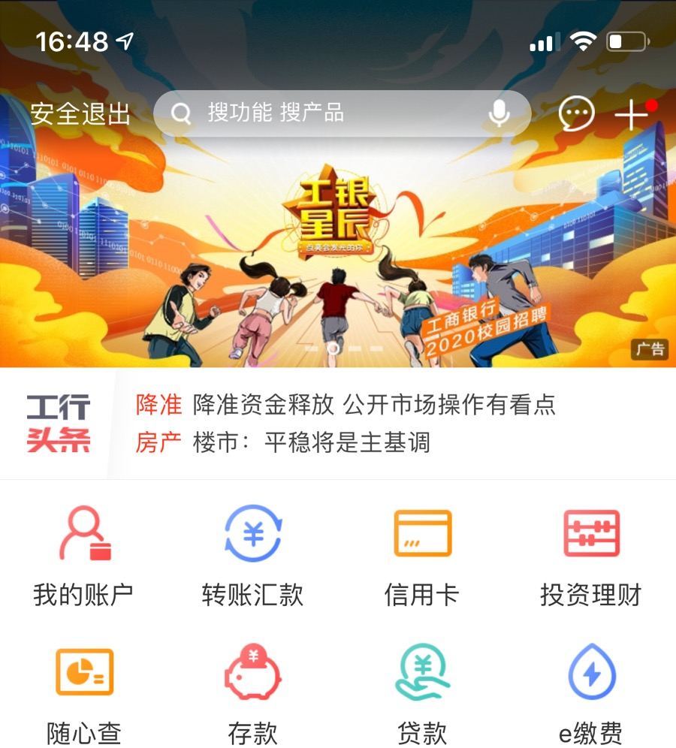
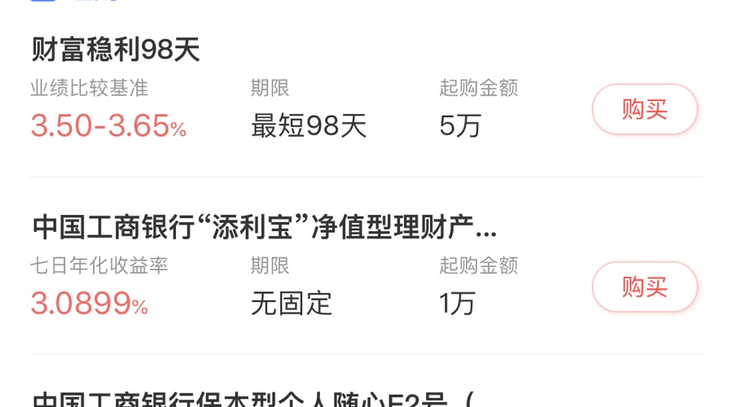
ICBC mobile app
Focus on functionality:
E-transactions linked with online account (phone bill payment, water bill, electric bill, etc)
Deposit business instead of credit services
More options on investment and finance
Easy to use

Slide 9

Account summary
Citi Mobile focus on:
Credit card services, especially build up a client friendly user experience/environment
Detailed transactions, account balance, credit card due date/payment balance
Private banking services, investment portfolio, multinational services
Improvement needed in the future:
Business diversification besides credit card business
Develop and implement investment and financing functional e-payment with mobile app

Slide 10

Thank you

