Slide 1
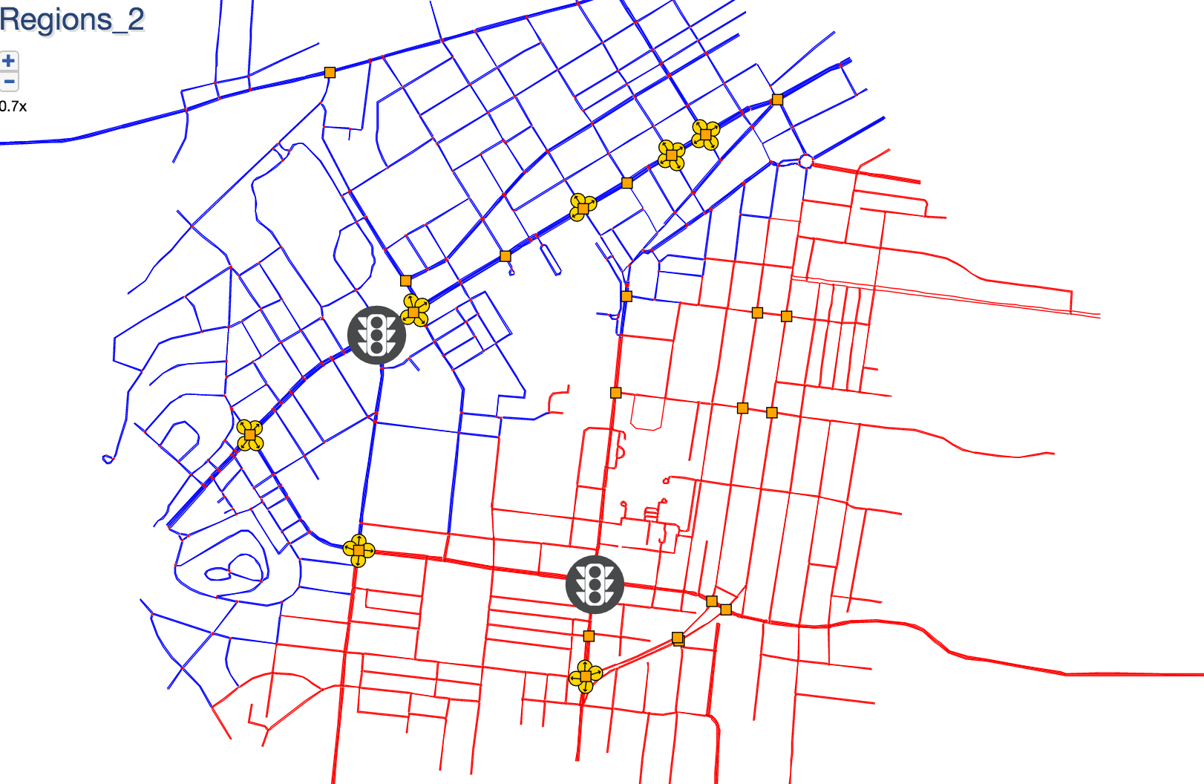
Submap

Slide 2
Morning

Slide 3
Afternoon

