Slide 1
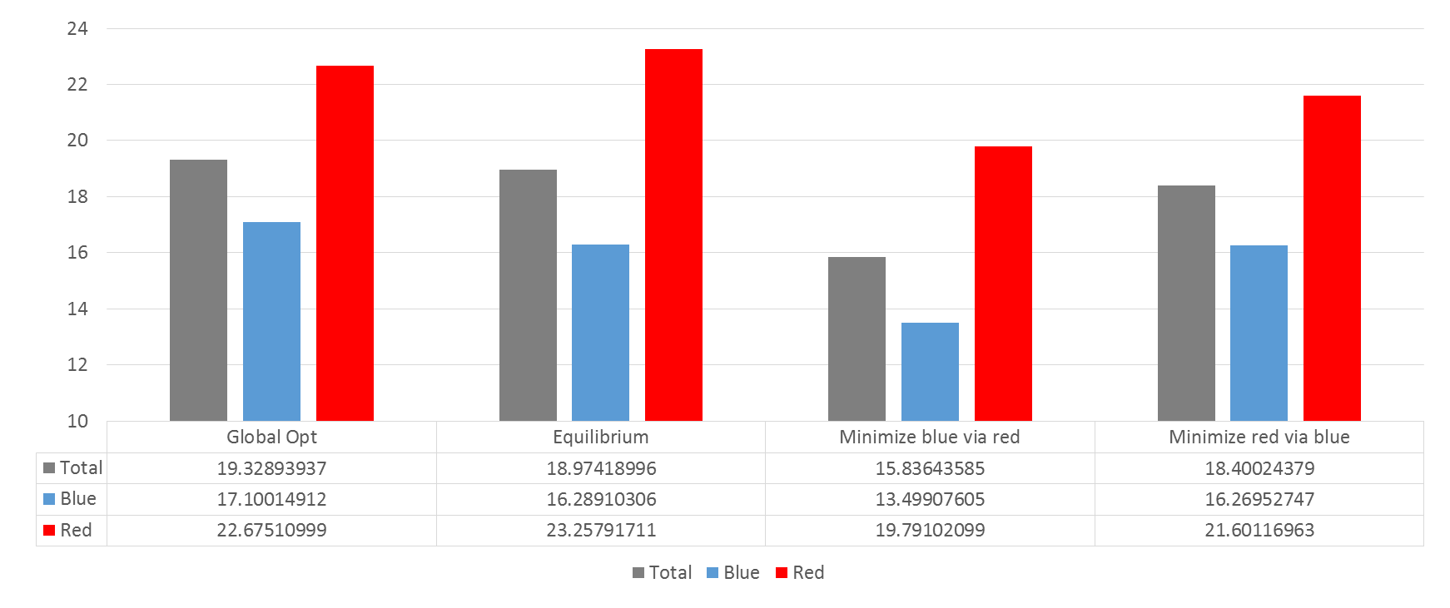
2 regions, morning
#Intersections: 5
Blue:3
Red :2

Slide 2
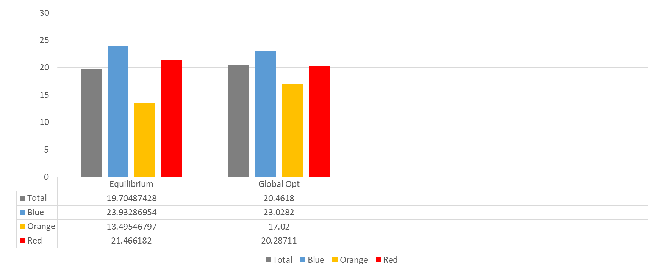
3 regions, morning
#Intersections: 5
Blue:1
Red :3
Orange:1

Slide 3
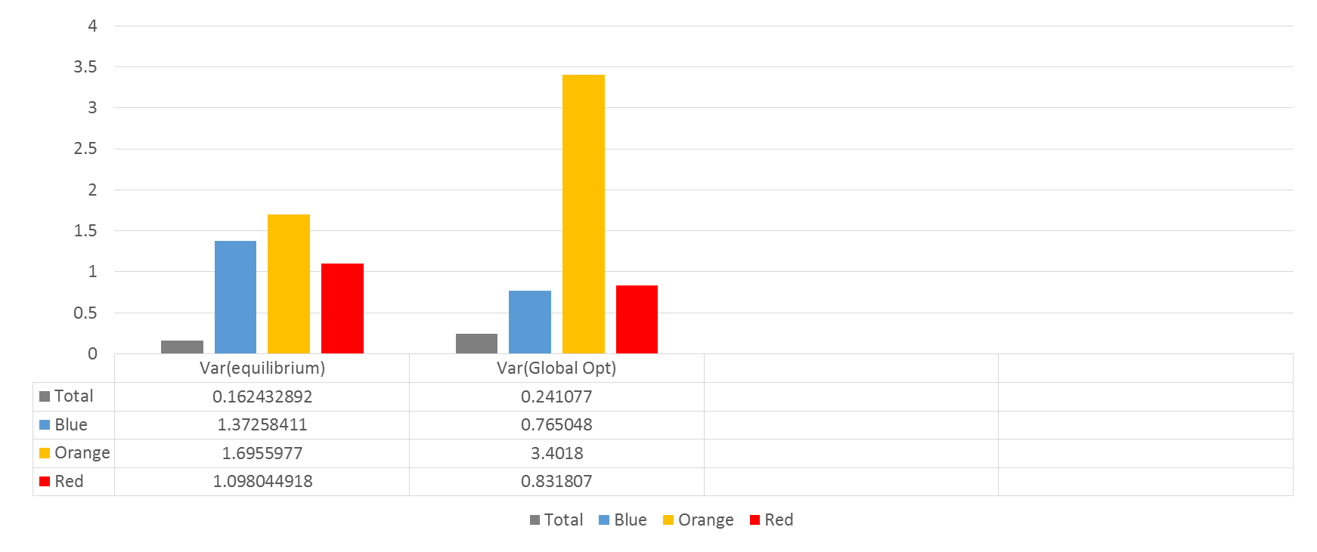
3 regions, morning
#Intersections: 5
Blue:3
Red :2

Slide 4
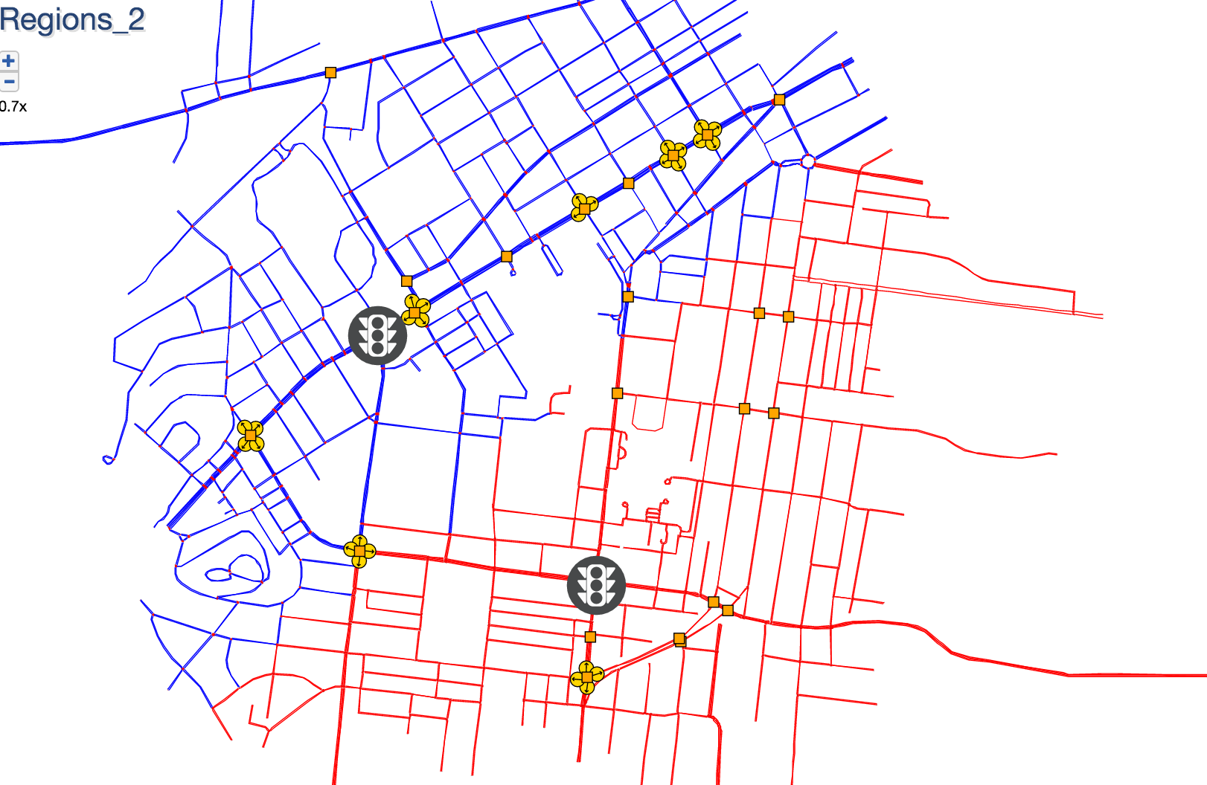
Submap

