Slide 1
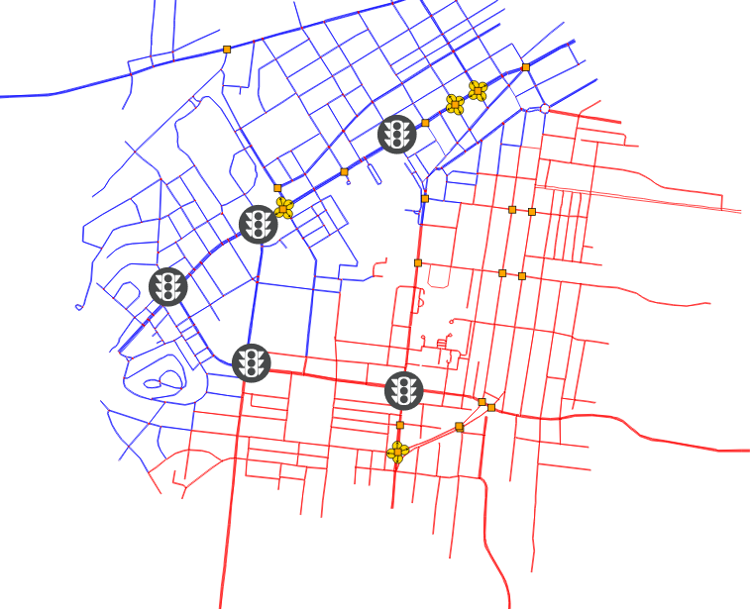
2 regions

Slide 2
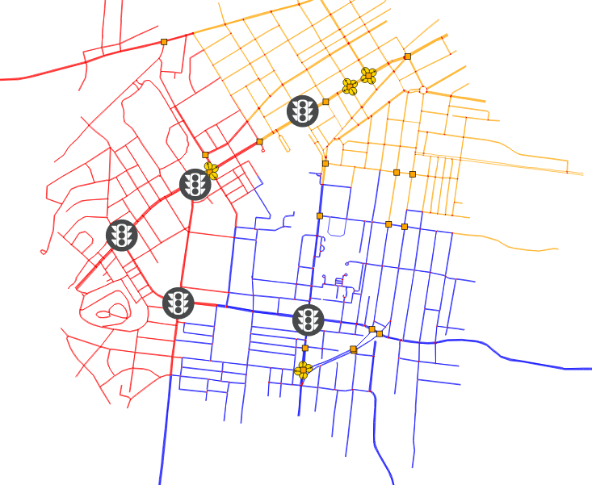
3 regions

Slide 3
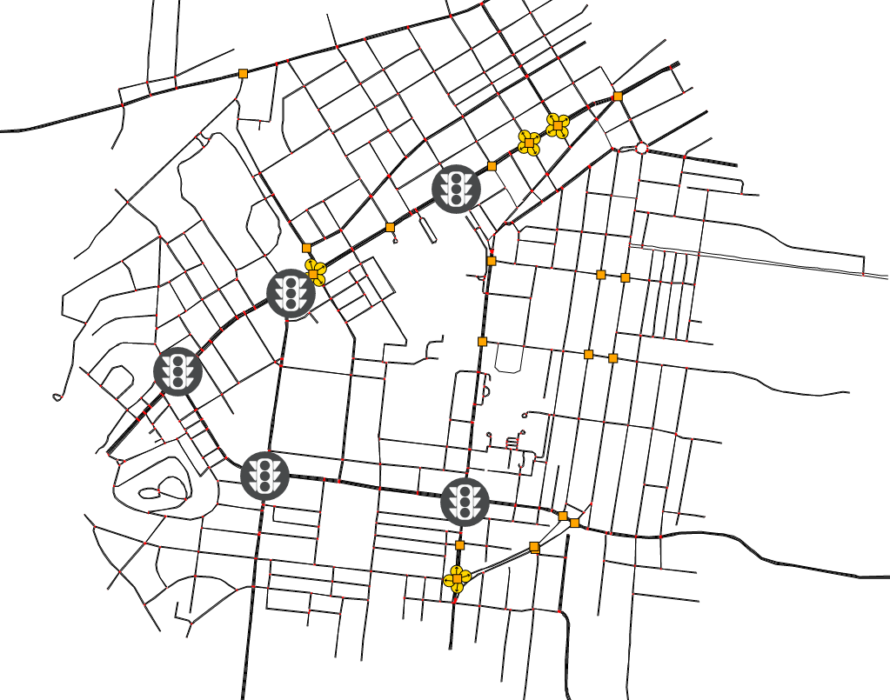
1 region

Slide 4
2 regions, morning
#Intersections: 5
Blue:3
Red :2

Slide 5
3 regions, morning
#Intersections: 5
Blue:1
Red :3
Orange:1

Slide 6
Result
baseline
optimal
controller
baseline
controller
resilient
(1 attacker)
resilient
(2 attackers)
resilient
(5 attackers)
1 attacker
2 attackers
5 attackers

