Slide 1
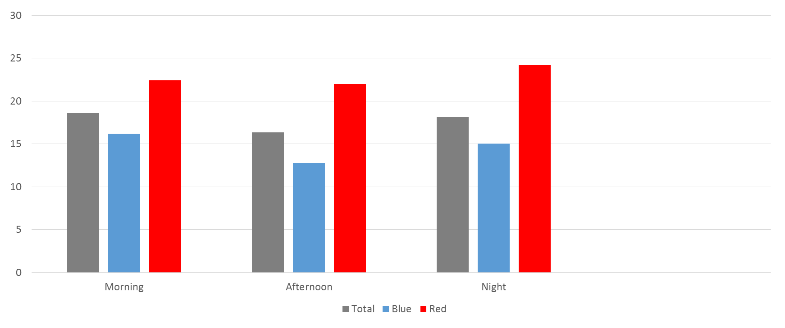
Submap with 2 regions

Slide 2
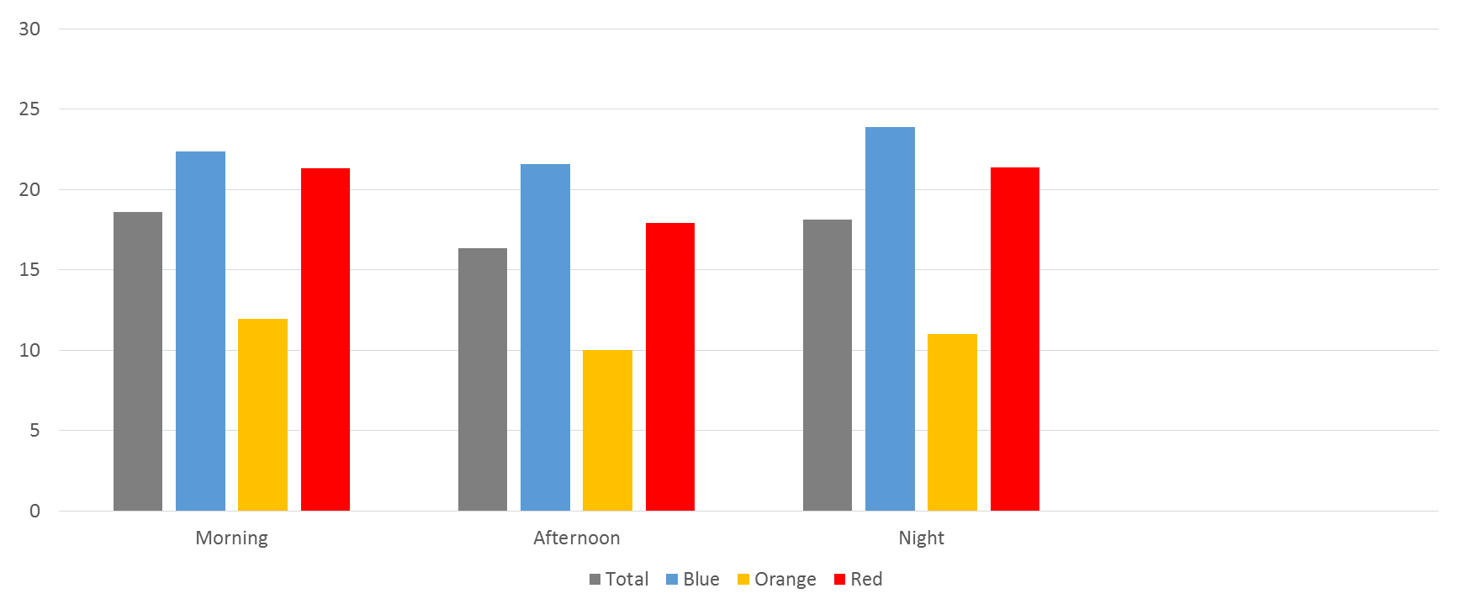
Submap with 3 regions

Slide 4


