Slide 1

Home Energy Monitoring System
Software Patterns - Group 2
December 1, 2015

Slide 2
Members
Putra, Guntur
Fakambi, Aurélie
Schaefers, Joris
Menninga, Wouter
Notes:
SoftArch group 3
Busy with developing architecture that can save lives

Slide 3
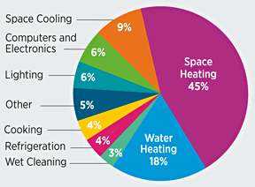
Introduction
How to save money? Predicting the bill?
How to save the world? Conserving energy?
An example of home energy consumption
How to reduce home energy-related costs. http://greenifynow.com/wp/?p=795, 2013
Notes:
- Useless use of electricity at house
Climate COP21
How to save money? By estimating the bill?
How to save world by conserving energy in house hold?

Slide 4
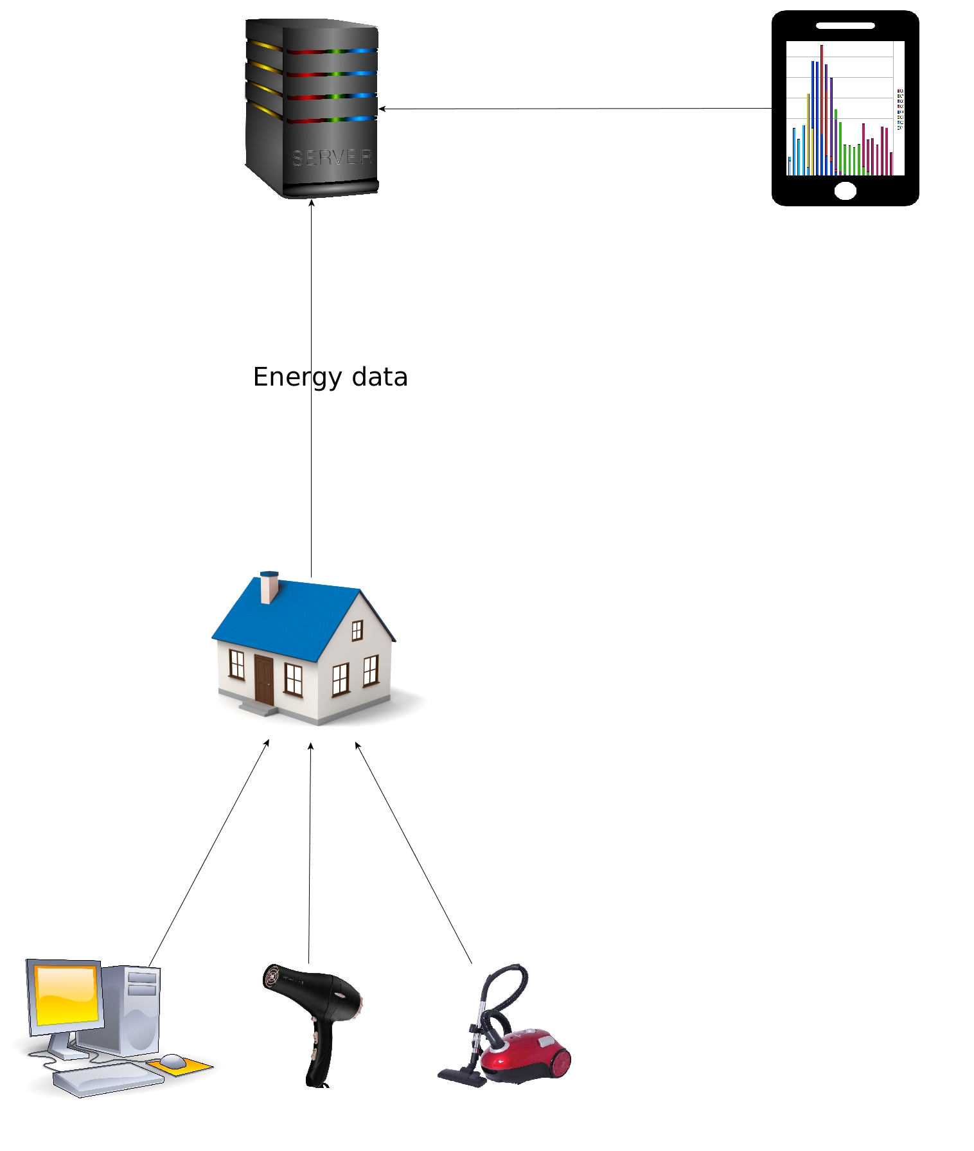
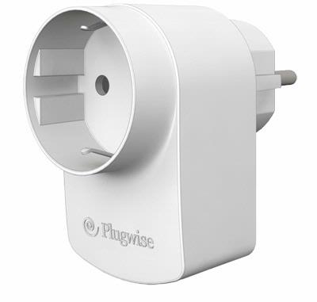
System Context
Sensors are mounted (3rd party)
Notes:
The sensing part is not ours
Dashboard
We are non profit team, doesn’t really care abt the money

Slide 5
System Context
Notes:
The sensing part is not ours
Dashboard
We are non profit team, doesn’t really care abt the money

Slide 6



Key Drivers
Usability
Reliability
Compatibility
Notes:
List what are those
Why are those important?

Slide 7
Patterns
Layers
Service Layer
Front page controller
Domain model
Unit of work
Shared repository
Data mapper
Broker
Model-view-controller
Template view

Slide 8
Layers
Notes:
Explain where does the MVC pattern reside
Go through the layers briefly

Slide 9
Presentation Layer
Model-View Controller
Template View
Notes:
What is that?
How it works?
Where is it?

Slide 10
Service Layer

Slide 11
Domain Layer

Slide 12
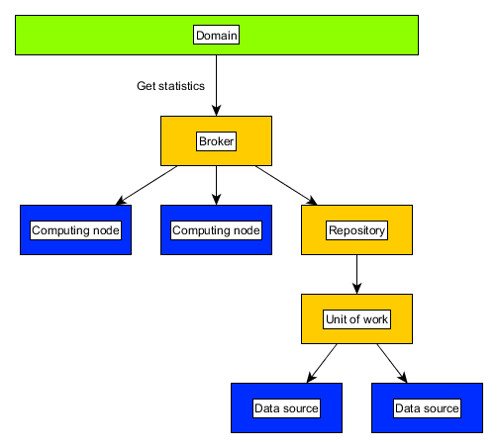
Broker

Slide 13
Data Source Layer

Slide 14
Data Source Layer
Shared Repository
Data Mapper with Unit of Work

Slide 15
Unit of Work

Slide 16
Conclusions
Home Energy Monitoring System gives statistics about electricity usage of a house.
We provide the API, 3rd developer are free to build the sensors.
Several software patterns are implemented in the system.
Evaluation will be carried out in the next stage.

Slide 17
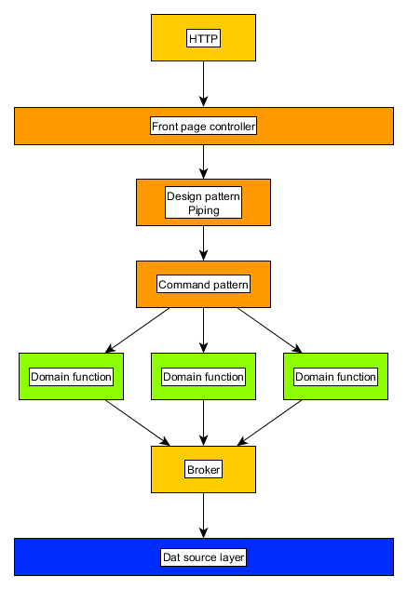
Front page

