Slide 1

RUG 2015/2016
Software Patterns Second Presentation : Pattern-Based Recovery Docker
Joris Schaeffers
Wouter Menninga
Guntur Dharma Putra
Aurélie Fakambi

Slide 2

Introduction
« Docker is an open-source project that automates the deployment of applications inside software containers, by providing an additional layer of abstraction and automation of operating-system-level virtualization on Linux » Wikipedia
Lightweight, fast and secure

Slide 3
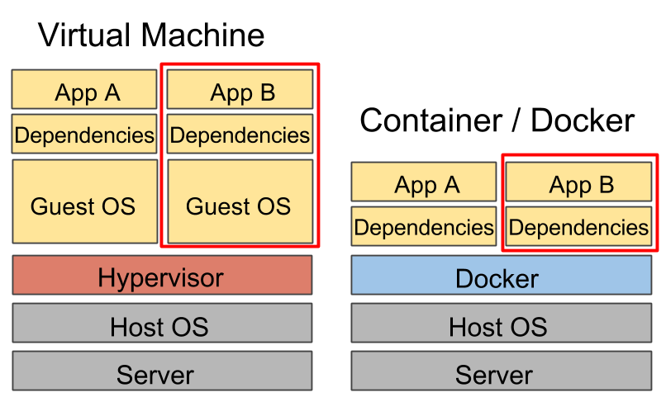
Hardware Emulation
virtualization
Operating system level of virtualization + Performance

Slide 4
Stakeholders
Software developers
Software Maintainers
Cloud providers
The open container initiative
Docker developers
Plugin developers

Slide 5
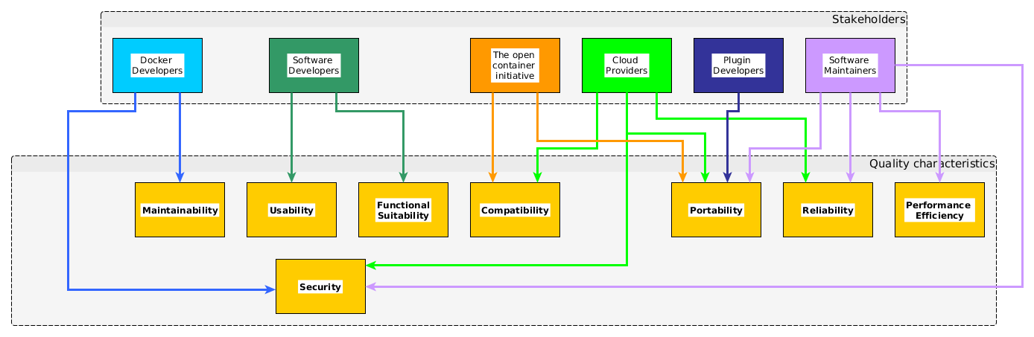
…& their concerns

Slide 6

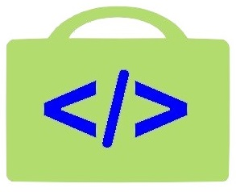

Key Drivers
Portability Reliability
Security
Platform and
hardware agnostic

Slide 7
Docker Architecture
CLIENT-SERVER
Client & Deamon
Three main inside components :
Images to build
Containers to run
Registries to distribute

Slide 8
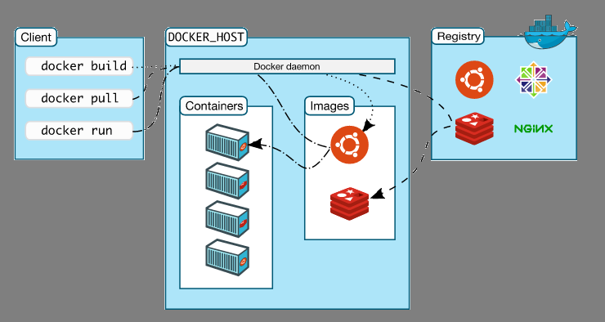
Logical view

Slide 9
Patterns
Client-Server
Layers
Shared repository
Publish-Subscribe
Brokered authentication
Plugin
Proxy

Slide 10
Layers
+ Security
+ Reliability
+ Portability

Slide 11
Client-Server
+ Portability
? Security
+ Reliability
+ Modularity and Operabilty

Slide 12
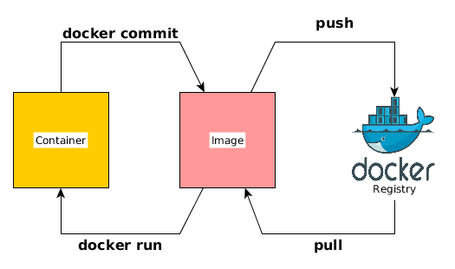
Shared/Active Repository
Through the Docker registry : store and distribution of images
+ Security

Slide 13
Publish Suscribe
The notification mechanism in the Active Repository

Slide 14
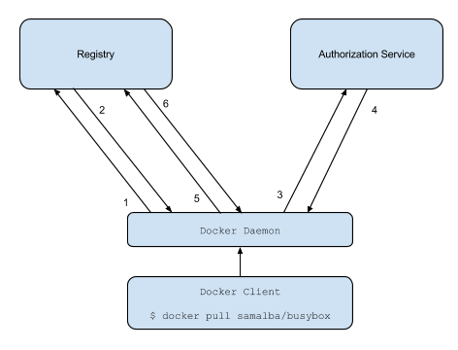
Brokered Authentication
+ Security

Slide 15
Broker
+ Portability
Interoperability
+ Security
- Performance

Slide 16
Plugin
+ Portability
+ Modifiability
+ Security

Slide 17
Evaluation
Are the key drivers validated by the patterns ?
Goal of the second part : matching KD and Patterns

Slide 18
Thanks for you attention

Slide 19
Sources

