Slide 1
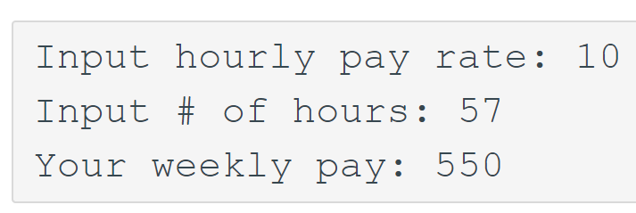
Hourly Worker - Overtime Pay
This is the 08_24 activity due via Codio – extended to be submitted by EOD 08/29.
Get the hourly pay rate & # of hours from the user, compute & output the weekly pay, but do not pay for the extra hours beyond 50. Also, for the overtime hours (that is, hours beyond regular 40 hours), pay at 1.5 times regular rate.
Here is one sample input & output:

Slide 2
Problem: Safe Heart Rate
You can calculate your maximum heart rate by subtracting your age from 220. Example:
if you're 45 years old, subtract 45 from 220 to get a maximum heart rate of 175.
If you are 19 years old, it will be 220-19=201. This is the maximum number of times your heart should beat per minute during exercise.
Write a program to get the user’s age & heart rate as input, output whether it is SAFE or UNSAFE.
Reference: Mayo Clinic

Slide 3
Packing Problem – packing1.cpp
Ask the user for the capacity.
Keep getting the items until their total exceeds the capacity.
Output the final total, without exceeding the capacity.
Enter capacity: 10
Input items:
3
5
1
4
Total: 9

Slide 4
Packing Problem #2 – packing2.cpp
Enter capacity: 10
Input items:
3
5
1
4
Total: 9
3
5
Total: 7
…
After outputting the total, accommodate the final item in the next package and keep going!
Infinite loop is OK.
How would you do this ????

Slide 5
Packing Problem #2
Enter capacity: 10
Input items:
3
5
1
4
Total: 9
3
5
Total: 7
…
After outputting the total, accommodate the final item in the next package and keep going!
Infinite loop is OK.
Loop
read item
IF it can be accommodated
add to total
ELSE
output current total
init total with this item

Slide 6
Kattis Problems :
Digit swap
Echo Echo Echo
Jack lantern juxtaposition
R2

