Slide 1
Silly problem: Add all digits of a number – addDigits1.cpp
Write your idea first, then proceed to code to get an input number and add all digits and output the result.
Sample Input | Output | Explanation
12 | 3 | 1+2 = 3
123 | 6 | 1+2+3 = 6
225522 | 18 | 2+2+5+5+2+2 = 18

Slide 2

Strings

Slide 3
C++ strings : Basics
Complex data type (int & double are simple data types)
Treat it like a flexible box that contains a series of characters
Mutable – we change contents of the box (unlike Java String)
Chars can be accessed like an array
String library comes with tons of in-built functions, including length(), find(), substr(), etc.
Full details @ cplusplus.com/reference/string/string

Slide 4
Back to Silly problem: Add all digits of a number – addDigits2.cpp
Can we redo it with a string input?

Slide 5
It is a girl!
Two software engineers couple are trying to select a perfect name for their baby girl!
But they have several potential names – cannot pick one!
We can use time(), srand() and rand() to do reasonably random pick (babyname.cpp)
string names[] = { "Emma", "Julie", "Tiffany", "Lucy", "Angie",
"Jackie", "Jill", "Lia", "Melody", "Karen" };

Slide 6
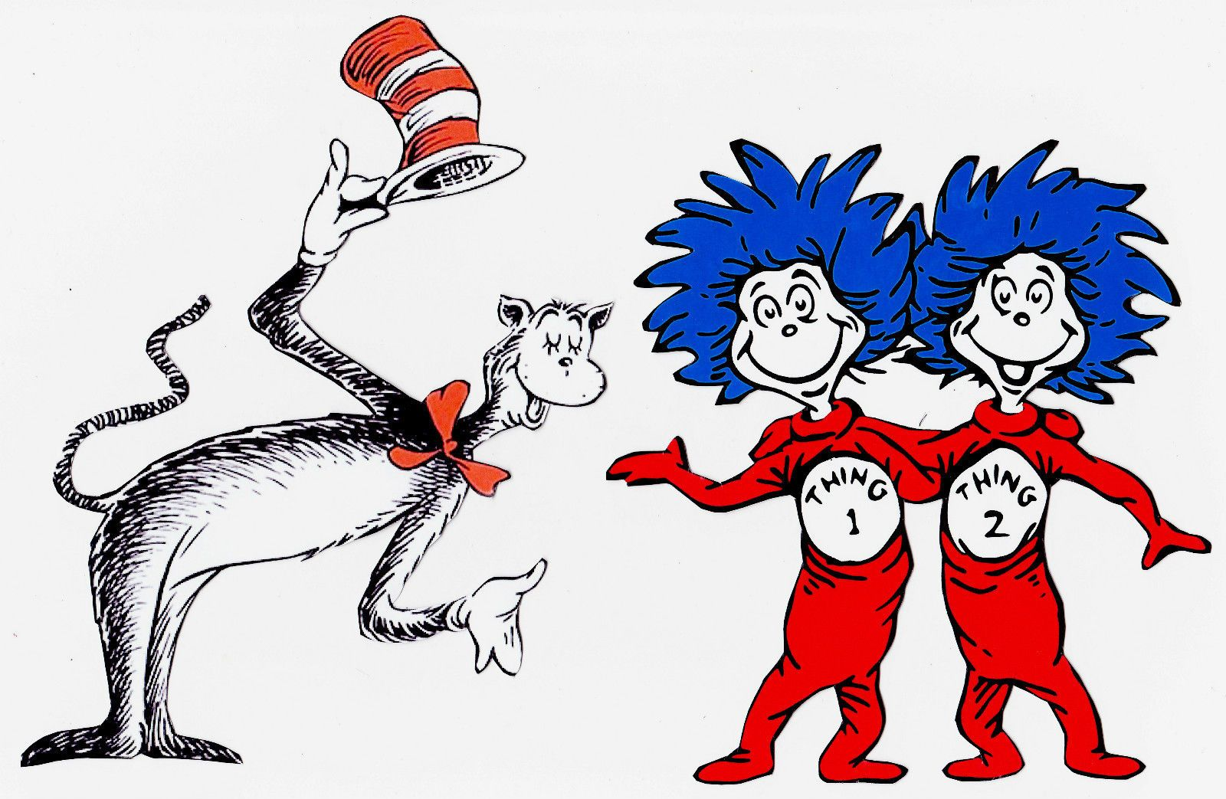
It is a girl!
They go for Dr. checkup – find out there are twins! (twins.cpp)

Slide 7
It is a girl!
Next Dr. checkup reveals that there are 4 babies ☺ (babies4.cpp)
Try on your own :
Enhance it to ask the user for # of babies, then output that many unique names (babies.cpp)
Use an array to store the selected names!

Slide 8
Try on your own
Random quotes from a file
Ask the user about the # of quotes to be read.
Open quotes.txt and read those quotes
Ask the user how many quotes to display? (Assume that this number is smaller than # of quotes)
Display that many randomly selected quotes. All of them should be unique.
In case the user’s input number is more than # of lines available in the file, use the actual # of lines as the limit.
Find the longest names
Get a sequence of names and output the longest name.
Enhance to find all the longest names (if multiple ones there)
Input of “end” ends the list.
Sample input & output:
john jack melody jill steven pat end | melody steven

Slide 9
Submission Activity: Wireless System Simulation

Slide 10
Random Passwords
You might have used auto-generated random passwords provided by web-browsers like Google Chrome.
Let us code a function to generate such a password based on the requirements passed as arguments.
// min & max length, min # of lower case letters,
// min # of upper case letters,
// min # of digits (0-9), min # of special chars (!@#$%^&*+:;)
string generatePassword(int minLength, int maxLength, int minLower, int minUpper, int minNumber, int minSpecial) {

Slide 11
Input format validation
Here are a few commonly used input items that requires format validation (Use functions to simplify the logic):
Social Security Number: NNN-NN-NNNN
UTDallas NetID: AAANNNNN
Start date: NN/NN/NNNN or a few other formats
Phone number: NNN-NNN-NNNN or (NNN) NNN-NNNN
Password: min length 8, min one lower case, one upper case, one number & one special character
Properly formatted names (example: Abraham Lincoln)

Slide 12
Date Validation
N/N/NN to NN/NN/NNNN are allowed.
Month should be 1 to 12.
Day should be 1 to 28/30/31 depending on the month.
Don’t worry about the leap years.

Slide 13
Distribution by first letter – firstLetter.cpp
Google for “top 1000 baby names” and get the names, clean them up and store in a file – filename babynames.txt should be in the folder if you do not want to search.
Read the names from it and find the distribution by first letter of those names.
Output the distribution like
A:155, B:12, …
How about the distribution by last letter?
int index = names[0] – ‘A’;
counters[index]++;

