Slide 1

Strings

Slide 2
C++ strings : Basics
Complex data type (int & double are simple data types)
Treat it like a flexible box that contains a series of characters
Mutable – we change contents of the box (unlike Java String)
Chars can be accessed like an array
String library comes with tons of in-built functions, including length(), find(), substr(), etc.
Full details @ cplusplus.com/reference/string/string

Slide 3
Submission activity - Palindrome check
Write the following functions
bool palindromeCheck(string word)
checks whether the parameter is a palindrome
int palindromeMismatches(string word)
returns # of character mismatches.
Enter word: abcba
It is a palindrome!
Enter word: abcbb
# of mismatches: 1
Enter word: zerorez
It is a palindrome!
Enter word: abcdef
# of mismatches: 3
I have posted 2 solutions – please check both.

Slide 4
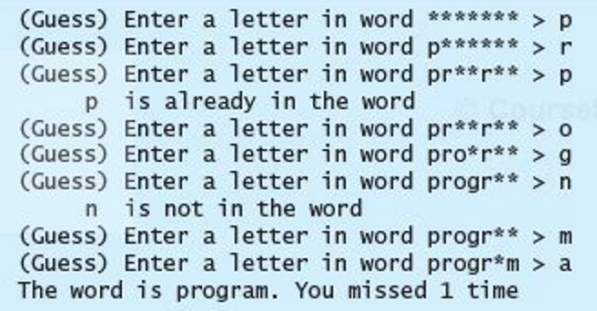
Hangman game start with hangman.cpp &words.txt from box
Write a hangman game that prompts the user to guess one letter at a time. Each letter in the word is displayed as an asterisk. When the user makes a correct guess, the actual letter is then displayed. When the user finishes a word, display the number of misses.

Slide 5
Hangman game …
Move the code for the game to a function.
Read lot of commonly used words in every-day conversations from a text file.
Select a random word & invoke the game function.
Prompt the user to play again & do so if the user wants.
Keep going until the user says No.

Slide 6
Strongly encourage you to try on your own - Random Passwords
You might have used auto-generated random passwords provided by web-browsers like Google Chrome.
Let us code a function to generate such a password based on the requirements passed as arguments.
// min & max length, min # of lower case letters,
// min # of upper case letters,
// min # of digits (0-9), min # of special chars (!@#$%^&*+:;)
string generatePassword(int minLength, int maxLength, int minLower, int minUpper, int minNumber, int minSpecial) {

Slide 7
Strongly encourage you to try on your own Balanced string
Input is a sequence of ( and ) characters
Input string is balanced if it has equal # of ( and ).
Balanced:
(), )(, ()(), (()), )()(, ((()())()
Not balanced:
()), (()()(, (((), (()))),((()())()

Slide 8
Strongly encourage you to try on your own – Super-balanced strings
Input is a sequence of ( and ) characters
A super-balanced string is a balanced string for which the balance for any prefix does not go below 0. In other words, no prefix has more ) than (s.
Super-balanced:
(), ()(), (()), (()()), ((()())())
Balanced, but NOT super-balanced:
)(, ())(, ())((),()()()())(()

Slide 9
Try on your own - Popular child names
Read the children’s names from an input file names.txt (represents the kids in a school or a community or city).
Output the distribution, that is, count for each name.
Find the most popular name & output it
Furthermore : Output the top 10 popular names
How to read the file?
Use additional variable ifstream variable and reopen the file:
ifstream finput2(…)
Close and reopen the file:
finput.close();
finput.open(….);
Simply move the read pointer in the file:
finput.seekg(0);

Slide 10
Try on your own - Distribution by first letter
Google for “top 1000 baby names” and get the names, clean them up and store in a file – filename babynames.txt
Read the names from it and find the distribution by first letter of those names.
Output the distribution like
A:155, B:12, …
Another variation : How about the distribution by last letter?
int index = names[0] – ‘A’;
counters[index]++;

Slide 11
Try on your own - Input format validation
Here are a few commonly used input items that requires format validation (Use functions to simplify the logic):
Social Security Number: NNN-NN-NNNN
UTDallas NetID: AAANNNNN
Start date: NN/NN/NNNN or a few other formats
Phone number: NNN-NNN-NNNN or (NNN) NNN-NNNN
Password: min length 8, min one lower case, one upper case, one number & one special character
Properly formatted names (example: Jey Veerasamy)

Slide 12
Try on your own - Date Validation
N/N/NN to NN/NN/NNNN are allowed.
Month should be 1 to 12.
Day should be 1 to 28/30/31 depending on the month.
Don’t worry about the leap years.

Slide 13
Compare Strings – compareStrings.cpp
Get 2 lines of input (2 strings)
Compare both strings ignoring the white spaces and output whether they are same or not. Ignore case as well.
Example – these qualify as same strings:
I love Music → IloveMusic strcasecmp()
Ilo vemu sic → IloveMusic
Both strings are same!
Use #include <cctype> to access the utility functions:
isspace(), toupper(), tolower(), etc.

Slide 14
Sample C program
Standard header file: stdio.h
Input: scanf()
Output: printf()
Output formatting: %d for int, %f for float, %lf for double, %s for string
C++ header file cstdlib ←→ C stdlib.h
Several more C header files we use in C++!

Slide 15
C Strings vs. C++ Strings
Strings in C – array of char
ends with NULL character, e.g. abc
string.h (cstrings) has several support functions: strlen(), strcat(), strchr(), strcpy(), …
We will NOT spend much time on these…
Strings in C++ is a complex data type
Lot more sophisticated, with high level functions
Can still be accessed like array of char
Header file <string>
a | b | c | \0

