Slide 1

FTD Project
Therin Watson & Francois Jack

Slide 2

Introduction: What is a fail to deliver?
A fail to deliver is a mistake. A fail-to-deliver (FTD) primarily occurs when an options contract becomes In-The-Money (ITM), and shares of the security in question are now obligated to be purchased and delivered as per the contracts terms.
Large financial entities, primarily Market Makers and Broker Dealers, who write and create options contracts to be sold to traders, are the entities who create FTDs by neglecting or failing to purchase shares of a security before their required settlement date.
When a contract is processed or fulfilled, but the shares are not located on the market, an FTD is posted equal to the number of shares not located.
This fail is then reported to and recorded by FINRA and the SEC. The SEC posts all market fail-to-deliver data on their website every 15 days, for all equities trading on US markets.
FINRA is the entity in charge of making sure the FTD obligations are eventually purchased and fulfilled, as well as levying fines and other “punishments” for failing to settle securities in a timely manner

Slide 3
What is the purpose of this Project?
This project is actually a culmination of three projects completed over the span of the UofT Fintech Bootcamp Course
Project 1 made use of data gathering and analyzation skills learned in this course, to study Fail-to-Delivers on a market-wide scale, in order to determine how frequently they occur, and at what quantities. As well as to attempt to measure their effect on Close Prices of various stocks
Project 2 took the conclusions from Project 1, and applied Machine Learning techniques learned in Class to try and use Fail-to-Deliver and Short Interest data alongside short-term technical analysis indicators, to attempt to create Machine Learning models which could attempt to predict close prices of various stock symbols
Project 3 expands and improves upon Project 2, and is a demonstration of how the Machine Learning models created could be realistically used to influence real-life trading decisions

Slide 4
Why Fail to Delivers?
The initial interest in Fail-to-Delivers started in January of 2021, when massive retail interest and buying pressure of Gamestop (GME) stock caused the price of the security to jump hundreds of points higher, reaching an all-time-high of $483 at one point in time
While the publicly reported short-interest of over 140% was most likely the major driver behind public interest in purchasing the security, one of the other important and “unique” statistics of the security was its frankly unreal amounts of FTDs posted throughout 2020, particularly in the weeks leading up to January 28th, when various Market Makers informed their brokerage partners, they would no longer be processing the brokerages’ users’ buy orders on GME and other “meme” stocks.

Slide 5

Summary of Project 1
The first project aimed to use newly learnt data collection and analysis techniques to compare Gamestop, AMC, NOK, BB and other “meme” stocks against the rest of the market
Questions that were asked included:
Are FTDs common on the market?
Is there anything in common with stocks that do post high FTDs?
How does GME and others compare to the stock market as a whole when it comes to FTDs?

Slide 6

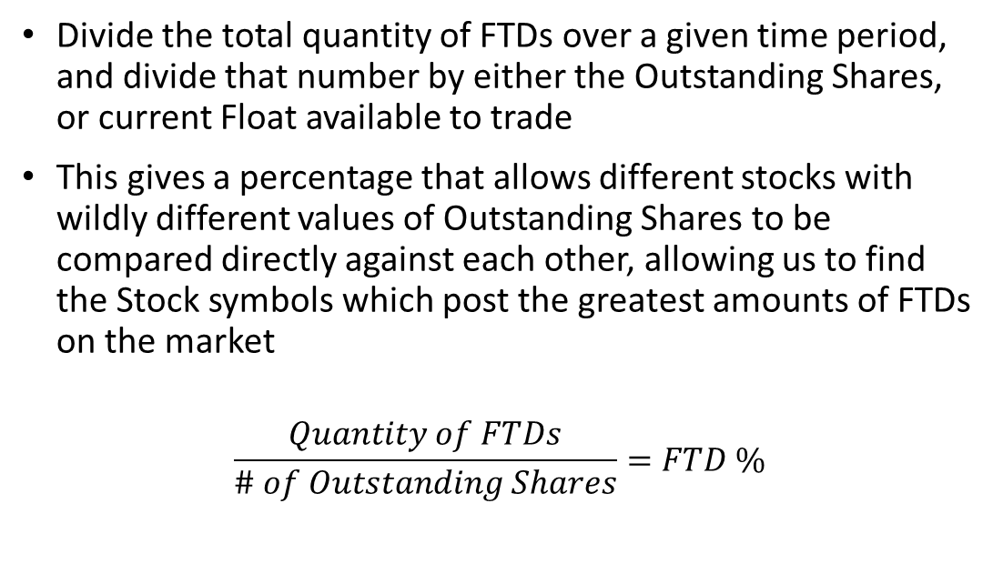
How to compare FTDs of different Stocks?
Divide the total quantity of FTDs over a given time period, and divide that number by either the Outstanding Shares, or current Float available to trade
This gives a percentage that allows different stocks with wildly different values of Outstanding Shares to be compared directly against each other, allowing us to find the Stock symbols which post the greatest amounts of FTDs on the market
$$\frac{Quantity of FTDs}{\# of Outstanding Shares}=FTD \%$$

Slide 7
Results of Project 1
At the time of Project Completion in October 2021…
Compared to ALL stocks and ETFs traded on the NYSE that have traded for 5 years or longer:
GME ranked 63rd for FTDs posted and recorded by the SEC with a quantity of Fails equal to 77% of their outstanding shares (or approximately 70 million shares which failed to deliver on time) over a twelve-month span
Of the top 100 symbols with the highest FTDs in the past year – 73 were ETFs while only 27 were stocks.
520 symbols posted FTDs greater than 10% of their outstanding shares
11 symbols posted FTDs greater than 160% of their outstanding shares
JCST, a gold-mining ETF, was the top symbol, with just over 570% of their outstanding shares having failed-to-deliver in the past year

Slide 8
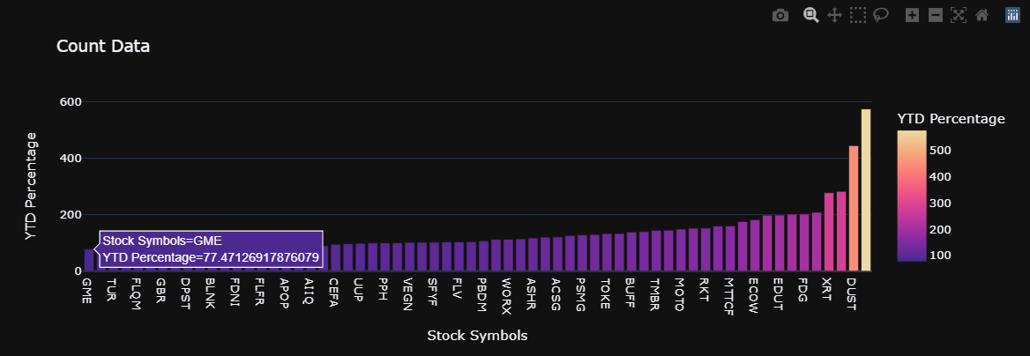
63 stocks and ETFs on the market posted FTDs at rates higher than GME, relative to their outstanding shares

Slide 9
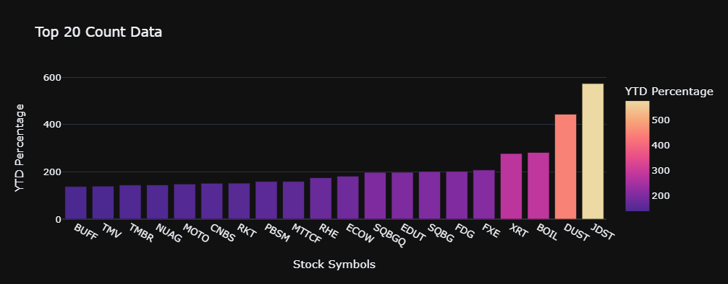
List of Top 20 Failing-to-Deliver stocks on the market

Slide 10
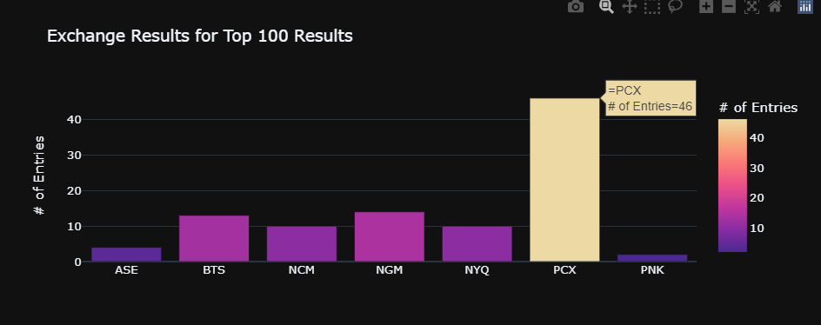
The PCX (Pacific Exchange) is an extreme outlier as the exchange with most Symbols of the Top 100 results

Slide 11
Conclusions from Project 1
With over 12,000 stock symbols looked at, only slightly more than 1500 posted FTDs greater than 1% of their Outstanding Shares
While Gamestop is definitely high in the list for FTDs, and easily the highest among the “meme” stocks, it is not the highest on the market and over 60 symbols have more FTDs relative to Gamestop
Fails are much more common with ETFs than they are with individual Stock Equities
Not conclusive at this point whether FTDs have an effect on price or not
Was assumed at this point that symbols with high FTDs would also have accompanying high Short-Interest metrics and volume – later research confirmed this to be true

Slide 12
Quick Summary of Project 2
Using the results from Project 1, alongside Machine Learning (ML) techniques in class – would it be possible to predict the close price using Machine Learning with Fail-to-Deliver data?
This Project accomplished three things:
Created a data gathering process to combine 5+ years (from January 2016 onwards) of historical price data with FTD data from the SEC, and Short Interest data from FINRA into Dataframes ready for Machine Learning
Calculated and appended short-term Technical Indicator (TI) data into the dataframes to add features to and assist with the ML Models
Provided early versions of Neural Network (NN) models which were able to accurately track and predict close price, even though they were not yet practical for prediction, much less real-life trading decisions

Slide 13
Project 3
Project 3 is the culmination of the two previous projects, and ultimately a massive improvement over Project 2
Project 3 aimed to take the models created in Project 2 and improve upon them, in order to prepare them for actual real-life trading scenarios
It expanded upon the Machine Learning techniques already used, adding different types of Models (such as LSTM) to the Project, as well as improving the model training method in order to allow for 1, 2, 5 and 10 day predictions using the created models
Additionally, a front-end interface has been created which allows for interaction with the model results, allowing you to search for specific symbols and see the various model results

Slide 14
Summary of Project 3 Results
The Project was overall successful - models were developed which can provide a forecast of future stock prices
Proved that models which include FTD data are more accurate. Including the FTD data certainly improves the accuracy of price predictions
LSTM and other 3-dimensional models (GRU) are very powerful but take forever to both setup and train
While forecasting price data, it is difficult to gauge model accuracy, because of the placeholder data required to fill in the testing data, which throws off the accuracy of the end predictions
Models which predicted January close prices were generally accurate – while magnitudes of price movements were often incorrect and/or severally exaggerated, most models appeared to correctly predict whether the price would be higher, or lower, on a 10-day forecast period

Slide 15
Next Steps
Build upon the forecasting strategy by combining model results together, and improve methods of evaluating and displaying results
Continue to improve and test existing models by experimenting even more with different layers and activation types
Learn to shape data for experimenting with LSTM and other model types that allow for missing/incomplete data features
Add GRU models to the project – should not be difficult as current shaping process for LSTM is the same for GRU
Continue work on the front-end of the project in order to better display model results and data

Slide 16
Data Sources Used
SEC Website for Fail-to-Delivers
https://www.sec.gov/data/foiadocsfailsdatahtm
FMP API for Historical Pricing and Float Data
https://fmpcloud.io/documentation
Investor’s Exchange (IEX) API for Outstanding Share Data
https://iexcloud.io/docs/api/
Short Interest Data from FINRA through NASDAQ/Quandl API
https://data.nasdaq.com/data/FINRA-financial-industry-regulatory-authority

